Slide 1
Routes into Working with Children, Young People and Adults
Dr Andrew Morrison Principal lecturer
Department of Education, Childhood & Inclusion
Sheffield Hallam University
Notes:
Welcome and introduction to speaker(s)

Slide 2
Education Studies degrees
Education Studies
Education with Autism, Disability and Special Educational Needs

Slide 3
These courses are for you if...
You are interested in a career in education (teaching or non-teaching)
You want to understand/ work with children, young people or adults
You want to keep your options open while you explore possibilities
You want to gain more work experience

Slide 4
Have a think...?
Who influences our learning?
What are some of the barriers we face with learning?

Slide 5
Education
Philosophy
Sociology
Social Policy
Psychology
Social welfare
History

Slide 6
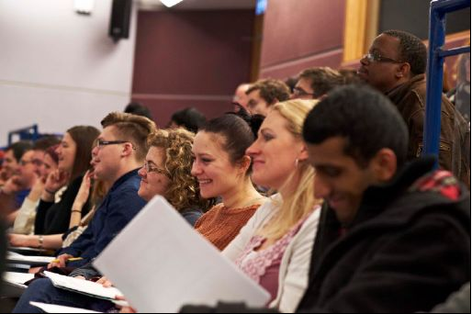
Course Overview
The subject of education is multidisciplinary and as a student you study how it relates to a range of other subjects, esp.: History, Sociology and Psychology.
with placement experience in a variety of educational settings during each year of the course
a focus on social justice
a focus on literacy and language in learning
a particular strand exploring socio-cultural perspectives on 'difference'..
all enabling a specialist understanding of issues of in/exclusion in education

Slide 7
WHY CHOOSE HALLAM?
No formal exams
Assessments linked to the workplace
A placement during each year of the course
Taught by staff with wide-ranging professional and academic expertise
Opportunities to work in varied groups
International opportunities
Notes:
A limited number of international placements are available in Freiburg and Santander for second year students with a good level of German or Spanish
Natatlie Sixsmith Ed studies and disability studies year 3 - "no exams the tutors placement experience
nice distance from home (Manchester) debating issues
nice city learning to learn
variety of teaching group size support"

Slide 8
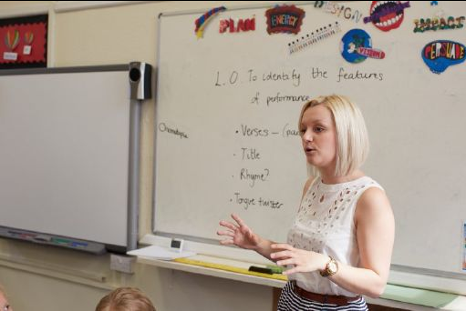
Career Options
Teaching
Educational support
Education projects/ research
Educational administration
Arts education
Children and family services
Youth services
Policy advisory work

Slide 9
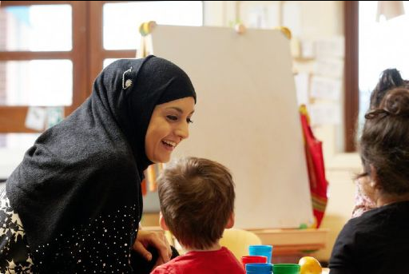
Career Options
Health and social care
Local Council
Police
Nurseries
Play Projects
Graduate Training Schemes
Advisory Role e.g. Leisure

Slide 10
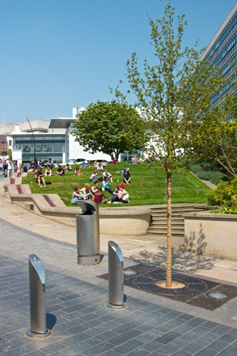
Thank you
Andrew Morrison
a.morrison@shu.ac.uk

