Slide 1
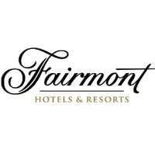
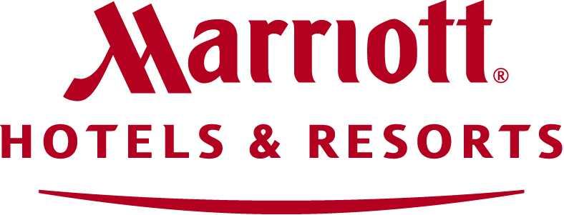
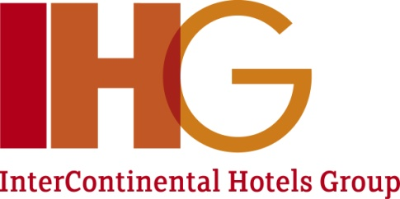
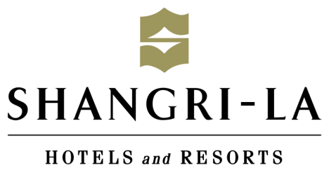
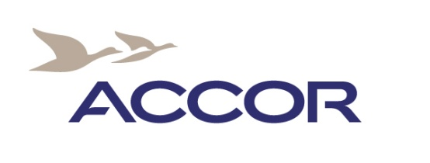
Opportunities for doing business in russia: Tourism and hospitality industry potential
By Dr. Konstantin B. Kostin

Slide 2
Tourism and Hospitality Industry in Russia
2012: 128 new hotels (over 40 000 rooms) under construction and development
2011:
occupancy rate 57,7%, +5%
Average daily room rate (ADR) RUB 4896,88 (+3,8%)
Revenue per available room RUB 2 872,90 (+9%)

Slide 4
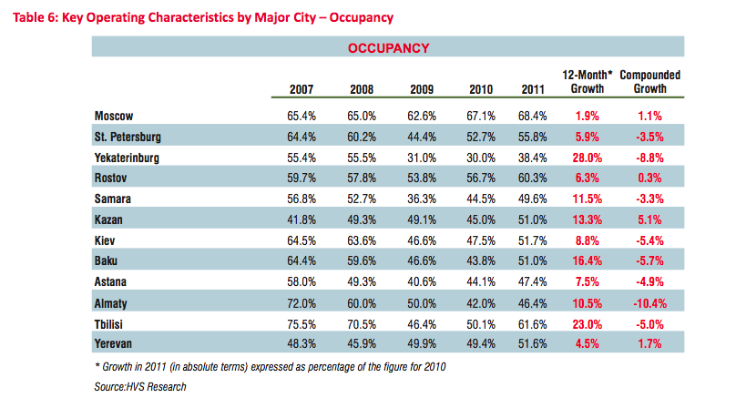
Key Figures

Slide 5
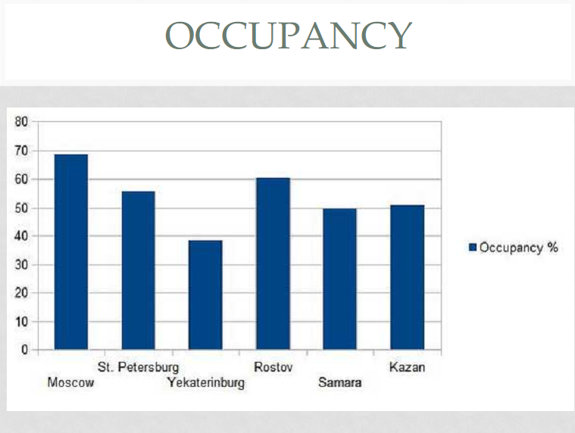

Slide 6
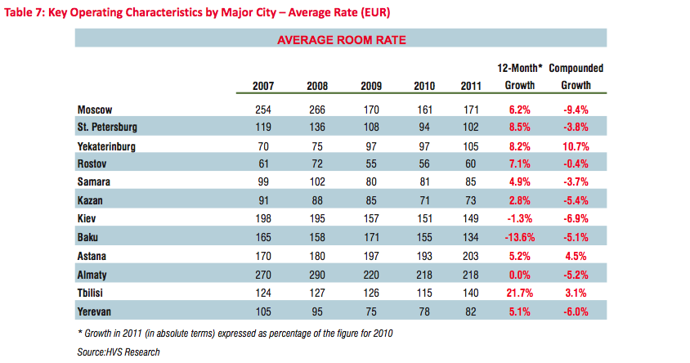
Key Figures

Slide 7
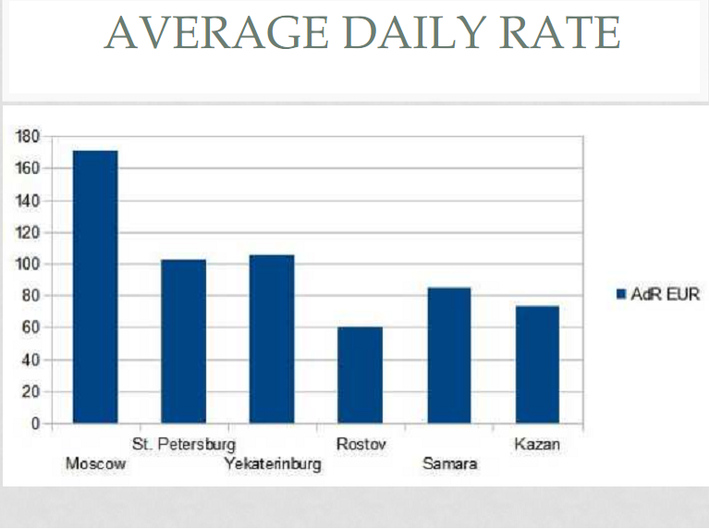

Slide 8
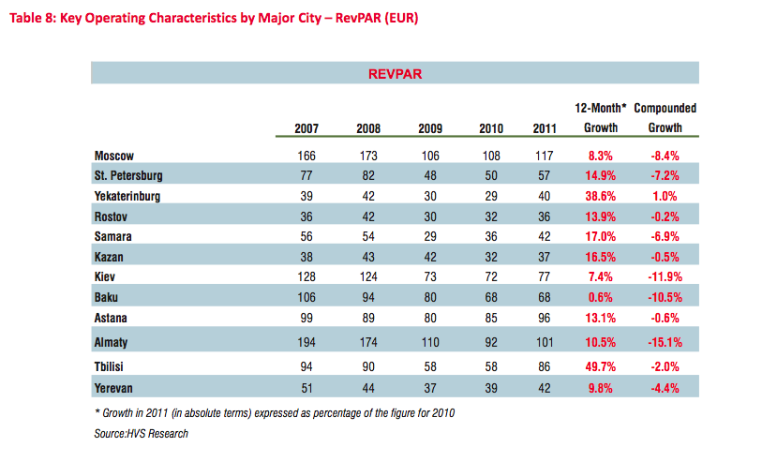
Key Figures

Slide 9
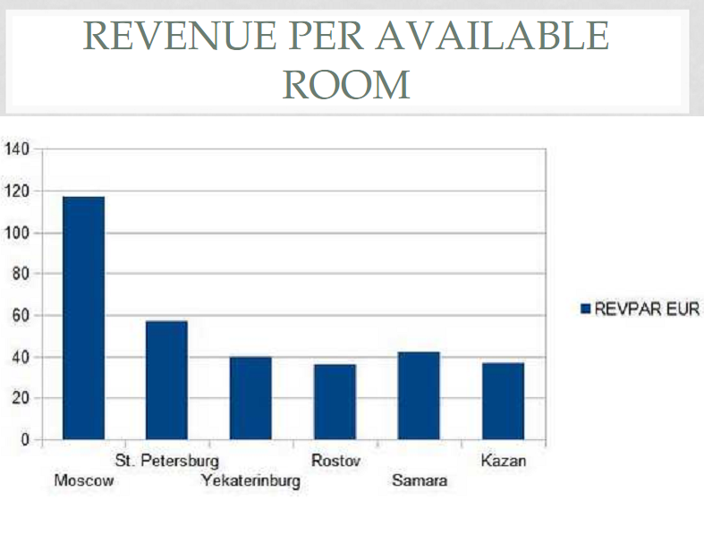

Slide 10
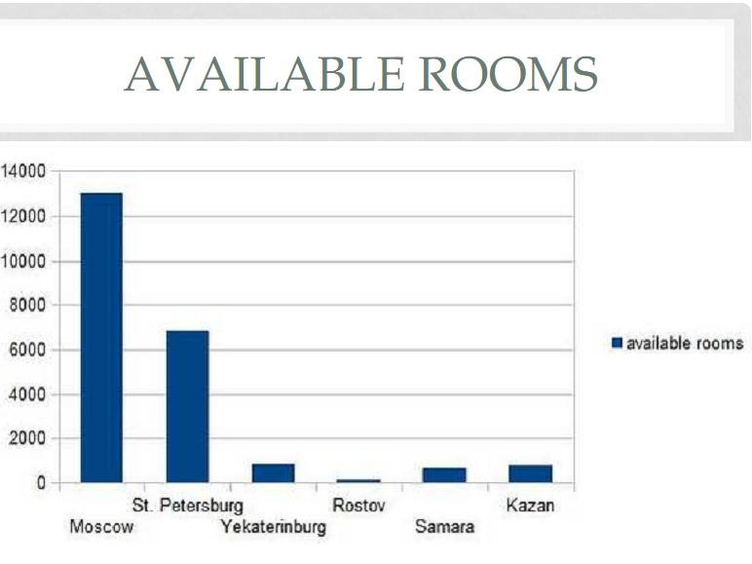

Slide 11
Tourism and Hospitality Industry in Russia
Hospitality industry is developing & market is growing
Infrastructural development
Amount of customers
Average nights spent in hotels
Increasing room rates
International brands
More expensive hotels
Additional hotel services

Slide 12
INDUSTRY LIFE CYCLE: HOSPITALITY
Sales ($)
Stage IV
High cash
dividends
Moderate cash
dividends
Stage V
High Dividend Payout Ratio and then no
dividends
Stage III
Stock
dividends
and splits
Maturity
Low cash
dividends
Expansion
Stage II
Stock
dividends
Decline
Stage I
No cash
dividends
Growth
Development
Development
Stage I
Growth
Stage II
Expansion
Stage III
Maturity
Stage IV
Decline
Stage V
Time

Slide 13
Tourism
Over 22 million international tourists from 224 countries in 2010 (Federal Security Service of Russia)
Russian authorities encourage Russian regions to attract investors
Plan: doubling the hotel amount by 2025
North Caucasus area: mountain skiing

Slide 14
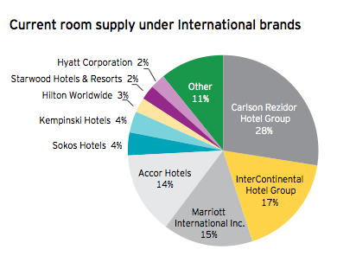
Current Room Supply Structure

Slide 15
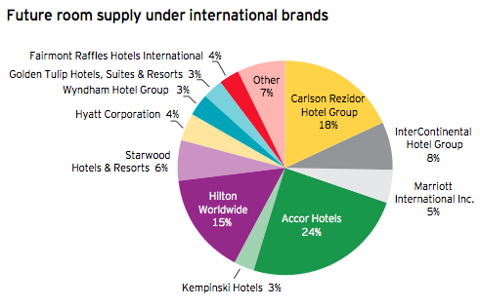
Forecasted room supply structure

Slide 16
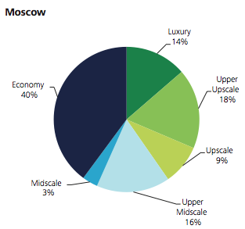
Hotel Types

Slide 17
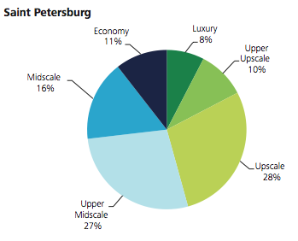
Hotel Types

Slide 18
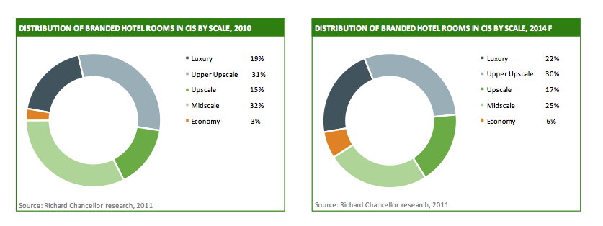
Hotel Types

Slide 22
What are the advantages and disadvantages for foreign hotel chains to enter the Russian market?
Advantages
infrastructural development of the industry, number of guests grows
industry in its growth phase has enough capacity for development
Sochi Olympic games in 2014
Disadvantages
high political and economic risks
lack of skilled personnel
terms and conditions of obtaining relevant permits
authorizations for the construction of accommodation facilities

Slide 23
Largest Domestic Hotel Chains
Russian companies:
Azimut:
Over 20 hotels in operation and under development with more than 5,500 rooms in Russia, Germany and Austria.
Positioned in the most dynamic segment of the hospitality industry for business, leisure and group travel
Heliopark:
8 hotels (located in Russia, Germany ), and 9 more projects are in the implementation stage.
Strategy: compehensive Hotel Development
Amaks hotel:
Manages 21 hotels, located in the regions of the Russian Federation and Belarus

Slide 24
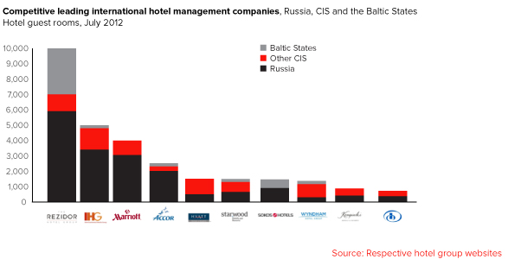
International Hotel Chains in Russia
Foreign companies:

Slide 25
LARGEST HOTEL CHAIN IN RUSSIA: REZIDOR

Slide 26
Largest International Presence in Russia
Rezidor:
Currently, Rezidor manages 20 hotels in Russia
The strategy of the group is to have more than 40 hotels with 10,000 rooms in operation
Marriott Hotel & Resorts:
Currently operates 19 hotels in Russia & CIS across six lodging brands
The strategy of the group: more than 30 hotels open by 2015
Accor:
Currently, Accor's network in Russia-CIS is 14 hotels (over 3500 rooms).
The strategy of the group: reach a network of 50 hotels (over 10 000 rooms) in Russia-CIS by 2016

Slide 27
Largest Growth
Hilton:
The first Hilton Hotel in Russia was opened in 2008
Currently the group has 30 hotels (5638 rooms) under development in Russia.
IHG:
Currently has 16 hotels across Russia and the CIS including 11 hotels in Russia
Continue to grow in Moscow and St. Petersburg and work with local investors to introduce managed and franchised hotels across the country.

Slide 28
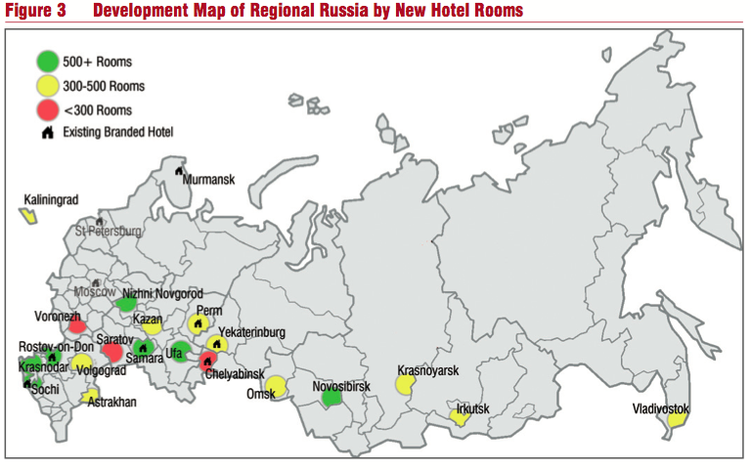
Pipeline in Russia

Slide 29
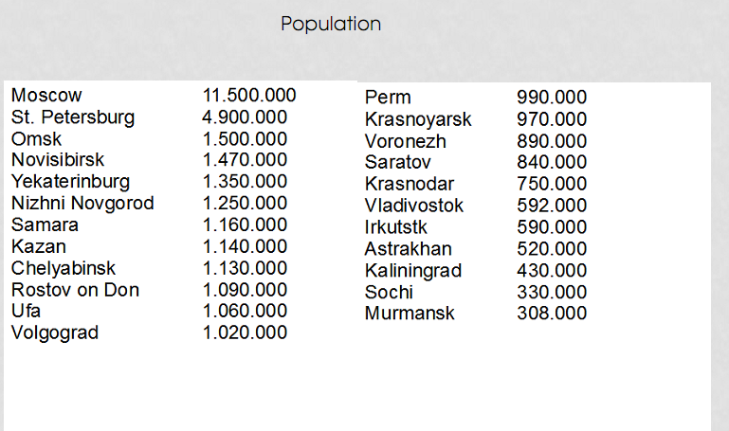
Population

Slide 30
Competition
Increased demand for ”Boutique Hotels”
Small hotels, boutique type are increasing their market share
Example: St Petersburg
Hostel
94% of people going on holiday this summer would consider hostel accommodation.
Budget
Other
Airbnb
Couchsurfing
Homeholiday

Slide 31
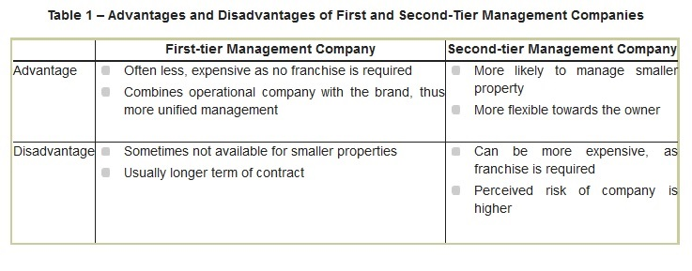
entry modes
Contract Management:

Slide 32
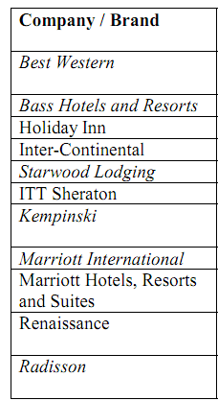
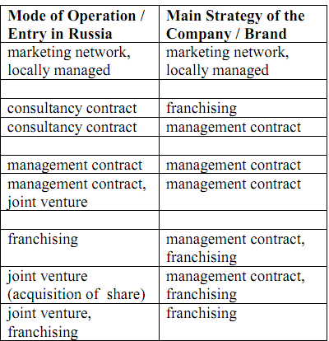
ENTRY MODES: END OF THE 90s

Slide 33
What are the best entry modes and pros & cons for them?
Franchisee:
System of permanent relations between a franchiser (hotel chain) and a franchisee (hotel property). Hence all the knowledge, marketing & promotion programs, brand image and success are used in return for mutual satisfaction of interests
Advantages
Coherent and clearly defined concept
Functional business strategy
Optimized and measurable financial and promotional results
Business safety and sustainability
Working tools and procedures with a high and guaranteed productivity
Competitive marketing & sales programs
Global distribution & sales systems, already tested and generating additional guest flux to the franchisee

Slide 34
What competitive advantages do foreign hotel companies have over Russian Hotel Business?
STRENGTS
Money: Financing
Quality
Management system
Knowledge of the market
Network
OPPORTUNITIES
Open a new market (high-quality economic-class hotel)
Developing regions
Cultural and World events
Build up reputation (make greater profits)
Great demand
Limited competition
Buy old buildings and renovate them, preferrably in city center.
Revenue Management
Russia has 14 cities over 1 million habitants
WEAKNESSES
Scarce skilled man-power
Cultural differences
Really new market (hard to estimate the real danger)
THREATS
Vague hotel qualification system
State-owned old soviet Hotels, refurbished and kept by the government.
Existing competitors (other big groups)

Slide 35
Entering strategy, expected payback, revenue drivers and risks
Investment in Russia
The Russian hotel business is one of the most dynamic industries showing high annual growth
2011: the hotel service market grew by 12% in volume terms
Market value increased by 22% and reached 144 billion rubles (3.5 billion euros or about $4.5 billion).
PAYBACK PERIOD (PP)
Expected PP varies by chosen market area (8-15years)
GOP (gross operating profit)
Europe varies from 3–4% to 10–12%, while in Russia it reaches 45–55%, although over the last 3 years it has steadily been going down due to growing salaries and taxes and decreasing incomes

Slide 37
Hotel acquisition
Examples of hotel acquisition in Russia:
Ritz Carlton Moscow (2011): 700 millions $
National Hotel Moscow: 165 millions $
Metropol Hotel Moscow: 300 millions $
Pekin Hotel: 60 millions $

Slide 38
Marketing
Comprehensive Marketing analysis
Knowing the customer needs
Knowing the competitors
Branding

Slide 39
Revenue management
The primary aim of Revenue Management is selling the right product to the right customer at the right time for the right price.
Data Collection
Segmentation
Forecasting
Optimization
Dynamic Re-evaluation

Slide 40
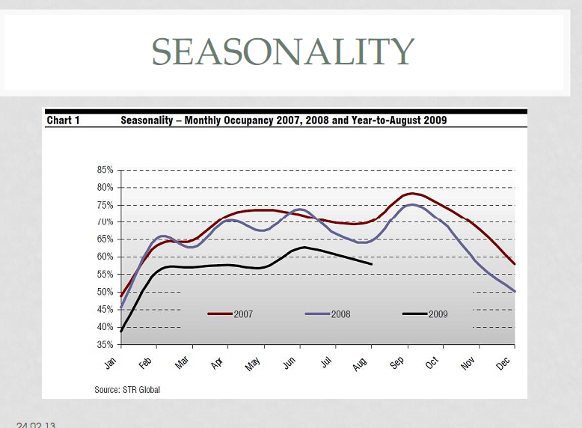

Slide 42
Thank you for your Atention!

