Slide 2
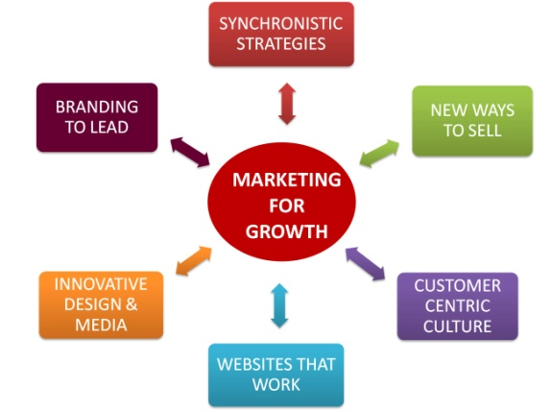
Motivations for Development
Lack of Relevant Materials
Desire to Forward Subject Materials
Passion for the Subject

Slide 3
The Book Three Themes
Theme 1:Understanding Experience & The Consumer (Chapters 2-4)
Defining the Experience
http://youtu.be/O8B1ZNv9m4s (Thompson)
http://youtu.be/ekpBrywvRpo (M&S)
However
http://youtu.be/-F4t8zL6F0c (Social Marketing)
Perspectives of Marketing
Consumer Resources & THEF Experiences

Slide 4
Theme 2:The Consumer as Individual (Chapters 5-8)
Consumption & The Consumer
Habitus, Distinction & Cultural Capital
http://youtu.be/-o7X1hJwBJA (Saga)
Interpreting Marketing
The Semiotics of Experience
http://youtu.be/gQGMuxJ0vCc
http://youtu.be/dxQgcTNiq-g

Slide 5
Theme 3: The Marketer as Moral Guardian (Chapters 9-10)
Ethics, Sustainability & The Green Consumer
http://youtu.be/aMfSGt6rHos
Greenwashing
http://youtu.be/Ei6JvK0W60I
http://youtu.be/odI7pQFyjso
A Manifesto for THEF Marketing
Marketing is a social and cultural activity
Critical to understand the relationship between product & consumer
Marketing is a multi-disciplinary subject
Consumer is an individual & will interpret the world as an individual
The concept of the 'Sovereign Consumer' should no longer be used to mitigate the excess of marketing & the Market

