Slide 1
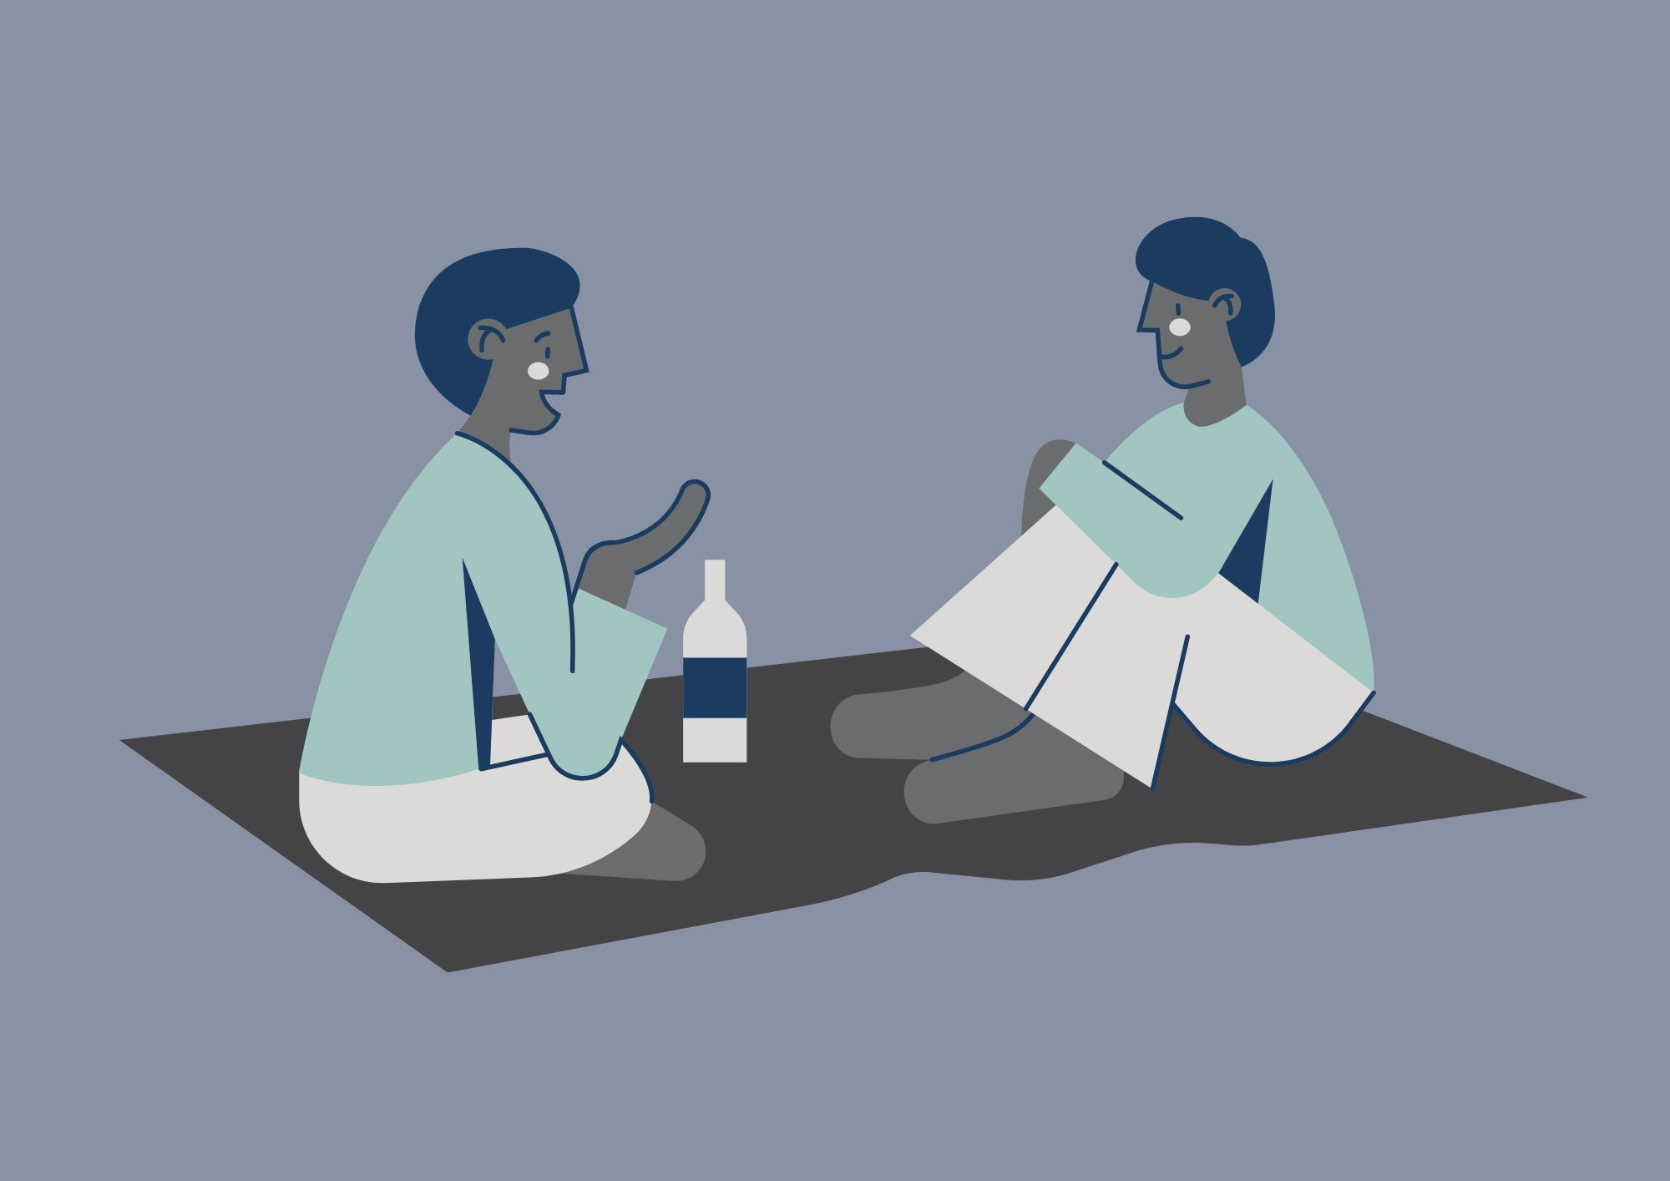
Practical Peer Support
Please note: We might use your anonymised comments and confidence ratings for service promotion and evaluation. ​
If you would prefer that we don't do this, please let us know at any time at disability-support@shu.ac.uk

Slide 2
What to Expect
Ground Rules
We will share tips, strategies and resources to help with email and calendar management.
You can connect with others with shared experiences to learn from each other.
Please communicate in ways you are comfortable with.
Online: we will stay in the meeting until 3.15pm for any questions. The session will then end. We will share sources of support in the chat.
In person: Come and go and move around if needed.
(Online only!) Please have your microphone off unless speaking. ​
During activity or discussions, join in if you feel able and feel free to ask questions. ​
Respect the opinions, privacy and information shared by others in the group. ​

Slide 3
Self-evaluation (online)
What number are you right now on today's topic?
1 = very unconfident
2 = somewhat unconfident
3 = neutral
4 = somewhat confident
5 = very confident

Slide 4

Self-evaluation (in person)
Please take a few minutes to fill in part 1 of a short self-evaluation
It asks you to rate your confidence levels in the skills we will cover today
We will also ask you to fill part 2 in at the end to see if you have gained confidence in your skills

Slide 5

Discussion
- What made you come here today?
- What do you find most difficult about managing your inbox?
What has helped you with these difficulties in the past?
Can you think of anything to share?

Slide 6
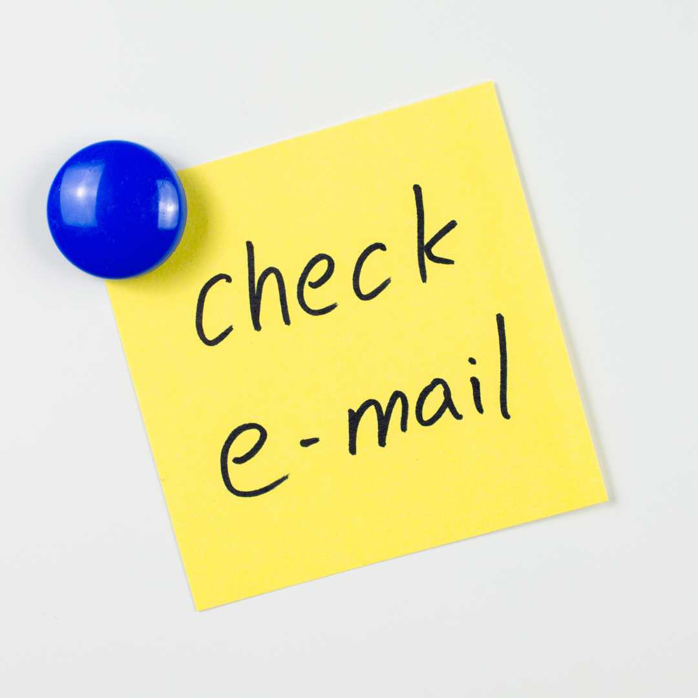
Managing Your Emails
Checking emails:
How often?
When?
Where?
How long do you spend on this?
You need to check your student email regularly
What stops you?

Slide 7
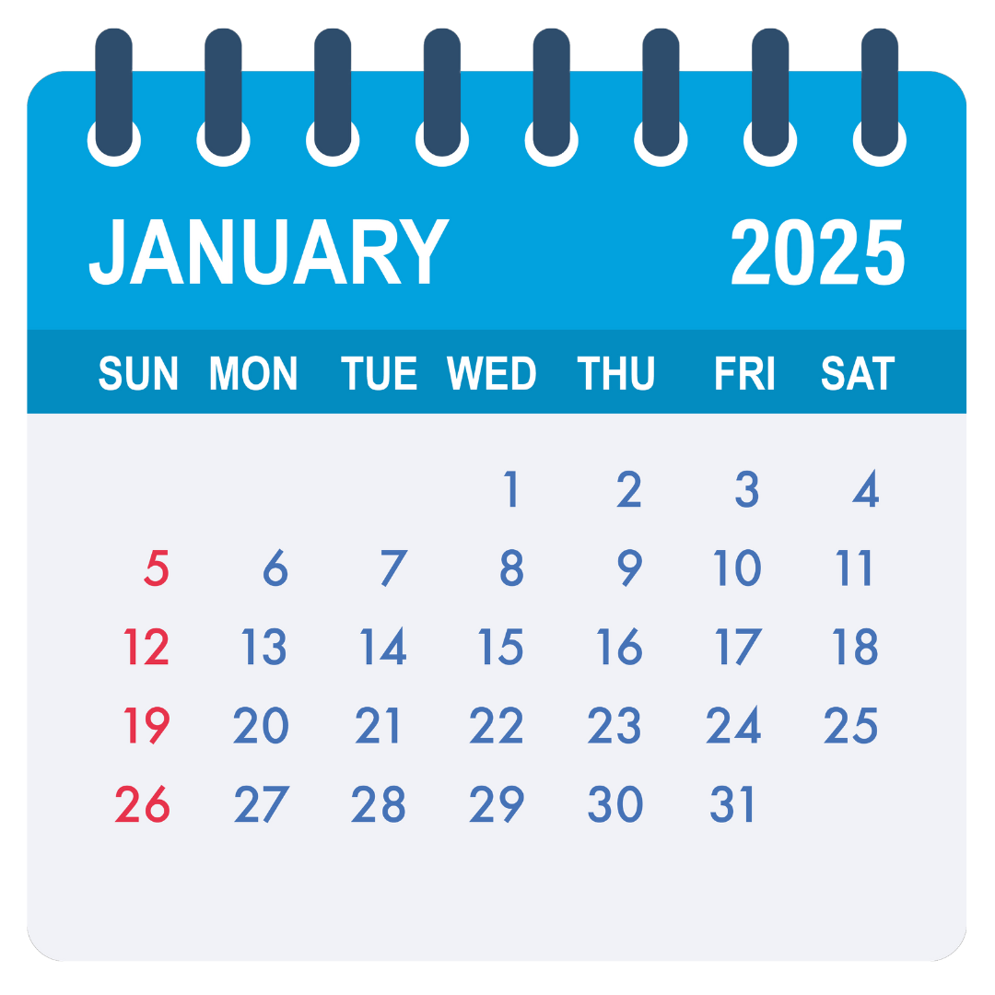


Build it into your routine
Build ‘Tiny Habits’:
Set your goal – When? Where? How often? How long for?
Make a plan to help you stick to it.
Use cues - alarms / reminders / calendar or diary / peer check ins / rewards.
ABC
Anchor the new habit in an existing routine.
Behaviour – make the new habit as tiny and easy as possible.
Celebrate – a positive emotion will help wire it into your brain.
Seinfeld Strategy: Don’t break the chain.
Mark every day that you stick to your plan on a calendar, even if it's not at the time you intended.
If you ‘break the chain’ make extra effort to make sure you don’t miss 2 days in a row.

Slide 8

Inbox Organisation
Does anyone have any ways that they organise their inbox already that they could share?
Create folders
Use flags and tasks
Categorise with colours
Mark read / unread
Search and filter
Set rules

Slide 9

5 Minute Tidy
This is a minimum of 5 minutes - you can change the length of time to suit you
5 minutes to delete not-useful emails and move ‘for reference’ emails into a folder
You will be left with those that are important or need action
Start working through the things that need an action – prioritise if necessary (use flags to help)
If there is time left – apply some of the organisation tools from the previous slide

Slide 10
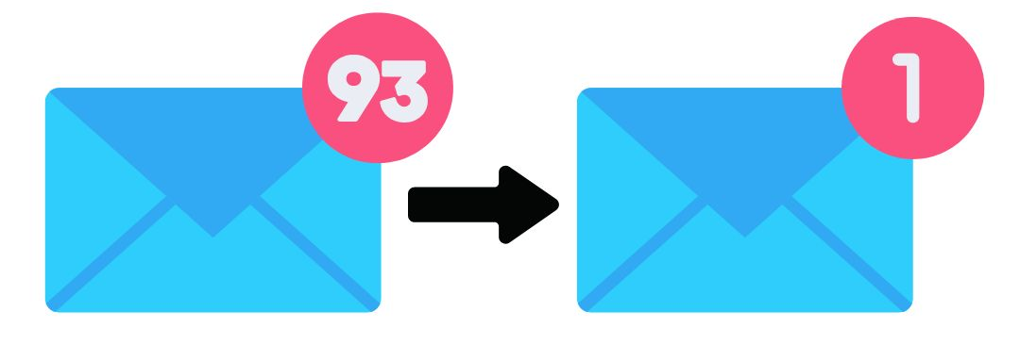
Inbox ‘almost’ zero
Create a folder and name it ‘Archived - Date’
Move all emails into this folder
You can still search - they are not deleted but your inbox is in a more manageable state
Once you are on top of your main inbox - use a 5-minute tidy for your ‘Archived’ folder each day to start working though it

Slide 11
Strategies: OHIO
O
...Where possible. Or handle it as few times as possible.
Only
Use the 4 T’s:
H
Handle
Tackle it
If it’s quick, easy or straight forward
Task it
If it needs a bit more thought and attention
Toss it out
If it’s unimportant
Transfer it
Unsure, need clarification or help to deal with it
I
It
O
Once

Slide 12
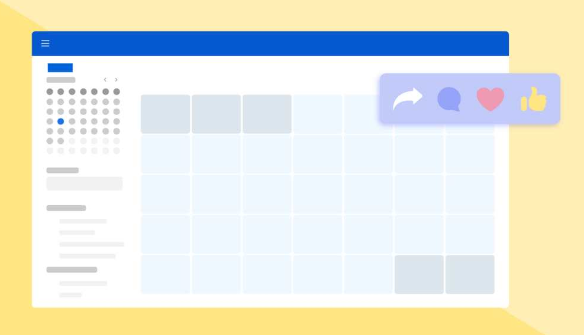
Calendar Management
Email and organisation in one place
Sync your calendar and timetable
Use the different views and layouts
Block your time out
Set recurring reminders
Use the reminders
Mark as important
Categorise with colours

Slide 13
Resources to help you
Reduce Digital Distractions
Digital support available at Hallam:
Hallam Digital Skills
Assistive Technology
LinkedIn Learning
IT Help
Skills Centre Digital Technologies
Digital Bootcamp

Slide 14
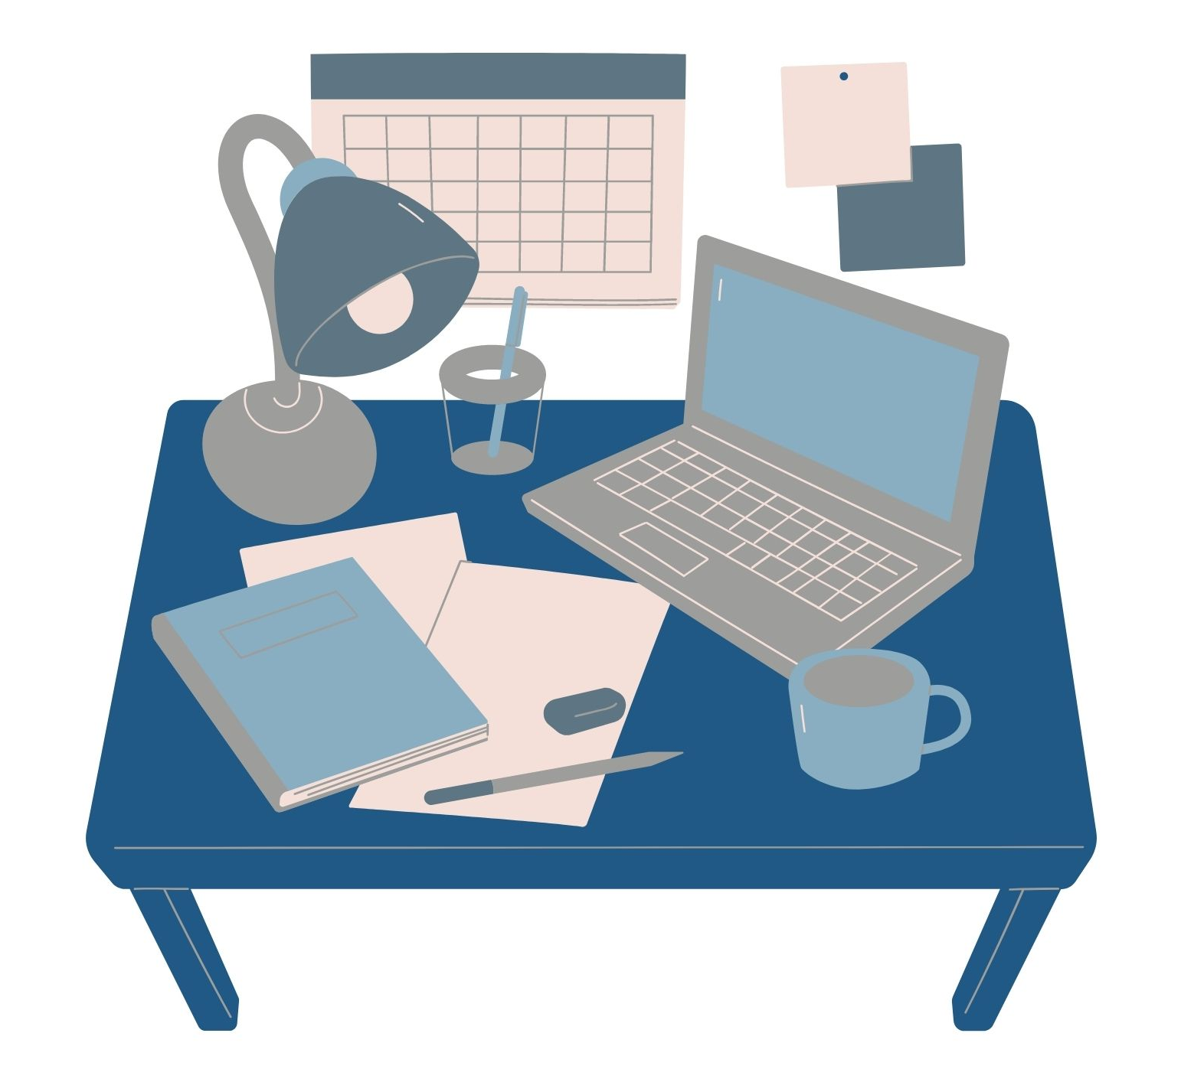
Activity
If you have brought a device with you...
Apply some of the organisation techniques or try a strategy
What will help you to manage your inbox or calendar more easily? Don’t try to do everything at once, change one thing at a time.
or
If you haven’t got a device with you...
Create an Email or Calendar Management Plan
Remember – think about how often, when, where, how long you want to spend on this, barriers and how you will overcome them.

Slide 15
Discussion and
Self-reflection
What has been useful for you today?
What will you take away?
One thing I will try this week - write it down
Does anyone want to share what their one thing is?

Slide 16
Self-evaluation (online)
What number are you now on today's topic?
1 = very unconfident
2 = somewhat unconfident
3 = neutral
4 = somewhat confident
5 = very confident
What have you gained / learned from the session?
What would you tell others about the session?

Slide 17

Self-evaluation and Feedback (in person)
Please take a few minutes to fill in part 2 of your self-evaluation
It asks you to rate your confidence levels in the skills now we are at the end of the session.
We want to make sure that these sessions are useful to you and others. Please share some feedback to help us to do that.
This should only take a few minutes and can be completed anonymously.

