Slide 1
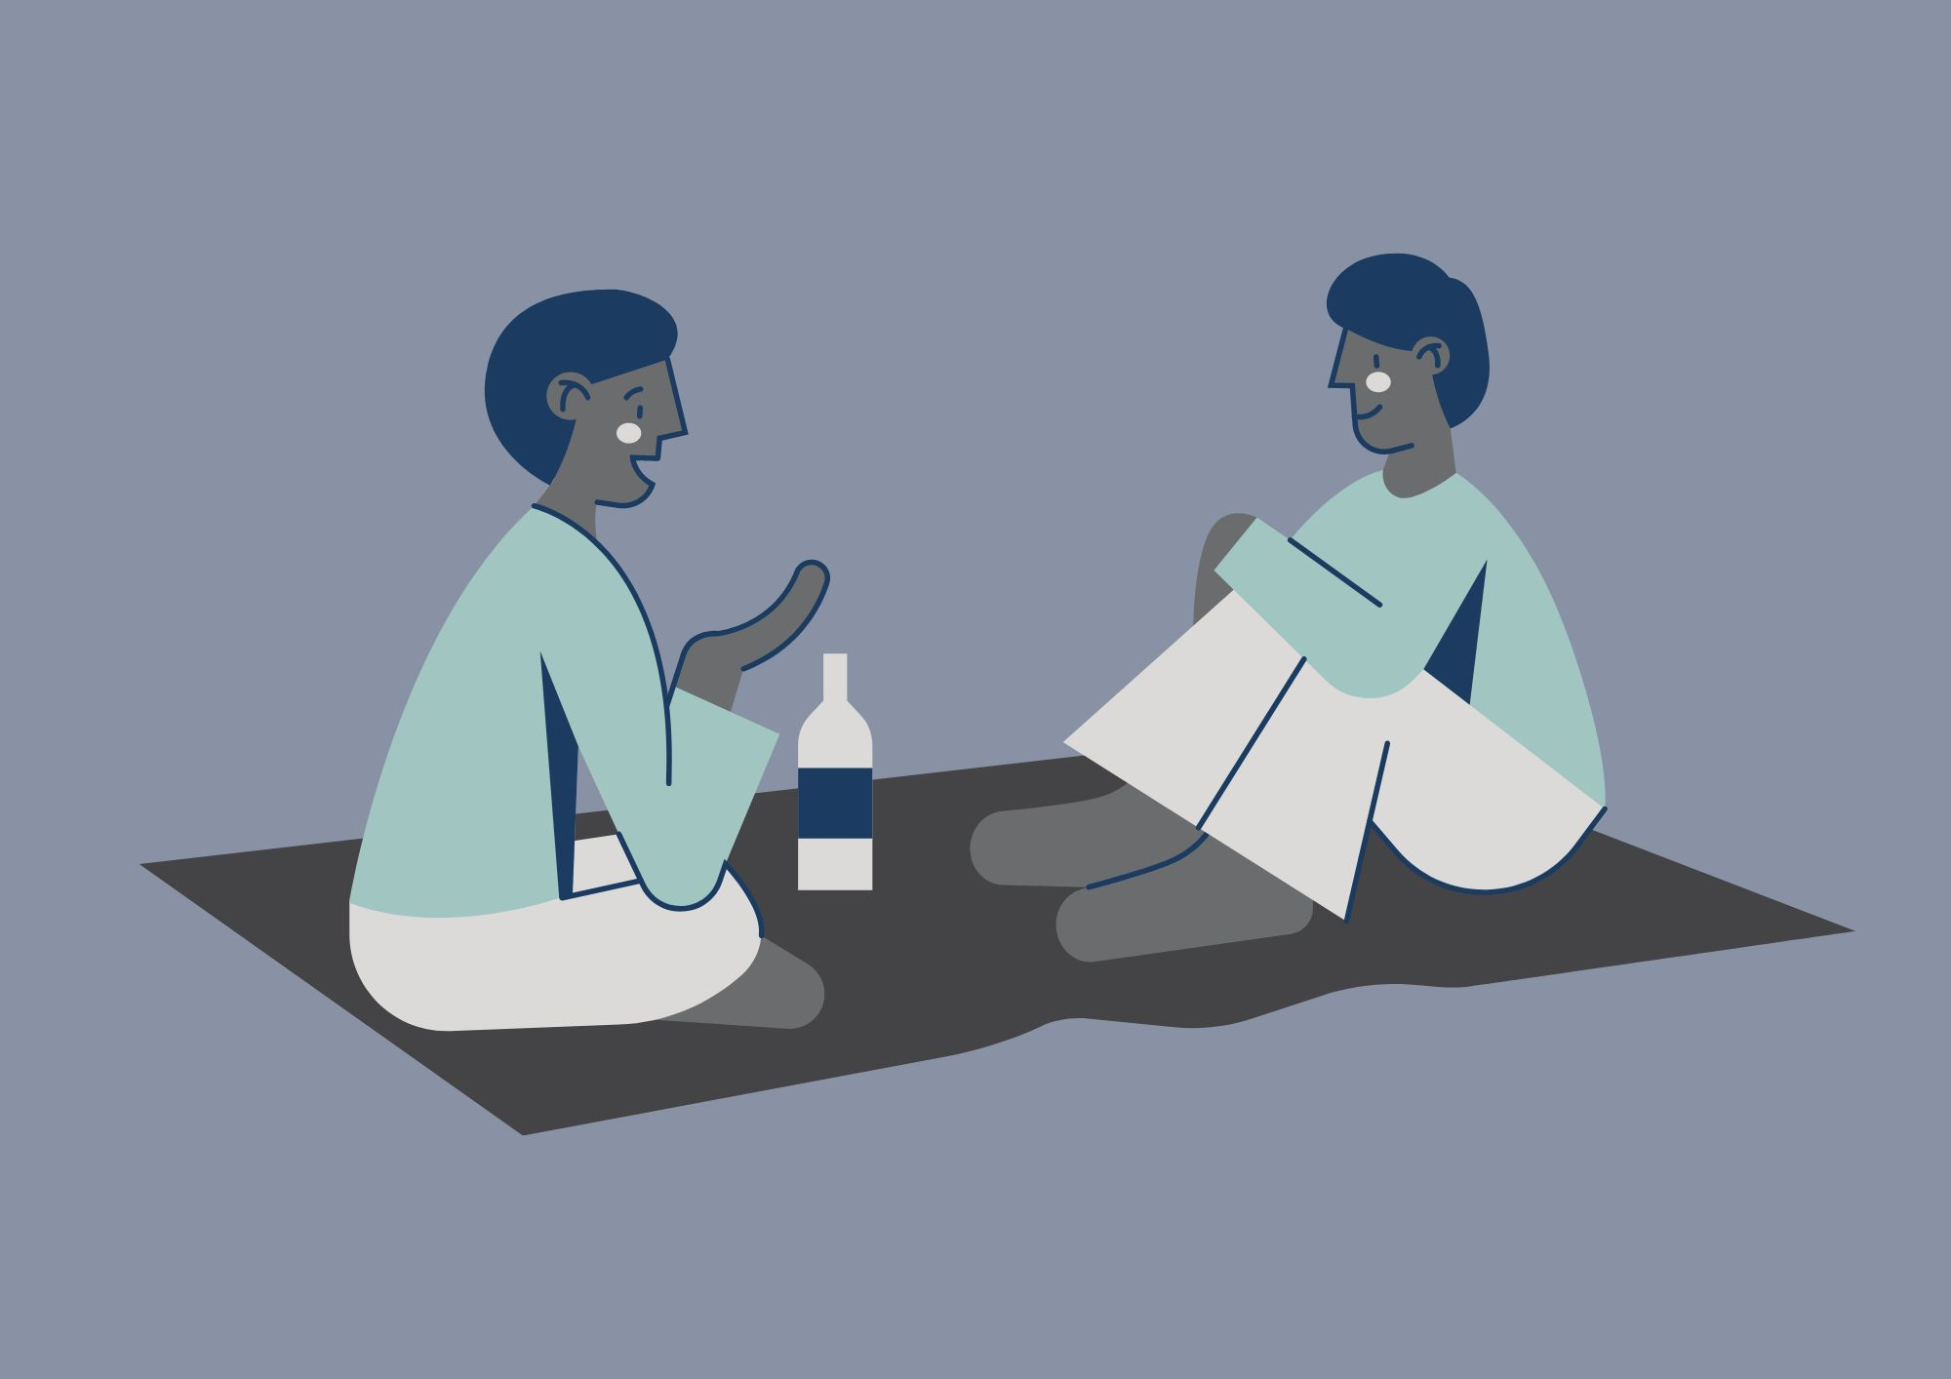
Practical Peer Support
Please note: We might use your anonymised comments and confidence ratings for service promotion and evaluation. ​
If you would prefer that we don't do this, please let us know at any time at disability-support@shu.ac.uk

Slide 2
What to Expect
Ground
Rules​
We will share tips, strategies and resources to help with managing your studies, deadlines and assignments.
You can connect with others with shared experiences to learn from each other.
Please communicate in ways you are comfortable with.
Online: we will stay in the meeting until 3.15pm for any questions. The session will then end. We will share sources of support in the chat.
In person: Come and go and move around if needed.
(Online only!) Please have your microphone off unless speaking. ​
During activity or discussions, join in if you feel able and feel free to ask questions. ​
Respect the opinions, privacy and information shared by others in the group. ​
Notes:
LD
Online
Point 4 -
There is no pressure to join in with discussion, but we do recommend you do in order to get the most out of the session. Nothing forced, just encouraged.
There are different ways you can engage e.g. verbally, post it notes / via the chat, visually, emojis or reactions, hand gestures, with the resources. Happy to share something on your behalf if you don’t feel comfortable – just pop it in the chat / write it down
If you have a question and this then makes it hard to focus on the next things – please just ask or if you don’t feel comfortable, pop it in the chat / on a post it note.
Point 5 -
Fidget toys available if they help with focus.
microphones off when not speaking to reduce background noise. (online)
Join in if you can. This helps you and others to get the most out of the session.
Respect – everyone is different and this is ok, let’s appreciate when people do share something - it can be a tough thing for some people to do, no judgement.
Confidentiality – this is a safe space.

Slide 3
Self-evaluation (online)
What number are you right now on today's topic?
1 = very unconfident
2 = somewhat unconfident
3 = neutral
4 = somewhat confident
5 = very confident

Slide 4

Self-evaluation (in person)
Please take a few minutes to fill in part 1 of a short self-evaluation
It asks you to rate your confidence levels in the skills we will cover today
We will also ask you to fill part 2 in at the end to see if you have gained confidence in your skills

Slide 5

Discussion
- What made you come here today?
What do you find most difficult about managing your studies, deadlines and assignments?
What has helped you with these difficulties in the past?
Can you think of anything to share?

Slide 6

Planning
Planning and visualising your time
To plan work for your deadlines / revision / any university task, you also need to consider the other things in your life.
This will give you a realistic picture of when / for how long each day you can do university work.
Office 365 planners
Employment / Placement / Volunteering
Rest / recharging / recovery
Hobbies
Life admin / Appointments
Exercise
Self-care
Shopping / Cooking / Eating
Emails / Self-directed study
Housework
Sleep
Travel
Planning
If you have deadlines close together, how can we make this more manageable?

Slide 7
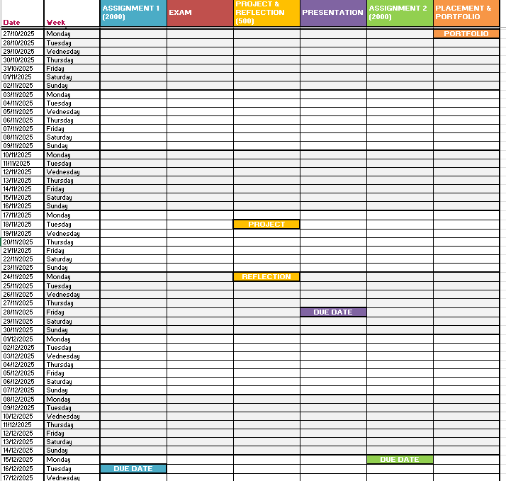
Understand your time
Use a longer-term planner of some sort to help get the ‘big picture’ of the time you have for your work.
Try one of the year planners or our Overview Planner in your resource booklet.

Slide 8
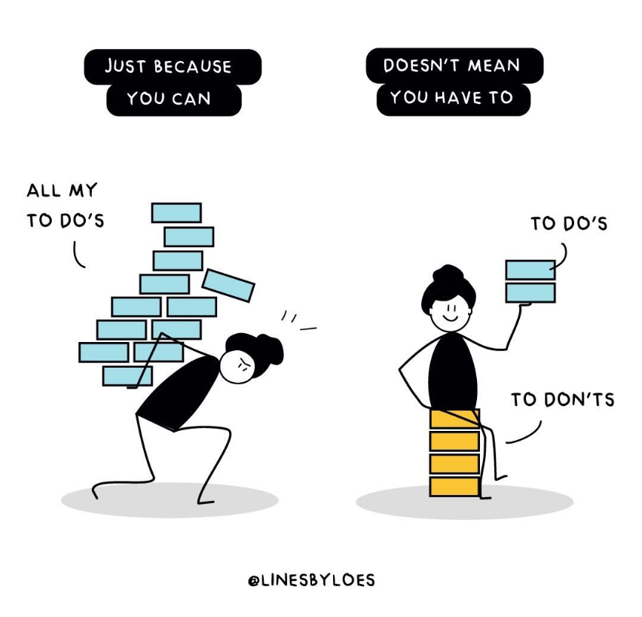
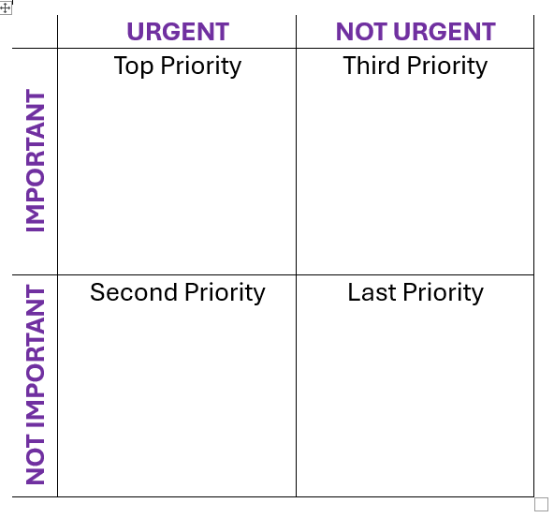
Prioritising
Not all your tasks will fit into the time you have.
You might not achieve everything you want to achieve.
All of this is OK.
We do want to try to at least achieve the most important things, and we can set ourselves up to be able to do this by taking some time to prioritise our to do list.

Slide 9
One task?
Cleaning the bathroom
Completing an assignment
Gather cleaning supplies.
Take cleaning supplies to bathroom.
Tidy / clear surfaces.
Dust surfaces.
Empty bins.
Wash towels and mats.
Clean the shower/bath.
Clean the sink and countertops.
Clean the toilet.
Vacuum / sweep / mop floors.
Empty mop bucket.
Return cleaning supplies.
Understand the question / brief.
Research:
  Library trips / searches.
  Reading and making notes.
Plan structure / content.
Write draft.
Final draft.
Proofread.
Submit.
Ask yourself – “What do I need to do to get to the next step?”

Slide 10





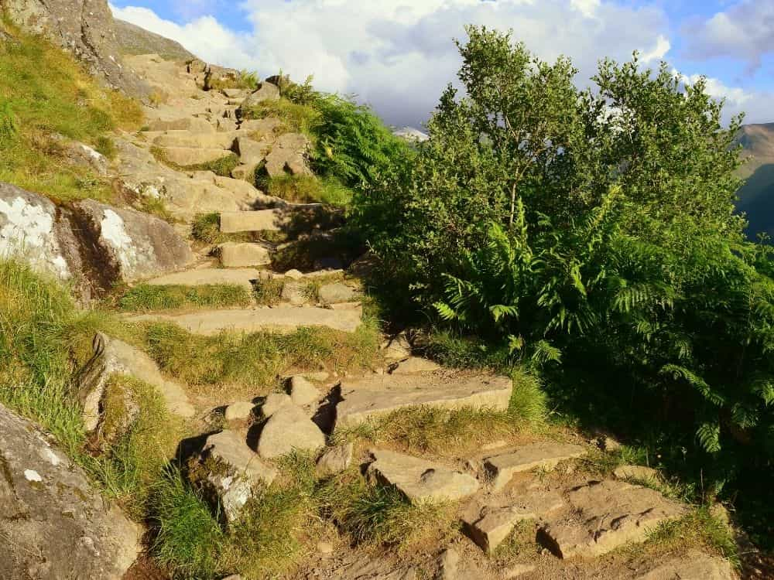


Prepare / Get Support
Which mountain would you rather climb? Why?
Who is more likely to get to the top of the mountain? Why?

Slide 11

Breaking down time and tasks
Task Breakdown
MindView
Word document
to-do lists
Leeds Beckett Assignment Calculator
Studiosity's Assignment Calculator
Academic writing resources and support:
Academic Writing
Reading, Notetaking and Revision

Slide 12
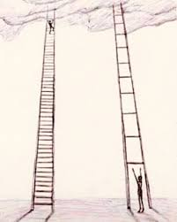
Make it Manageable
Break it down
Keep it simple
Prioritise
Be prepared
Be realistic
Be kind to yourself
Be structured
Be flexible
Be SMART - Specific, Measurable, Achievable, Relevant, Time-Bound.
Know where to find any help you may need

Slide 13

Suggested Next Steps
Use the Student Overview Planner 2025-26 to plan out your time for any upcoming assignment deadlines.
OR
Use Task Breakdown to break down a task (assignment / revision / presentation etc) into smaller steps.
Use any of the resources to help you.
Remember to be realistic e.g. how much time do you have? How long will that take you? Can you give yourself ‘buffer time’?

Slide 14
Discussion and Self-reflection
Discussion
What has been useful for you today?
What will you take away?
Self-reflection
One thing I will try this week - write it down
Does anyone want to share what their one thing is?

Slide 15
Self-evaluation (online)
What number are you now on today's topic?
1 = very unconfident
2 = somewhat unconfident
3 = neutral
4 = somewhat confident
5 = very confident
What have you gained / learned from the session?
What would you tell others about the session?

Slide 16
Self-evaluation and Feedback
Please take a few minutes to fill in part 2 of your self-evaluation
It asks you to rate your confidence levels in the skills now we are at the end of the session.
We want to make sure that these sessions are useful to you and others. Please share some feedback to help us to do that.
This should only take a few minutes and can be completed anonymously.

