Slide 1
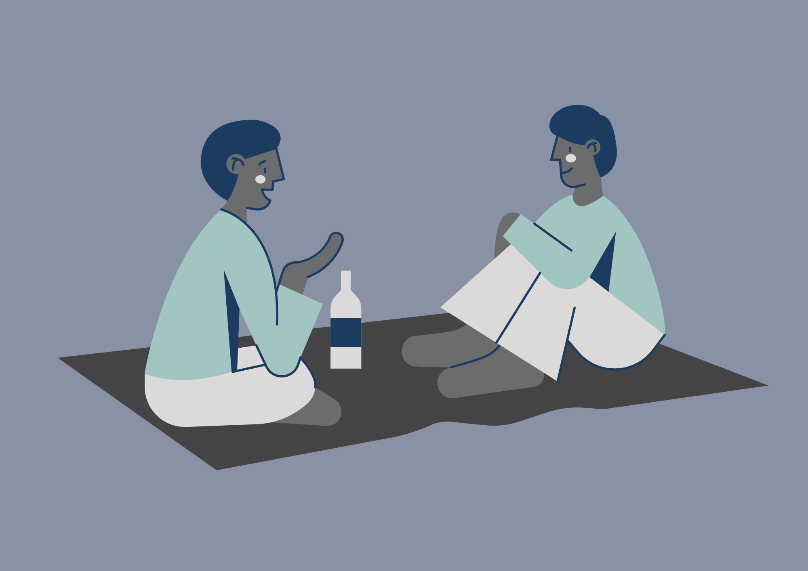
Practical Peer Support
Please note: We might use your anonymised comments and confidence ratings for service promotion and evaluation. ​
If you would prefer that we don't do this, please let us know at any time at disability-support@shu.ac.uk

Slide 2
What to Expect
Ground Rules
We will share tips, strategies and resources to help with motivation and procrastination.
You can connect with others with shared experiences to learn from each other.
Please communicate in ways you are comfortable with.
Online: we will stay in the meeting until 3.15pm for any questions. The session will then end. We will share sources of support in the chat.
In person: Come and go and move around if needed.
(Online only!) Please have your microphone off unless speaking. ​
During activity or discussions, join in if you feel able and feel free to ask questions. ​
Respect the opinions, privacy and information shared by others in the group. ​

Slide 3
Self-evaluation (online)
What number are you right now on today's topic?
1 = very unconfident
2 = somewhat unconfident
3 = neutral
4 = somewhat confident
5 = very confident

Slide 4

Self-evaluation
Please take a few minutes to fill in part 1 of a short self-evaluation
It asks you to rate your confidence levels in the skills we will cover today
We will also ask you to fill part 2 in at the end to see if you have gained confidence in your skills

Slide 5

Discussion
- What made you come here today?
What do you find most difficult about motivation and procrastination?
What has helped you with these difficulties in the past?
Can you think of anything to share?

Slide 6

Understanding your Motivation
Three components:
Activation, persistence, intensity.
Extrinsic v intrinsic:
Extrinsic motivation – behaviours carried out to receive an external reward or outcome. (Enjoyment of eating cake).
Intrinsic motivation – behaviours carried out for their own sake that the person finds rewarding. ​(Enjoyment of the process of making a cake).
What extrinsic and intrinsic factors motivate you?​ Which type of motivation is likely to give you the best results? ​

Slide 7
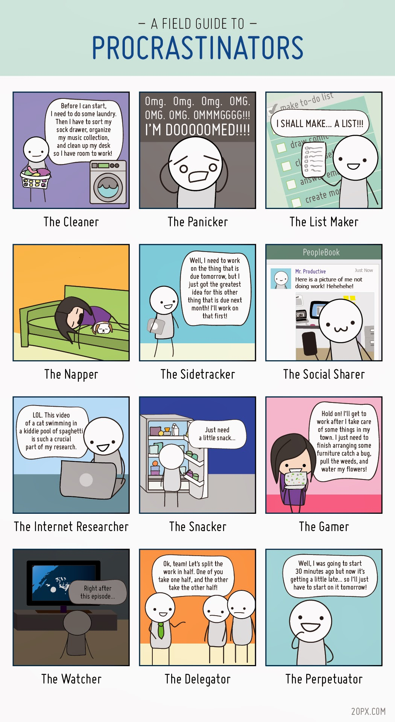
How do we Procrastinate?
Do you identify with any of these types of procrastination?
Thought:
Can you use the way you procrastinate to help your motivation?

Slide 8
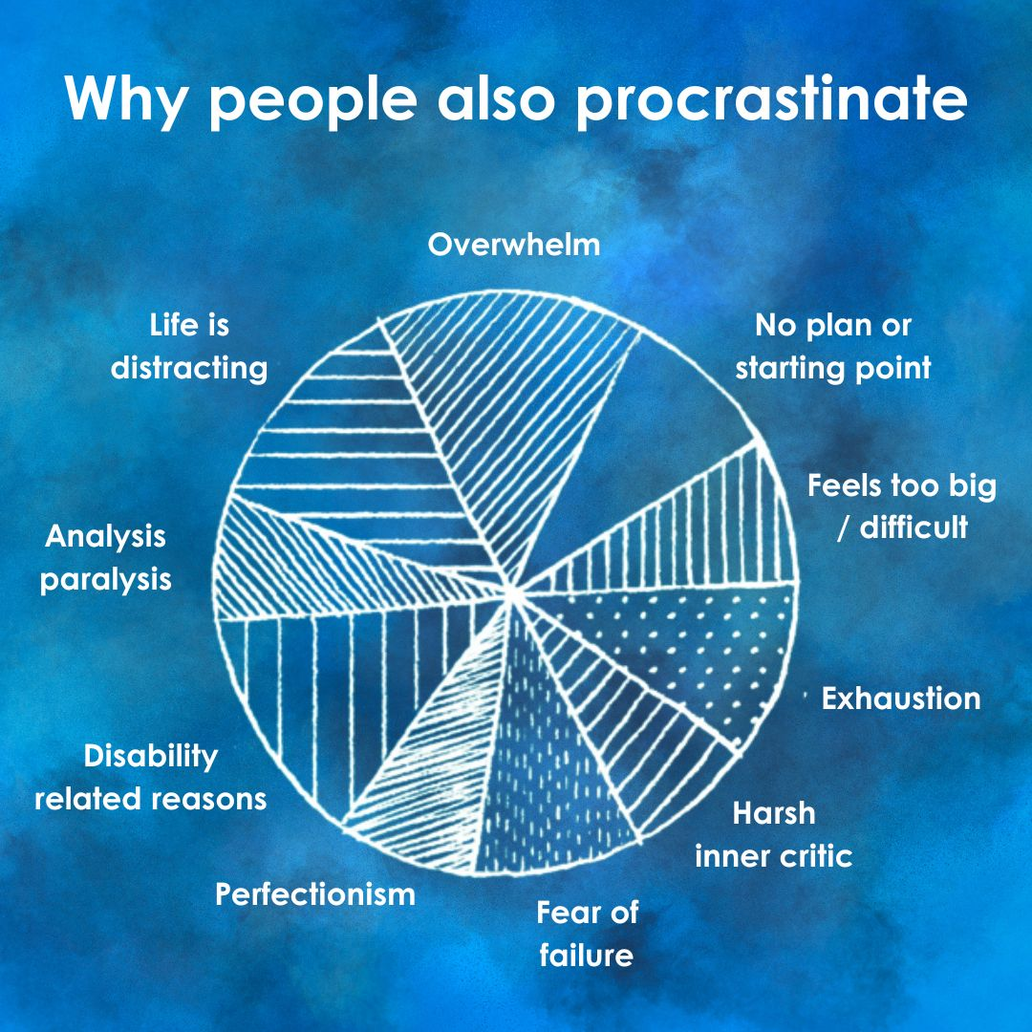
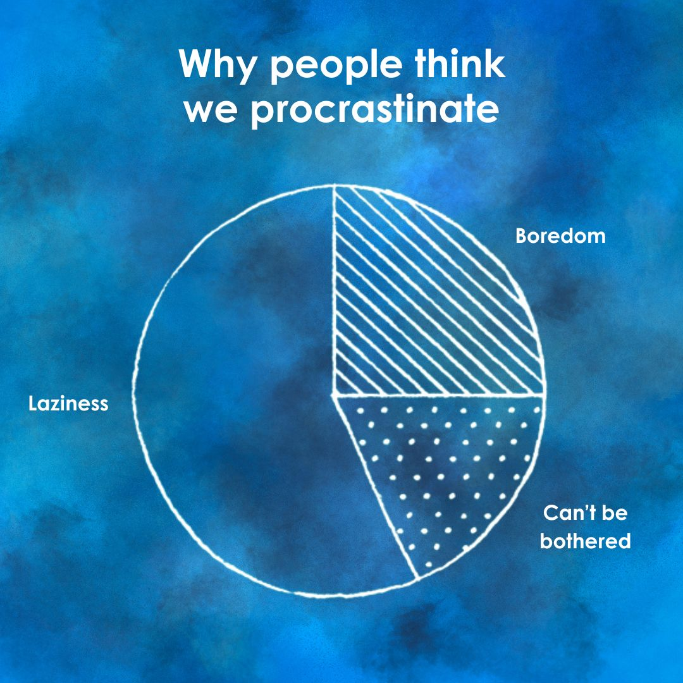
Why do we procrastinate?

Slide 9
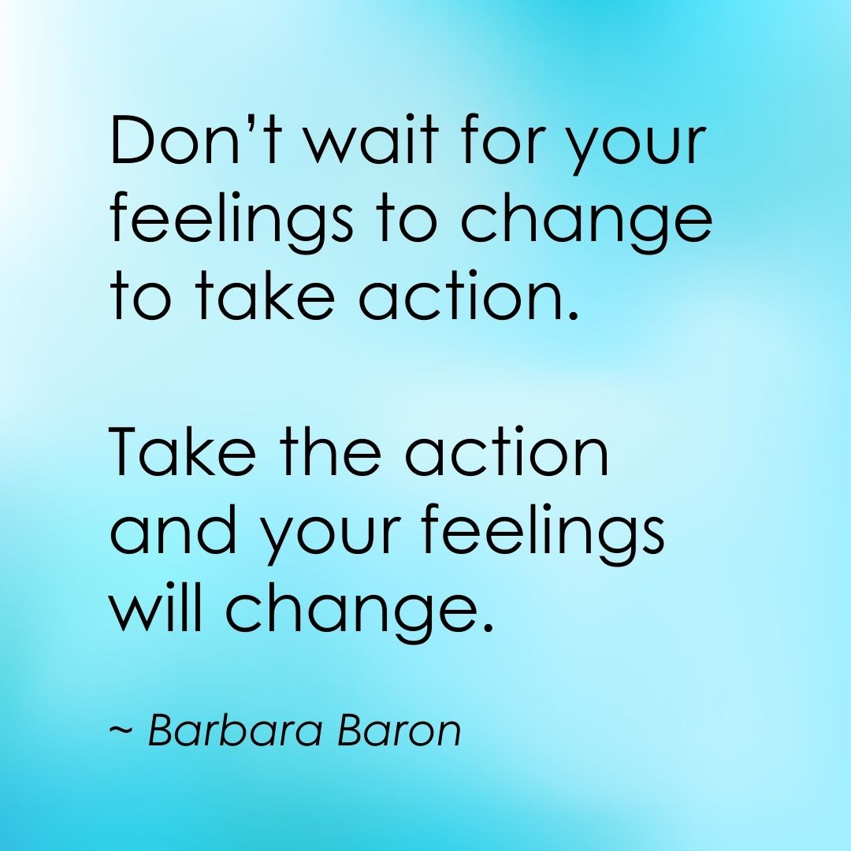
Getting Started
The 10-Minute Rule: Commit to a short time and then reassess.
Make a plan.
Manage your task or your to-do list.
Focus on the things you can do or the things you can control.
Identify incentives.

Slide 10








Prepare / Get Support
Which mountain would you rather climb? Why?
Who is more likely to get to the top of the mountain? Why?

Slide 11
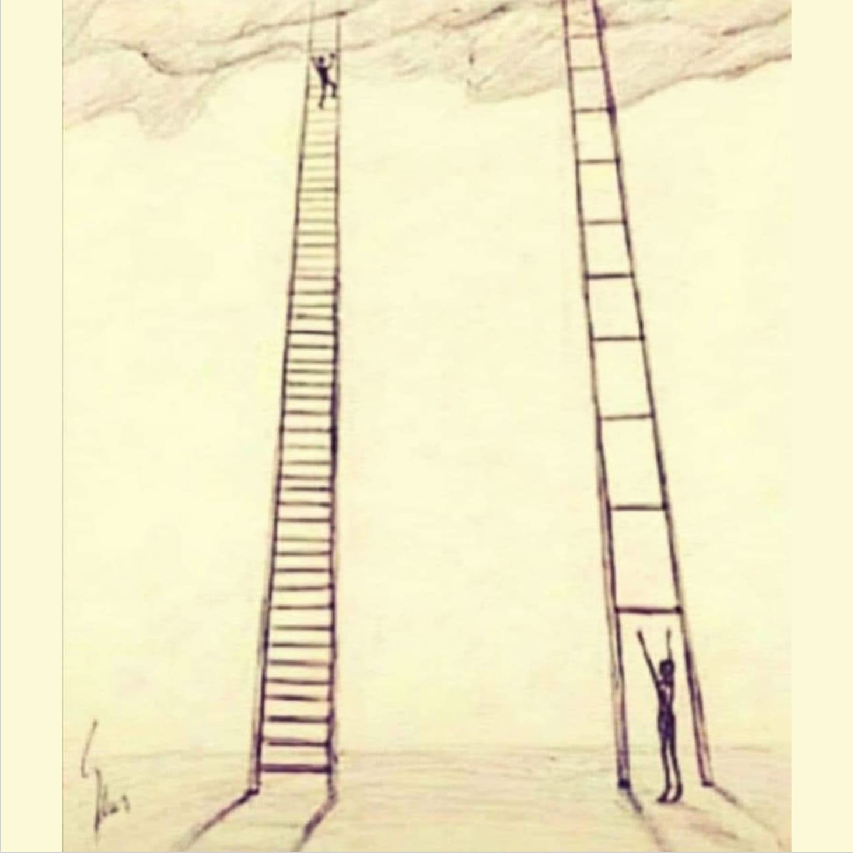
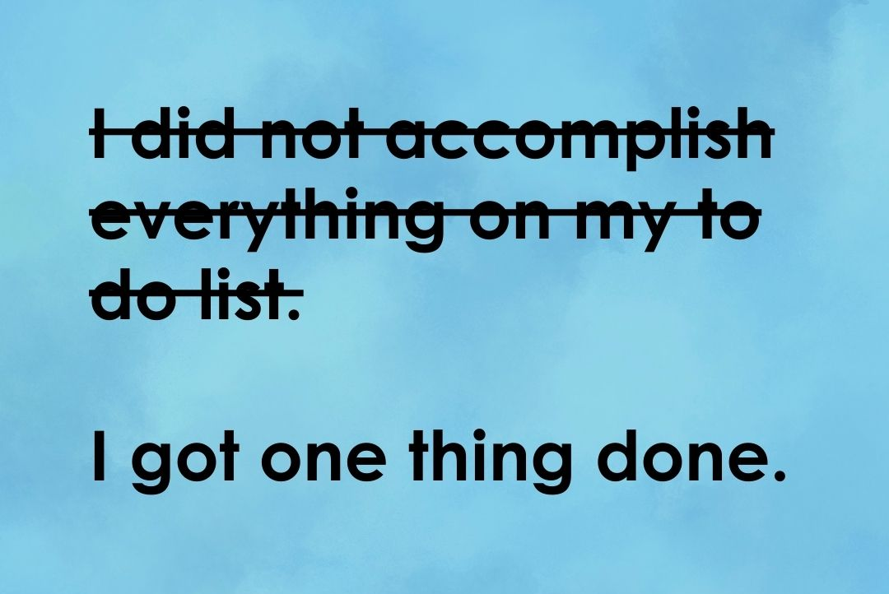
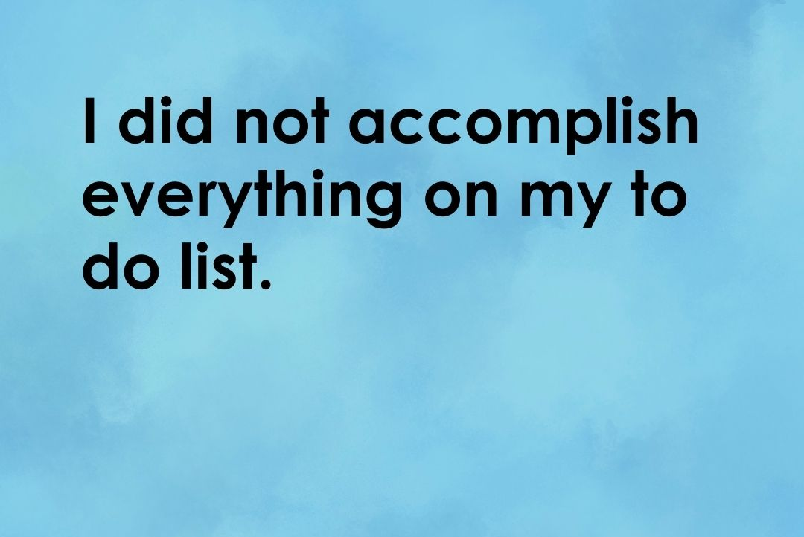
Reframe your Thoughts
Struggling doesn’t = failing.
Progress is progress, no matter how small.
Good enough is sometimes good enough.
“Just one small positive thought in the morning can change your whole day” ~ Dalai Lama
What is the thought that’s stopping you?
How can we challenge it?

Slide 12
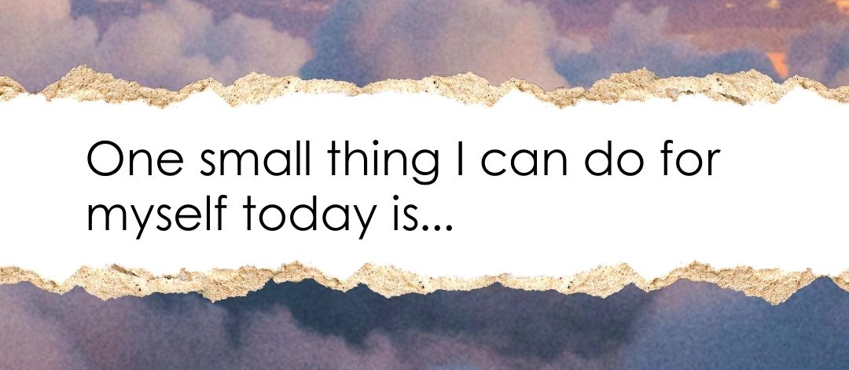
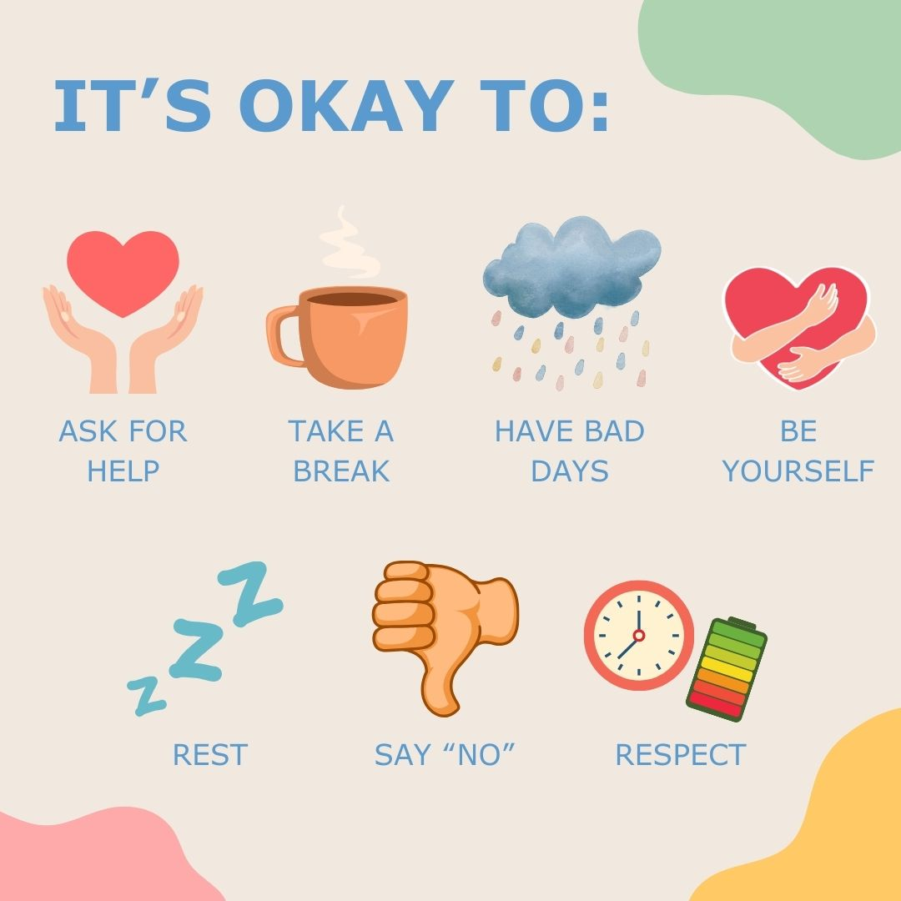
Self-compassion and care
Sleep
Nutrition
Hydration
Exercise
Health
‘Me’ time
Be kind to yourself.
There is no ‘normal’ way to work
What would you say to a friend?
Quiet the harsh inner critic.
Balance is important.
Consider what you need from the day, not just what the day needs from you.

Slide 13

Celebrate wins
Rewards!
Acknowledge achievements and progress.
Praise and positive talk go a long way.

Slide 14

Activity
Create a Motivation Plan / Action Plan
This is to refer to as a prompt / reminder for when you are struggling to focus / struggling to motivate yourself / feeling overwhelmed.
Include suggestions that you think might work for you.
Use any of the Motivation and Focus resources to help you.

Slide 15
Discussion and Self-reflection
What has been useful for you today?
What will you take away?
One thing I will try this week - write it down
Does anyone want to share what their one thing is?

Slide 16
Self-evaluation (online)
What number are you now on today's topic?
1 = very unconfident
2 = somewhat unconfident
3 = neutral
4 = somewhat confident
5 = very confident
What have you gained / learned from the session?
What would you tell others about the session?

Slide 17
Self-evaluation and Feedback (in person)
Please take a few minutes to fill in part 2 of your self-evaluation
It asks you to rate your confidence levels in the skills now we are at the end of the session.
We want to make sure that these sessions are useful to you and others. Please share some feedback to help us to do that.
This should only take a few minutes and can be completed anonymously.

