Slide 1
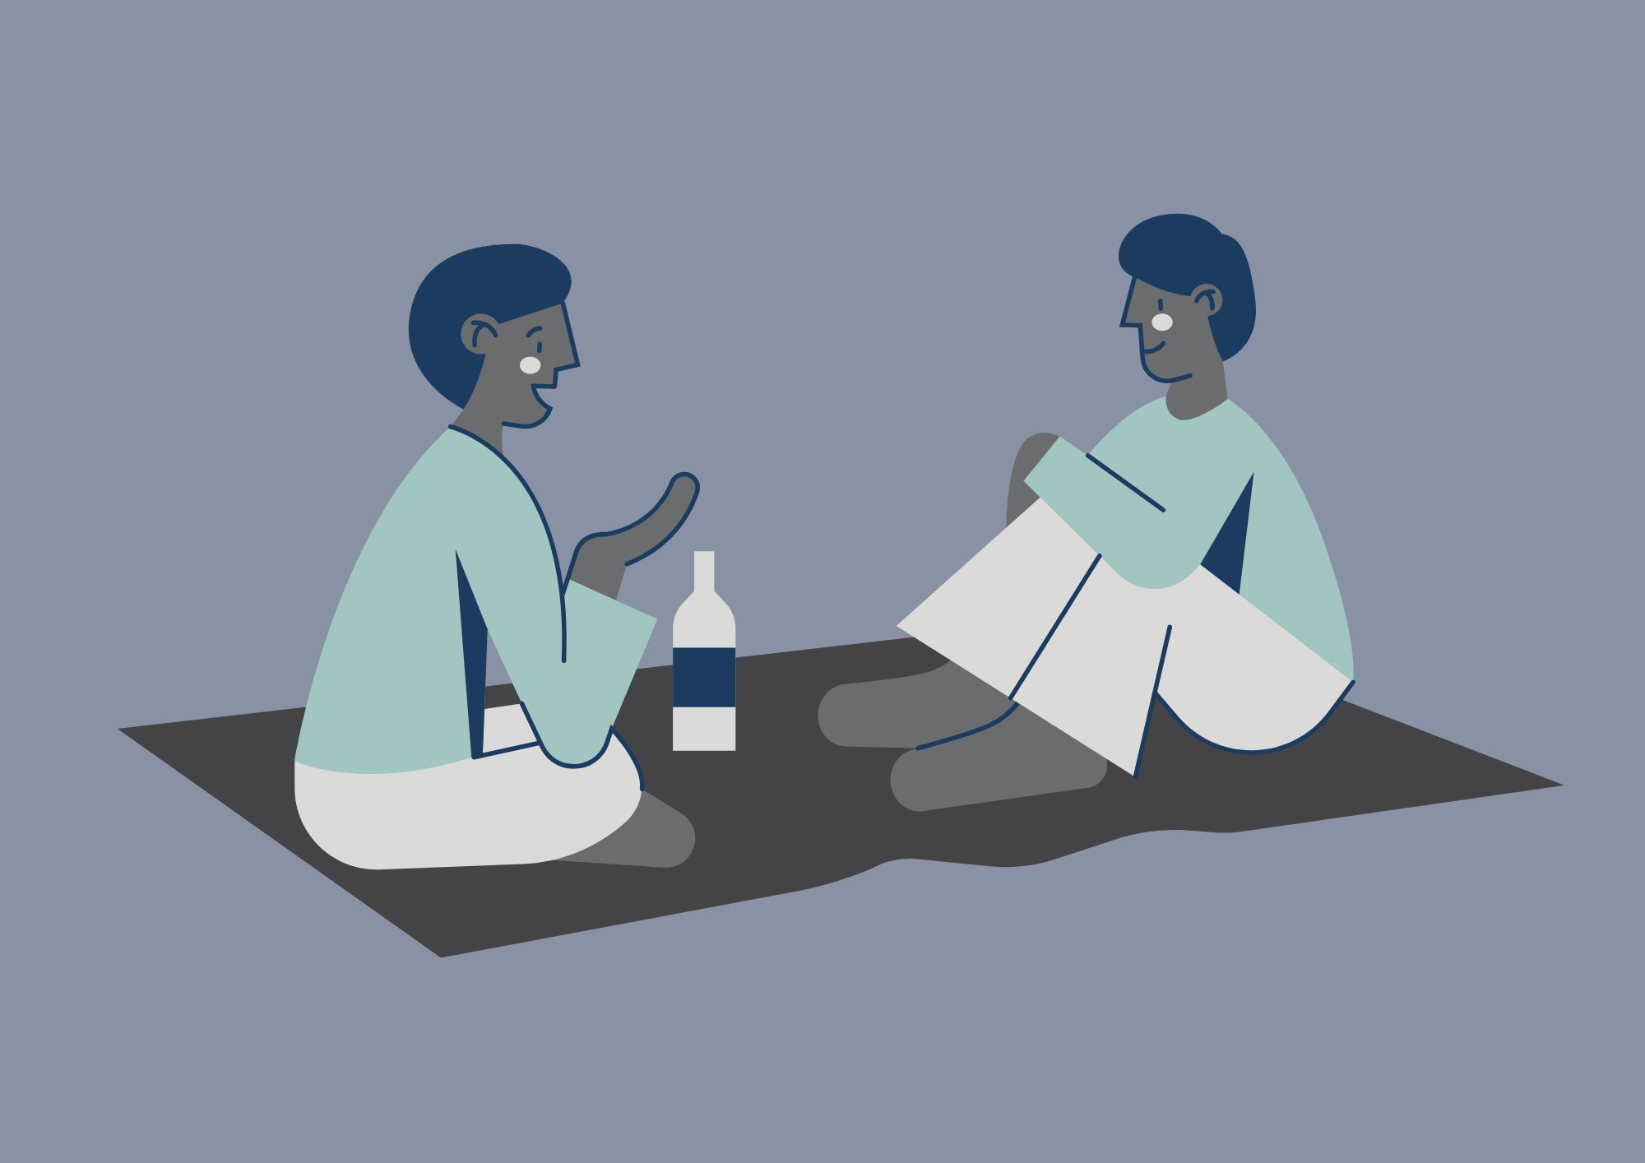
Practical Peer Support
Please note: We might use your anonymised comments and confidence ratings for service promotion and evaluation. ​
If you would prefer that we don't do this, please let us know at any time at disability-support@shu.ac.uk

Slide 2
What to Expect
Ground
Rules​
We will share tips, strategies and resources to help with productivity and focus.
You can connect with others with shared experiences to learn from each other.
Please communicate in ways you are comfortable with.
Online: we will stay in the meeting until 3.15pm for any questions. The session will then end. We will share sources of support in the chat.
In person: Come and go and move around if needed.
(Online only!) Please have your microphone off unless speaking. ​
During activity or discussions, join in if you feel able and feel free to ask questions. ​
Respect the opinions, privacy and information shared by others in the group. ​

Slide 3
Self-evaluation (online)
What number are you right now on today's topic?
1 = very unconfident
2 = somewhat unconfident
3 = neutral
4 = somewhat confident
5 = very confident

Slide 4

Self-evaluation
Please take a few minutes to fill in part 1 of a short self-evaluation
It asks you to rate your confidence levels in the skills we will cover today
We will also ask you to fill part 2 in at the end to see if you have gained confidence in your skills

Slide 5

Discussion
- What made you come here today?
- What do you find most difficult about staying productive and keeping focus?
What has helped you with these difficulties in the past?
Can you think of anything to share?

Slide 6
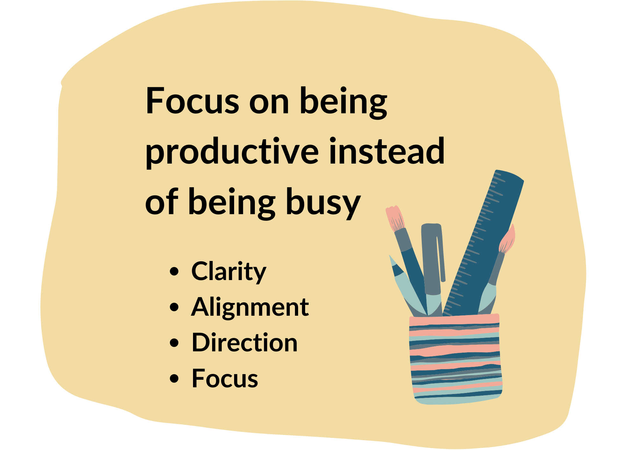
What do we mean by ‘being productive’?
Doing what is necessary
Producing a lot / something of quality
Achieving something
Some days this will differ
Efficiency
Maximising time
Producing results
Focus and concentration
When are you most productive?
At what point in the day?

Slide 7
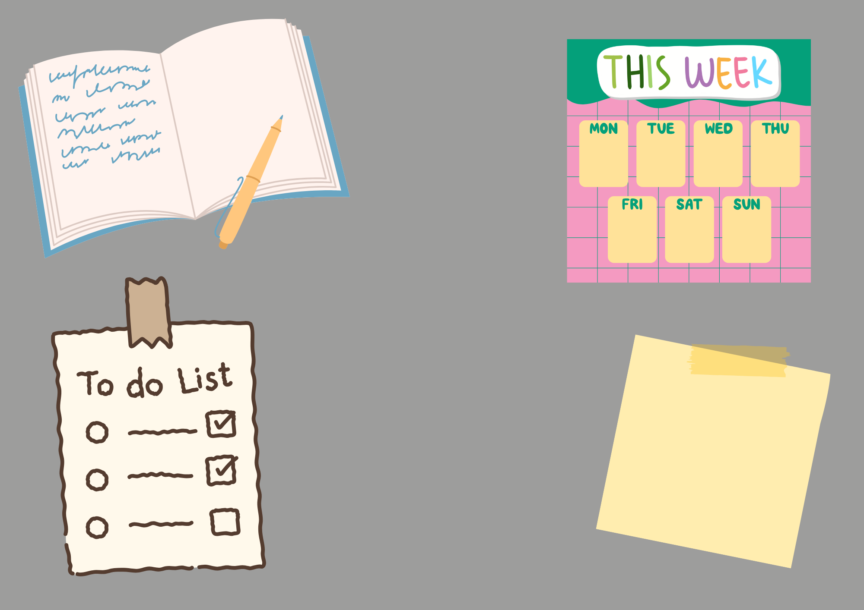


Write things down
“Use your head, don’t use your head!”
“The mind is for having ideas, not for holding them.”
– David Allen

Slide 8
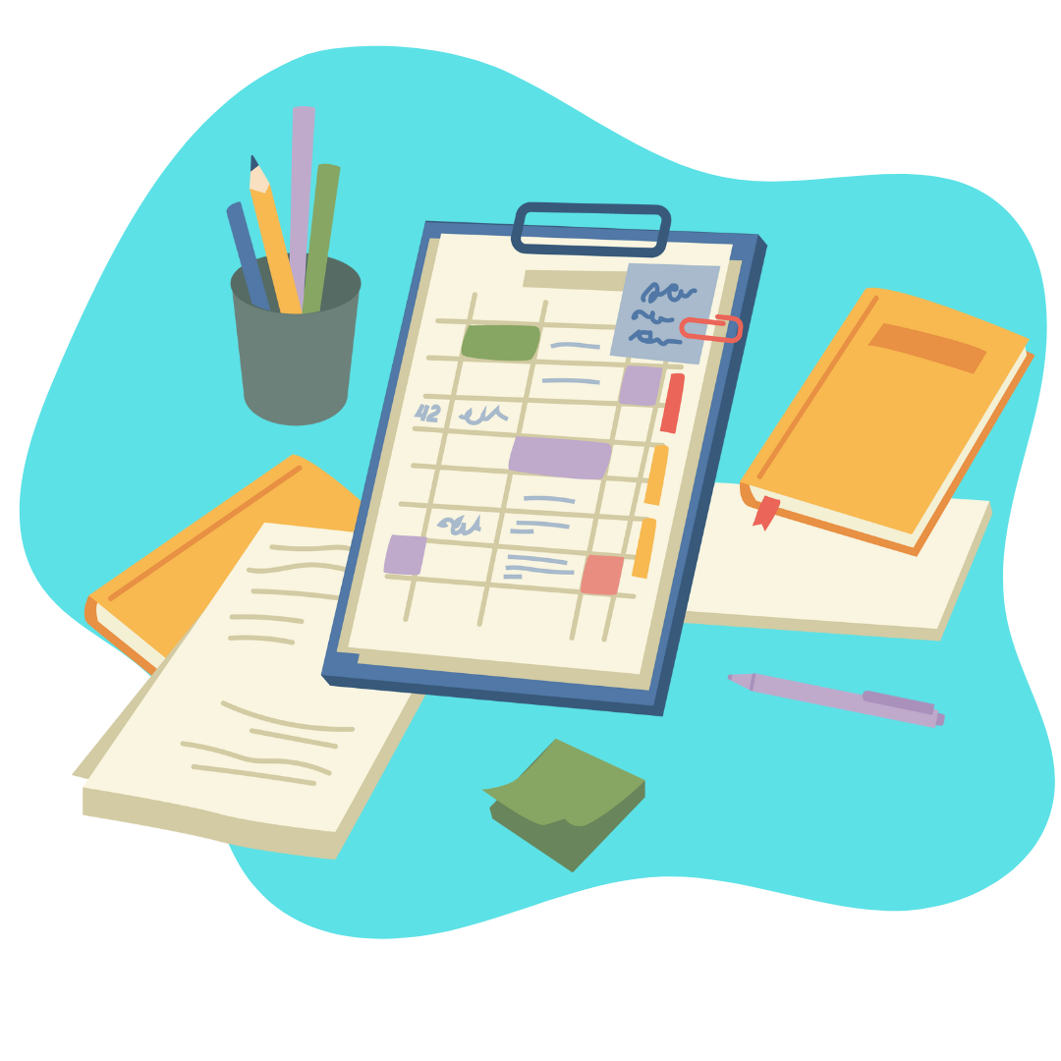
Plan - break it down
Task Breakdown
MindView
Word document
To-do lists

Slide 9

SMART Goals
Specific
Measurable
Achievable
Relevant
Time bound

Slide 10
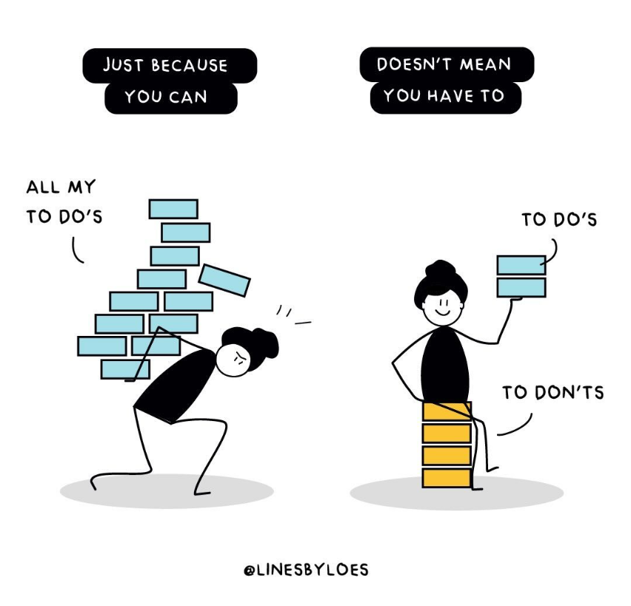
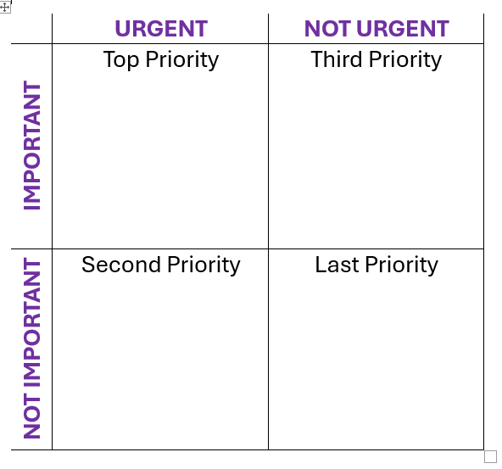
Prioritising
Not all your tasks will fit into your day or week.
You might not achieve everything you want to achieve.
All of this is OK.
We do want to try to at least achieve the most important things, and we can set ourselves up to be able to do this by taking some time to prioritise our to do list.

Slide 11
Strategies: OHIO
O
...Where possible. Or handle it as few times as possible.
Only
Use the 4 T’s:
H
Handle
Tackle it
If it’s quick, easy or straight forward
Task it
If it needs a bit more thought and attention
Toss it out
If it’s unimportant
Transfer it
Unsure, need clarification or help to deal with it
I
It
O
Once

Slide 12
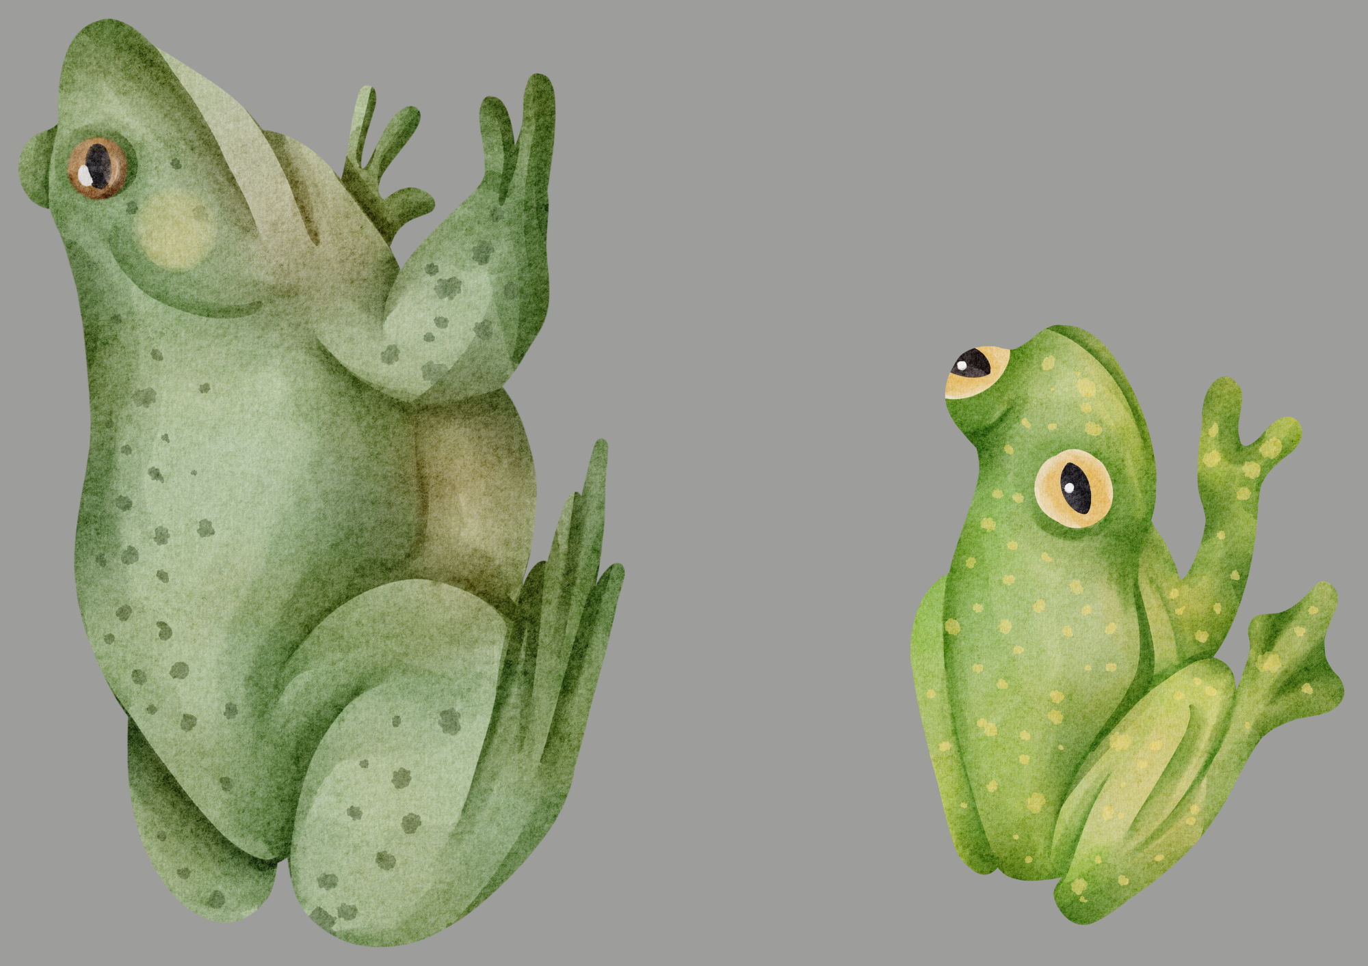
Eat That Frog

Slide 13

3/3/3
3 urgent tasks
3 x hours on a big or important task or project
3 maintenance tasks

Slide 14
1-3-5 Rule

Slide 15

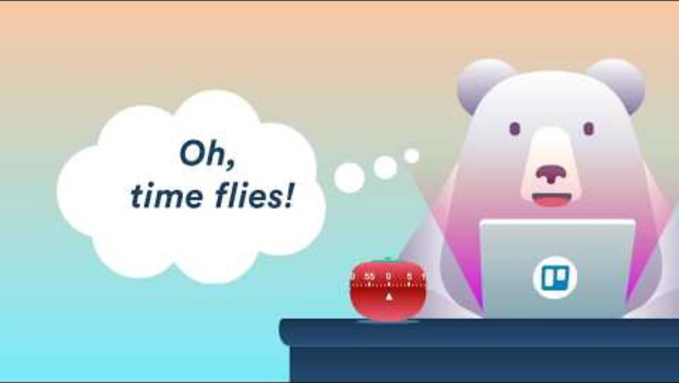



Timer Techniques
Apps:
Focus to do
Forest
Alarms
Pomodoro Technique
Timers

Slide 16
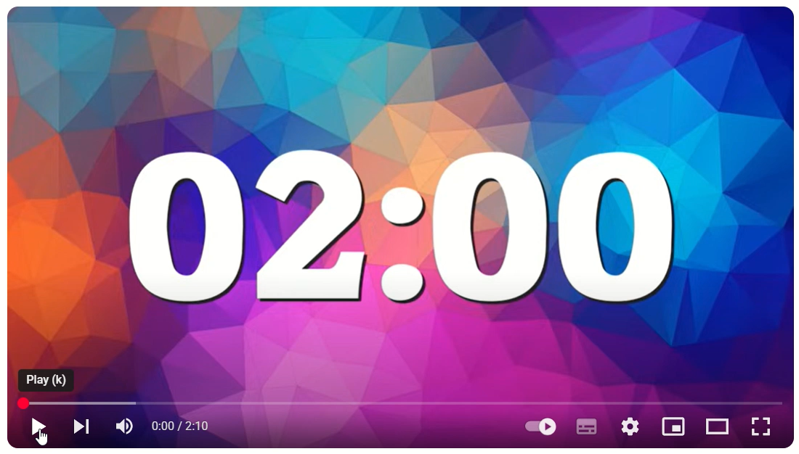
2 Minute Rule
Commit to just two minutes, then decide to continue.
Use a timer to stay focused and avoid distractions.
Focus on completing the smallest step, not the whole task.
Break big tasks into smaller, two-minute actions.
Start with a task that takes less than two minutes.
Repeat the process until you gain momentum.
Celebrate the starts - you’re building a habit of taking action.

Slide 17

Focus
Environment
Body doubling / lone working
Limit distractions
Reduce Digital Distractions
Schedule your focussed time
Be realistic – how long can you reasonably focus on something productively for?
Be flexible with what you hope to achieve, avoid multitasking
Take a break / change things up
Make it fun / a challenge.
What works for you?

Slide 18
Discussion and
Self-reflection
What has been useful for you today?
What will you take away?
One thing I will try this week - write it down
Does anyone want to share what their one thing is?

Slide 19
Self-evaluation (online)
What number are you now on today's topic?
1 = very unconfident
2 = somewhat unconfident
3 = neutral
4 = somewhat confident
5 = very confident
What have you gained / learned from the session?
What would you tell others about the session?

Slide 20
Self-evaluation and Feedback (in person)
Please take a few minutes to fill in part 2 of your self-evaluation
It asks you to rate your confidence levels in the skills now we are at the end of the session.
We want to make sure that these sessions are useful to you and others. Please share some feedback to help us to do that.
This should only take a few minutes and can be completed anonymously.

