Slide 1
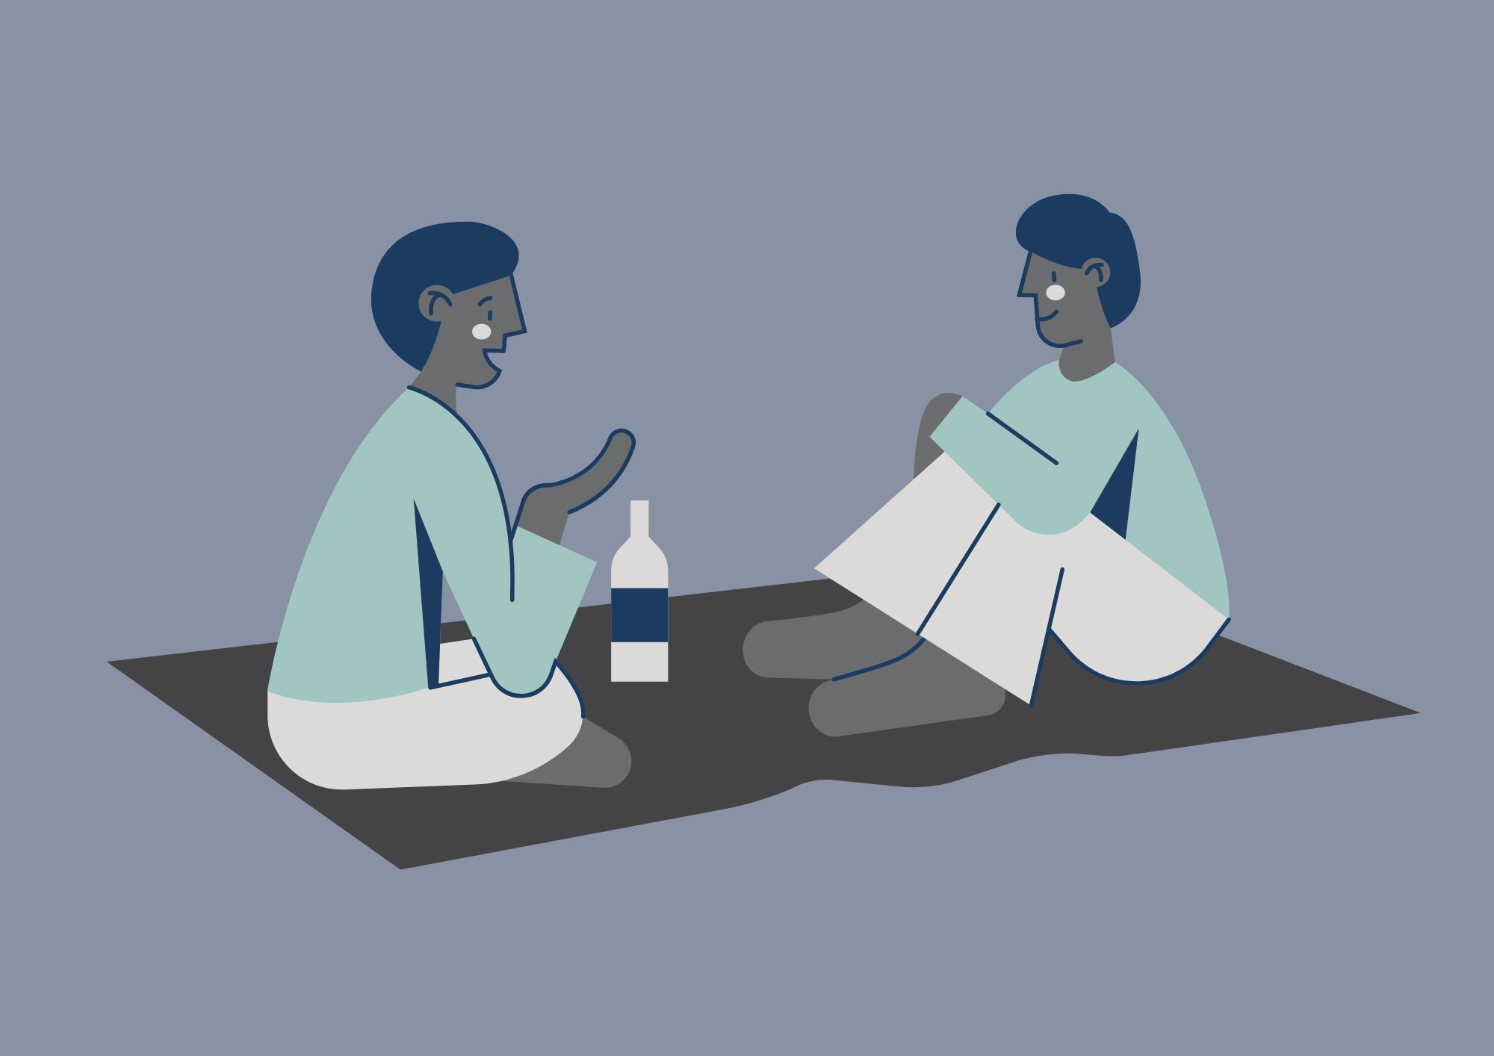
Practical Peer Support
Please note: We might use your anonymised comments and confidence ratings for service promotion and evaluation. ​
If you would prefer that we don't do this, please let us know at any time at disability-support@shu.ac.uk

Slide 2
What to Expect
Ground
Rules​
We will talk through social opportunities and support and will share some practical tips.
You can connect with others with shared experiences to learn from each other.
Please communicate in ways you are comfortable with.
Online: we will stay in the meeting until 3.15pm for any questions. The session will then end. We will share sources of support in the chat.
In person: Come and go and move around if needed.
(Online only!) Please have your microphone off unless speaking. ​
During activity or discussions, join in if you feel able and feel free to ask questions. ​
Respect the opinions, privacy and information shared by others in the group. ​

Slide 3
Self-evaluation (online)
What number are you right now on today's topic?
1 = very unconfident
2 = somewhat unconfident
3 = neutral
4 = somewhat confident
5 = very confident

Slide 4

Self-evaluation (in person)
Please take a few minutes to fill in part 1 of a short self-evaluation
It asks you to rate your confidence levels in the skills we will cover today
We will also ask you to fill part 2 in at the end to see if you have gained confidence in your skills

Slide 5

Discussion
- What made you come here today?
- What do you find most difficult about finding and accessing support at Hallam?
What has helped you with these difficulties in the past?
What do you find most difficult about finding and accessing social opportunities?
Can you think of anything to share?

Slide 6
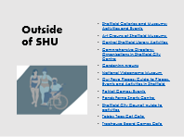
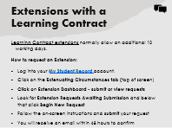
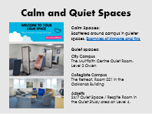

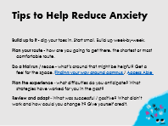

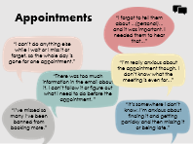
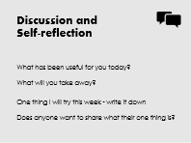
Jump to Content

Slide 7

Support at Hallam
Not sure who or where to go to with your question / issue?
MyHallam
Hallam Help

Slide 8
Support for your course
Student Support Advisers
Academic Advisor
Module Leaders
TORS (Technical Operations Resources & Services)
Notes:
Course specific:
Student Support Advisers provide help & advice for managing your academic studies alongside day-to-day life.
Academic Advisor and module leaders offer support around your modules and assessments. These can be found on your course Blackboard site. How do I find out who my named Advisers are?
TORS (Technical Operations Resources & Services) - access for specialist areas / facilities.

Slide 9
Support for Study
Systems and Technology:
IT Help
Hallam Digital Skills
Assistive Technology
LinkedIn Learning
Library & Skills:
Library Gateway
Library Help
Skills Centre - Skills Check
Subject Librarians

Slide 10
Support for your Health and Wellbeing
Medical:
Student Health
Wellbeing & Belonging:
Student Wellbeing
Report and Support
Multi-faith Chaplaincy
Disabled Student Support:
Disabled Student Support
Learning Contracts
Disabled Students Allowance
Assistive Technology
Practical Peer Support

Slide 11

Hallam Students’ Union Support
Hallam Students’ Union
Help and Support
Get Advice

Slide 12

Activity
Look through the support available so you know it is there if or when you need it.
One way to make sure it’s easy to find:
Open your browser on your phone.
Go to your bookmarks.
Create a Support at SHU folder.
Scan the QR codes and bookmark the webpages to that folder.

Slide 13
Extensions with a Learning Contract
Learning Contract extensions normally allow an additional 10 working days.
How to request an Extension:
Log into your My Student Record account.
Click on the Extenuating Circumstances tab (top of screen)
Click on Extension Dashboard - submit or view requests
Look for Extension Requests Awaiting Submission and below that click Begin New Request
Follow the on-screen instructions and submit your request
You will receive an email within 48 hours to confirm

Slide 14






Appointments
“I forgot to tell them about ...(personal)... and it was important. I needed them to hear that...”
“I can’t do anything else while I wait or I miss it or forget, so the whole day is gone for one appointment.”
“I’m really anxious about the appointment though, I don’t know what the meeting is even for...”
“There was too much information in the email about it. I can’t follow it or figure out what I need to do before the appointment. ”
“It’s somewhere I don’t know. I’m anxious about finding it and getting panicky and then missing it or being late.”
“I’ve missed so many I‘ve been banned from booking more.”

Slide 15
Tips for Appointments
Prepare for your appointment:
1. Identify the purpose of / your goals for the appointment or meeting.
2. Gather relevant information that might be needed or useful.
3. Prepare your questions or what you want to say.
4. Plan your arrival or virtual connection.
5. Consider your comfort and needs.
During your appointment:
Use the things you have prepared to help you.
Ask for clarification on anything you don't understand.
Doc Ready

Slide 16

Finding Social Opportunities

Slide 17

Activities at SHU
Student Wellbeing & Belonging Events
GoGlobal helps international students meet new people, experience different cultures and develop personal and professional skills.
Just Play ‘is Sheffield Hallam’s inclusive and relaxed sports programme designed for students who simply want to have fun, stay active, and meet new people — no commitment, no experience needed, and best of all, it’s completely FREE!’
SHU Sports Leagues ‘provide a semi-competitive, fun, and recreational opportunity to participate in sport.'

Slide 18

Students’ Union
Students’ Union – events
Students’ Union - societies
Students’ Union - support for disabled students
Students' Union – volunteering ‘a great way to help out in the community, meet new people, develop skills and confidence, and impress potential employers.’

Slide 19
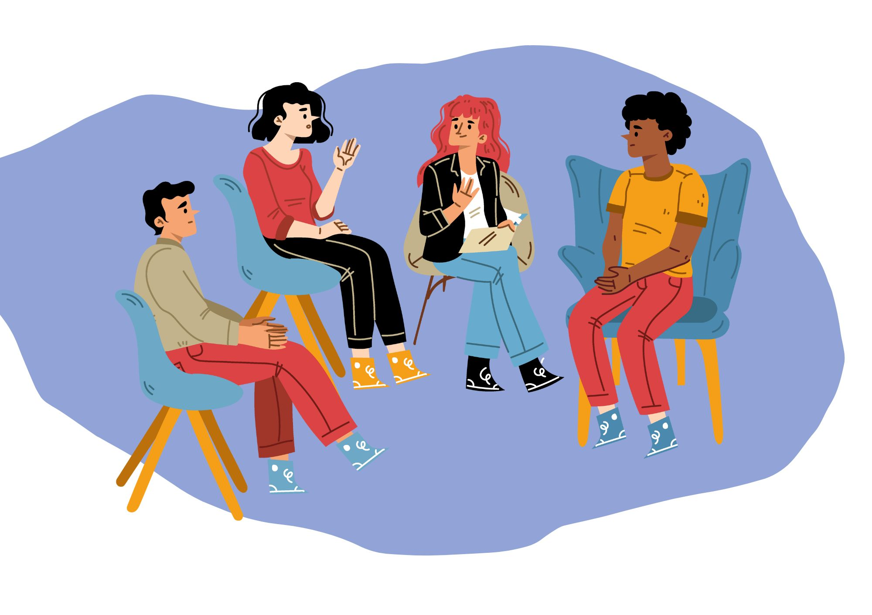
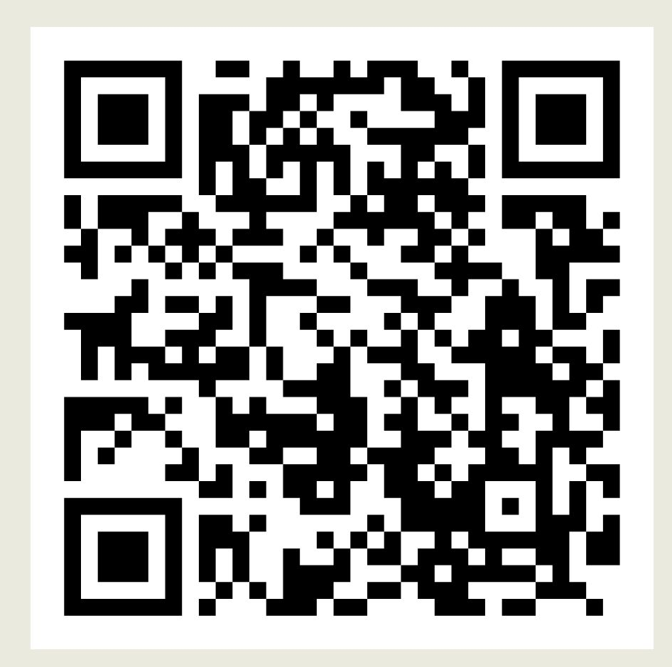
Find a Supportive Community
Societies are a great way to try something new, meet new people with similar interests and discover exciting trips and socials.
Join a society:
Login to the student’s union website with your SHU login.
Choose the society membership you wish to join and add it to your basket.
Click through to the checkout (the basket icon at the top of the screen).
Pay for any membership fee (usually free) and fill in your details.
Contact the society to find out the next meeting or they will contact you.
Follow their social media to keep up to date with any upcoming events.

Slide 20
Adopt or Start a Society
If there’s not a society for your interest / hobby, you could adopt or start one!
Adopt:
Decide which society you would like to adopt.
Email the Societies Team on activitiesadmin@shu.ac.uk to tell them you want to adopt the society. Include which students will be the President, Secretary and Treasurer, along with their student numbers.
Book onto a Society Induction!
Start:
Find 10 students that are interested in forming a society.
Complete the application form found at the bottom of the page. A panel will review this.
Once your society is provisionally approved, select your committee
Send the committees’ names and student numbers to the Societies Team
Book onto a Society Induction!

Slide 21
Contacting a group / society
Use this if it helps. You can edit it to suit what you want to say
Hi
I am interested in joining …
Please can you tell me the following information?
When the society / group meets
Where / How the society / group meets
How often the society meets
What happens at a typical event
I am autistic / have A[D]HD etc / I might need some support with the following things when I join your society … / I might need to bring a friend to the first meeting etc
Please can I attend your next session to see what it is like before I join?
Thank you

Slide 22
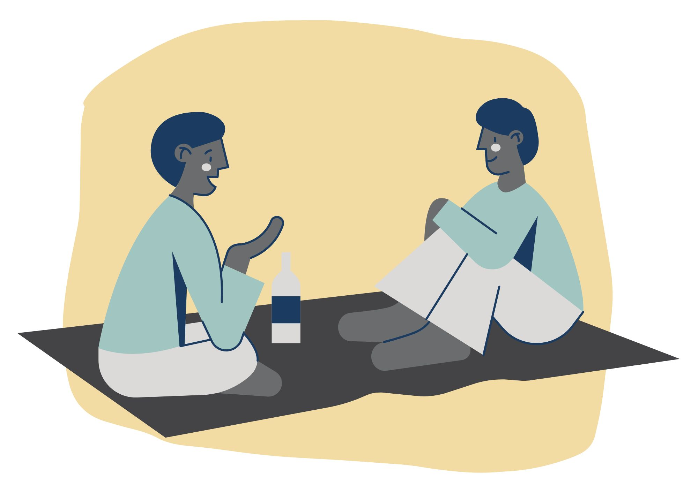
Peer Support
We run ‘Check-In’ sessions alternate weeks after these sessions.
Come along and discuss topics like; Time management, organisation, study and assignments, student life, or simply use the session to be social.
Being around others who get it makes us feel less alone.
Get support from peers and help others in an understanding and supportive environment.
Booking Link and QR code to follow

Slide 23

Practical Advice - Interactions
Conversation Starters:
Some of the advice on here is helpful, for example ‘Asking a question is a way to signal that you’re friendly and open to social interaction’.
Some advice might not be so helpful e.g. ‘tone is more important than words’ The link is included because there are lots of practical examples of conversation starters.
If you know of any other sites / apps that are helpful on conversation starters, and are happy to share with the group, please do!
Making Friends: For Autistic Adults:
‘Small talk’ can often progress into more in-depth conversations and you may find you have things in common with the person you are talking to.’

Slide 24
Student Perspective: Meeting People
By a student employee in Disabled Student Support, July 2025
Do things you enjoy. Whether that is playing boardgames, rock climbing, amateur theatre or being socially aware. There are going to be spaces in Sheffield for these, and you’ll meet people through them.
Try new things! Whilst doing things you already enjoy is great, you can try lots of new activities that you might have wanted to do but not have had the chance. University is a great time to do these things. This could be volunteering, new sports, or new hobbies.
Meet the people on your course in and out of university. It not only could lead to better connections but also makes studying a lot easier. Ask if anyone wanted to go for a drink before or after a class (And it doesn't need to be alcoholic! If you ask, then you get to ask where you go.)
Don’t put pressure on yourself or others to become friends. Relationships can and will occur naturally and not every person you meet will be your best friend. Passing friendships, acquaintances and close friends are all important in a healthy life.

Slide 25
Activity
Look through the social opportunities available and make a plan to attend something.
Make social opportunities easy to find:
Open your browser on your phone.
Go to your bookmarks.
Create a Social folder.
Scan the QR codes and bookmark the webpages to that folder.
Questions? Now is a good time to come ask to us :)

Slide 26

Tips to Help Reduce Anxiety
Build up to it - dip your toes in. Start small. Build up week-by-week.
Plan your route - how are you going to get there, the shortest or most comfortable route.
Do a trial run / recce - what’s around that might be helpful? Get a feel for the space. Finding your way around campus / Access Able
Plan the experience - what difficulties do you anticipate? What strategies have worked for you in the past?
Review and adapt – What was successful / positive? What didn’t work and how could you change it? Give yourself credit.

Slide 27

Find Your Calm
Grounding Items
Carry an item with you that helps you feel calm.
Name:
5 things you can see
4 things you can touch
3 things you can hear
2 things you can smell
1 thing you can taste
Mental Distractions
Counting
Calculations
Spelling
Category game
Alphabet game

Slide 28


Reduce Anxiety in the Moment
Box Breathing
In for 4 seconds
Hold for 4 seconds
Out for 4 seconds
Hold for 4 seconds
4 – 7 – 8
In for 4 seconds
Hold for 7 seconds
Out for 8 seconds

Slide 29

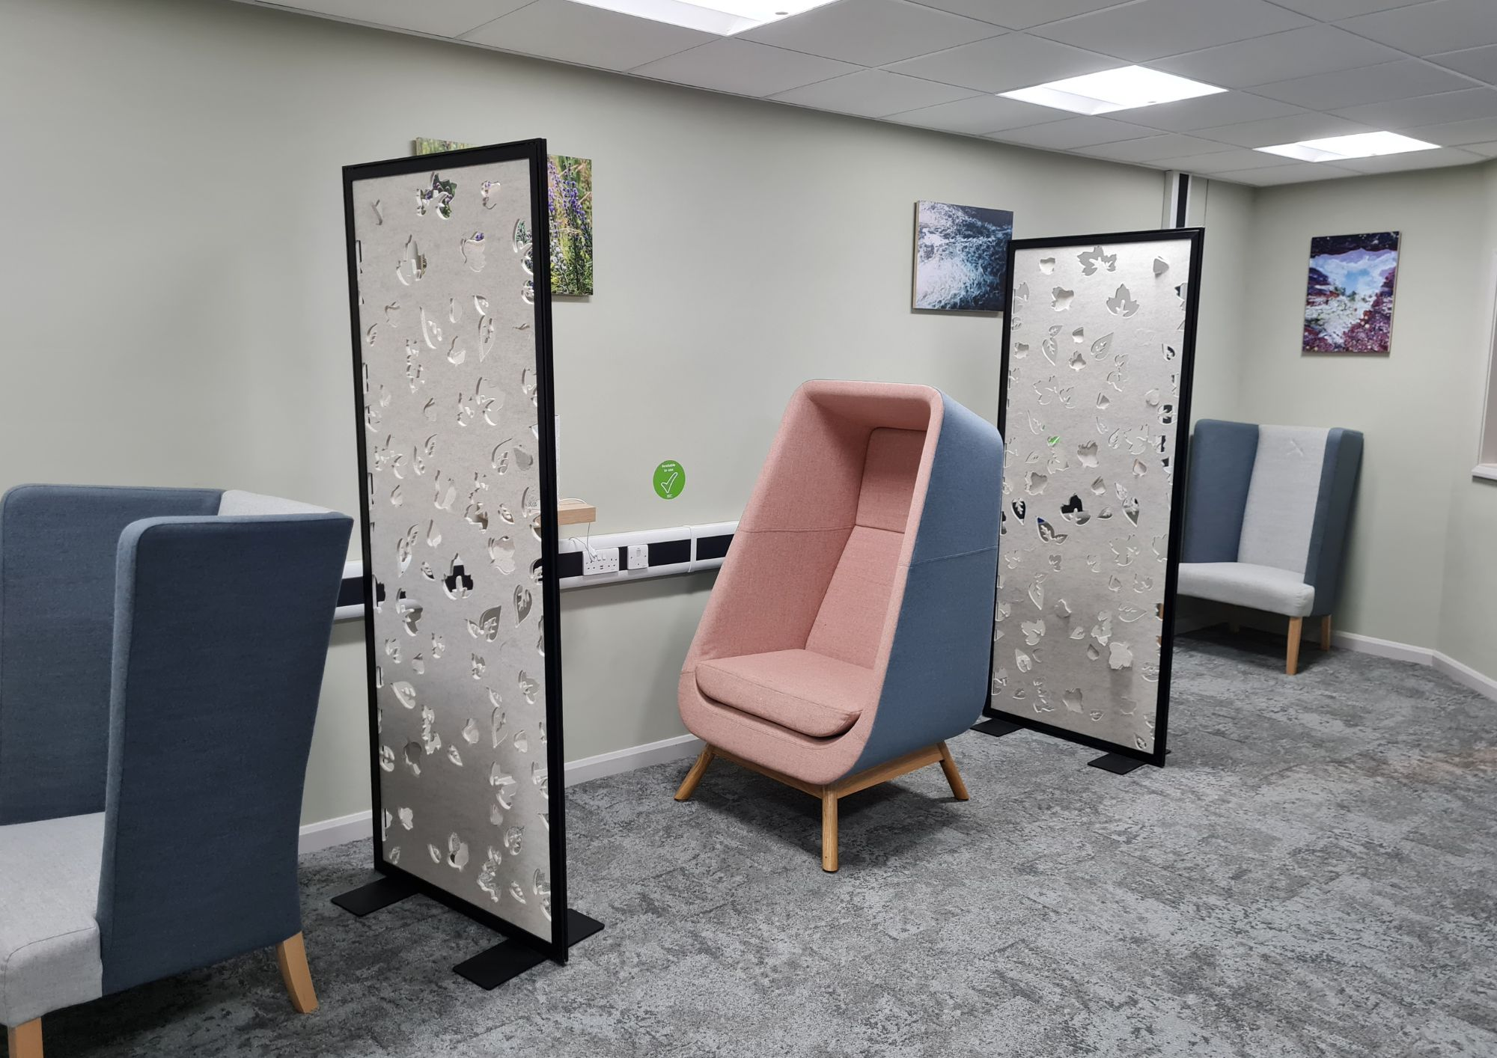
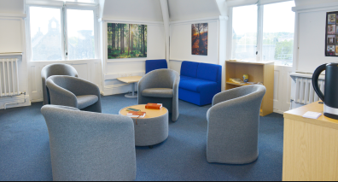
Calm and Quiet Spaces
Calm Spaces:
Scattered around campus in quieter spaces. Examples of signage and tips
Quiet spaces:
City Campus
The Multifaith Centre Quiet Room, Level 2 Owen
Collegiate Campus
The Retreat, Room 221 in the Oaklands Building
Adsetts
24/7 Quiet Space / Respite Room in the Quiet Study area on Level 4.

Slide 30

Outside of SHU
Sheffield Galleries and Museums: Activities and Events
Art Groups at Sheffield Museums
Central Sheffield Library Activities
Comprehensive Directory: Organisations in Sheffield City Centre
Gardening groups
National Videogame Museum
Our Fave Places; Guide to Places, Events and Activities in Sheffield
Patriot Games; Events
Ponds Forge Sports Centre
Sheffield City Council guide to activities
Tabby Teas Cat Cafe
Treehouse Board Games Cafe

Slide 31
Disability Support and Groups
Sheffield Royal Society for Blind People – link to groups
Disability Sheffield
Sheffield Support Hub (Mental Health)
Adult Autism and ADHD Support Hub
Sheffield ADHD Peer Support Group
Sheffield Autistic Society
Sheffield Parent Carer Forum
Sheffield Mind – Peer Support
If you know of any other groups / organisations, and are happy to share with the group, please do!

Slide 32
Discussion and Self-reflection
What has been useful for you today?
What will you take away?
One thing I will try this week - write it down
Does anyone want to share what their one thing is?

Slide 33
Self-evaluation (online)
What number are you now on today's topic?
1 = very unconfident
2 = somewhat unconfident
3 = neutral
4 = somewhat confident
5 = very confident
What have you gained / learned from the session?
What would you tell others about the session?

Slide 34

Self-evaluation and Feedback (in person)
Please take a few minutes to fill in part 2 of your self-evaluation
It asks you to rate your confidence levels in the skills now we are at the end of the session.
We want to make sure that these sessions are useful to you and others. Please share some feedback to help us to do that.
This should only take a few minutes and can be completed anonymously.

