Slide 1
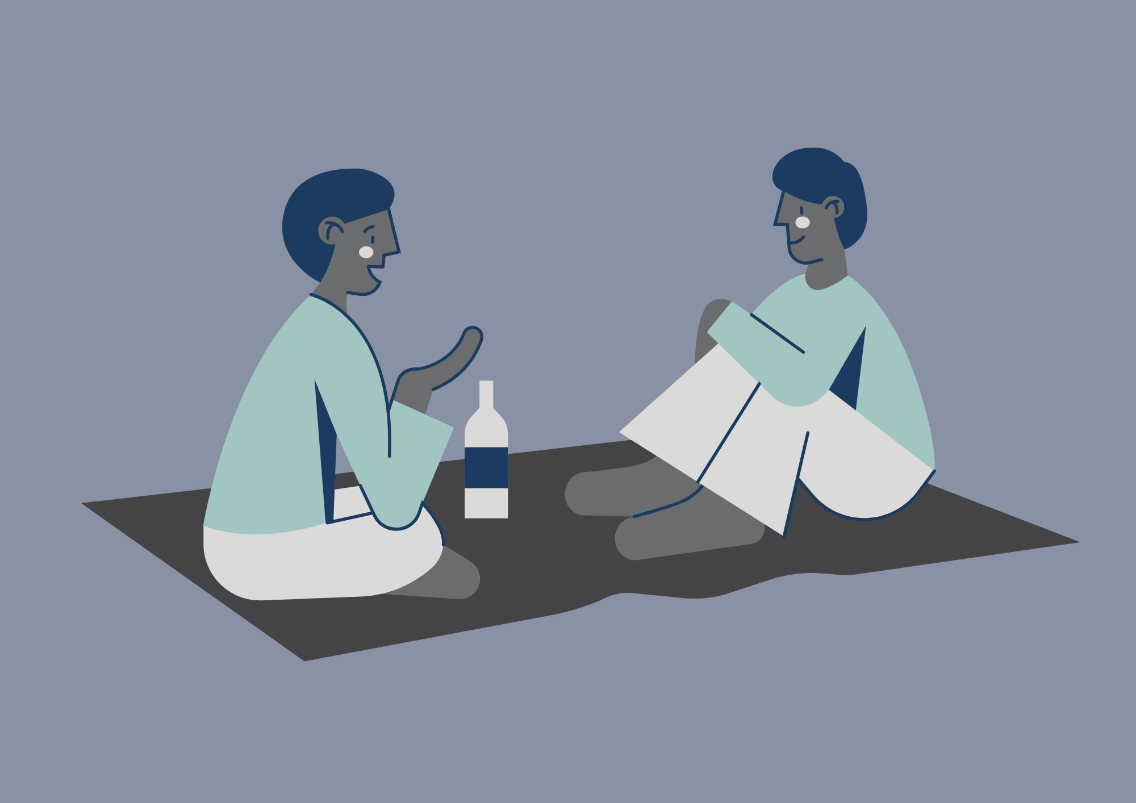
Practical Peer Support
Please note: We might use your anonymised comments and confidence ratings for service promotion and evaluation. ​
If you would prefer that we don't do this, please let us know at any time at disability-support@shu.ac.uk

Slide 2
What to Expect
Ground
Rules​
We will share tips, strategies and resources to help with time management and organisation.
You can connect with others with shared experiences to learn from each other.
Please communicate in ways you are comfortable with.
Online: we will stay in the meeting until 3.15pm for any questions. The session will then end. We will share sources of support in the chat.
In person: Come and go and move around if needed.
(Online only!) Please have your microphone off unless speaking. ​
During activity or discussions, join in if you feel able and feel free to ask questions. ​
Respect the opinions, privacy and information shared by others in the group. ​

Slide 3
Self-evaluation (online)
What number are you right now on today's topic?
1 = very unconfident
2 = somewhat unconfident
3 = neutral
4 = somewhat confident
5 = very confident

Slide 4

Self-evaluation (in person)
Please take a few minutes to fill in part 1 of a short self-evaluation
It asks you to rate your confidence levels in the skills we will cover today
We will also ask you to fill part 2 in at the end to see if you have gained confidence in your skills

Slide 5

Discussion
- What made you come here today?
- What do you find most difficult about time management or organisation?
What has helped you with these difficulties in the past?
Can you think of anything to share?

Slide 6
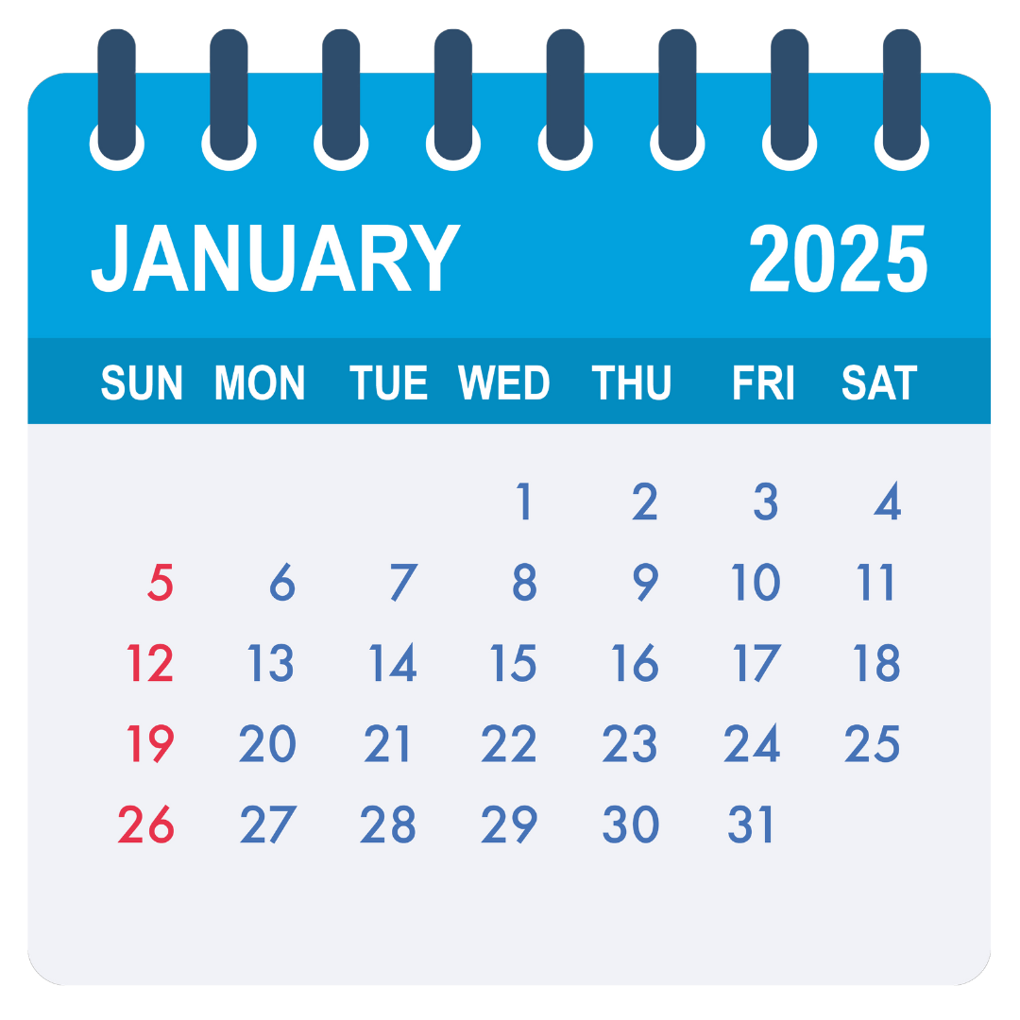


Developing a Routine
Habits:
21 – 90 days to form
Seinfeld Strategy:
Don’t break the chain.
Mark every day that you do the task on a calendar.
If you ‘break the chain’ make extra effort to make sure you don’t miss 2 days in a row.

Slide 7
Build ‘Tiny Habits’
A
B
C
Anchor the new habit in an existing routine.
Behaviour – make the new habit as tiny and easy as possible. You can build on this.
Celebrate immediately after doing the new habit. A positive emotion will help wire it into your brain.
BJ Fogg (2020) https://tinyhabits.com
Tiny Habits: The Small Changes that Change Everything.

Slide 8

SMART Goals
Specific
Measurable
Achievable
Relevant
Time bound

Slide 9

Planning your time
Let’s say you have a big coursework deadline in a few weeks.
You also have many other things in your life.
To plan for your deadlines, you also need to consider the other things in your life. This will give you a realistic picture of when / where / for how long you can do your university work.
What are the other things in your life?

Slide 10
Some Ideas
Paid employment | Hobbies | Life admin | Caring/family commitments | Winding down time
Timetabled teaching | Emails | Housework | Shopping | Self-care
Travel | Getting ready | Cooking/ eating | Socialising | Recharging / recovering time
Rest | Appointments | Planning! | Self-directed study | Sleep

Slide 11
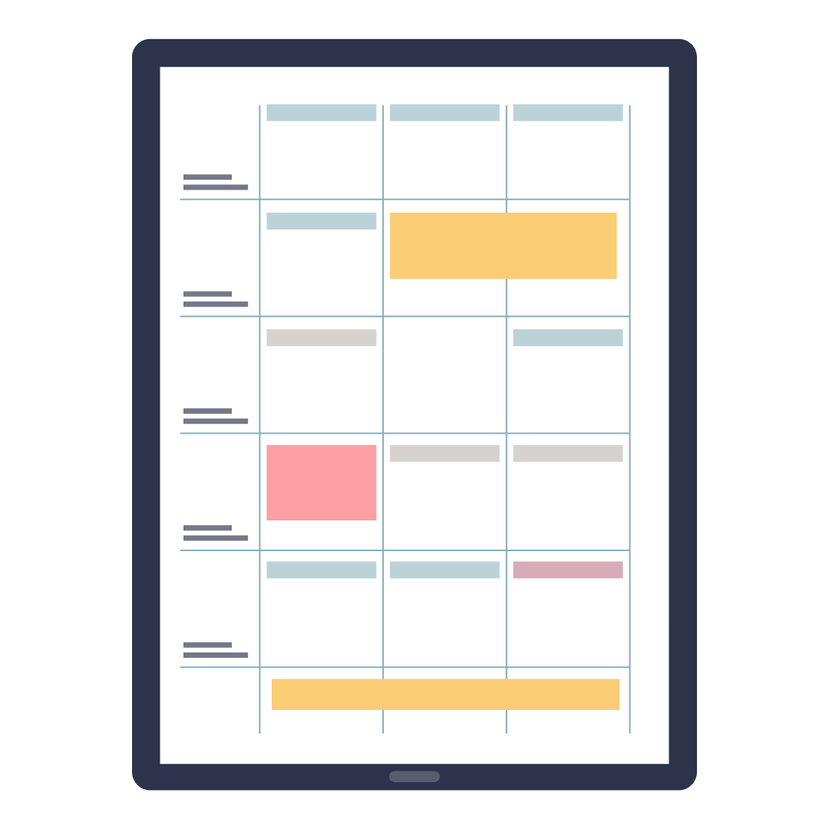
Time Blocking
Identify what you need to do / work on for the day.
Figure out when you’re most productive.
Group similar tasks if possible.
Schedule your time blocks.
Block breaks and personal time.
Don’t be too specific for the block.
Allow for buffer time.
Adjust as needed.

Slide 12
Resources to help you
Timetables (paper / electronic / outlook calendar)
Planners (year / month / week / day)
To-do lists (paper / electronic / integrated / stand-alone)
Prioritisation (important / urgent etc)
Apps, phone timers and reminders, outlook calendar
Take some time to look at our resource webpages

Slide 13

Remember...
Build in change gradually.
Be realistic.
Be flexible / more rigid if you need to.
Use tools to help you remember to do it
If you don’t do something one day, that doesn’t mean you have failed. Do it now, pick it back up again tomorrow, set a reminder.
You don’t need to fit into a way of working, you need to find a way of working that fits you. It can take a while to figure this out – you might need to try a few different things before finding what works.

Slide 14
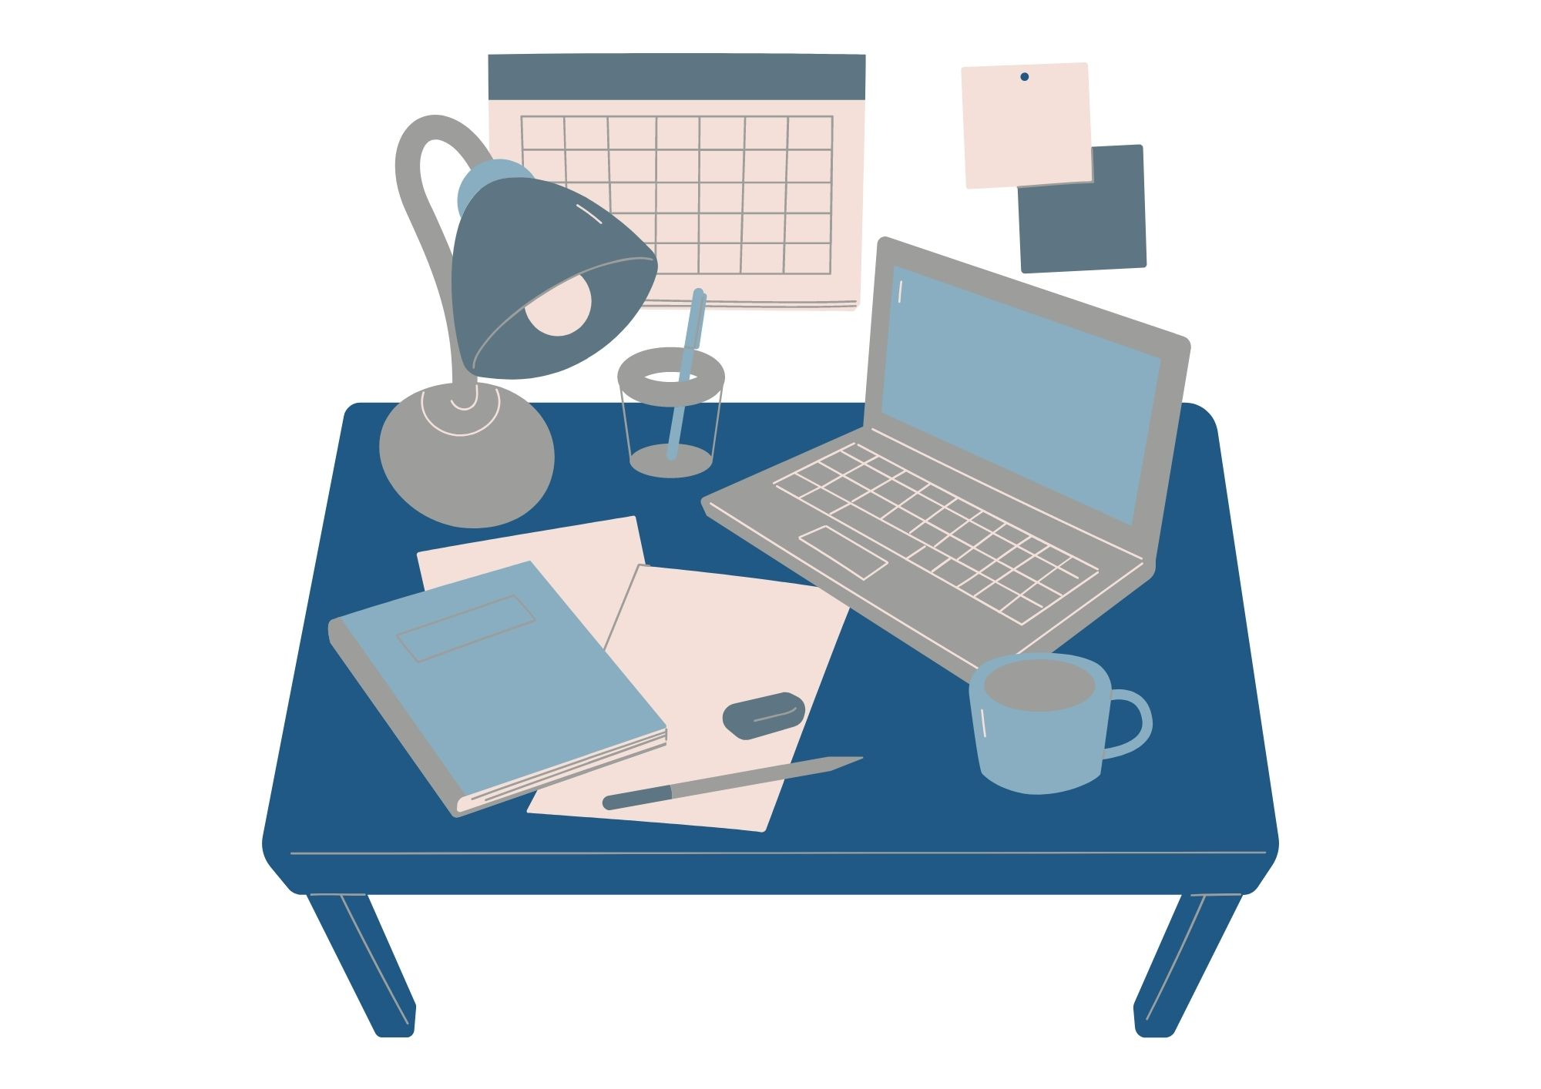
Suggested next steps
Create a plan for the next week
Include the main things in your life
Include both teaching and self-directed activities
or
Set a goal for yourself
Choose one thing that you want to build in or change
Think about how you can help yourself to do this or stick to it

Slide 15
Discussion and
Self-reflection
What has been useful for you today?
What will you take away?
One thing I will try this week - write it down
Does anyone want to share what their one thing is?

Slide 16
Self-evaluation (online)
What number are you now on today's topic?
1 = very unconfident
2 = somewhat unconfident
3 = neutral
4 = somewhat confident
5 = very confident
What have you gained / learned from the session?
What would you tell others about the session?

Slide 17
Self-evaluation and Feedback (in person)
Please take a few minutes to fill in part 2 of your self-evaluation
It asks you to rate your confidence levels in the skills now we are at the end of the session.
We want to make sure that these sessions are useful to you and others. Please share some feedback to help us to do that.
This should only take a few minutes and can be completed anonymously.

