Slide 1
Community-led housing: Lessons from research and practice
Dr Tom Archer, CRESR, Sheffield Hallam University
Dr Tom Moore, Liverpool University
Phillipa Hughes, Sheffield University
Dr Yael Arbell, CRESR, Sheffield Hallam University
Notes:
- Thanks for attending. Thanks Julian
Synthesis of research together, and separately, over recent years. Long term and ongoing studies of CLH grant programmes for Power to Change, research with Nuffield Foundation funding, and Nationwide Foundation. Opportunity to share finding, reflections and learning from across these.
I’m going to try to set the scene, define the territory a bit, before handing over to Tom and Phillippa.

Slide 2
Working definition: What is Community Led Housing?
Where there is meaningful community engagement and consent in a development process.
Where a community groups/organisation owns, manages or stewards homes
Where the benefits of their activity accrue to the local / specified community and are protected in-perpetuity.
Notes:
Conscious some of you may know nothing about CLH, so set out a basic definition
Read though
Sector def
Area X is a village with a shortage of affordable housing, as shown by local housing needs surveys.
With the help of specialist enablers, residents form a community benefit society to address this. Members include those who want a home, and those who are just keen to help.
The group approaches local landowners for sites and submits a planning application.
With a mixture of revenue and capital grants the group works with professionals to plan the scheme, identify a developer, and a partner to manage the homes when complete.

Slide 3
The drivers for alternative responses to housing provision
Shortage of affordable, good quality housing
Lack of services/facilities
Empty properties and buildings
A sense of powerlessness / lack of control
A lost sense of community
MICRO
Reduced housing development grants
New ‘affordable’ market-linked tenures
Reliance on the private sector for new housing
Social housing providers caught between various objectives and responsibilities
MESO
Financialisation of land/housing
Austerity politics
Spatial inequalities/differentials
MACRO
Notes:
The price of hectare of residential land in 2019 was £161m in Kensington and Chelsea and £370k in Carlisle.

Slide 4
Motives for Community Led Housing (CLH)
Archer et al (2021). Homes in Community Hands Evaluation: Year Two
Notes:
- The research framework includes it in this 'logic model' as well as a narrative description of how the programme will operate, create outcomes etc.
- I though we could take some time to walk through this and discuss it together.
- Go through elements

Slide 5
Community Led Housing in 2021
‘.... across England, there were around 650 active community led housing projects. These projects are planning an estimated 12,000 homes’
Archer and Harrington (2021). Delivering the community led housing pipeline in England
Notes:
- The research framework includes it in this 'logic model' as well as a narrative description of how the programme will operate, create outcomes etc.
- I though we could take some time to walk through this and discuss it together.
- Go through elements

Slide 6
The Homes in Community Hands (HCH) programme

Slide 7
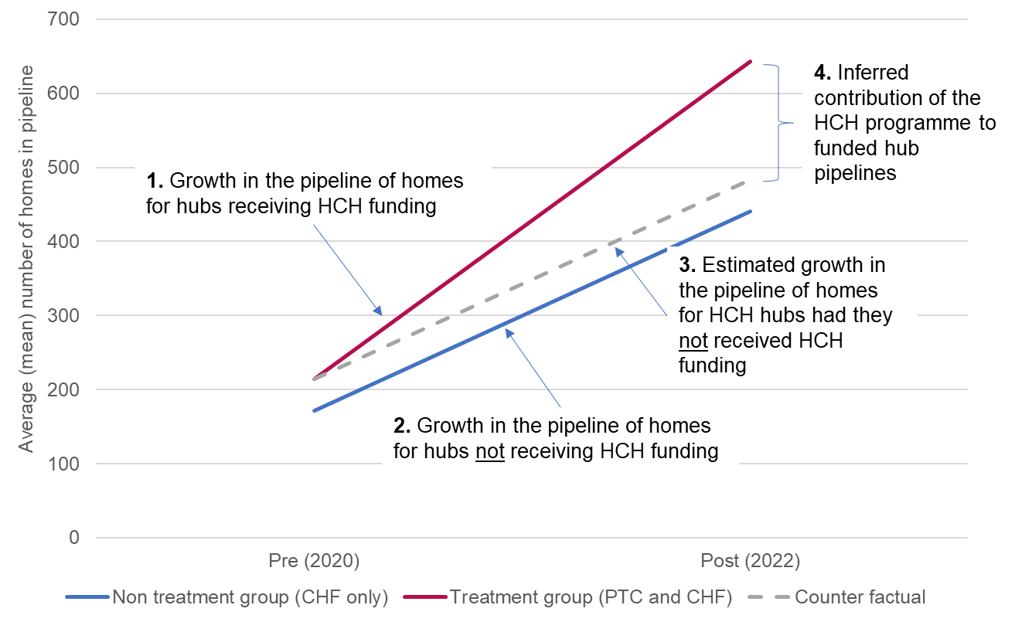
Funded enabler hubs
Arbell et al (2022). Homes in Community Hands Evaluation: Year Three

Slide 8
Affordable housing
‘...grantees expect to deliver significantly higher levels of affordable housing per scheme (76-80 per cent of homes created) than the typical development project funded by the Government’s national Affordable Homes Programme’.
Arbell et al (2022). Homes in Community Hands Evaluation: Year Three

Slide 9
Wider investment beyond housing
Arbell et al (2022). Homes in Community Hands Evaluation: Year Three

Slide 10
Participation and civic action
“A lot of people within our little circle just become better at varying things that they've never tried before...So we've got people who have, you know, training on finance and things like that...So, we've developed a group of people who, again, are getting very good at resolving differences and stuff”. (LGC participant)
Arbell et al (2022). Homes in Community Hands Evaluation: Year Three

Slide 11
Attrition rates and slow progress
Arbell et al (2022). Homes in Community Hands Evaluation: Year Three

Slide 12
Barriers to growth
Revenue funding is scarce and has been short-termist
Issues related to the pandemic have affected participation, planning and the development process
Land and existing property remains difficult to secure in some areas
Enabling infrastructure is difficult to sustain financially
The demands on volunteers and those involved can be significant
New challenges with rising interest rates, inflation in building material prices, and pressures on household finances

Slide 13
Community-led housing Enabling Hubs Tom Moore (University of Liverpool Philippa Hughes (University of Sheffield)

Slide 14
Introduction and context
Enabling hubs are a key development in the growth of the community-led housing sector
28 Enabling Hubs registered across England forming a network overseen by the Community Led Homes partnership
Investment from central government as part of Community Housing Fund and Power to Change – Homes in Community Hands programme
The Community Led Homes partnership website states that enabling hubs “are regional organisations that provide one-to-one technical support to groups” and that “the evidence shows that when an enabling hub exists, the more community led homes are built in the vicinity.” (Community Led Homes, Accessed: 2/6/22).
They also perform lobbying and influencing roles.
Broader context of housing crises, localism and austerity.
Notes:
Presentation based on the findings from two separate research projects which had resonance with each other

Slide 15
Key takeaways
Variation in the organisational form and function of hubs as a result of national and local circumstances.
Hubs have been critical to the growth of community-led housing.
Hubs, as a form of third sector infrastructure, are becoming more entrepreneurial in an attempt to diversify their funding sources.

Slide 16
Implementation of enabling hub network
Interaction between the national programme and local circumstances have led to significant variation in the form and function of enabling hubs in different parts of England.
Institutional constraints – vertical
(Funding rules, expectations)
Institutional constraints – horizontal
Enabling hub
(Local government input, preferred models)
Transformation
Existing community-led housing organisations
CLT umbrellas
Networks of community-led housing groups
Emergent local community-led housing organisations/ partnerships

Slide 17
Institutional constraints – vertical
National Community Housing fund:
Employ qualified advisers
Promote all forms of community-led housing
Incorporated entity (or hosted within one) and not for profit – can replace networks
operate within its own defined geographical area without significant overlap with other hubs
Commit to an aim of becoming self-sustaining financially
(But Homes in Community Hands more flexible )
Also – more broadly for the sector - interaction with Homes England affordable housing programmes (tenures, RP)
Notes:
Employ qualified advisers (this links to the training and accreditation process and in general links to a narrative of professionalism in the sector- creating a stable profession of community- led housing advice and advisors)
Promote all forms of community-led housing ( idea that groups should be provided with a range of options – though my research showed that local established ,odels tend to be what is replicated)
Incorporated entity (or hosted within one) and not for profit – ( this seems obvious but this process means that it can’t be an informal network for example) can replace networks
operate within its own defined geographical area without significant overlap with other hubs
Commit to an aim of becoming self-sustaining financially – this means they need to produce a fee in some form, might suggest a preference for projects which are less risky + create isomorphic pressure

Slide 18
Institutional constraints – Horizontal
Examples of hub changes (2020-2021)
Wessex Community Housing to Middlemarch enabling hub
Cambridge and Peterborough Combined authority – change of political leadership – hub to ‘return’ to East Cambridgeshire
Leeds Community Homes – consultancy to be People Powered Homes LCH to focus on being housing provider (RP)
Defined features, but there were exceptions or variations based on local factors
Local negotiation over; geographical boundaries, organisation hosts, relationship to existing projects
Local authorities significant piece of this negotiation
Other significant funding streams (CHF 1 local government funding, Home in Community Hands)
Established models of producing community-led housing
Local arrangements becoming more important as the national funding landscape changed
Funding an ever present concern – not clear that many hubs are becoming financially self-sustaining – what will they do afterwards?
Notes:
Defined features, but exceptions or variations based on local factors (for example East cambs)
Local negotiation over; geographical boundaries, organisation hosts, relationship to existing projects
Local authorities significant piece of this negotiation
Local arrangements becoming more important as the national funding landscape changed

Slide 19
Hubs help CLH grow
Hubs support CLH groups in progressing their projects, providing critical support to local volunteers.
Active work with under-represented and diverse communities to broaden the scope of CLH.
A range of policy impacts, including political commitments and support for the delivery of new policies (e.g. land disposals based on social value criteria).

Slide 20
Entrepreneurial
Whilst effective in generating new projects, the grant funding regime has been short-termist.
Hubs are increasingly diversifying their funding streams, but face temporal and practical challenges in creating what are effectively new community businesses.
As financial sustainability becomes concerning, what are the implications for hub’s organisation, enabling work, and delivery?

Slide 21
Conclusions
Individual hubs were a construction of local resources and national investment, leading to variation in how they operate.
Hubs have an important role to play in supporting CLH growth,
Interrupted and short-term nature of funding disrupts efforts to grow the sector in a sustainable fashion, but hubs are responding through becoming more entrepreneurial.
Some evidence of, an isomorphic pressure on community-led housing to engage in development seen as less risky + secure income stream for hub
Lessons from the trajectory of other third sector infrastructure?

Slide 22
CLH and diversity
Meaningful participation
Recruiting for diversity

Slide 23
Getting the balance right
Equality
Liberty
Accessibility
Participation
Affordability
Autonomy
Inclusion
Agency
Diversity
Ownership
Equal opportunities

Slide 24
Diversity means many things

Slide 25
BAME Communities in CLH
Under-representation in the CLH sector within projects, hubs and advocacy organisations
Practitioners noticed a lack of awareness of CLH amongst BME communities
Many new CLH developments are in rural areas
Policy context: urban co-ops for diverse members in the 80s
Racism: Nothing “culturally specific” about CLH

Slide 26
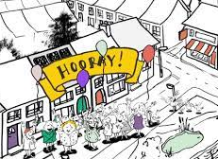
Planning for inclusion
Each community faces different challenges.
To be inclusive, CLH must develop:
homes that are affordable, accessible and enable people to age in place
communities that are welcoming and tolerant
Management structures that are inclusive, empowering and accessible

Slide 27
Meaningful participation
A range of models: maximalist and minimalist
Participation: benefits and barriers
High expectations and inclusion: a trade-off?

Slide 28
Cultural capital: subtle barriers
Skills and life experiences implicitly / explicitly required to join intentional communities
Education
Activism and volunteering
Literacy and the digital divide
Minutes, emails, phone apps...

Slide 29
Can the membership process be too friendly?
“ . . . very few people came through that route [the social housing register] and when they did (...) they thought we’re a bunch of hippie nut jobs. (. . .) Coming to a social in the communal room with a bunch of strangers . . . it’s a bit like - um - kind of going to the coffee after church . . . as opposed to going to the council to check on the waiting list, it’s probably outside of a lot of people’s experience of housing, isn’t it? You don’t normally get private landlords trying to force warm soup on you”
(Cooperative member)

Slide 30
Too much information?
“Life-changing events that happened to you.
What mattered in your life, as your life developed.
Your recent life; what you have been striving for recently?
What is your philosophy of life?”
(excerpted from a community’s application form)

Slide 31
Inclusive management structures
Is the process clear and simple?
Scale
Who makes decisions?
Who has power, who sets the table?
Source: Sturts Farm website

Slide 32
Enabling developers and partners
“Taking the pain out of the process”
Community-led or community consultation?
Power imbalance
Equal opportunities <> Liberty
Source: Housing 21

Slide 33
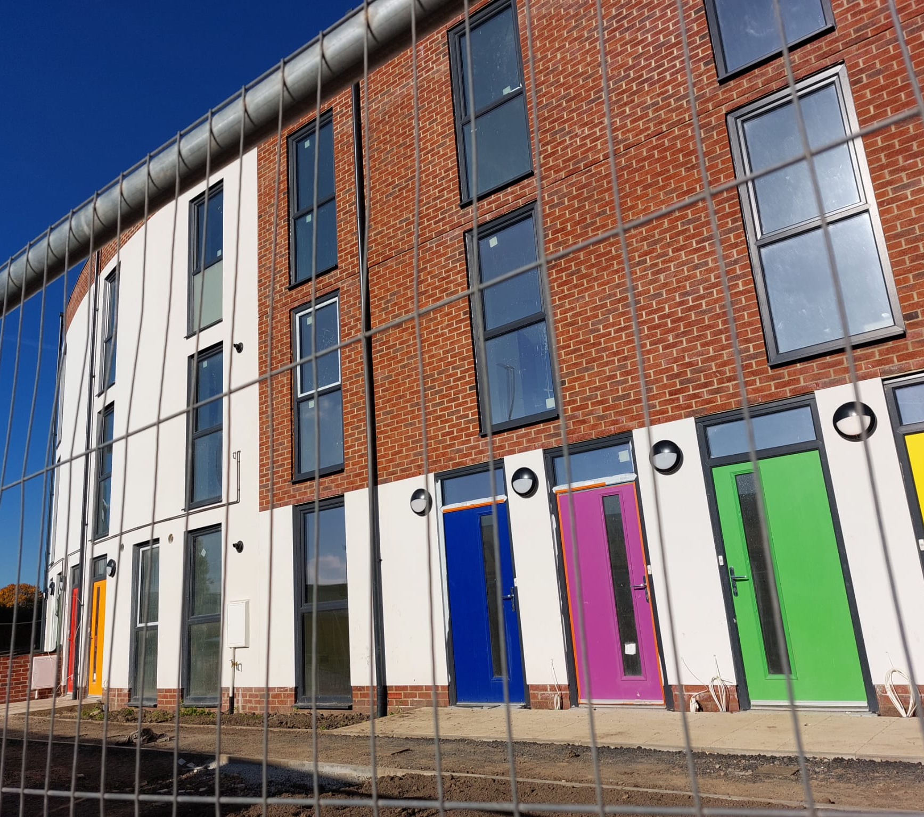
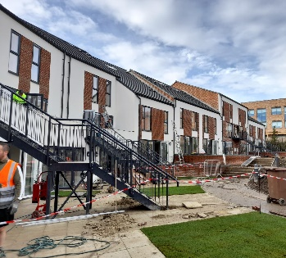
Chapeltown Cohousing
Chapeltown, Leeds
12 years in the making
Cooperative
Just moved in
26 households
Affordable rent
Shared ownership
Source: Chapeltown Cohousing

Slide 34
Recruiting diverse membership
Intentional community – what’s the intention?
Inclusion and radical welcome
Diversity and equity
Limits to diversity
Source: Chapeltown Cohousing

Slide 35
Challenges and opportunities
EDI requires ongoing work
New partnerships, greater inclusion
CLH bodies promoting diversity

Slide 36
Thank you
Dr Tom Archer, CRESR, Sheffield Hallam University
Dr Tom Moore, Liverpool University
Phillipa Hughes, Sheffield University
Dr Yael Arbell, CRESR, Sheffield Hallam University

