Slide 1

Excess mortality in Glasgow: a ‘Glasgow Effect’ or just another political effect?
David Walsh
Glasgow Centre for Population Health
June 2022

Slide 2
Today – two presentations
(25 mins-ish)
Part one: Glasgow
  What do I mean by ‘excess mortality’?
  What explains it?
  (A case study of political effects on health)
Part two: more recent political effects on health
(5 mins-ish)

Slide 3
Part one: excess mortality in Glasgow
a.k.a…

Slide 4
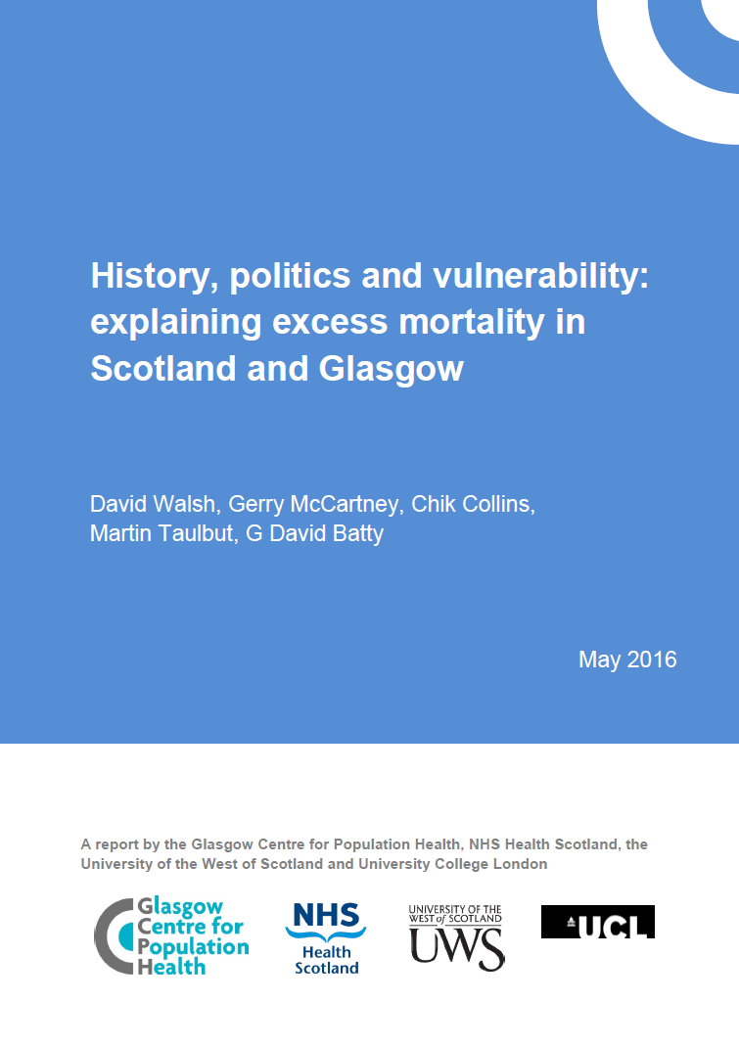

Slide 5
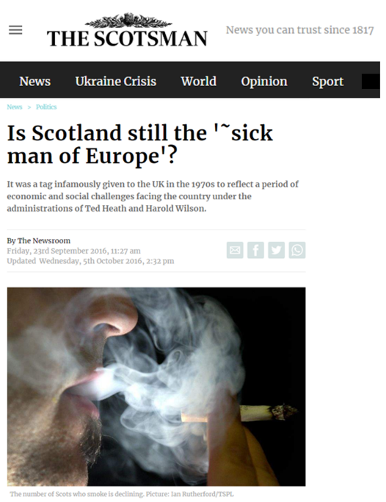
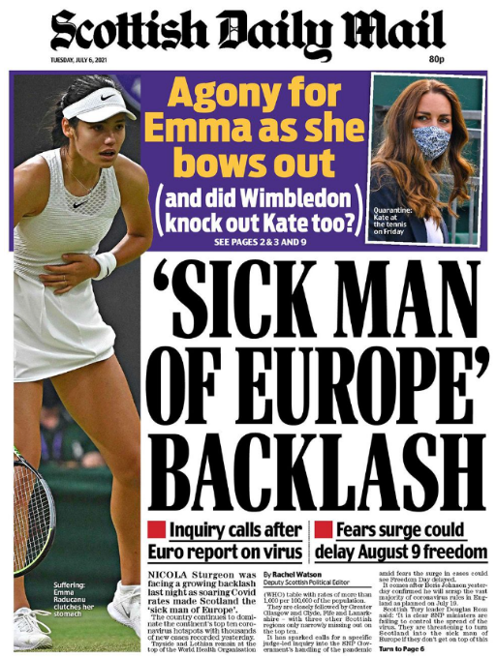

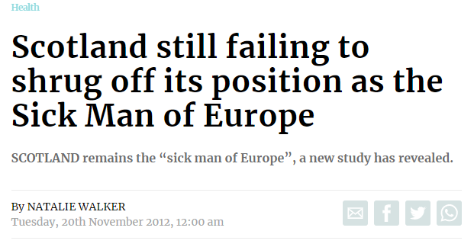
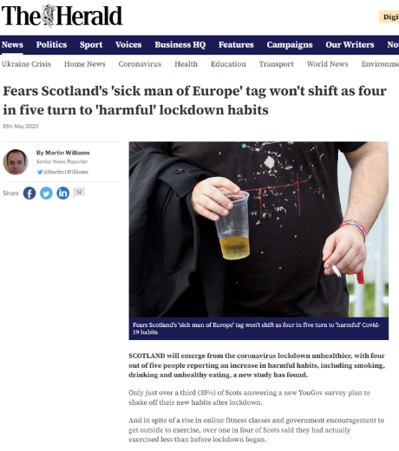
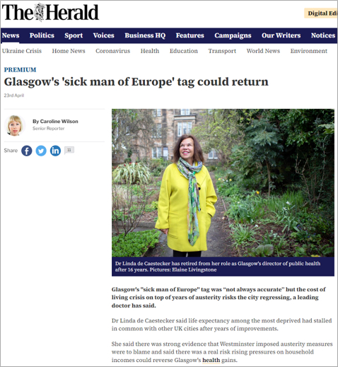
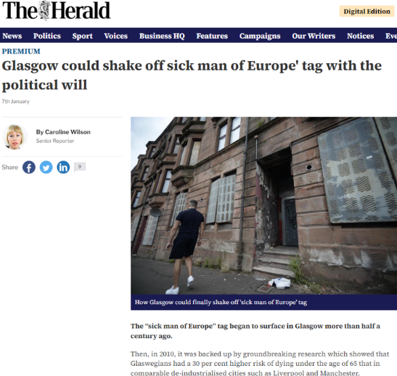
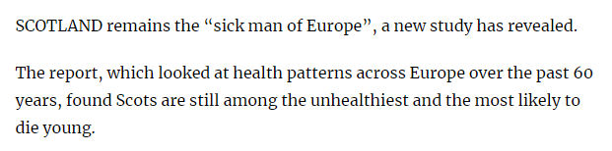
Scotland’s & Glasgow’s health

Slide 6
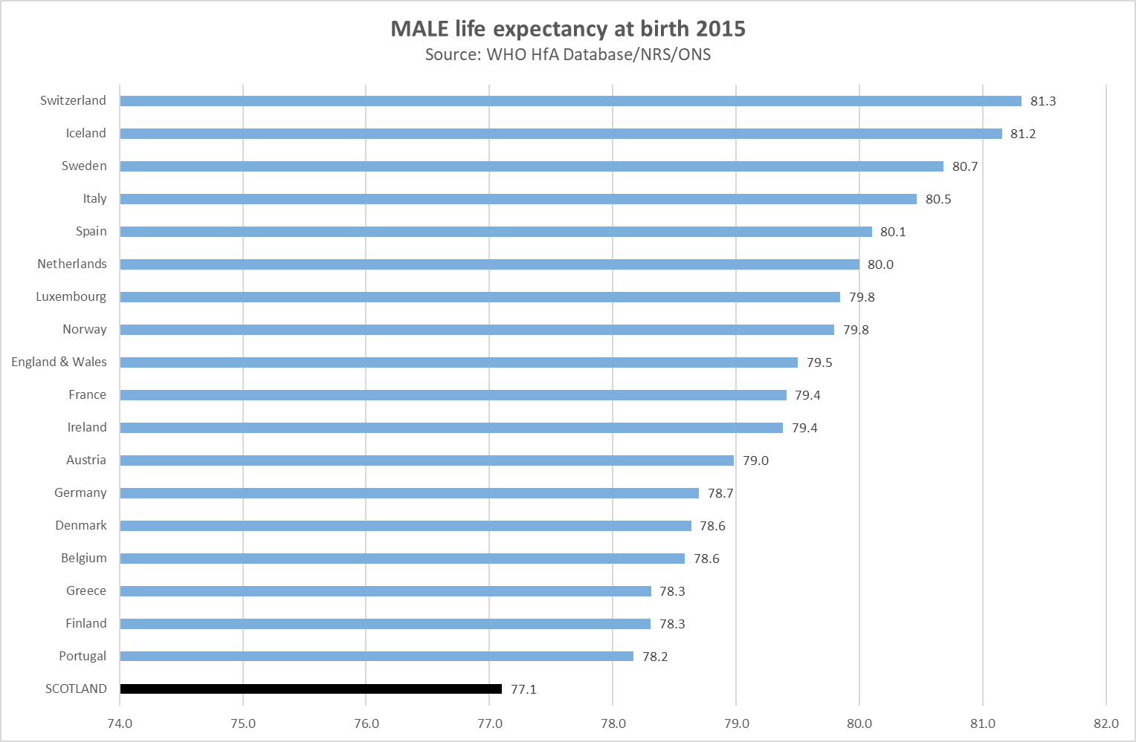
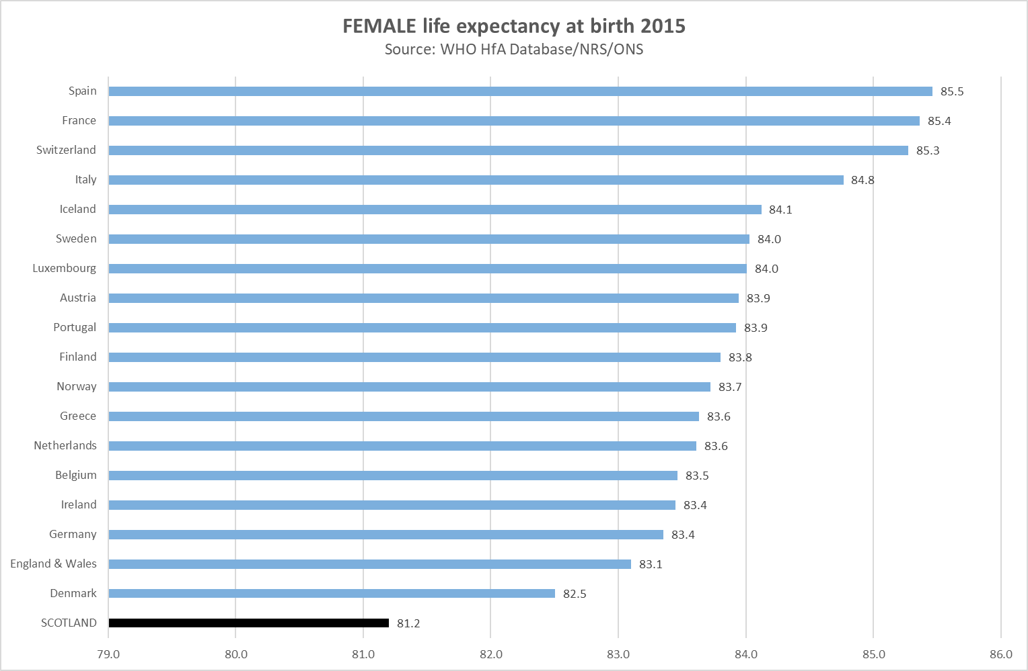
Scotland & other Western European countries
Notes:
6

Slide 7
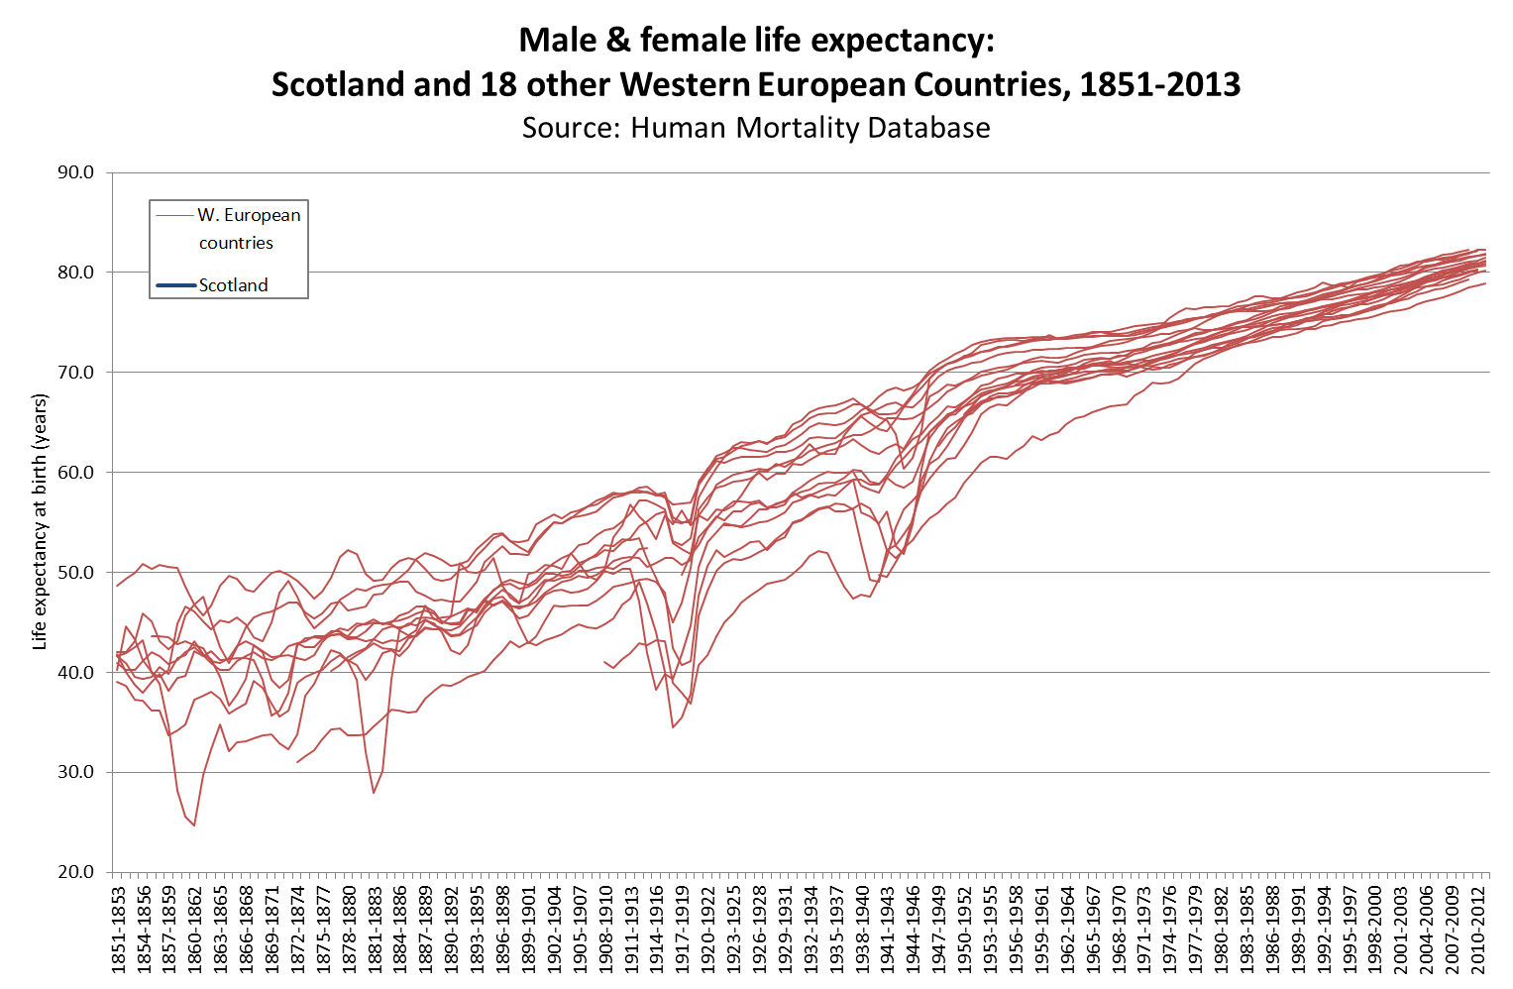
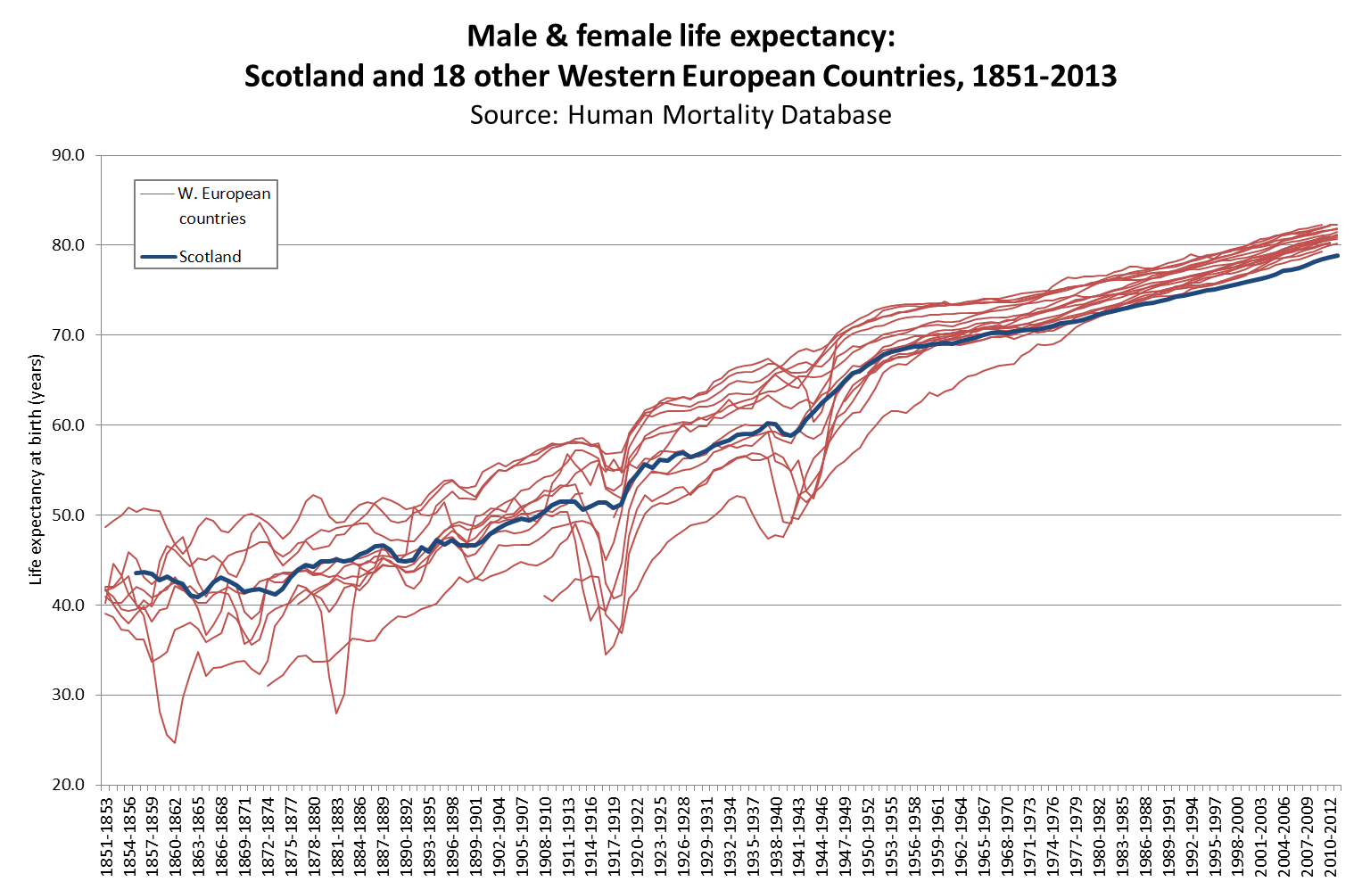
Not always the ‘Sick Man of Europe’

Slide 8
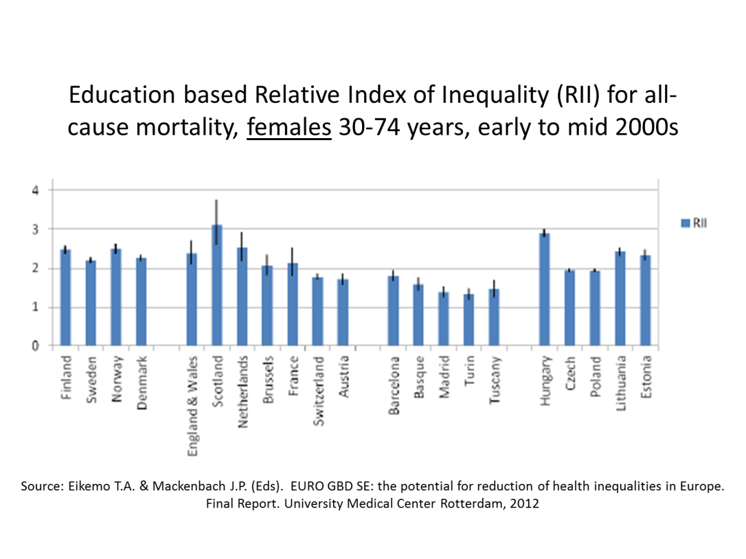
Scotland: widest health inequalities in W. Europe

Slide 9
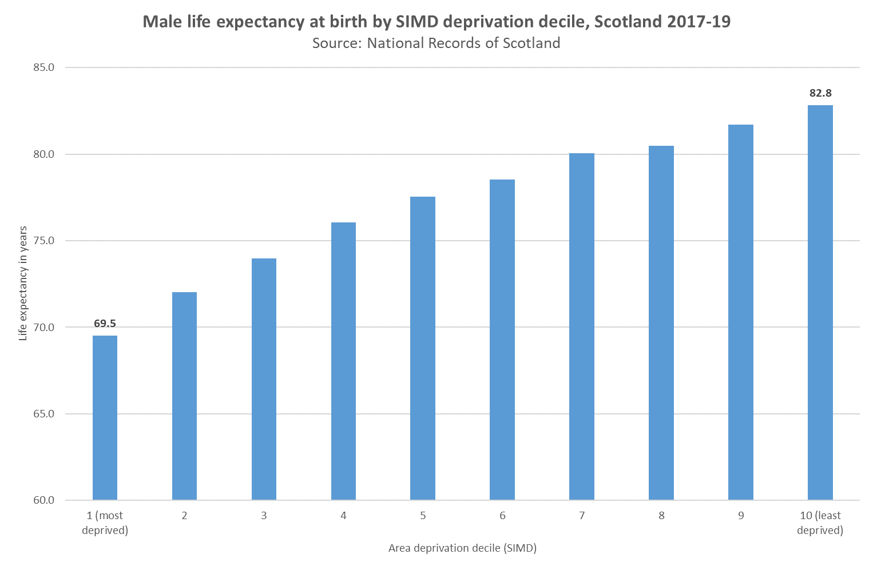
Health inequalities - Scotland

Slide 10
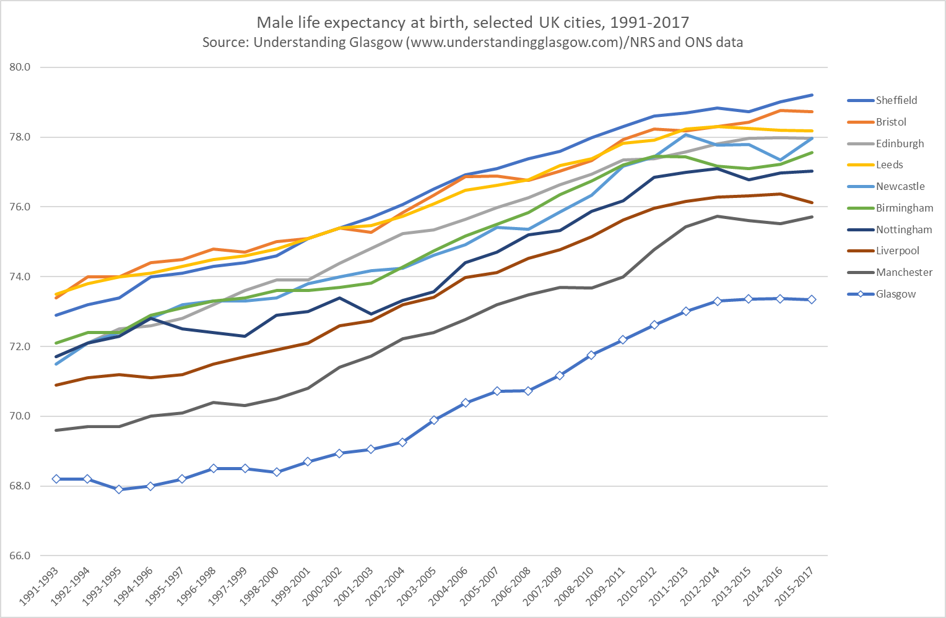
Glasgow’s health

Slide 11
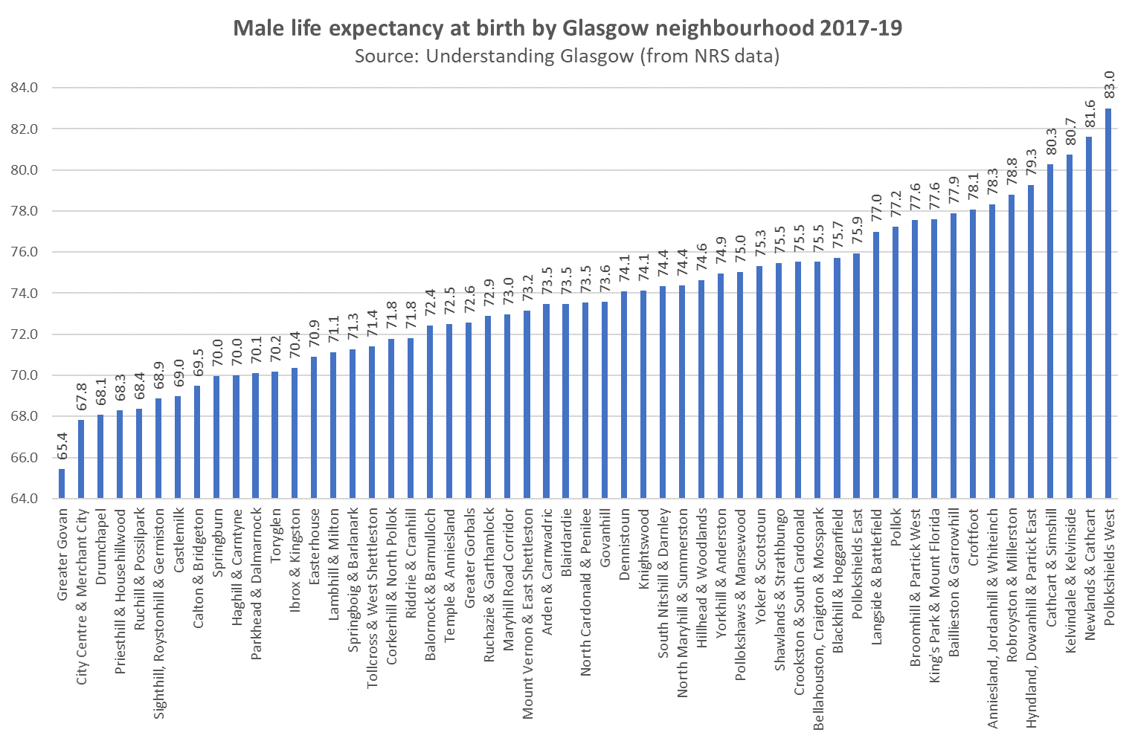
Health inequalities - Glasgow

Slide 12
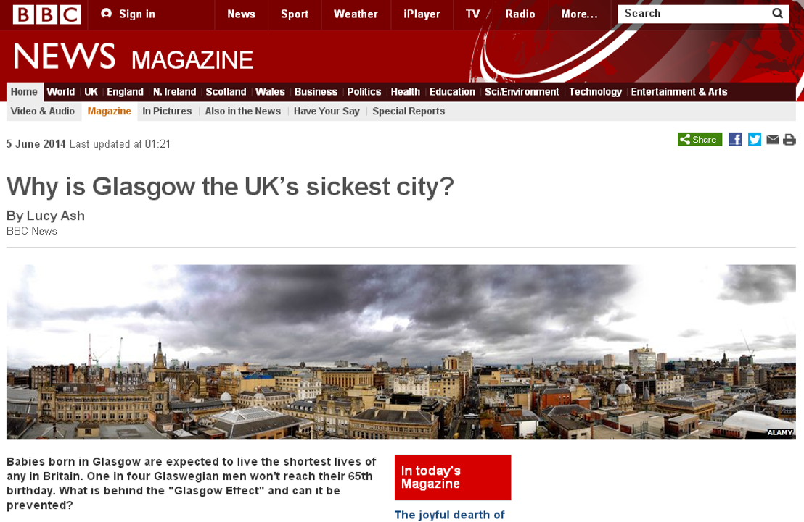

Slide 13
Explanation?
Traditional explanation: socio-economic deprivation (underpinned by effects of post-industrial decline)
NB Massively important: poverty and deprivation (and underlying/related factors e.g. deindustrialisation) main drivers of poor health in any society
But…not a sufficient explanation
‘Excess’ mortality: higher mortality observed in Scotland (compared to elsewhere in the UK) over and above that explained by differences in socio-economic deprivation
Ubiquitous in Scotland but greatest in and around Glasgow e.g.
  Glasgow vs Liverpool & Manchester 2003-07 (GCPH, 2010):
    30% higher premature deaths (<65 years)
    15% higher deaths all ages

Slide 14
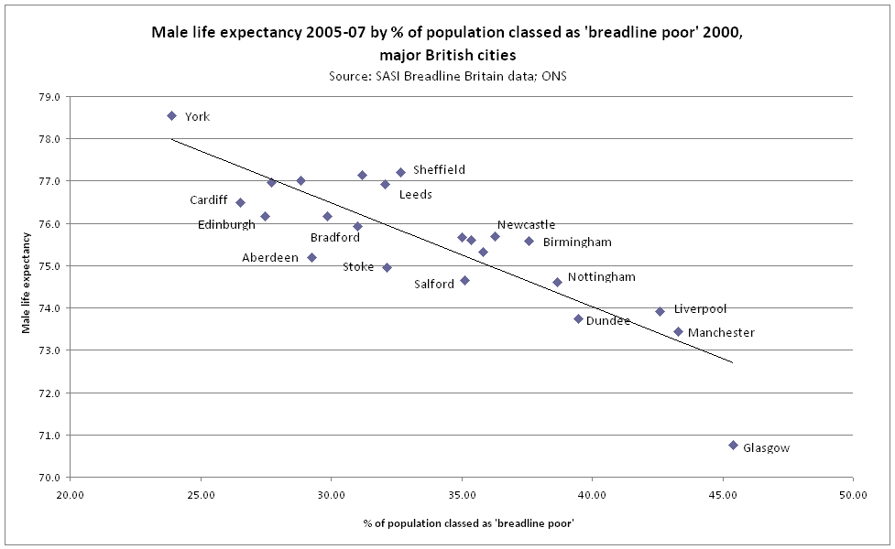
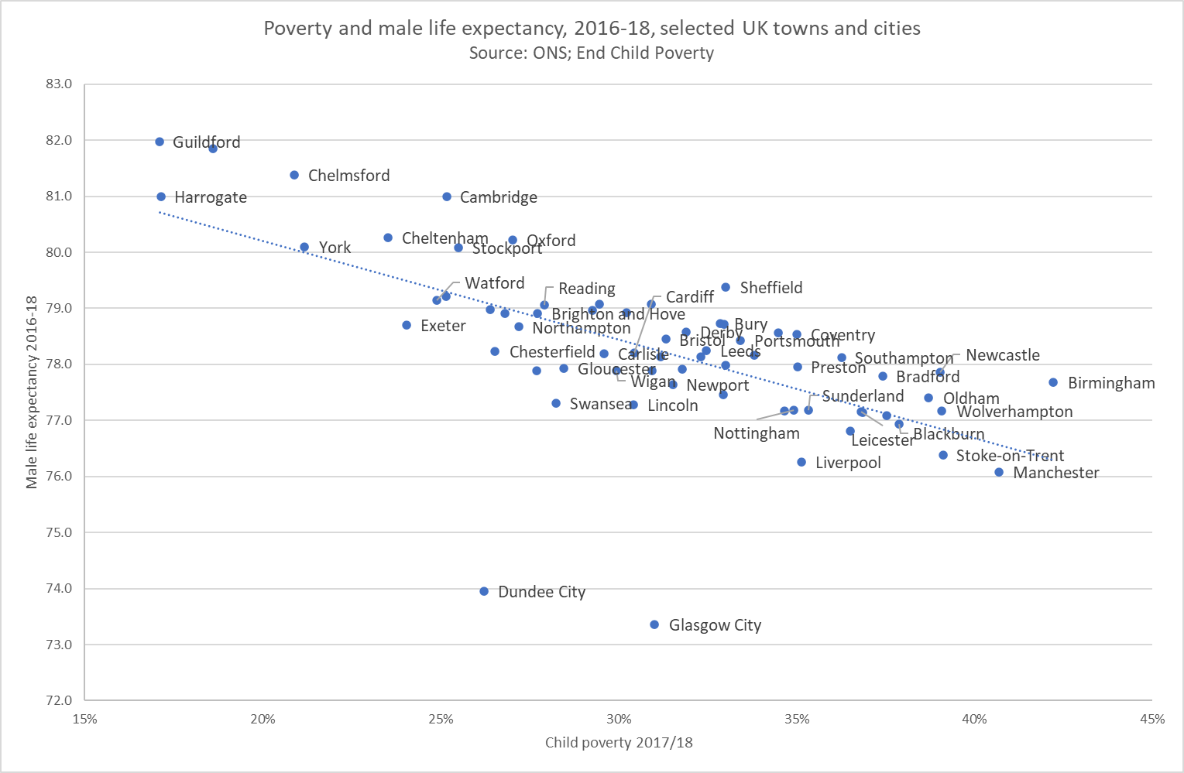
Poverty & life expectancy: UK cities

Slide 15
Explanation?
Scotland: highest mortality rates in Western Europe
Traditional explanation: socio-economic deprivation (underpinned by effects of post-industrial decline)
NB Massively important: poverty and deprivation (and underlying/related factors e.g. deindustrialisation) main drivers of poor health in any society
But…not a sufficient explanation
‘Excess’ mortality: higher mortality observed in Scotland (compared to elsewhere in the UK) over and above that explained by differences in socio-economic deprivation
Ubiquitous in Scotland but greatest in and around Glasgow e.g.
  Glasgow vs Liverpool & Manchester 2003-07 (GCPH, 2010):
    30% higher premature deaths (<65 years)
    15% higher deaths all ages
Unhelpfully referred to as ‘Scottish Effect’ and ‘Glasgow Effect’ (cue tedious rant…)

Slide 16
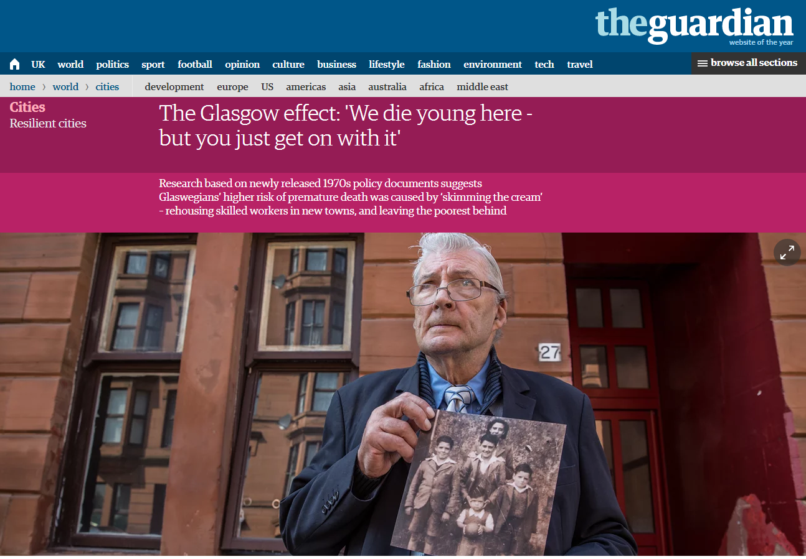
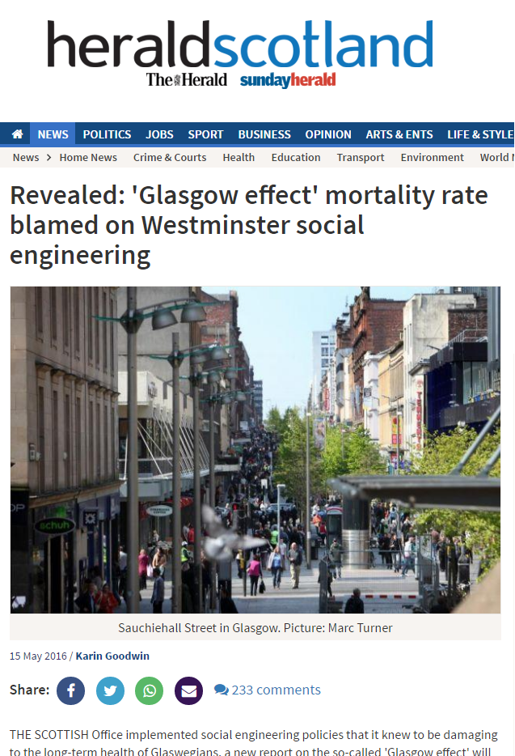
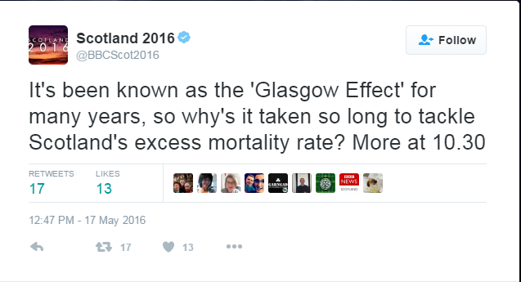
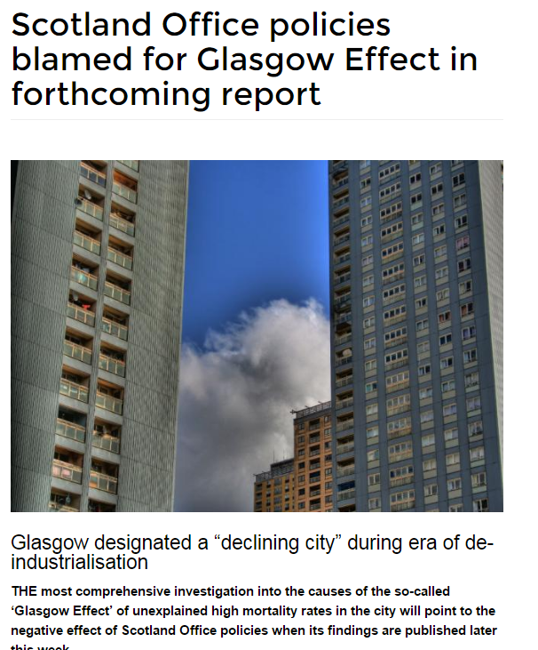
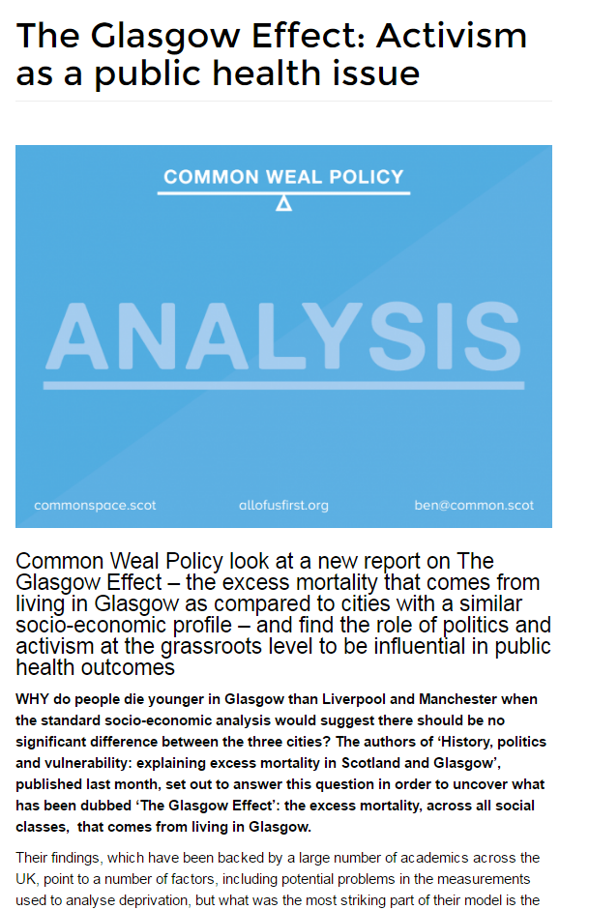
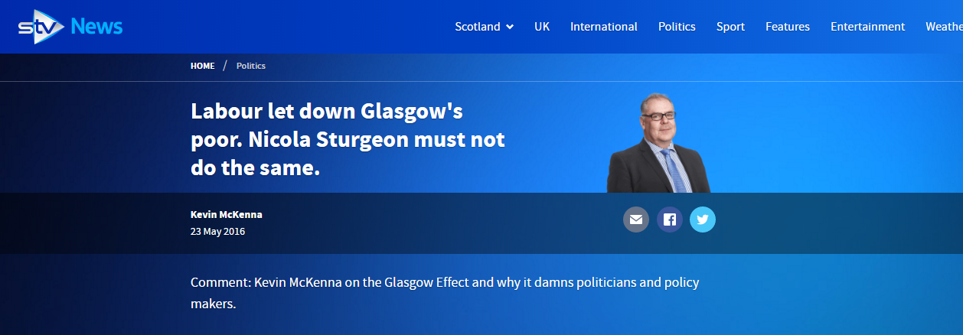
Don’t mention the war ‘Glasgow effect’…

Slide 17
What explains the excess?
Synthesising the evidence

Slide 18
Theories, theories, theories…
Artefact
Migration
Political attack/effects
Culture
Deindustrialisation
Income inequalities
Social mobility
Substance misuse cultures
Alienation/anomie
Family/parenting/early years
Social capital
(Health) services
Patterning of deprivation
Sectarianism
Individual values (e.g. psychological outlook)
Sense of coherence
Behaviours
Genetics
The weather

Slide 19
Theories not necessarily grounded in solid evidence
Irn Bru
Less broadband
Water impurities
A lack of runner beans
Fewer pet dogs
Submarines on the Clyde
Low air pressure
A general “curse”

Slide 20
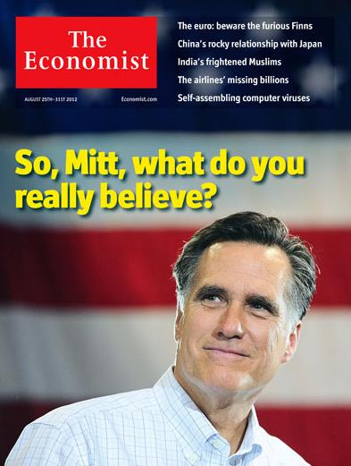
Theories not necessarily grounded in solid evidence
“It is as if a malign vapour rises from the Clyde at night and settles in the lungs of sleeping Glaswegians”
The Economist. ‘No City for Old Men’. August 2012

Slide 21
Synthesising the evidence
2016 report: we reviewed the evidence for 40 different proposed explanations
Created an ‘explanatory model’…
  which understands the main determinants of health…
  …including political influences on health

Slide 22
Explanatory model for Glasgow
Based on explicit comparison with Liverpool and Manchester (excellent comparator cities)
Very complex…

Slide 23
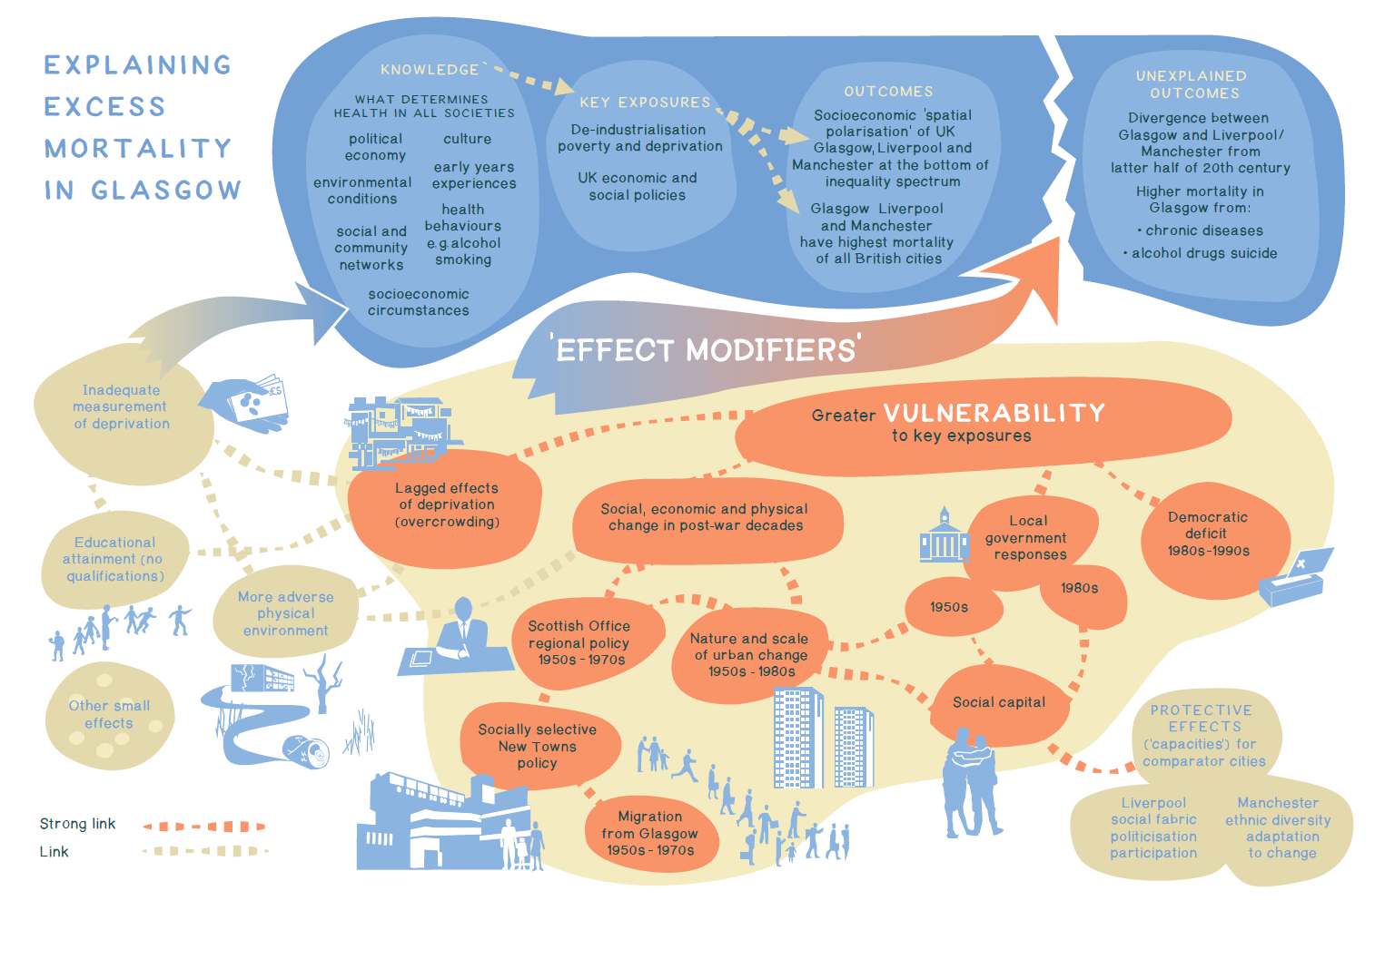

Slide 24
Explanatory model for Glasgow
Based on explicit comparison with Liverpool and Manchester (excellent comparator cities)
Very complex…
Key to the model is that Glasgow’s population has been made more vulnerable to the same key economic and political drivers of poor health as Liverpool/Manchester…

Slide 25
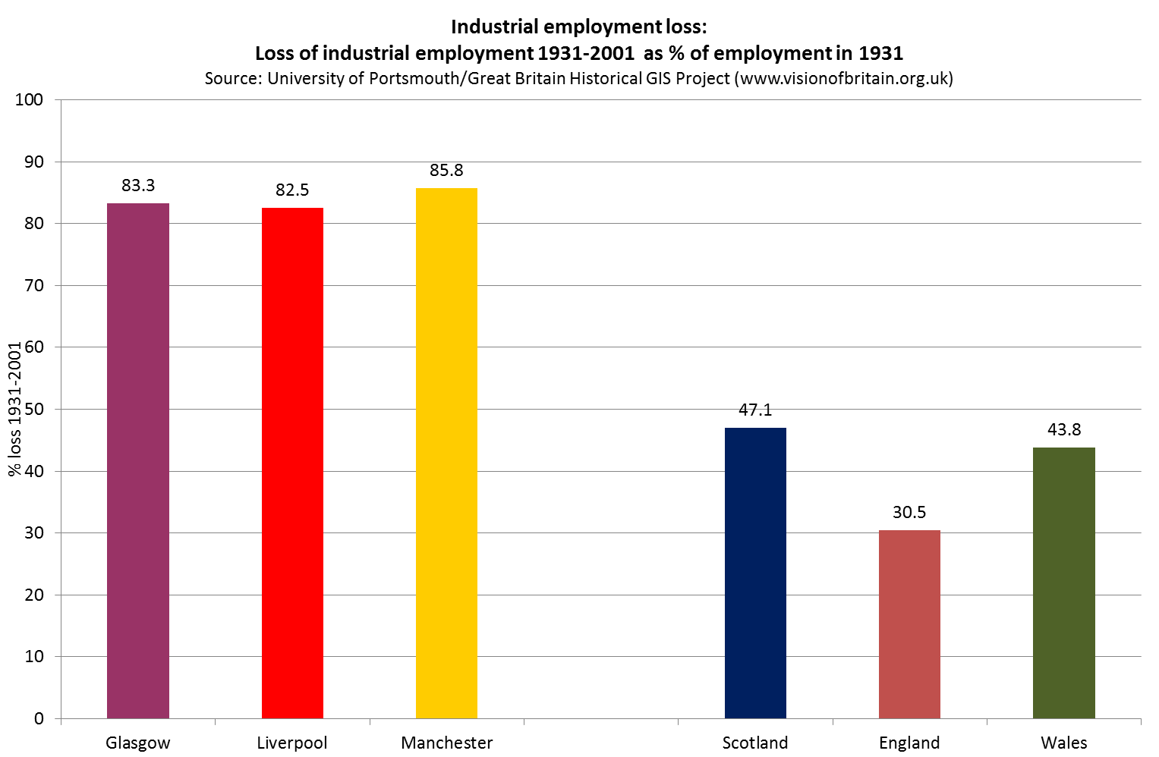
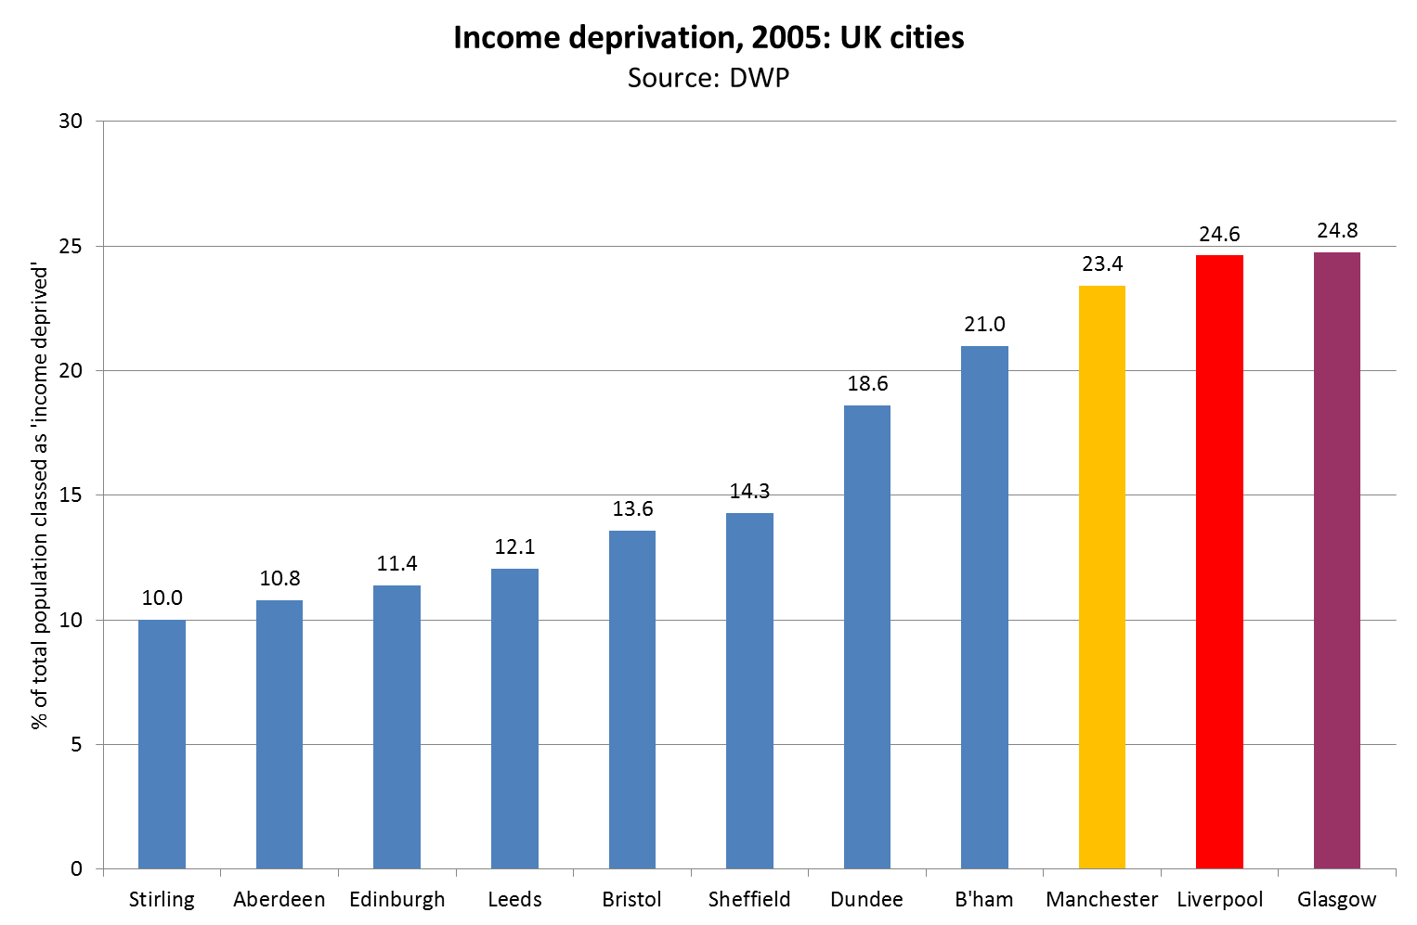
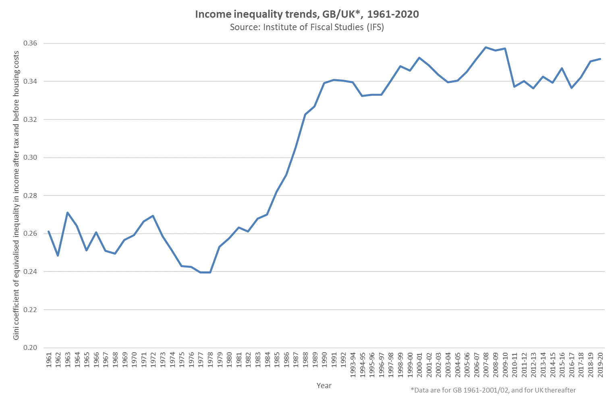
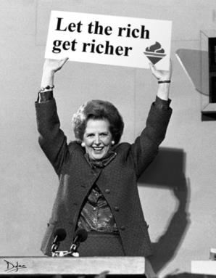
Key exposures
1979
Deindustrialisation
Poverty & deprivation
UK Government economic
policy since 1979

Slide 26
Explanatory model for Glasgow
Based on explicit comparison with Liverpool and Manchester (excellent comparator cities)
Very complex…
Key to the model is that Glasgow’s population has been made more vulnerable to the same key economic and political drivers of poor health as Liverpool/Manchester..
Population made more vulnerable by cumulative effects of a series of historical factors/events/ decisions…

Slide 28
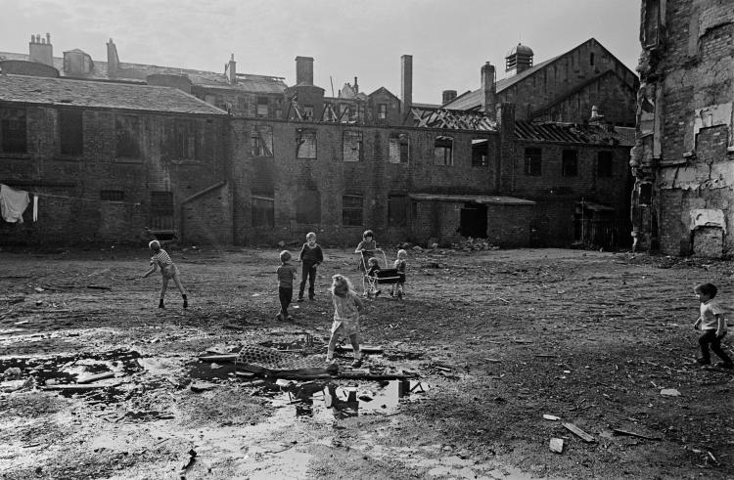
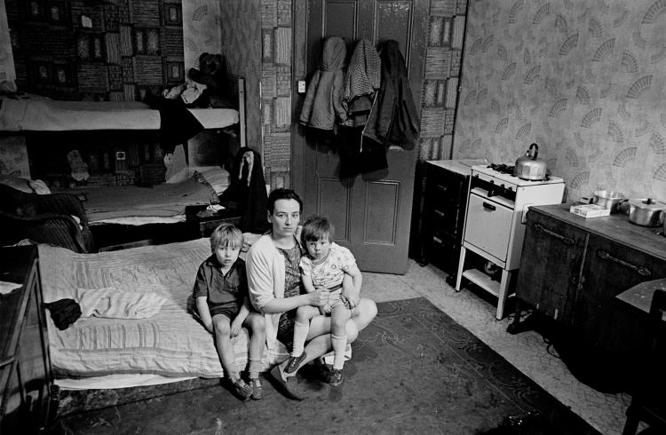
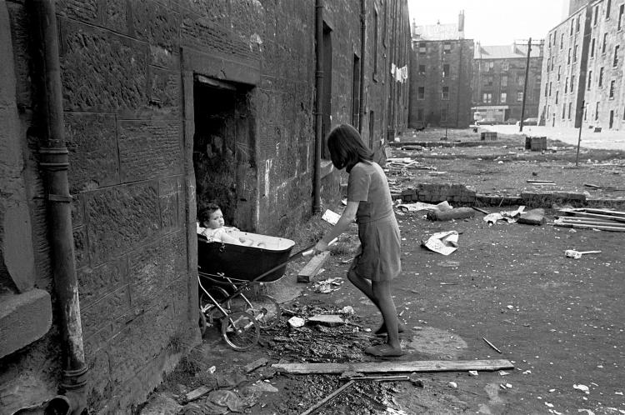
Housing conditions in Glasgow & Scotland 1969-1972
Source: Nick Hedges/Shelter Scotland (© Shelter 2015)

Slide 30
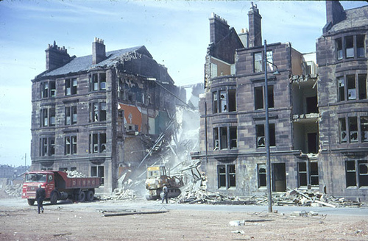
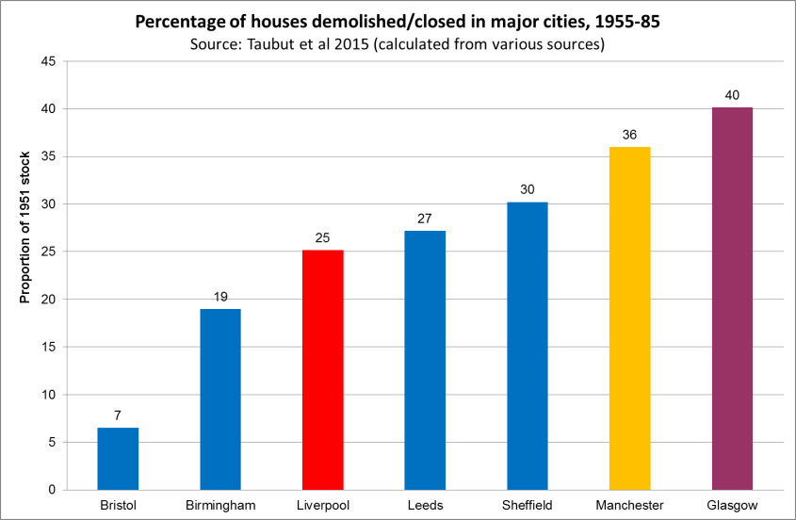
Nature & scale of urban change 1950s-80s

Slide 31
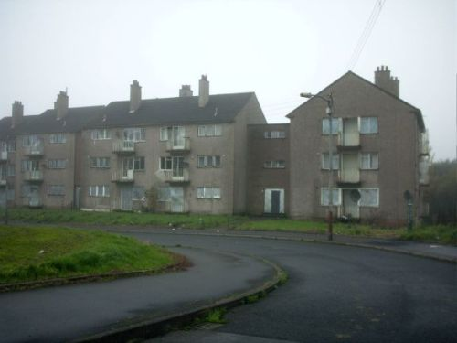
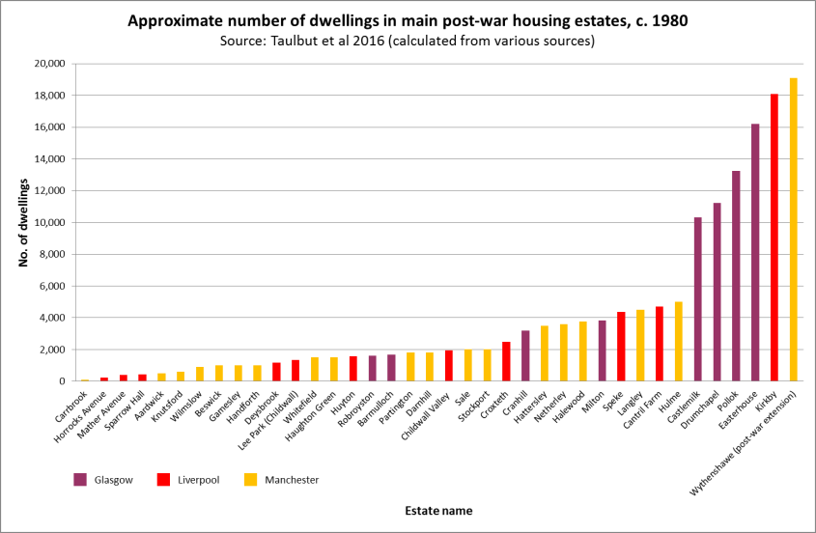
Nature & scale of urban change 1950s-80s

Slide 32
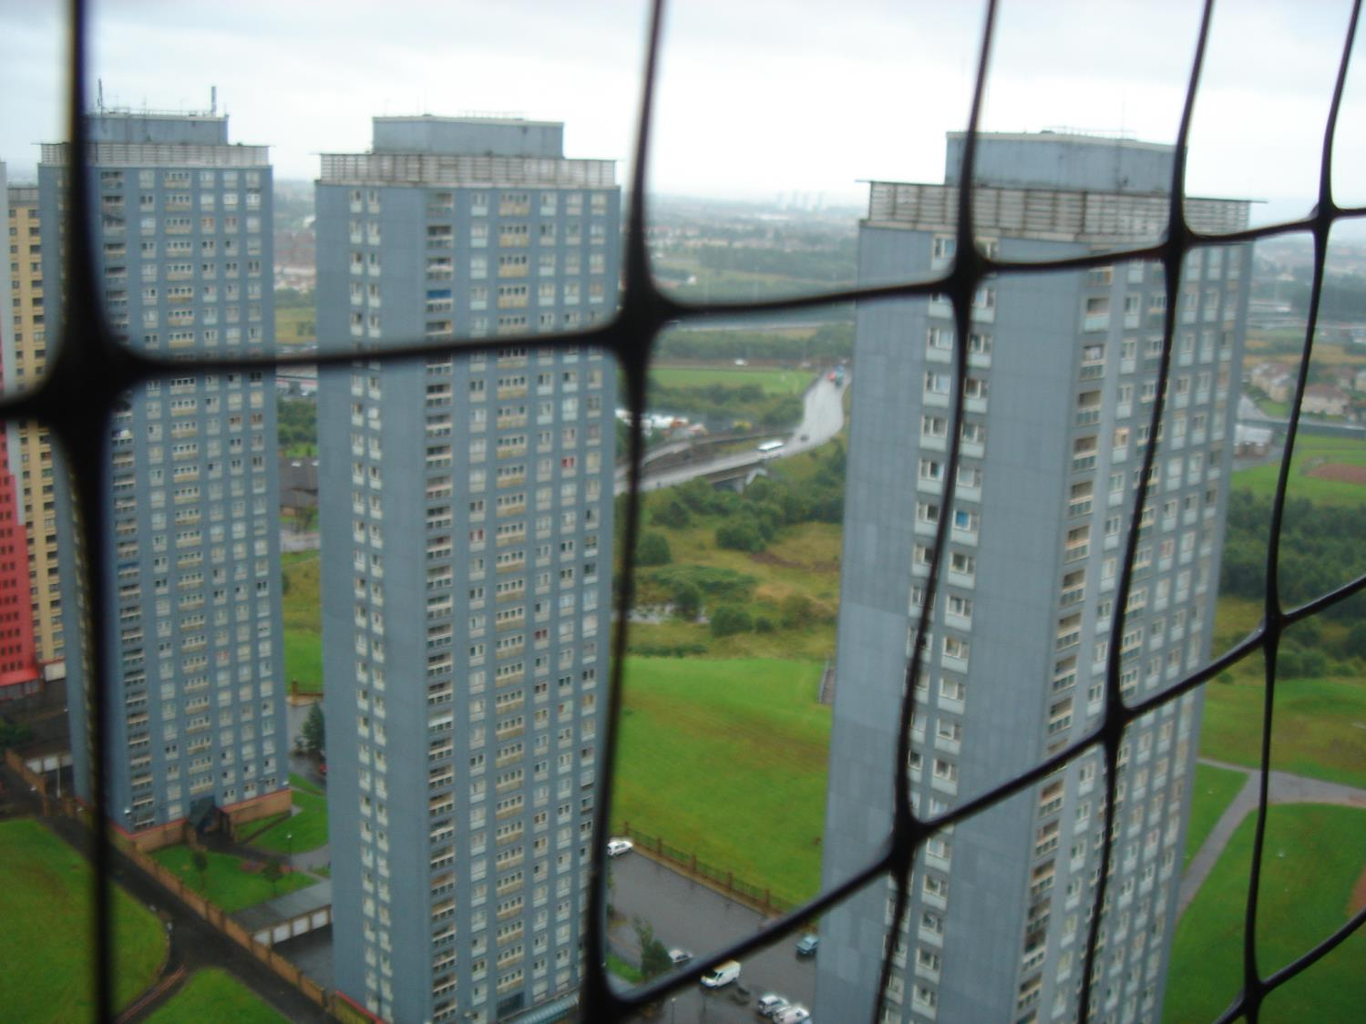
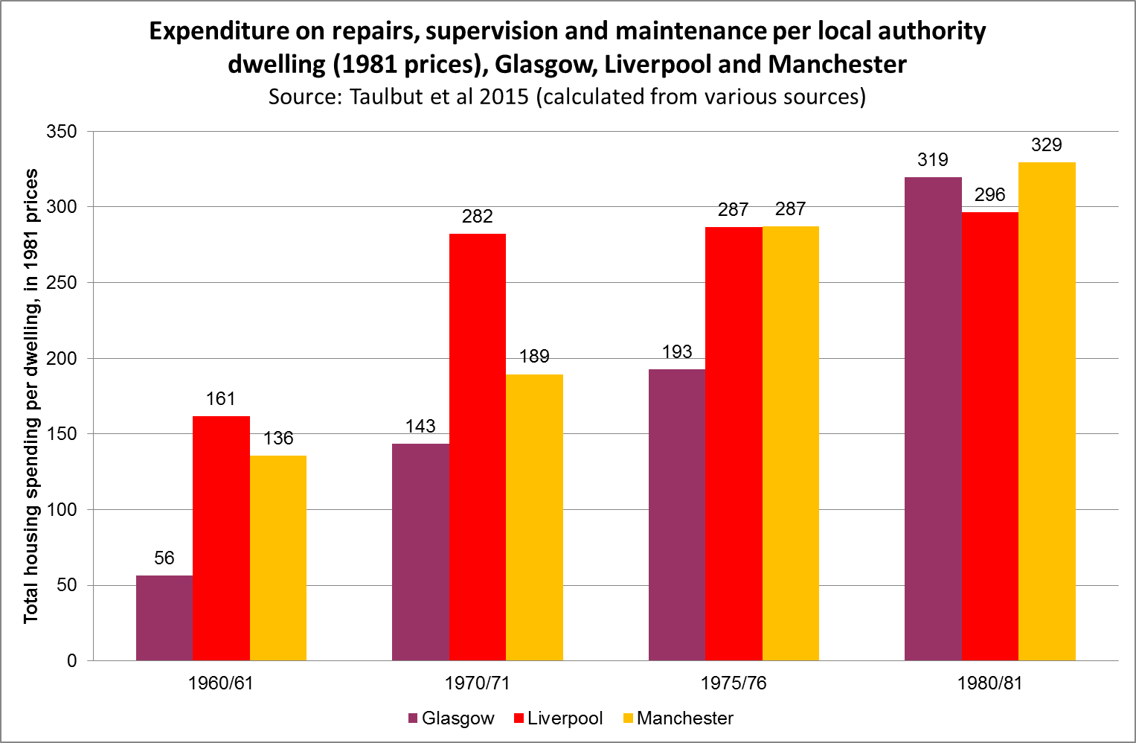
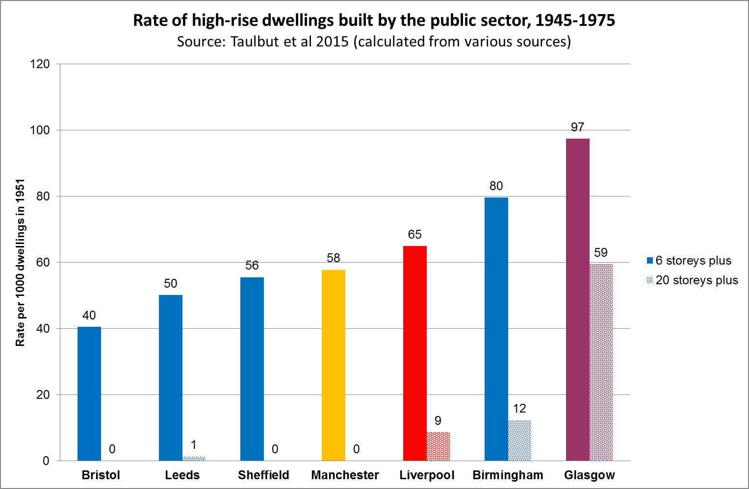
Nature & scale of urban change 1950s-80s

Slide 34
‘Scottish Office’ regional policy 1950s-1970s
‘Scottish Office’ was part of UK Government (but which had high levels of autonomy)
New research of previously secret government documents
Scottish Office response to deep-rooted post-WWII housing problems: to ‘sacrifice’ the city
  Glasgow officially designated a “declining city”
  All economic investment to be made outside the city
  Industry & sections of population moved outside the city e.g. socially selective New Towns policy
Policy extended & expanded during 1950s-70s despite clear awareness of consequences (socio-economic and health) for the city
1971 Scottish Office report: “[the policy] is destined within a decade or so to produce a seriously unbalanced population with a very high proportion of the old, the very poor and the almost unemployable”
Notes:
. Alongside other aspects of regional planning, one of the key components was the socially selective New Towns policy, whereby only particular sections of the city’s population (generally younger, skilled workers, in employment, and often with families) were chosen to live in the New Towns such as Cumbernauld and East Kilbride. This policy is referred to in some of the archive material as ‘skimming the cream of Glasgow’.

Slide 36
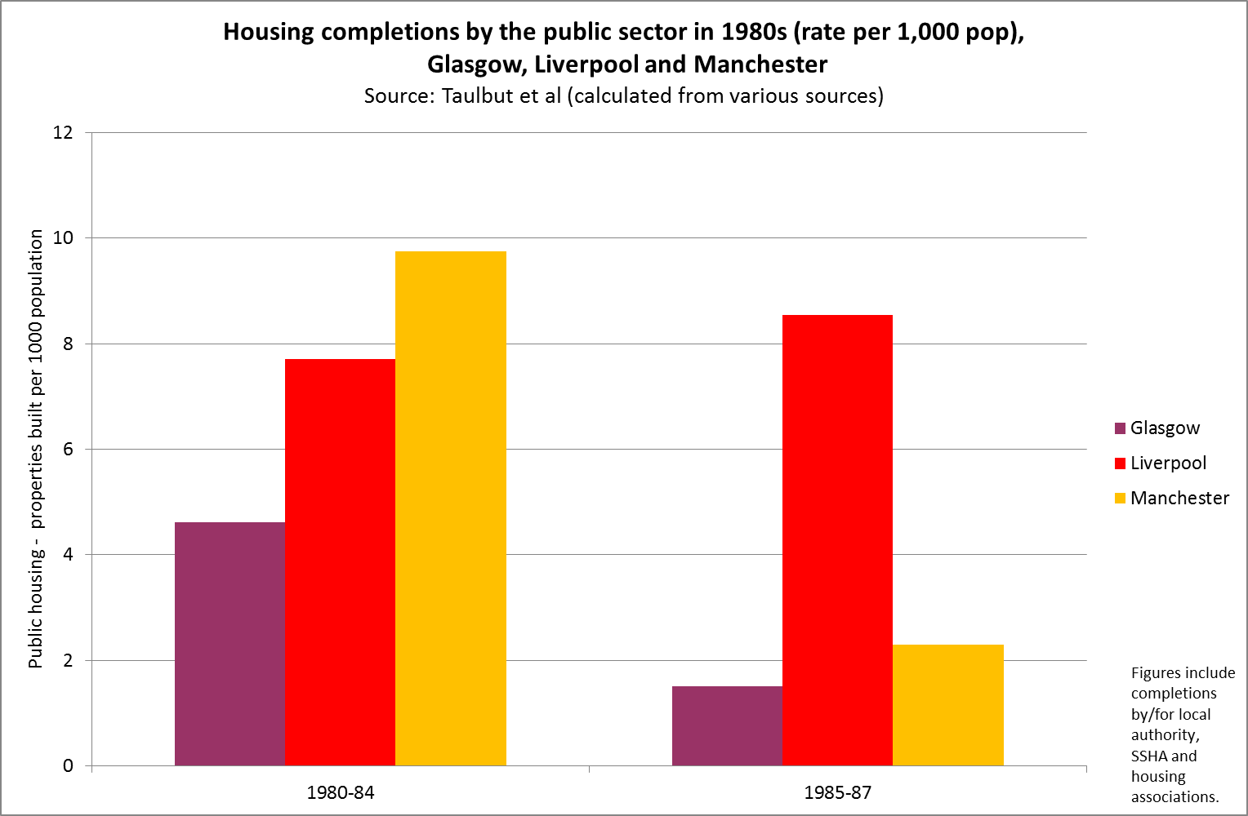
Local government responses 1980s
Different local government responses to right-wing UK (Conservative Party) Government policies
Very complex story but…
…in effect the comparator cities protected their populations better than Glasgow e.g…:
E.g. Liverpool:
  Mobilisation of opposition against UK government
  Widespread participation and politicisation of the public
  In response, greater priority given to (e.g.) poverty, new council housing
Whereas in Glasgow:
  Focus on inner-city gentrification
  Limited priority given to poverty and living conditions in peripheral estates

Slide 37
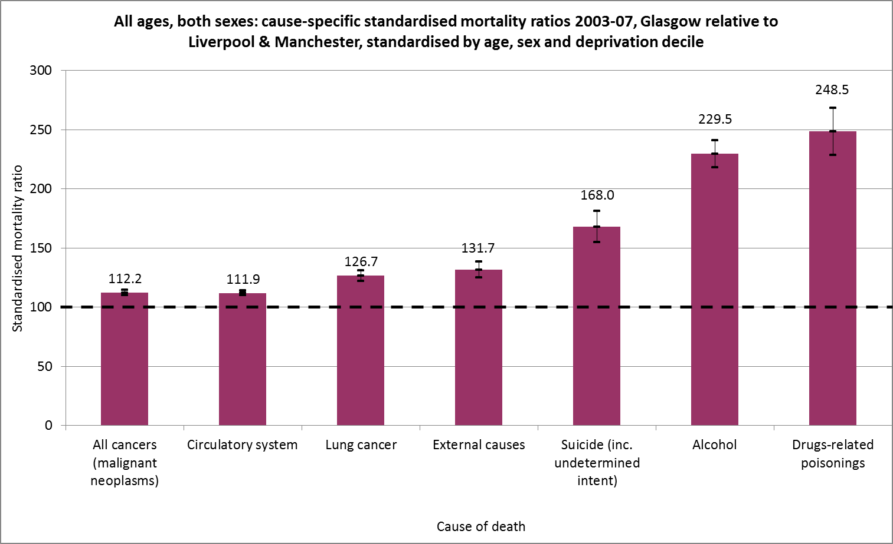

Slide 38
Conclusions (part one)
Health in Scotland (and especially Glasgow) characterised by extremely wide inequalities
‘Excess’ mortality plays a huge part in that
The scale of the excess is enormous – and tragic
Most likely underlying causes now identified
  Highly complex and multifactorial
  Glasgow made more vulnerable to economic/political exposures by a whole series of adverse historical factors and decisions
Emphasises importance of political (especially economic) decisions for population health
  Report includes 26 specific policy recommendations to address the issue
It’s not a ‘Glasgow effect’ – it’s a ‘political effect’

Slide 39
Part two: recent political effects on population health in the UK

Slide 40
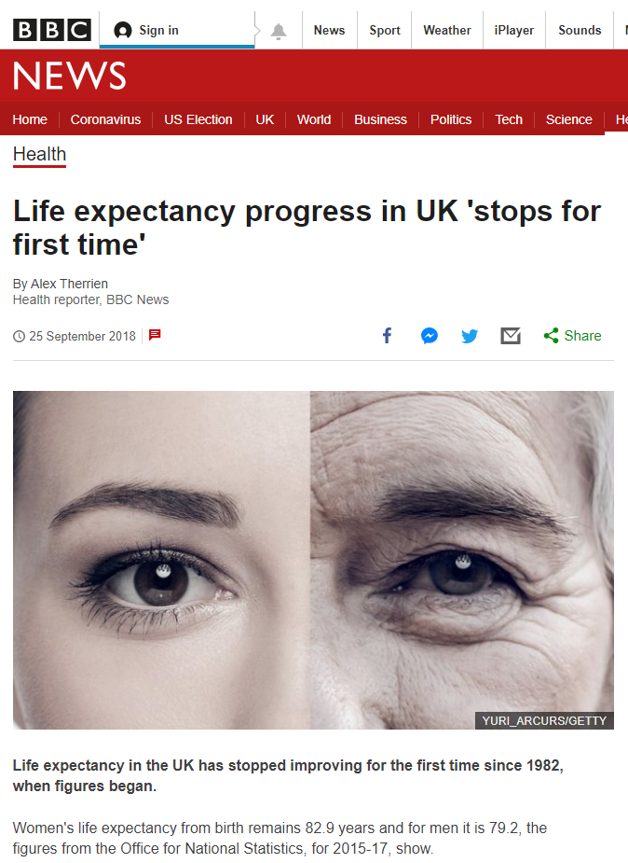
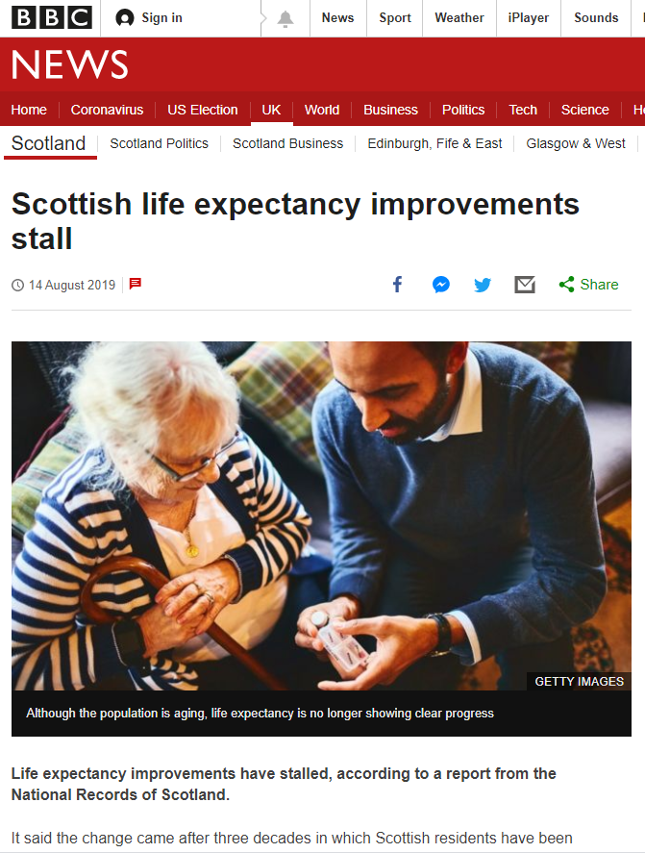
Background

Slide 41
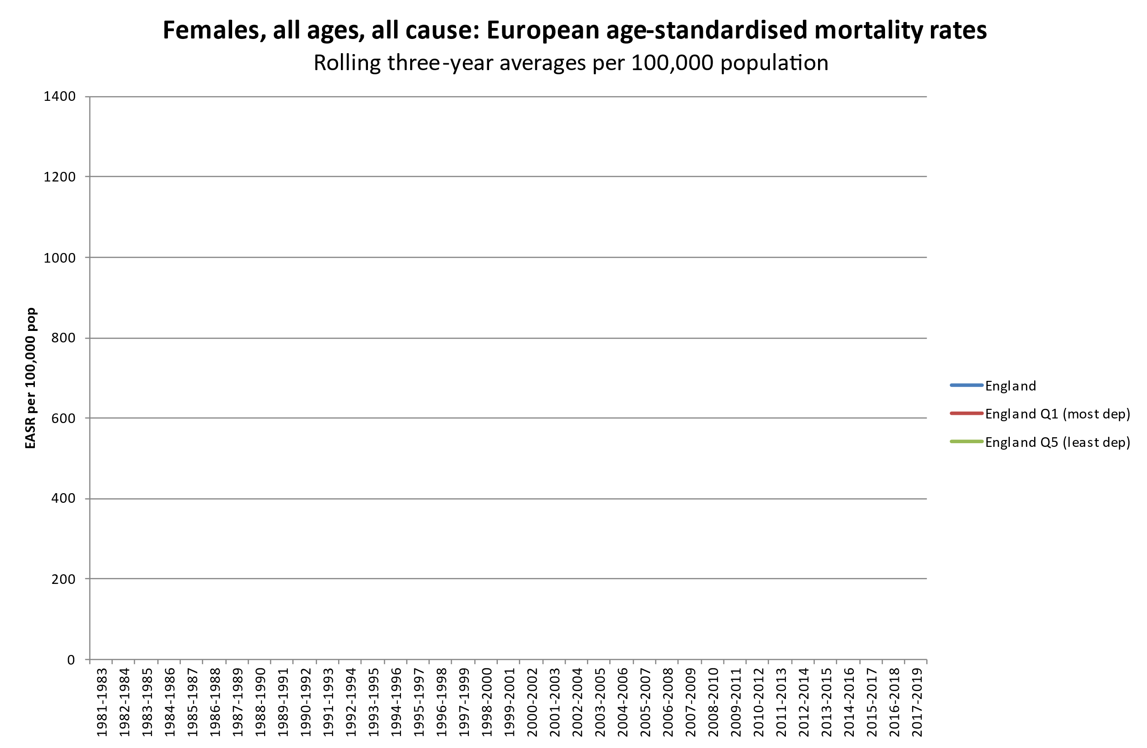
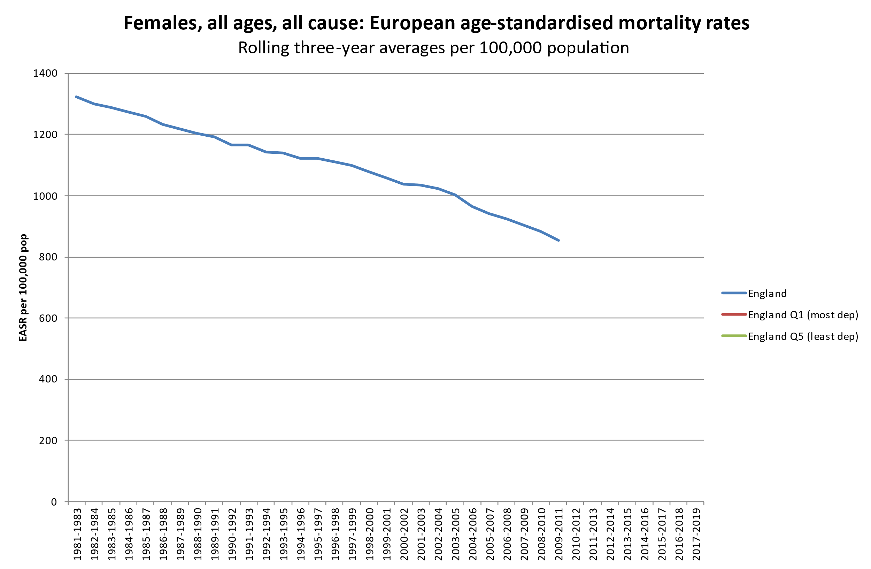
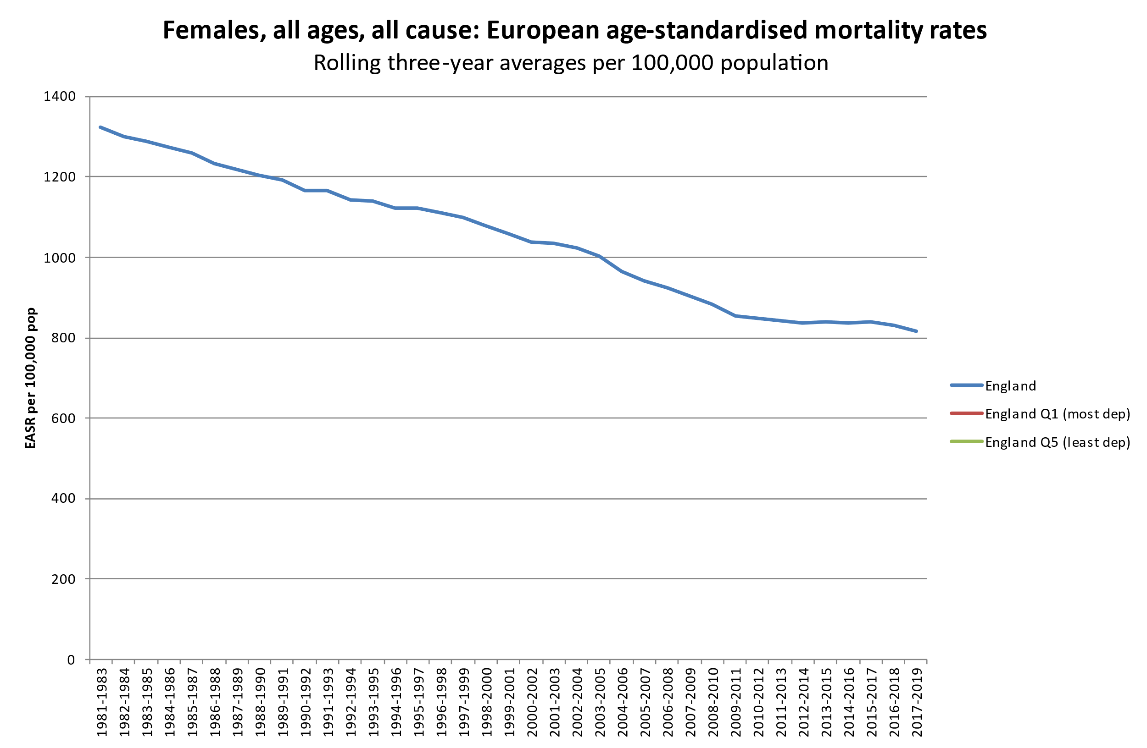
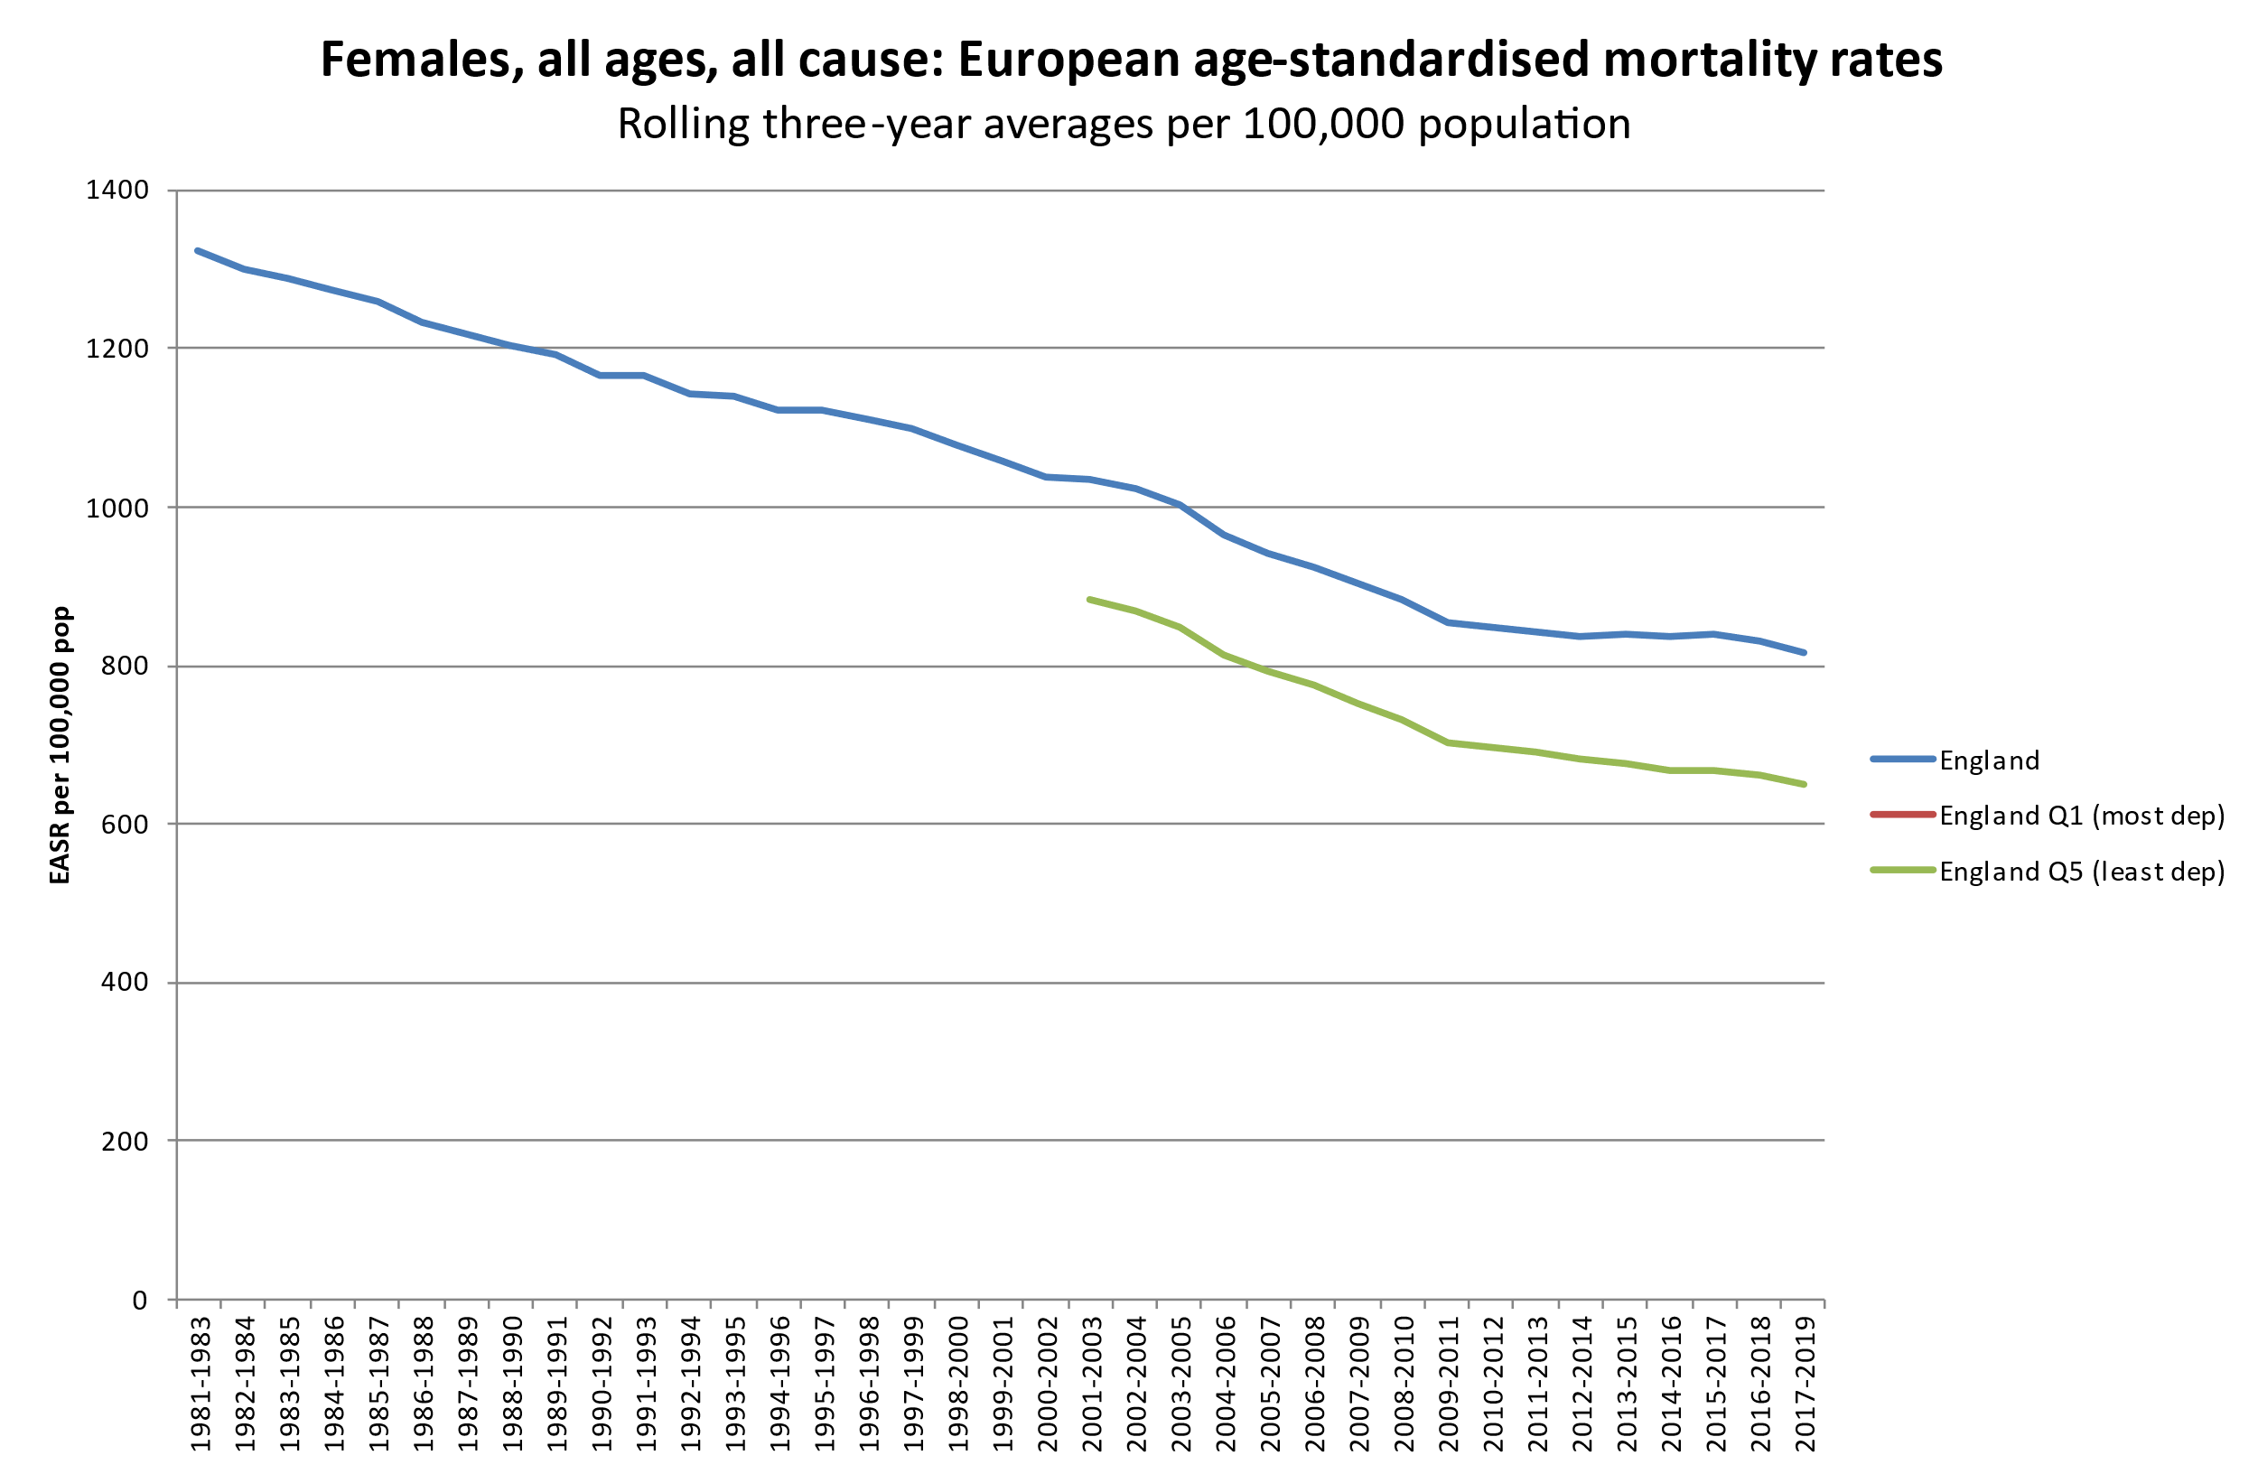
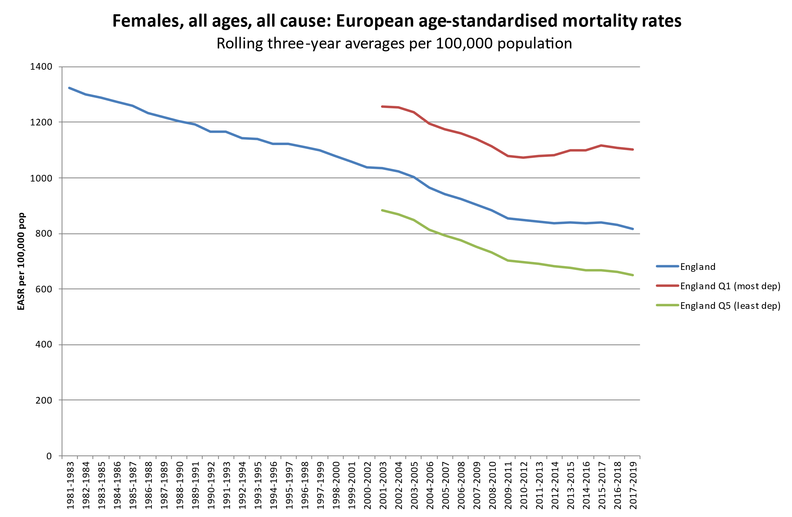





Political effects on health & health inequalities in the UK
2010: start of UK Government ‘austerity’ programme with aim of cutting public spending by £85 billion¹
Social security budget alone to have been cut by £47 billion by 2020/21²
Office for Budget Responsibility 2013.
Scottish Government 2017 (quoting OBR figures)

Slide 42





Is there evidence to support this?
Er, yes..
Huge literature on political determinants of health
International evidence of the impact of austerity policies

Slide 43









Is there evidence to support this?
Er, yes..
Huge literature on political determinants of health
International evidence of the impact of austerity policies
Wealth of UK evidence of the impact of this particular type of austerity…

Slide 44


Is there evidence to support this?

Slide 45
That’s enough deaths (and slides)

Slide 46
Points to end on
These recent changes – added to historical inequalities – are hugely important context for understanding the scale of COVID-19 inequalities
Urgent action needed
We should be shouting about this
In Glasgow’s case, yet another ‘adverse event’ in a long history of adverse, largely political, events
Please don’t use the term ‘Glasgow effect’!

Slide 47



And finally…
..other reasons why I hate the term ‘Glasgow effect’
‘thoughtful’
‘insightful’
‘thoughtful’ and
‘insightful’?

Slide 48
Further details
Drop me an email: david.walsh.2@glasgow.ac.uk
Excess mortality: https://www.gcph.co.uk/population_health_trends/scottish_excess_mortality
Recent mortality changes: https://www.gcph.co.uk/life-expectancy

Slide 49
Excess mortality in Glasgow: a ‘Glasgow Effect’ or just another political effect?
David Walsh
Glasgow Centre for Population Health
June 2022

