Slide 1
High Dimension Spatio-Temporal Clustering of Housing Price Sub-Markets: The Case of London’s Concentrated Growth
Jacob L. Macdonald | Dani Arribas-Bel | Alex Singleton
University of Sheffield Dept. Urban Studies and Planning | University of Liverpool Geographic Data Science Lab | University of Liverpool Geographic Data Science Lab
CRESR SEMINAR 2023
Sheffield Hallam University
October 11, 2023

Slide 2
Median Neighbourhood Prices 1995 - 2019
HM Land Registry data © Crown copyright and database right 2019. This data is licensed under the Open Government Licence v3.0.

Slide 3
Motivation & Research Question
Many economic and social urban processes occur in real time and over a continuum of space. Housing transactions can serve as a strong barometer for tracking such processes.
Sparse data at the most granular of scales is limited in its representability and power in modeling direct neighborhood price levels and changes.
High frequency and high-resolution data can, however, be used to classify neighborhood dynamics and identify (cluster) like-areas in terms of their transaction dynamics.
Using housing transactions aggregated to neighborhood units, this work defines similar clusters of (urban sub-market) areas in London based on their spatial and temporal price evolutions and spill-overs.
CAN WE EXTRACT ENOUGH INFORMATION FROM ONLY THE PRICES, LOCATION AND TIMING OF TRANSACTIONS TO BUILD OUT IDENTIFIABLE HOUSING SUB-MARKETS?

Slide 4
Data and Study Region
Capital city of London (UK). The density of transactions allow for granularly detailed analysis of neighbourhood dynamics.
Data from the HM Land Registry – tracking housing transactions from 1995 onwards.
3,175,800 transactions in Greater London from 1995 - 2019.
Referenced by date of sale and postcode.
Includes typology classification; indicator for new sale; indicator for freeholds.
Only includes for value transactions – i.e., excludes rentals; non-market housing; discount schemes; etc.
Transactions geo-referenced to a hierarchy of spatial administrative units (LSOA and above) using the National Statistics Postcode Lookup (NSPL).
In aggregating we move from a transactional database to a neighbourhood level database.

Slide 5
Data and Study Region
Right from the start, it is important to acknowledge the limitations that come with using this data.
- Transactions only (nothing about rental market)
- Not all transactions (gov. purchase orders; other non-market transactions)
- Not the exact location used for geo-coding but rather the broad postcode
- Limited (no) information about house size; structural characteristics
Still an extremely rich source of information related to property market dynamics across the country and their evolution in modern times.

Slide 6
Data: Transactional Level
Five-Year Bin | Count | St. Dev. | Unadjusted Prices (£) |  |  | Inflation Adjusted Prices (2019 £)*
 |  |  | Avg. | Med. | Max. | Avg. | Med. | Max.
1995 - 2000 | 873,974 | 168,572 | 137,013 | 96,500 | 32,477,000 | 626,285 | 457,823 | 145,231,253
2000 - 2005 | 944,539 | 234,142 | 239,559 | 188,000 | 24,750,000 | 585,997 | 453,720 | 73,307,741
2005 - 2010 | 730,401 | 362,947 | 341,316 | 250,000 | 23,500,000 | 602,781 | 450,773 | 38,089,583
2010 - 2015 | 650,720 | 1,377,321 | 514,409 | 332,000 | 225,000,000 | 698,375 | 455,377 | 235,071,620
2015 - 2019 | 489,091 | 3,361,655 | 730,451 | 435,000 | 594,300,000 | 741,756 | 441,893 | 571,762,655
* Adjusted for inflation using monthly London Consumer Price Index (CPI) for durable housing goods (ONS; base year = 2015)
To look for consistency of neighbourhood groupings over time, it’s important to consider inflation adjusted prices.
London highly influenced by outlier property transactions – particularly over the last decade.

Slide 7
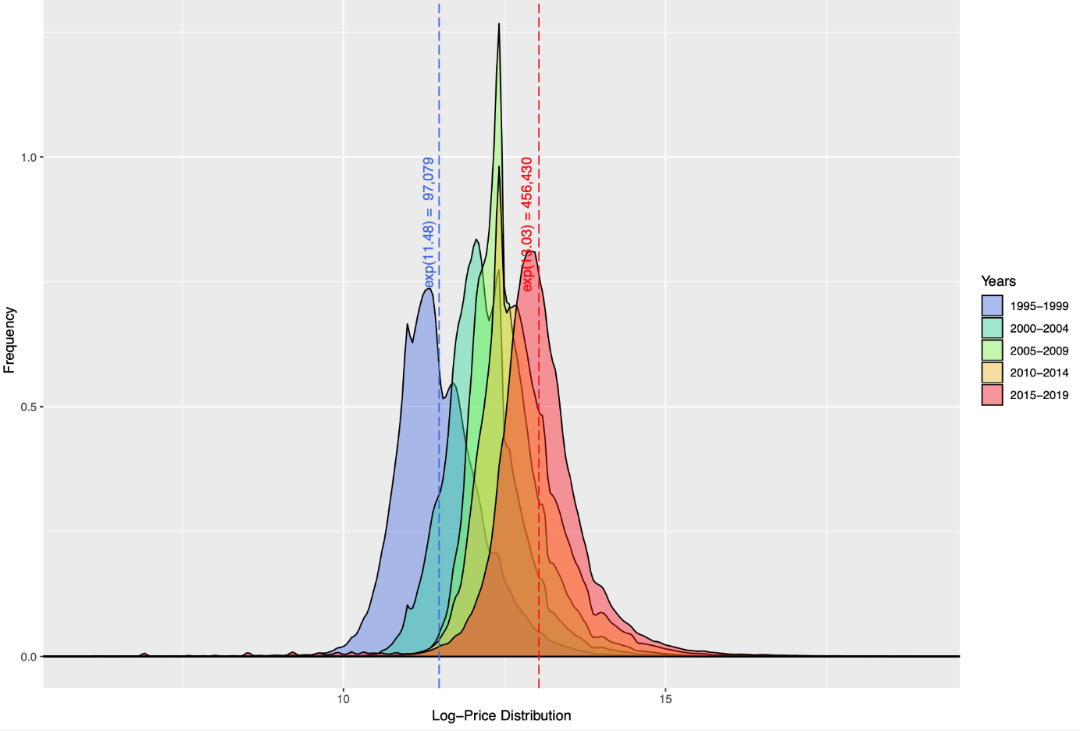

Slide 8
Neighbourhood Aggregation
The base unit of analysis is LSOA neighbourhoods (space) at monthly intervals (time) from 1995 to 2019. Individual transactions are aggregated using the median value.
Balanced panel (longitudinal) database of 1,406,985 month-LSOA units: 291 months and 4,835 neighbourhoods
Trade-off must occur between the number of transactions used to obtain the neighbourhood price level, the size of the temporal bin, and the size of the spatial bin.
While LSOA-months are appropriate for London, where transaction densities are the largest, the current sparsity of data cannot support this level of granularity outside the capital.

Slide 9
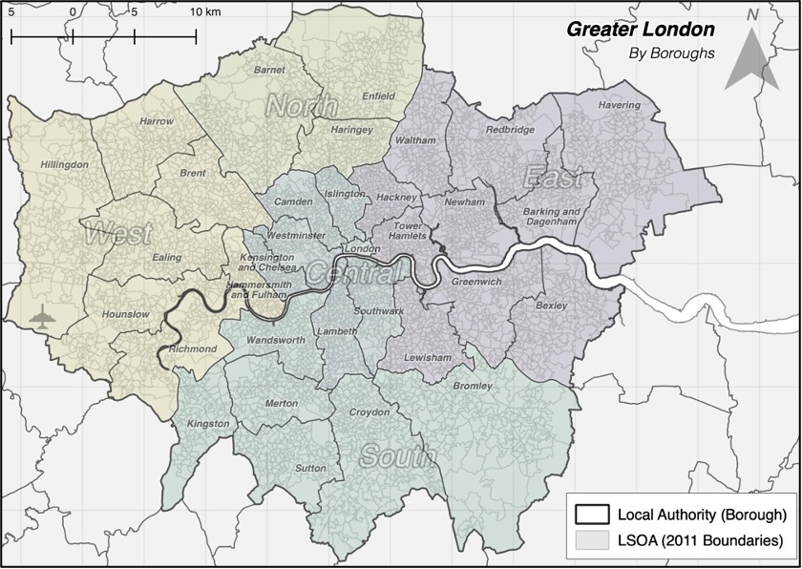
N = 4,835 LSOA (Neighborhood) Units
Avg. size 0.33 km² with min. number of dwellings = 220 units (4.60·10¹ per km²)
33 Boroughs (Local Authorities)
3,175,800 transactions from 1995-2019

Slide 10
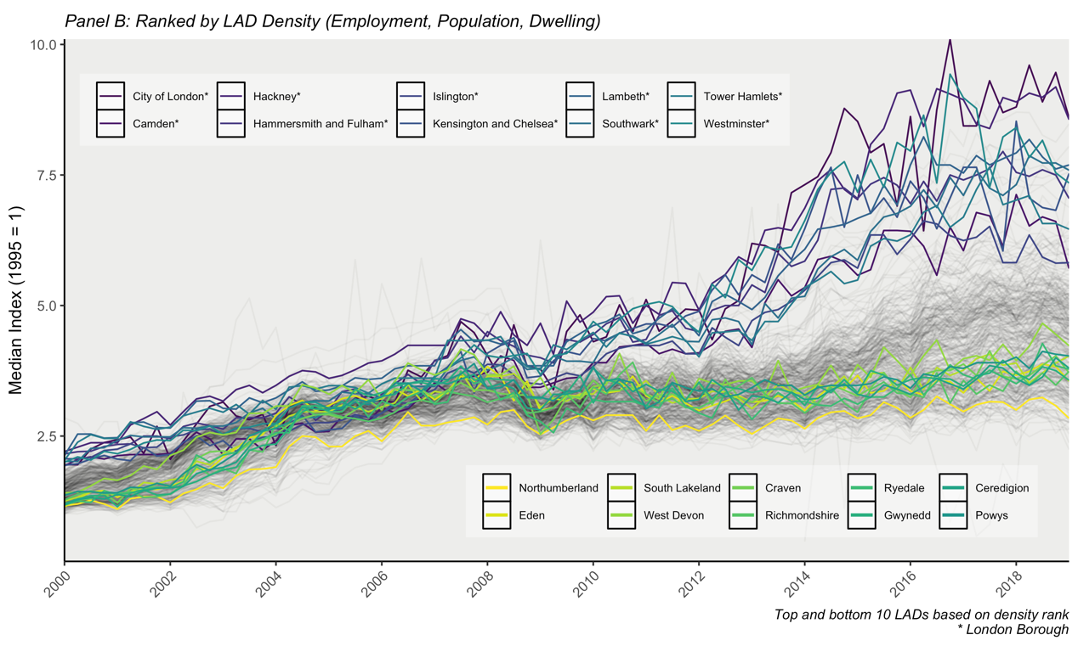
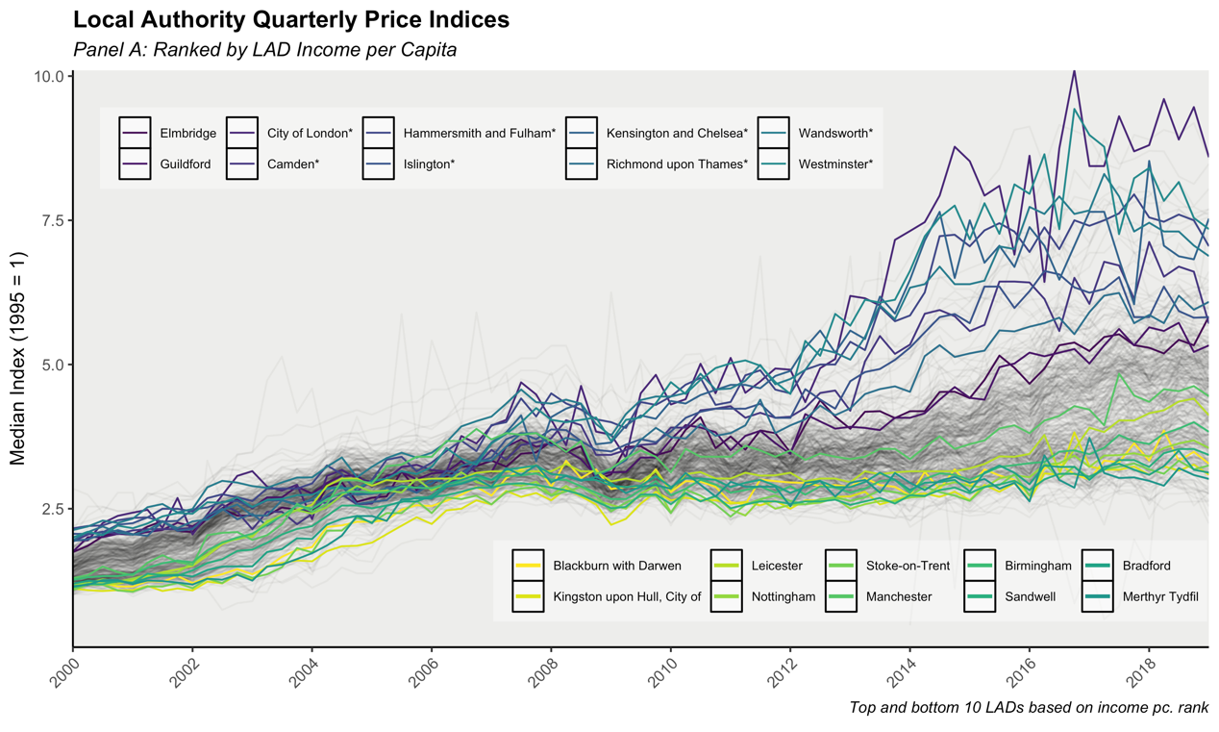
London: Temporal Dynamics
London is a clear outlier in terms of transaction prices and growth.
High price growth in London is further correlated with areas of high income per capita and high densities of employment and population.
Even within the London boroughs however, there is large variation in prices and growth rates.

Slide 11
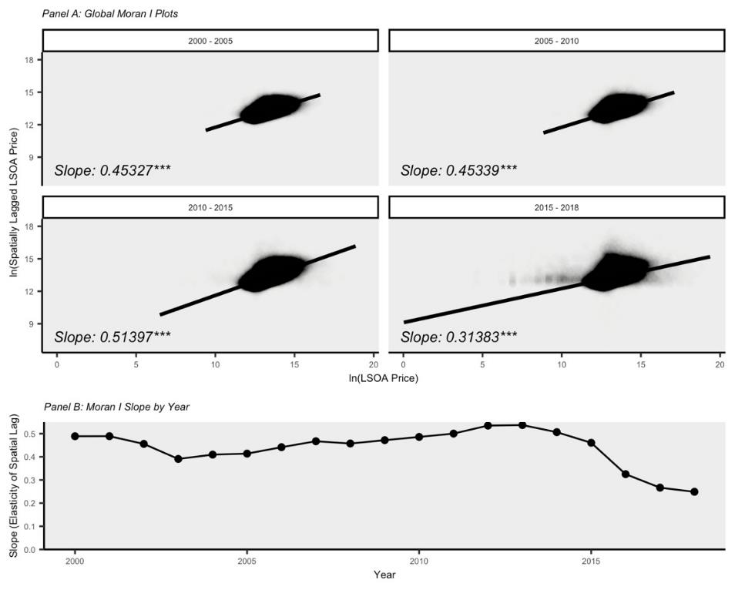
London: Spatial Dynamics
Neighbourhoods have significant spatial spill-overs with high correlation between a unit’s price and the spatial lag of contiguous tract prices.
Over time however, the strength of this spatial spill-over has been declining.
The decline in spatial correlation corresponds to the period of high growth in prices.
The growth across London is therefore not spatially equal in all areas – this high growth is driven by select high growth areas and isolated units.

Slide 12
Neighbourhood Clustering Methodology
Applying an unsupervised (global) K-means machine learning cluster algorithm can characterize blocks of neighbourhood units with relatively homogeneous prices, evolution, and spatial spill-overs.
Clustering of neighbourhoods is conditional on a set of input parameters which characterize the space and time price dynamics of each area.
Iterative sub-clustering breaks any potential large groupings down into sub-groups with marginally different characteristics (gradient effects).

Slide 13
Neighborhood Clustering Methodology
The K-means cluster algorithm is applied to a spatio-temporal longitudinal database of neighborhood (LSOA) units at monthly intervals.
The clustering input variables (spatial spill-overs and temporal parameter estimates) are generated on a rolling basis for each LSOA at every month.
Clustering on global (all years) and on inflation adjusted prices removes the significant temporal effect which would almost exclusively define the clusters groups if not.

Slide 14
Neighbourhood Clustering Methodology - INPUTS
Different sets of (price-based only) input parameters are used, each capturing the general idea on which we wish to cluster – broadly classified into three streams or domains.
Direct Price | Spatial Spill-Over | Temporal Evolution
Captures the direct “level” of a neighbourhood's price and transactions. Measured using direct (inflation adjusted) prices and transaction density. | Captures the strength and similarity between a neighbourhood’s price and those of the contiguous neighbourhoods nearby. Measured as the (inflation adjusted) 2nd order queen contiguous neighbour price average. 2nd Order Queen: Avg. 13.65 Links | Captures both the short and long-run dynamics of a neighbourhood's price evolution. Short-run effect measured by the average growth in the previous 6 months. Long-run effect measured by the parameter estimate of month impact on price growth over previous 6 years.
$$\left.P_{t}^{i}=β_{T}^{i}T_{t}+β_{T^{2}}^{i}{T^{2}}_{t}+ε_{t}^{i} ∀ i, j; t∈[t_{−72},t_{0}\right]$$

Slide 15
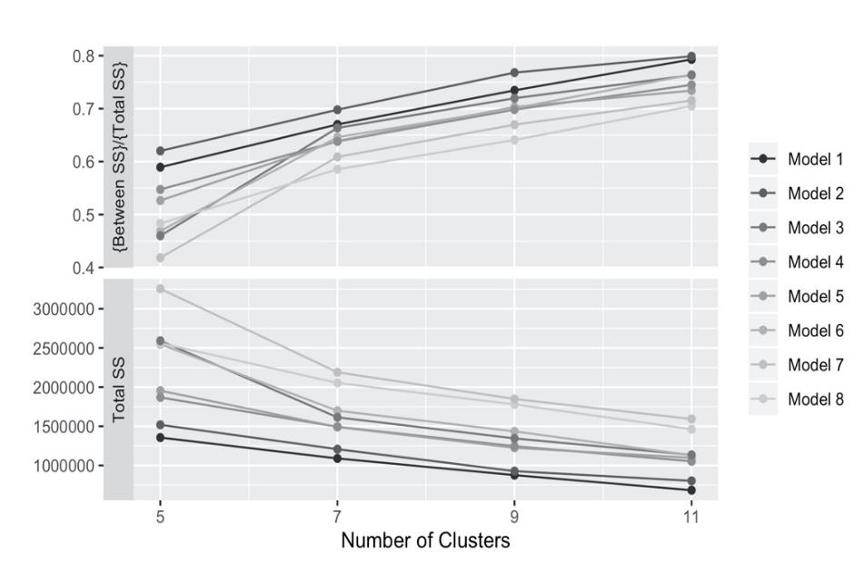
Model & Cluster Selection
 | Direct | Spatial | Temporal
Model 1 | Prices (2019 Adj.) | 2nd Order Queen Contiguity Spatial Lag (2019 Adj.) | $$β_{T}; β_{T^{2}}$$
Model 2 | Prices (2019 Adj.) | 2nd Order Queen Contiguity Spatial Lag (2019 Adj.) | Average Growth T-6 Months; $$β_{T}; β_{T^{2}}$$
Model 3 | Prices (2019 Adj.) | 2nd Order Queen Contiguity Spatial Lag (2019 Adj.) | Average Growth T-6 Months; $β_{T}; β_{T^{2}}$; Mean Square Error
Model 4 | Prices (2019 Adj.) | 2nd Order Queen Contiguity Spatial Lag (2019 Adj.) | $β_{T}; β_{T^{2}}$; Mean Square Error
Model 5 | Prices (2019 Adj.); Transactions/ km² | 2nd Order Queen Contiguity Spatial Lag (2019 Adj.) | $$β_{T}; β_{T^{2}}$$
Model 6 | Prices (2019 Adj.); Transactions/ km² | 2nd Order Queen Contiguity Spatial Lag (2019 Adj.) | Average Growth T-6 Months; $$β_{T}; β_{T^{2}}$$
Model 7 | Prices (2019 Adj.); Transactions/ km² | 2nd Order Queen Contiguity Spatial Lag (2019 Adj.) | Average Growth T-6 Months; $β_{T}; β_{T^{2}}$; Mean Square Error
Model 8 | Prices (2019 Adj.); Transactions/ km² | 2nd Order Queen Contiguity Spatial Lag (2019 Adj.) | $β_{T}; β_{T^{2}}$; Mean Square Error
Preferred model is the most parsimonious, Model 1, with 7 cluster groups.
Lowest within-group SS and highest between-group explanatory power

Slide 16
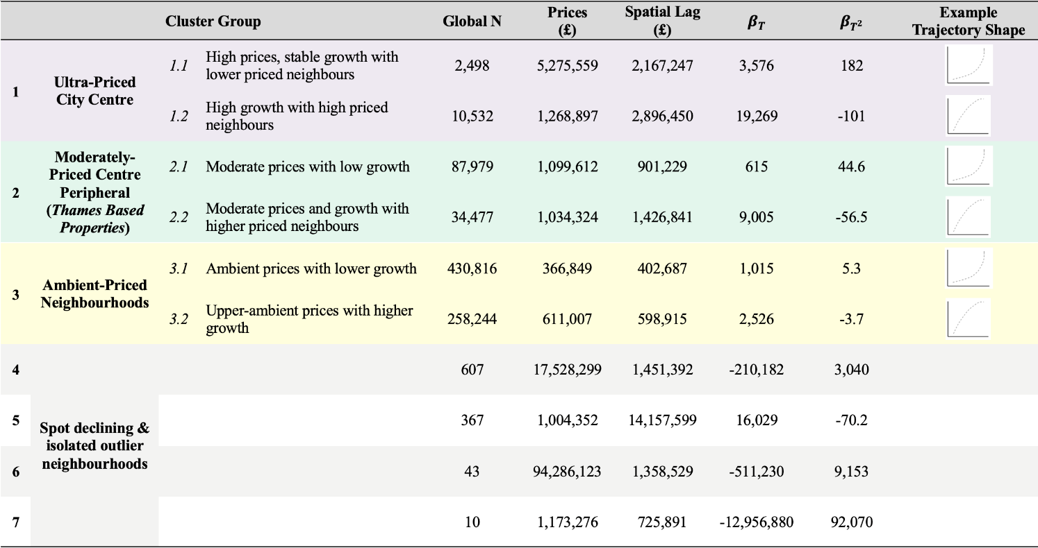
Cluster Groups and Characteristics

Slide 17
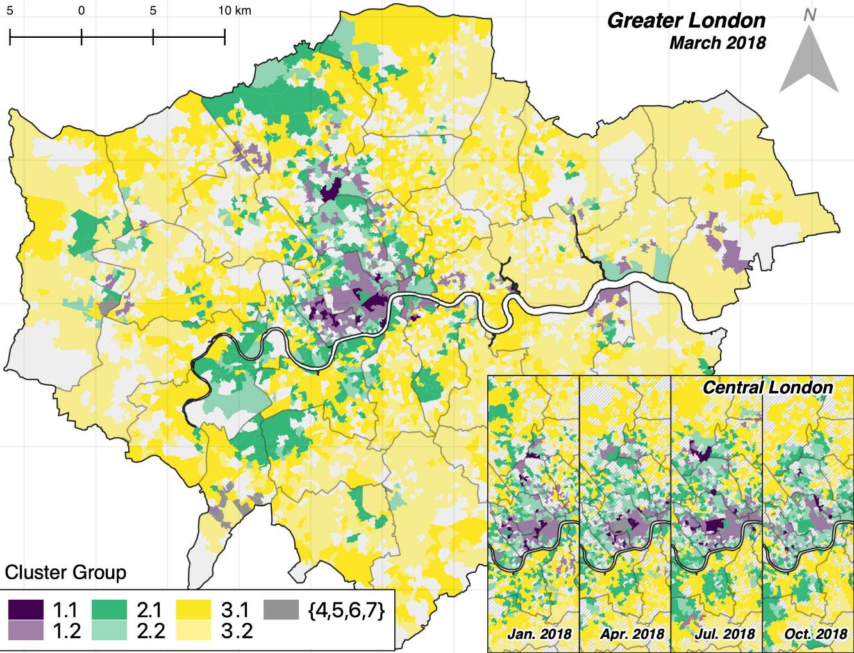

Slide 18
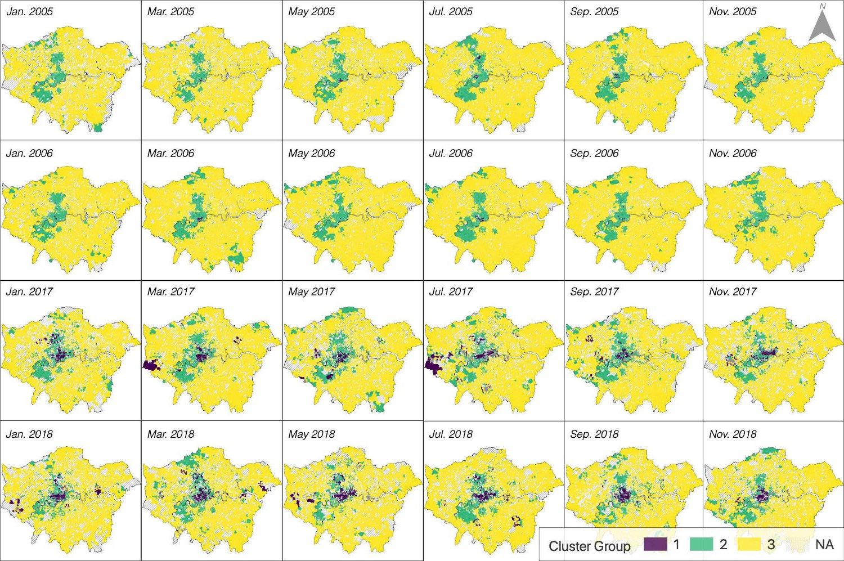

Slide 19
Persistent-Priced Neighbourhood Clusters
Using estimated space and time parameters – can we cluster and identify similarly priced areas which undergo common price transitions and dynamics.
High clustering over space and gradient effect of prices declining from City of London.
However similar areas seen towards the limits.
Three main groupings – ambient priced (pink); million-pound dwellings (green); ultra-rich (blue).
Can we identify declining or isolated neighbourhoods?
Can we see areas of high and fast transitions from low to ultra-high priced?
Where should we target local policy initiatives, and can we compare within-urban and between regions?

Slide 20
Cluster Group Classification
Cluster 1: Ultra-high-priced neighborhoods concentrated together in the city center. High prices, high growth and high-priced neighbors.
Cluster 2: Moderately priced neighborhoods peripheral to the core city center. The million-pound dwellings located along the Thames.
Cluster 3: Ambient level price neighborhoods with moderate growth. Sub-grouped by the intensity of prices and growth.
Cluster 4, 6, 7: Price outliers and declining neighborhoods.
Cluster 5: Isolated neighborhood surrounding by ultra-high-priced areas.

Slide 21
Cluster Groups and Characteristics

Slide 22
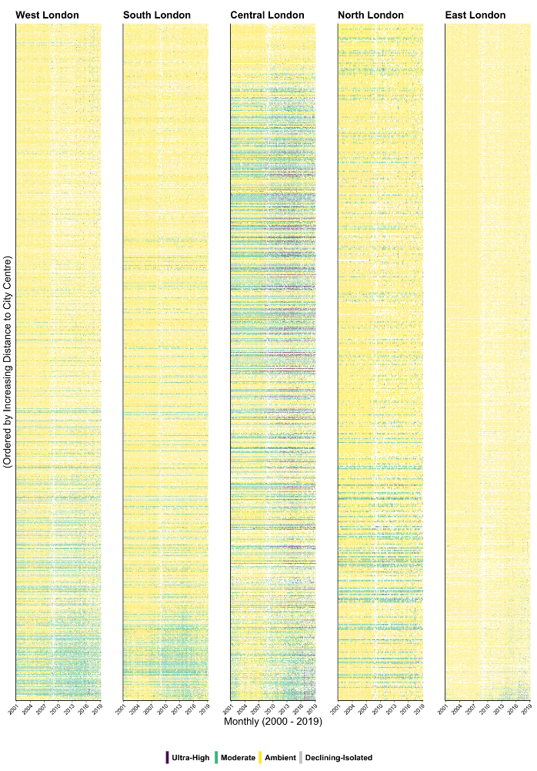

Slide 23
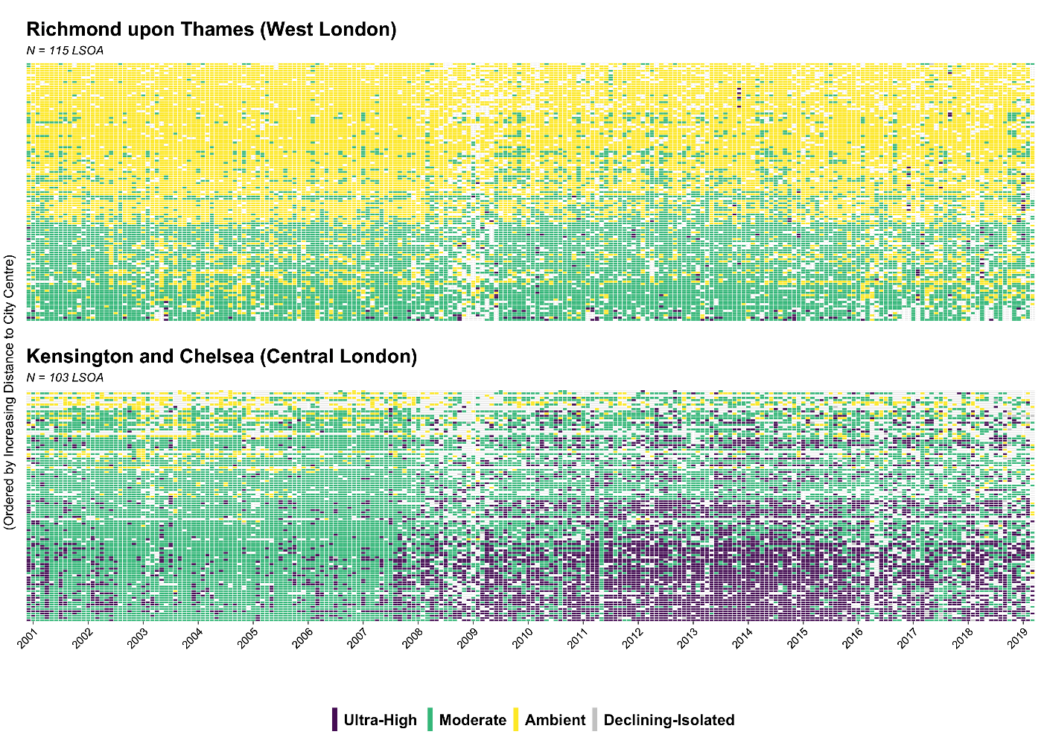

Slide 24
Discussions
The rolling nature of clustering – at every month – captures the ebbs and flows of neighborhood dynamics as they evolve and change over time.
This high-frequency neighborhood classification captures the dynamic nature of sub-urban housing markets.
The emergence of the relatively ultra-high-priced and high growth neighborhoods in the capital have only begun over the past decade.
Through these changes we can track which neighborhoods have consistent categorization, or which neighborhoods persistently remain the same.

Slide 25
What’s Next..?
How much can only price and location data over time tell us?
How well does this extend to broader markets, regions, areas?
How could this overlap/ correspond with other markets – labour; travel to work; strategic housing areas.

Slide 26
j.macdonald@sheffield.ac.uk
https://jacobmacdonald.org

