Slide 1
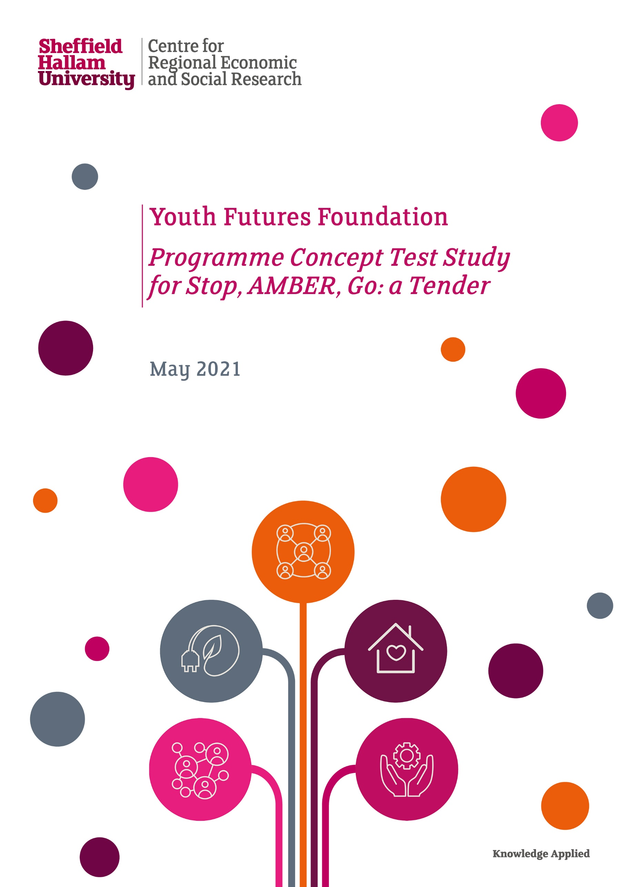
CRESR Seminar Series Decolonising knowledge in higher education: Lessons from the colonial experience in Northern Nigeria Dr Femi Owolade Sheffield Hallam University 13 December 2023

Slide 2
Contemporary curriculum reform: decolonising knowledge
In Western academic spaces, stakeholders are claiming commitments to "decolonisation". Yet in environments shaped by rankings, impact factors, citation numbers and third-party funding figures, what claims to be decolonial scholarship can easily end up being as extractive and violent as the subject it is claiming to confront.
Decolonisation in contemporary curriculum reform signifies a necessary shift towards dismantling Eurocentric perspectives, rectifying historical omissions, and fostering more culturally inclusive and socially just educational systems.
By decolonising knowledge, educators and HEIs can empower students to critically engage with a wider spectrum of perspectives, fostering greater empathy, understanding, and a more comprehensive view of global issues.

Slide 3
Decolonising knowledge: lessons from the colonial experience in Northern Nigeria
This presentation delves into the complex history of British colonisation of Islamic legal education in Northern Nigeria and subsequent efforts to decolonise this educational domain during the post-independence period.
The colonial experience in Northern Nigeria highlight the risks and dangers of perpetuating and reproducing colonialism by attempting to decolonise knowledge.

Slide 4
Colonising Islamic legal education in Northern Nigeria: past and present
From the colonial period on, western education in Northern Nigeria has been an arena marked by ambivalence over how to combine Islam with “modernity”—a concept with as many different definitions as the protagonists involved in the debate.
In postcolonial Northern Nigeria, Muslim graduates of western schools often evinced discomfort with their own education. This discomfort was visible in the generation of Muslim elites who were trained in colonial schools but whose careers peaked after independence.
Western-style schooling has been framed as a neocolonial practice (i.e. continuation or reimposition of colonialism), and denounced as un-Islamic by a vocal fringe, most notoriously the armed terrorist movement Boko Haram.

Slide 5
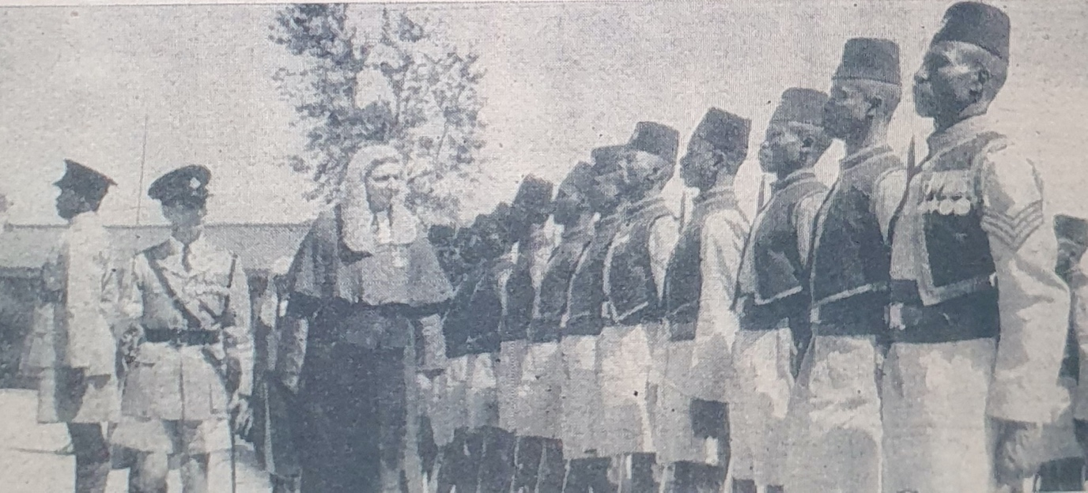
Legal colonialism in Northern Nigeria, 1900-1960
Chief Justice of Northern Nigeria, Sir Algernon Brown entertained by a police parade before opening the Magistrate’s Court of Northern Nigeria, Jos. 3 November 1956 [Source: Gaskiya ta fi Kwabo Newspaper]

Slide 6
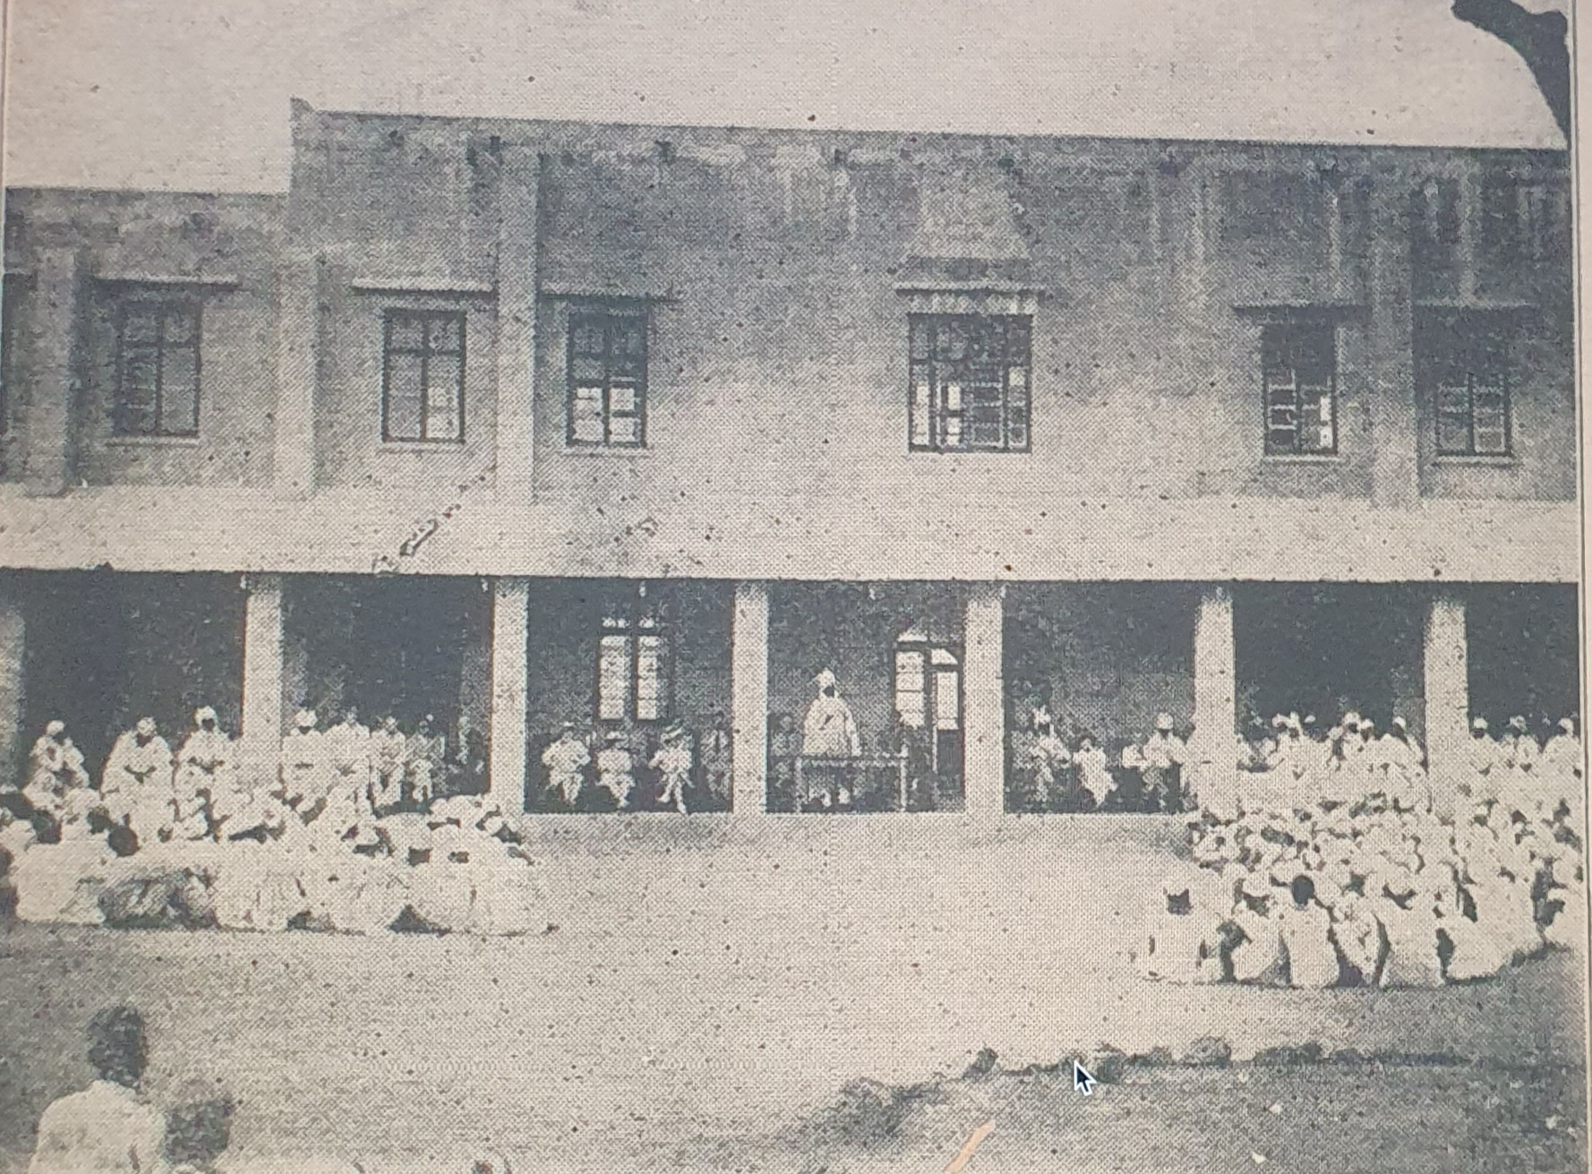
Colonising Islamic legal education in Northern Nigeria: The Kano Law School, 1934-1947
Emir Bayero of Kano addressing students of Kano Law School, with British officials and members of the colonial authority, c. 1940 [Source- Gaskiya Ta Fi Kwabo Newspaper]

Slide 7
The Kano Law School, 1934-1947
The Kano Law School was founded in 1934 as a premier centre for Islamic legal training in British Africa.
After the school graduated its first cohort of students in 1938, the graduates immediately occupied prominent positions in Colonial Courts of Northern Nigeria.

Slide 8
Decolonising Islamic legal education: From Kano Law School to Kano School of Arabic Studies
After the end of the Second World War in 1945, the process of decolonisation began in Africa.
In 1947, in an effort to decolonise Islamic legal education, British officials renamed the Kano Law School to the Kano School of Arabic studies.
Sheikh Awad, an African official, who had been a teacher at the Kano Law school, was named the principal of the Kano School of Arabic studies.
Performative decolonisation?
The governing structure and curricular activities of the renamed school appeared similar to its precursor.
But British officials reassured Nigerians in Colonial reports that the renamed school fits with the decolonisation agenda.
Citing a source published in Arabic, Musa Ali Ajetunmobi (2017) suggests that the renamed school was significantly anglicised, with English language becoming a key subject taught in the school. Changes made to the school were viewed as performative and resented by Nigerians.

Slide 9
Islamic legal education after British colonial rule
In 1960, Nigeria attained its independence. The School of Arabic Studies was renamed Ahmadu Bello College, after the first African Prime Minister of Northern Nigeria.
In 1975, Ahmadu Bello College became a university, and was renamed Bayero University College.
In 1977, a Faculty of Law was established in the university to produce lawyers trained in Islamic Law and English Common Law. The syllabus was designed to accommodate the two legal systems.

Slide 10
Faculty of Law, Bayero University Kano
Source: https://www.buk.edu.ng/

Slide 11
Decolonise Islamic legal education in Northern Nigeria: a product of and a reaction to the lasting British colonial influence
Efforts to decolonise legal education reflect different paths of colonial encounters, a product of and a reaction to the British colonial influence
Efforts spearheaded by “Muslim activist intellectuals” who argue for “neo-colonialism” and radical Islamic movements who argue for a “traditional” Islamic thought.
In both cases, we see the risks and dangers of perpetuating and reproducing colonialism by attempting to decolonise.

Slide 12
Questions for discussion

