Slide 1
The challenge of rebuilding household liveability: UK evidence and argument
Foundational Economy Research Ltd

Slide 2
The “cost of living crisis“ challenges foundational thinking + doing
The “cost of living” crisis challenges foundational thinking + doing: crisis demands new thinking about households, drivers of living standards + politics. After Covid crisis vindicated foundational thinking by performing the importance of essential services and key workers
Our response is a forthcoming book Nothing Works: challenges the UK political classes dream of escaping our problems through faster economic growth, with productivity delivering higher wages and the tax dividend from growth funding public services
As time is limited, I will pull out three themes related to bringing back the household as the basic unit of foundational analysis:
How income matters: what matters is not individual wages but household disposable and residual income. Rising cost of essentials in 2022-3 now squeezing residual income but acute crisis this has a pre history in the 2010s and exogenous shock only exposes internal UK problems
Living standards are about more than income. Household liveability depends on the three pillars of residual income + foundational services + social infrastructure; the foundational crisiss is about the crumbling of all 3 pillars.
Implications for policy and politics. There are limits on what the central state can deliver given limited capability and external constraints; importance of empowering scaleable social innovation which depends on local alliances for change and when there are
The book ranges much more broadly about the environmental costs of economic growth, the irrelevance of productivity and what “public service reform” can deliver

Slide 3

(1) How household income matters

Slide 4

The income that matters is household disposable + residual income
UK policy makers dream of faster growth + a high wage economy; as escape from a low growth + low wage economy: on a weekly earnings basis 28 % of UK jobs are officially “low paid”
Assumption that GDP/ GVA marketable output and gross wages drive living standards.
Ignores two complications:
Most Brits live in households with expenditure + income sharing: 19 million multi person h’holds vs 8 million single; both parents work in 3/4 of cases of couples with children; 70% of h’holds in deciles 9 and 10 have 2 earners.
Living standards depend on (a) disposable household income ie gross minus tax + benefits (b) residual household income after essentials (big 4 for all = housing, utilities, transport and food)

Slide 5
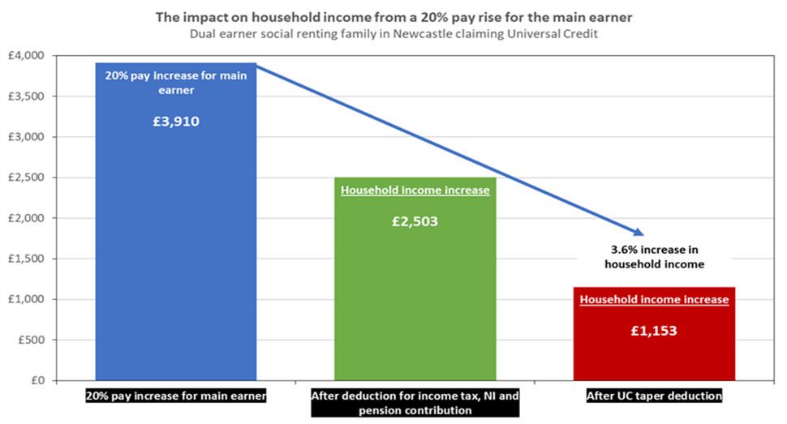
Issue (1) disposable to gross relation for UK low paid given the tax and benefits wedge
Low paid individuals pay more tax and get less benefit (Universal Credit) to top up low wages if they work more hours, get a pay increase or a better job
Example of 2 earner couple with kids: a 20% pay increase for main earner = a 3.6 % increase in household income; because (a) pay tax, social insurance + pension at 35p in £ on gross increase then (b) lose UC benefit at 55p in the £ of post tax income
Long standing UK problem of an effective marginal tax rate of around 70% for low pay households; with inflation for the low paid, it’s a price/wage spiral where they never catch up
Implications:
UK has a major income retention problem which is as important as low wages for the stressed household
Fiscally unsustainable: by the 2010s, 40 % of non –retired households receive more in benefits than they pay in taxes

Slide 6
Issue (2) residual to disposable relation for those with high housing costs
Residual to disposable income relation complicated because housing costs vary by tenure and region in the UK (even when utilities, transport and food do not )
Compare mean household income in two groups pre crisis in 2019: (a) high housing cost group of private renters = 25 % of London households (b) low housing cost group of owner occupiers with no mortgage = 31 % of NE households
London private renters disposable income 79% higher but residual just 23% higher than NE owner occupiers; lower per person as renter households are larger ( £213 vs 264)
Implications:
Tenure matters: social housing + rent control are just as important as wages in determining living standards
High GVA per cap city is a mosaic of living standards: tenure creates household lottery eg 2010s private renters vs London house owners get £ 20 k a year tax free; reinforced by mosaic of residential segregation (2:1 disposable y MC suburb: social housing

Slide 7
Issue (3) Acute crisis of residual income in 2022-3 overlays chronic problems in 2010s
Dramatic squeeze on residual income in 2022 ex rising cost of essentials including petrol and food; UK government “energy price guarantee” now caps average energy bill at £ 2, 500 = nearly twice the average in 2017 -18
Temporarily prevents unmanageable increases in energy bills; basic old age pension is £ 7,376 + 31 % of pensioners have no income from private pensions; winter 23-4 will be the test,
Acute crisis 22-3 overlays chronic problems in 2010s about residual income before Covid + Ukraine; CPI + 22% 2008-15 then + 10 % 2015 -22 with some staples of the poor like electricity + bus fares + 150 -200%
Increasing emergency use of food banks indicates growing household stress with users rising from 26,000 in 2009-10 to 1.9 million in 2019-20 before Covid lock down

Slide 8
(2) Living standards are about more than income

Slide 9
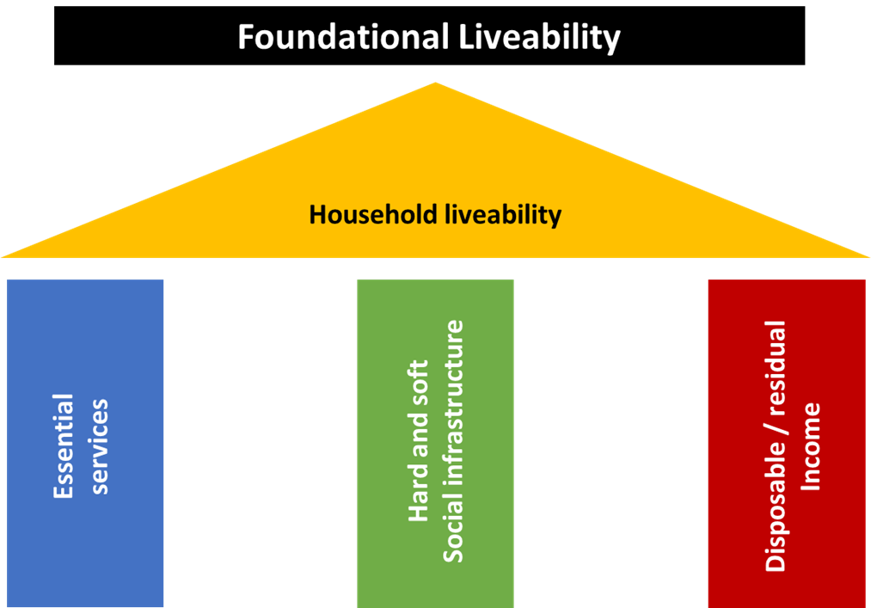
The aim should be household livability with three pillars (but our politics misses the point)
Liveability depends on the alignment of three pillars all individually crumbling because their importance is not registered politically
Essential services Free or subsidised services education, health and care. are crucial. UK households in income deciles 1-5 get more than £13k of benefits in kind. BUT underfunded from taxes because politicians + citizens underestimate the value of their “ welfare state” benefits.
Social infrastructure Parks, libraries and high streets, pubs, clubs and community centres for sociability not sustenance . What all ages want from responses to our community surveys of Morriston and Bleanau. BUT local government does not have the funding surplus to spend on infrastructure without a revenue stream.
Income (not individual gross wages) but household disposable after tax + benefits and residual income after the 4 essentials ( hoiusing, transport, utilities and food). BUT no strategy for managing residual income through tax thresholds, benefit tapers, social housing and rent control

Slide 10
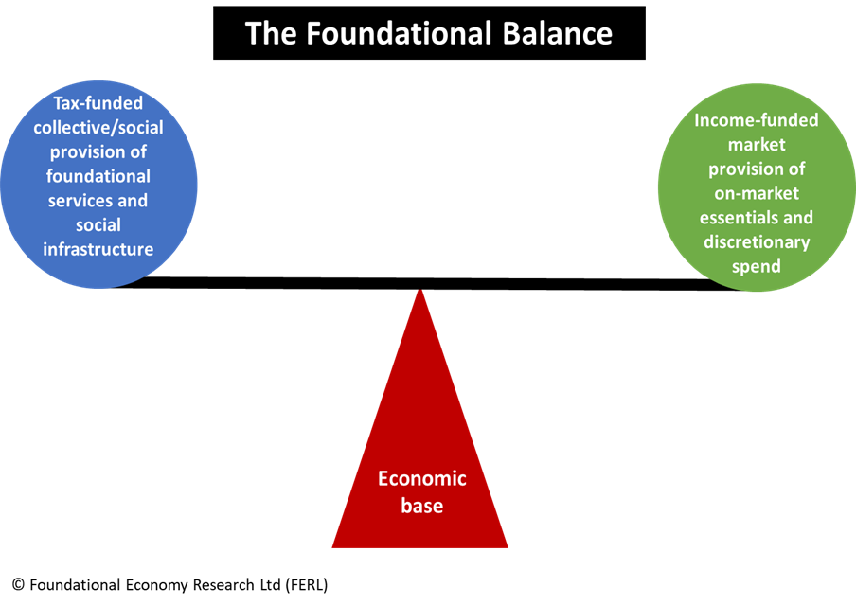
“Nothing works” because foundational balance has been politically undermined
Growth and high wages is about expanding market provision/ private consumption = nearly 2.3rds of UK GDP; assuming taxes on growth would fund public services when trend growth rate is declining.
Outcome = nothing social or private works properly for many households = strikes as symptom
Bottom three deciles had squeezed residual income in 2010s; damaged by sell off of social housing now c. 15 % of housing stock
Middling deciles see residual income now vanishing ; with rising mortgage interest rates, cost of 4 essentials from < 1/2 to around 2/3rds of disposable; plus any child care costs
Top three deciles got private affluence and public squalor: income for marketizing child care, eating out etc. but (outside London ) no private A and E

Slide 11
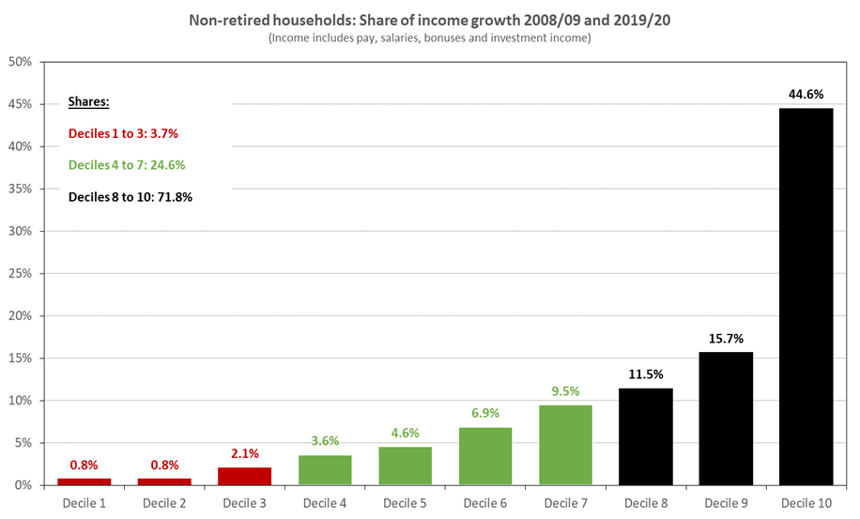
Higher GDP comes in lock step with increasing household income inequality
Higher wages thro higher productivity is the dream of centrist politicians; tho both are stagnating + available policy can’t easily raise productivity
If GDP per capita stagnates, GDP does increase when the workforce increases; hence current concern to get the inactive back into the workforce….
Lock step increasing GDP and increasing household inequality because of basic arithmetic; the different deciles claim similar % increases from any extra income but the upper deciles have a much larger income base; and they always end up with 2/3rds plus of any income growth
eg non retired households + their share of income growth in the 2010s (a) bottom 3 deciles get 4 % of the income increase (b) middle 4 get 25 % and © the top 3 get 71.8 %

Slide 12
Preoccupation with productivity occludes the distributional shift to capital
For centrist politicians + economists increasing productivity is the technicist holy grail; they don’t have policies to deliver but can make wistful counter factual calculations about how much more income we could have if productivity had increased.
The post 1979 power issue which centrists don’t want to talk about = distribution twixt capital and labour + near 10 % shift against labour.
The relevant counterfactual question: how much higher would household gross income be in 2019 if labour’s share of GDP was at the 1976 level of 57.3%?= (a) £7.083 for all households (b) £9744 in gross wages for the 20 million non retired households
Capitals share not recycled equitably to widows and orphans: the distribution of UK wealth (mainly pensions and house property) is twice as unequal as income.
NB a gross income calculation which reminds us we are in politics not economics

Slide 13
(3) Implications for policy and politics

Slide 14
How reset begins: with “adaptive reuse” from where we are at
Politics like other service activities has a front office and a back office: eg restaurant menu/ front office promises v kitchen + supply chain/ limit what ‘s deliverable
The right’s success is about front office promises: opportunist policies = whatever animates a superficial, inattentive and disorganised electorate to capture office
Centre left needs prior attention to back office processes if it’s exercise of power is not to end in disappointment; needs a politics of finding a way round constraints towards what’s deliverable and how
FE starting point
End/ aim is rebuilding liveability in a country where low incomes cannot be abolished, free low incomes from the disadvantages of poverty/ make low incomes more liveable which moves us towards good life for all
Means/ “ adaptive reuse” ie gradualist approach of work arounds starting from where we are at: what French architects Lacton + Vassal term adaptive reuse; which overlaps with the Levi Strauss idea of bricolage or the Japanese factory practice of kaizen;
Not the big picture vision of a different future but ways of working which engage system or place specifics and deliver meaningful improvement

Slide 15
What the central state can do directly : starter and stealth policies
After 50 years of “vote for us and we will fix the economy for you”, don’t expect too much, too quickly, too irreversibly from the central state:
Internal limits: Labour’s “ director of strategy” is a pollster/ Deborah Mattison; new policies so far = remixes with regions delivering on central objectives eg the Brown commission on local economic clusters or now the return of “public service reform“
External constraint: delivery limited by incapacity of run down Whitehall and L. A government machines; constraints on fiscal expansionism, monetary policy is with the B of England, trade deficit empowers financial markets….
But don’t discount UK central state which controls many levers + and has opportunities for direct workaround:
Starter policies playing on fairness + making connections: eg free school meals for primary children or real living wage for English care workers or establishing social insurance as hypothecated tax (equivalent of wedge policies for radical right)
Stealth policies for public good in areas of confusion eg changing tax thresholds + benefit tapers so the system is less predatory for the low paid

Slide 16
What the central state can do indirectly: switch policies which empower other actors
Switch policies are about empowering other actors to do what the central state cannot
Empower trade unions by repealing anti –union legislation and encourage trade union organisation; change the balance of forces between workers and employers so that workers could bargain for better wages from private and public employers (while the central state reformed the tax and benefits system to advantage lower income households).
Empower bottom up initiative + social innovation at the lower levels of multi level politics; in the mayoral cities + Wales + Scotland so top down meets bottom up
If national + regional government + local authorities recognise what they can and cannot do:
can’t do: risk investment even in utilities (eg Nottingham + Bristol disasters in municipal energy) show councils don’t understand business models and have inadequate governance
can do : in a world of splintered political agency Labour can act in alliance + sponsor social innovators inside and outside government.

Slide 17

But there are reasons to be cheerful (at least in Wales)
Ferment of non-governmental actors doing social innovation from Clwyd Alyn Housing Association on food deserts to Health Boards doing “grow your own” work force development
Local Authorities + Welsh Government: Gwynedd is tackling care reform; Welsh Government has experimented with new ways of working with stakeholder deep dives on afforestation and towns
Welsh Government is now going to review all its policies, starting with food and care. The review template has 3 objectives on liveability, the FE provider base + sustainability
“To achieve liveability for households through safeguarding residual income and developing foundational services”
Through three ways of working: Engage system or place specifics, get evidence, mobilise alliances for change inside and outside government
The Welsh do not have a prefigurative model but have started out on a narrow pathway

