Slide 1


HOUSING FOR AN AGEING POPULATION – FINDING SOLUTIONS FOR A ‘NOW OR NEVER’ MOMENT
‘AGEING WELL FOR ALL’
TUESDAY 4TH JULY 2023
Perspective from Abdul A Ravat
Involved with various providers, partners & organisations

Slide 2
Presentation will cover:
My journey into housing and in particular elderly provision
Current housing, care and support options against the backdrop of an ageing population
The Abbeyfield Society – examples of schemes development and actual delivery
Is housing responding to the diverse needs of older communities? – insight from the 2021 Census data
The big questions & Project X
Q&As

Slide 3






































































Slide 4
Housing Providers

Slide 5

Research Consultancies & Academia

Slide 6
Government Department, Agencies & Associations

Slide 7
Faith & Community Based Organisations

Slide 8
Press & Media

Slide 9
Private Sector Partners & Others

Slide 10
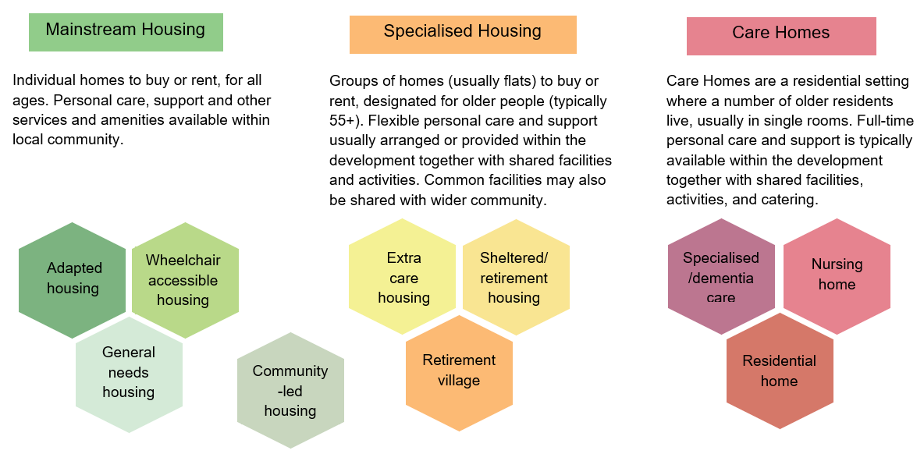
Housing options overview

Slide 11
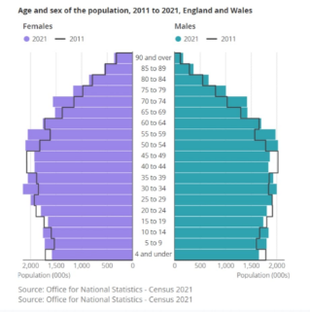
Age & gender of the population, 2011 to 2021, England & Wales

Slide 12
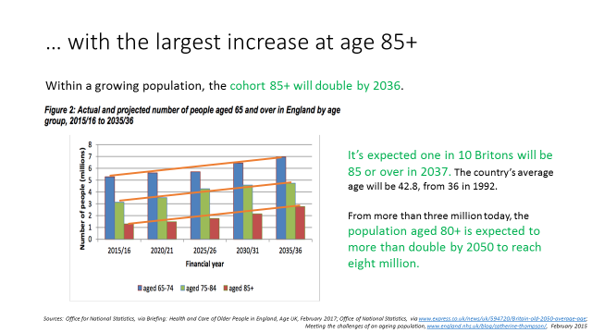
Growth in the elderly population

Slide 13
Proportion of older person Housing Association stock
General needs rent | 2,216,659 | 78.0%
Housing for older people rent | 262,072 | 9.2%
Supported housing rent | 140,323 | 4.9%
Low cost home ownership | 223,546 | 7.9%
Total | 2,842,600 | 100.0%
Source: RSH Social housing stock & rents 2022

Slide 14
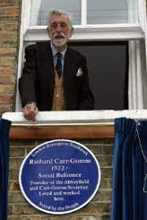
Founder of Abbeyfield – Richard Carr-Gomm
Major Richard Carr-Gomm, OBE
(2nd January 1922 – 27th October 2008)
Married for over 50 years and had 5 children.
Having served in the Royal Berkshire Regiment and the Coldstream Guards for 16 years, he resigned to volunteer and become the first male home help.

Slide 15
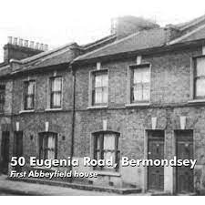
Where it all began
During this period Richard realised that the people he was looking after were often lonely and he wanted to provide them with support and security.
Richard decided to spend his Army gratuity on the first Abbeyfield house located in Bermondsey, East London – 50 Eugenia Road.
Soon after purchasing the first home, Richard invited two residents to move in, he had purchased five more properties and formally set up The Abbeyfield Society in 1956.

Slide 16
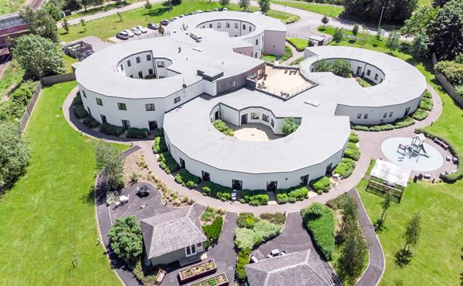
Where are we today
Today Abbeyfield has over 400 homes in the UK with more in Australia, Belgium, Canada, Jersey, South Africa and new Zealand all with committed staff and volunteers delivering the Abbeyfield vision to over 7,500 residents.
From Richard’s kindness, generosity and goodwill, he has helped to change the lives of thousands of people and will continue to well into the future.

Slide 17
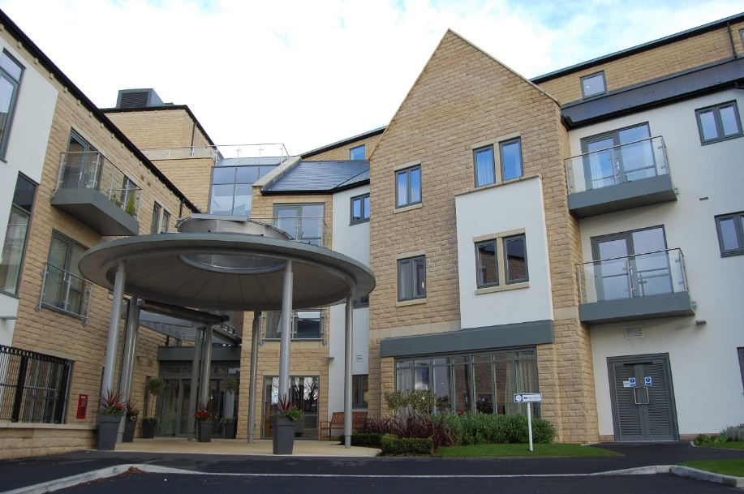
Abbeyfield The Dales, Bingley, West Yorkshire
47 Extra Care
30 Dementia rooms
Associated services on former Bingley Hospital Site
Start on site: October 2014
Completion: Spring 2016
Occupation: Summer 2016
Total Scheme Cost: £14.80M

Slide 18
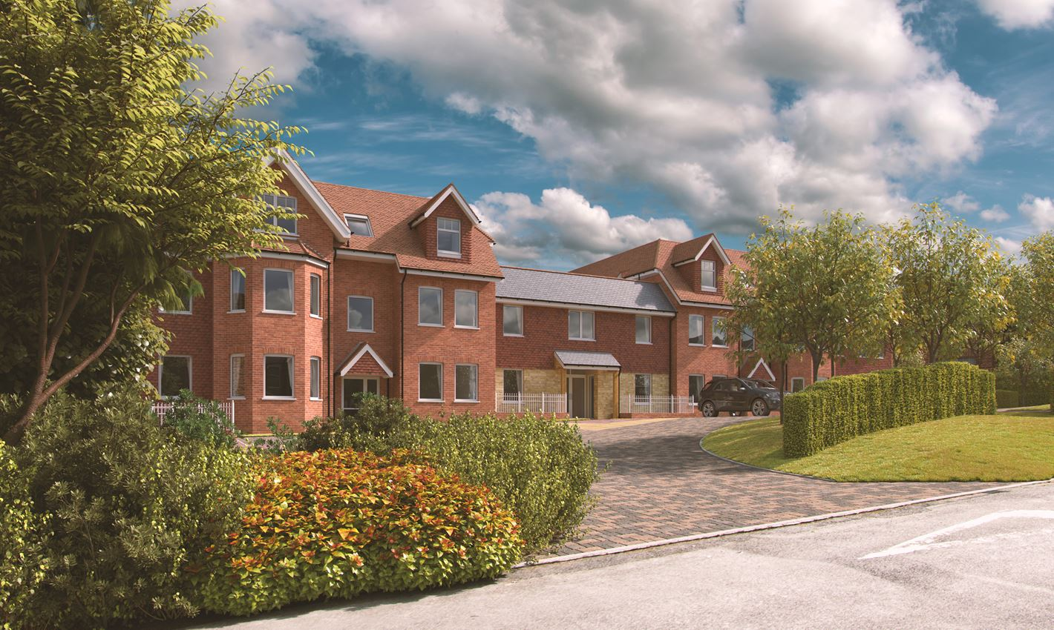
Abbeyfield South Downs, Holdenhurst
48 Extra Care -
  24 x 1 Bed
  24 x 2 Bed
Start on site: August 2019
Full Completion: April 2022
Occupation: Spring 2022
Total Scheme Cost: £13M

Slide 19
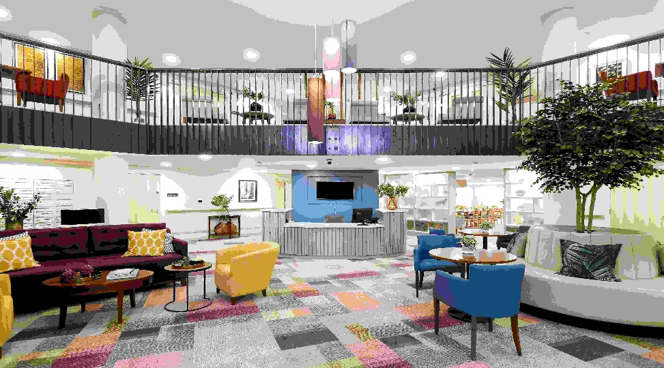
Southern Oaks & Nonsuch Society, Ewell, Surrey
47 independent Extra Care apartments
  36 x 1 Bed sale
  24 x 1 Bed affordable
Start on site: January 2017
Completion: Scheduled for 2019 actual January 2020
Occupation: From Spring 2020
Total scheme Cost: £18M

Slide 20
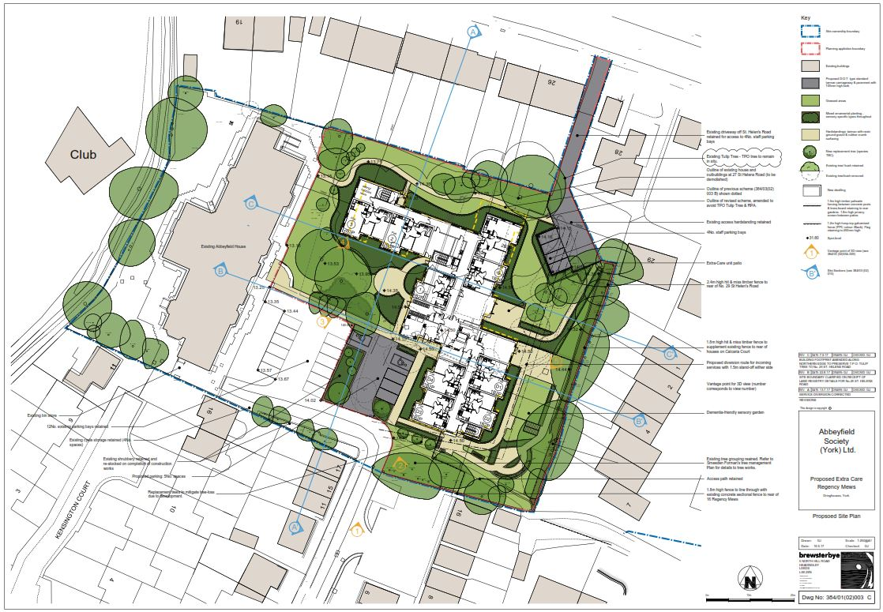
York Society, Regency Mews
25 Extra Care apartments
19 Social Rent Units
  6 x 1 Bed Dementia Units
  6 x 2 Bed Sale Units
Start on site: October 2020
Completion: December 2023
Occupation: January 2024
Projected Cost: £7.1M (£5.1M build contract)

Slide 21
Change in the age breakdown of BAMEs over the age of 55 according to 1991, 2011 & 2021 Censuses
BAME people aged 55 + from 1991 Census
BAME people aged 55 + from 2011 Census
BAME people aged 55 + from 2021 Census
18%
75 and older
55%
55 to 64 years old
28%
65 to 74 years old
N= 1,570,989

Slide 22
BAME people 75 years and older, 1991 to 2011
Source: Simpson, 2013

Slide 23
BAME people 75 years & older, 2011 to 2021
76,106
77,118
50,000
32,739
17,096
9,925
12,239

Slide 24
Housing Deprivation 2011 & 2021 Census
Ethnic Group | Age Band | 2011 | Census | 2021 | Census
 |  | NO | % | NO | %
White British | 50 - 59 | 18,234 | 6% | 359,606 | 5%
 | 60 - 69 | 13,492 | 5% | 192,275 | 4%
 | 70 - 79 | 8,963 | 5% | 117,322 | 3%
 | 80 and over | 7,750 | 7% | 67,623 | 3%
BAME | 50 - 59 | 8,371 | 20% | 232,706 | 21%
 | 60 - 69 | 3,071 | 14% | 90,102 | 15%
 | 70 - 79 | 1,916 | 14% | 33,210 | 12%
 | 80 and over | 710 | 13% | 19,099 | 12%

Slide 25
Housing Deprivation
 | Age | Housing Deprived
White British | 50-59 | 18,234 (6%)
 | 60-69 | 13,492 (5%)
 | 70-79 | 8,963 (5%)
 | 80 or over | 7,750 (7%)
BAME | 50-59 | 8,371 (20%)
 | 60-69 | 3,071 (14%)
 | 70-79 | 1,916 (14%)
 | 80 or over | 710 (13%)
Noronha (2019), Housing and the older ethnic minority population in England, Race Equality Foundation

Slide 26
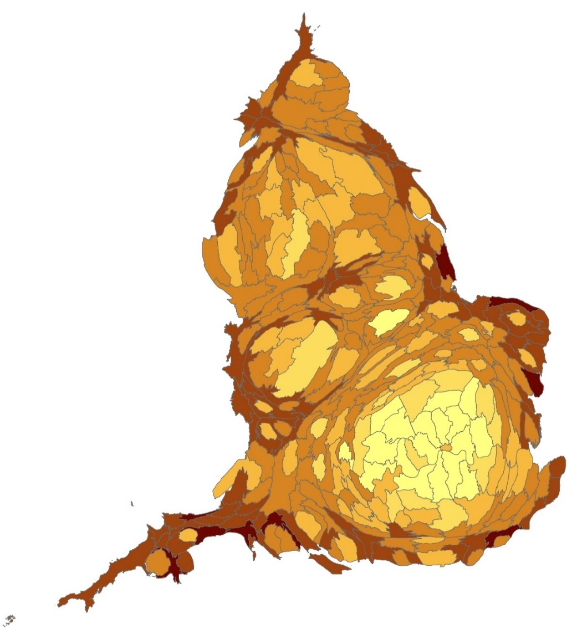
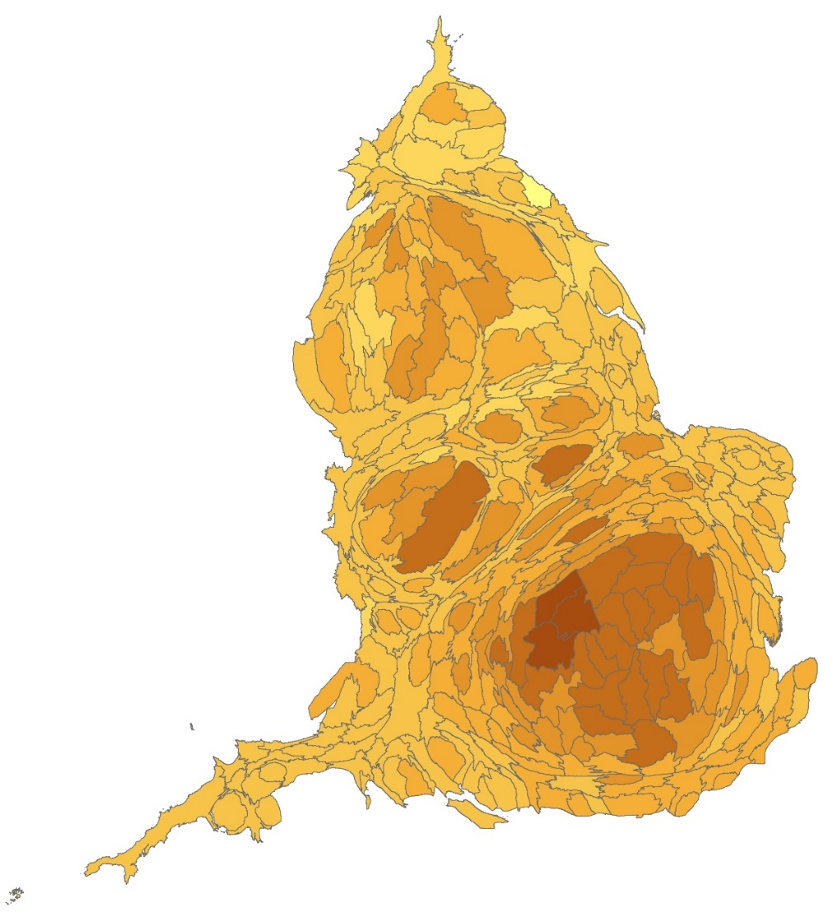
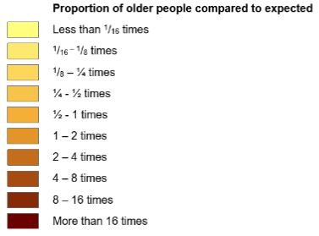
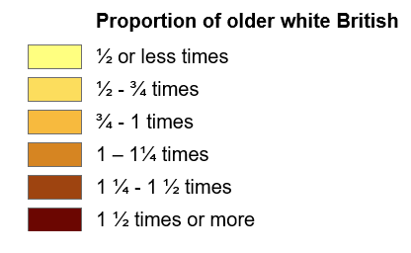
Concentrated in urban areas …
Standardised comparison of BAME over 50s by LAs
Source: standard 2011 census table LC2109EW (ONS, 2013)
Standardised comparison of White British over 50s by LAs
Source: standard 2011 census table LC2109EW (ONS, 2013)
Noronha (2019), Housing and the older ethnic minority population in England, Race Equality Foundation

Slide 27
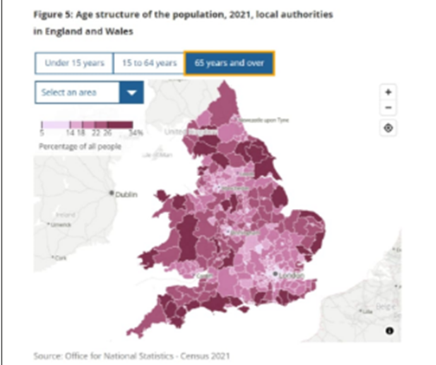
Age structure of the population, 2021, LAs in England & Wales

Slide 28
“We noted the growing numbers of older people in BAME communities. We believe the old assumption that people from BAME groups look after their older parents / grandparents at home is an oversimplification, it can no longer be expected that extended families will take on the sole responsibility for their relatives with dementia as they themselves grapple with the demands of contemporary modern life.
Quote From Lord Richard Best As Part Of Housing & Dementia APPG Report ‘Are we Ready’
“We urge local authorities to identify clearly the requirements for older people's housing that include those from minority communities and, through planning powers in collaboration with adult social care and housing services, seek to ensure these needs are met in a culturally and sensitive manner to avoid complete isolation.”

Slide 29
The big question: transforming our homes and communities
Final Thoughts:
Having a clear national focus for older people promoting awareness and changing attitudes to later life
Planning for an ageing population in existing outdated sheltered schemes as well as in new provision
Delivering and enabling new housing for older people across the public and private sectors and for all communities
Promoting an integrated approach to housing, care and health. More fundamental transformation of budgets and the breakdown of silo working – Joint Task Force.
Sustaining older people in mainstream housing, that promotes mixed communities and intergenerational housing – Project X

Slide 30
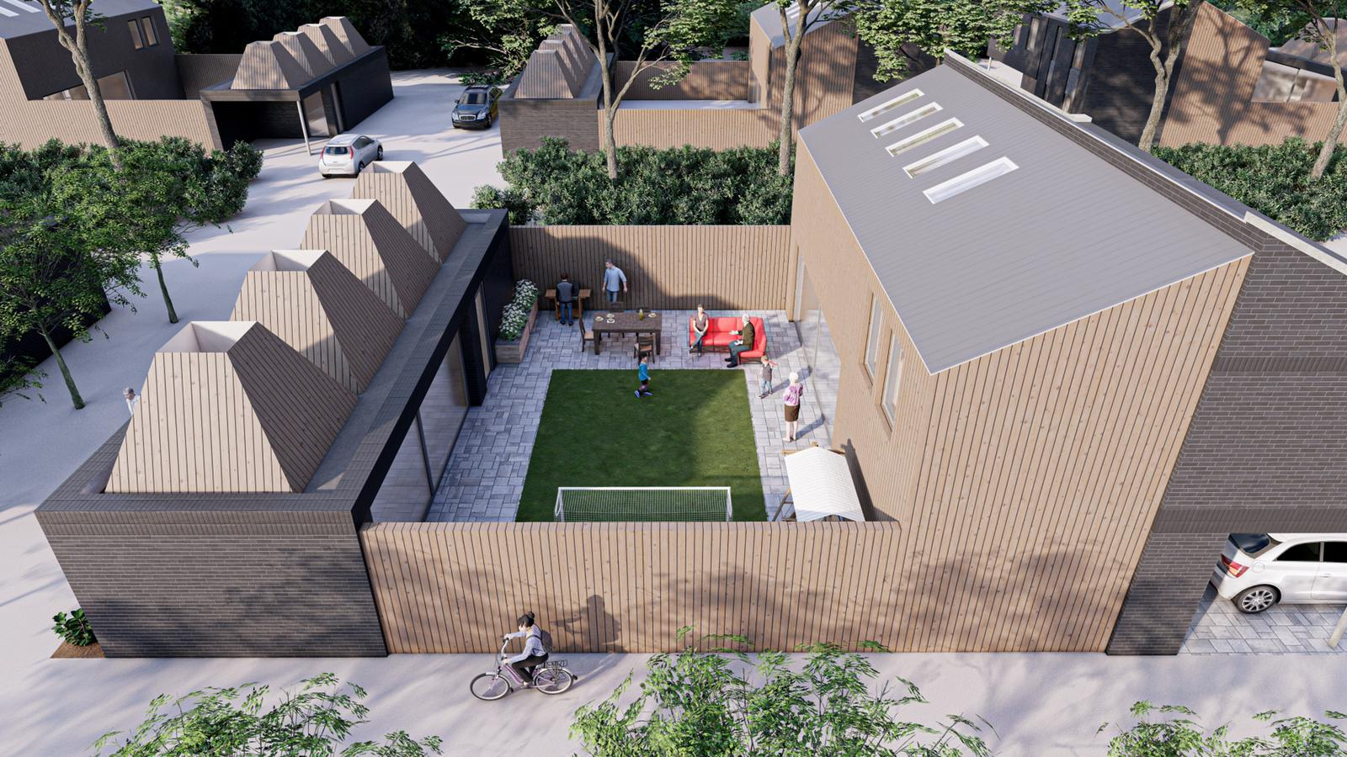
Project X:

Slide 31
Project X:

Slide 32
Thank You
Abdul A Ravat
E: a.ravat@abbeyfield.com
M: 07766 421 123

