Slide 1

Who is the Boss? Women in the app-based transport sector in Spain
Belen Martinez
CRESR – Sheffield Hallam University
b.martinez@shu.ac.uk

Slide 2
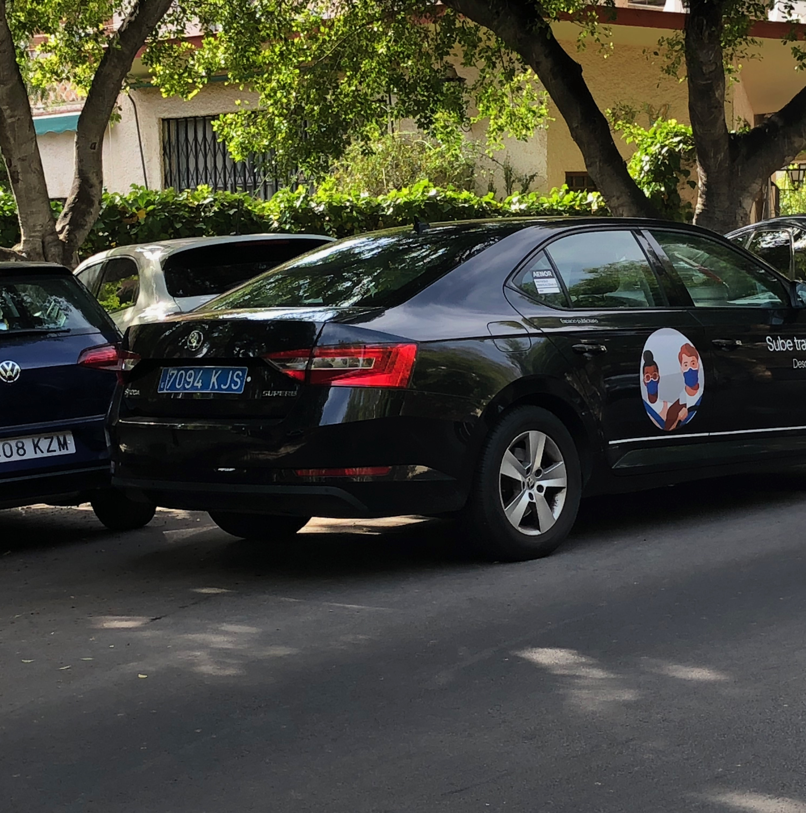
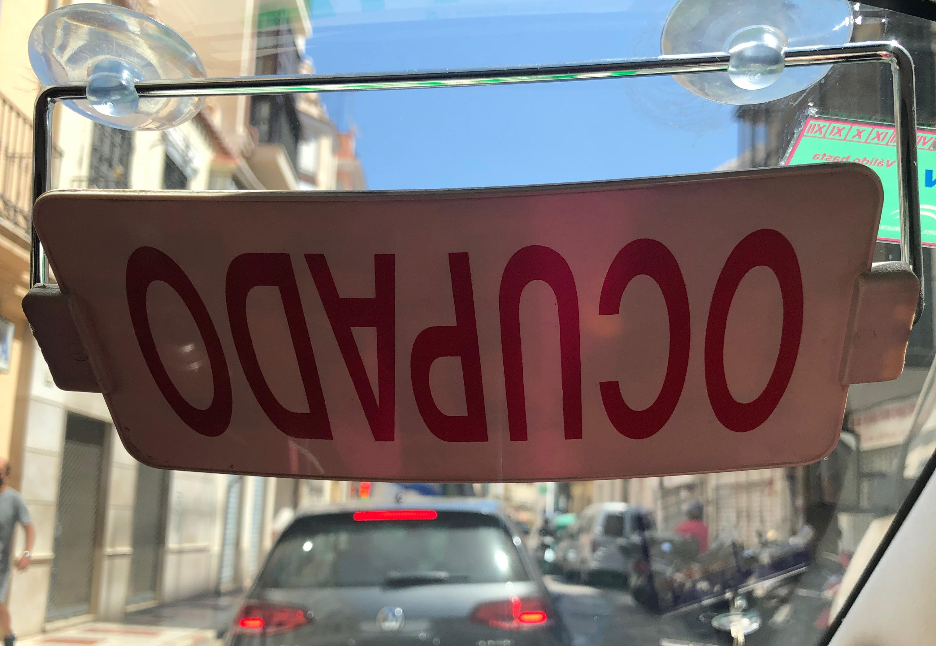
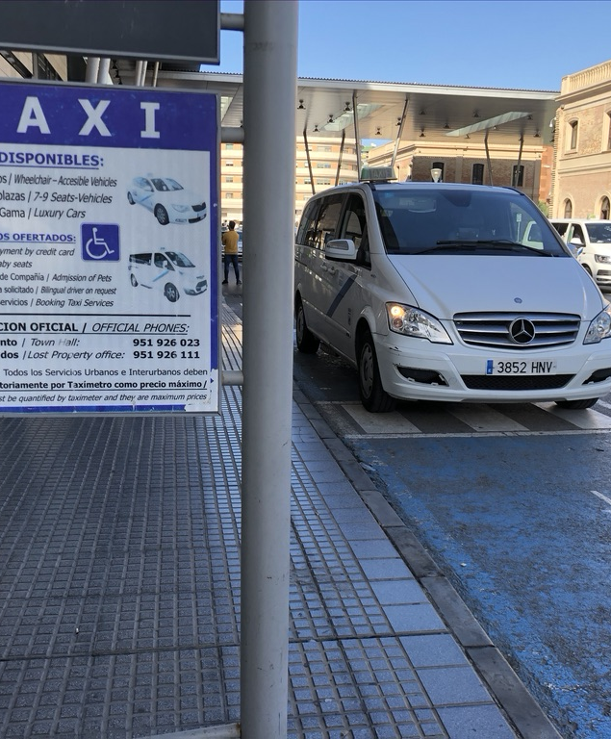
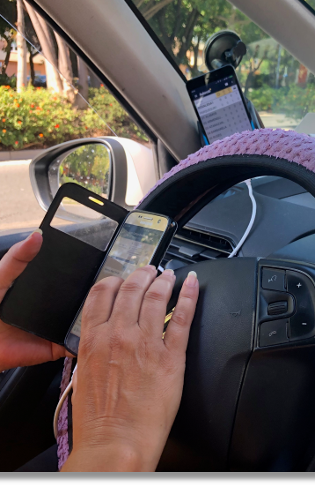
Introduction
Doctoral thesis (2024):
¡Mujer y taxista!
Analysing the experiences of women in Malaga’s male-dominated passenger transport sector

Slide 3
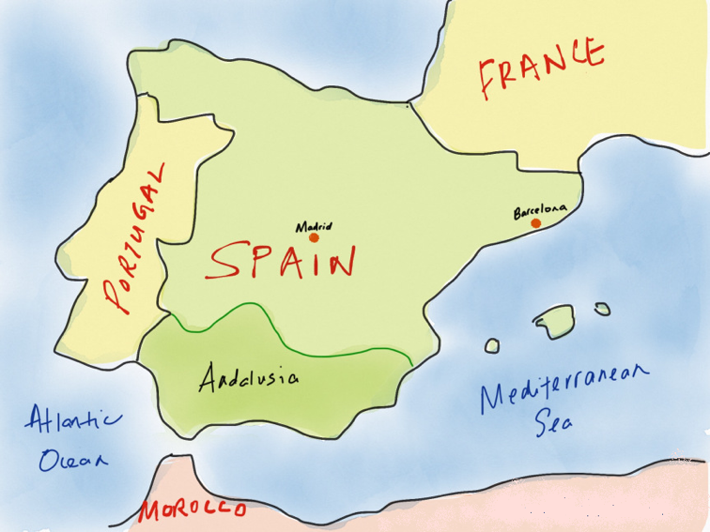
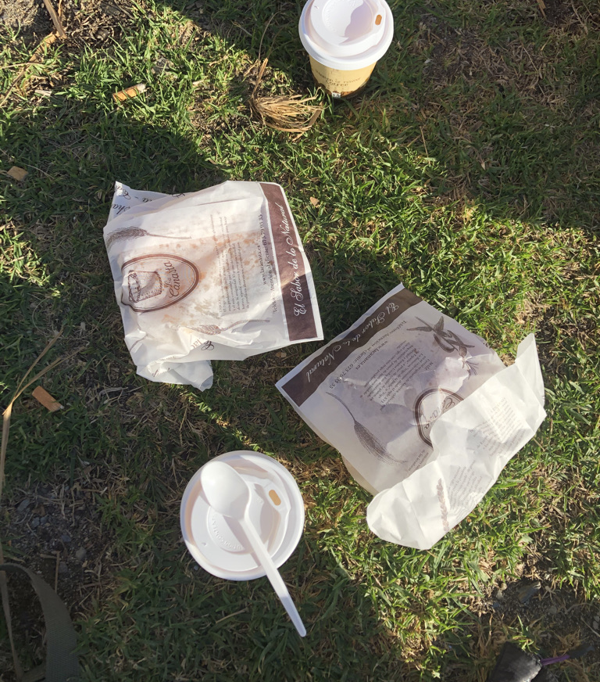

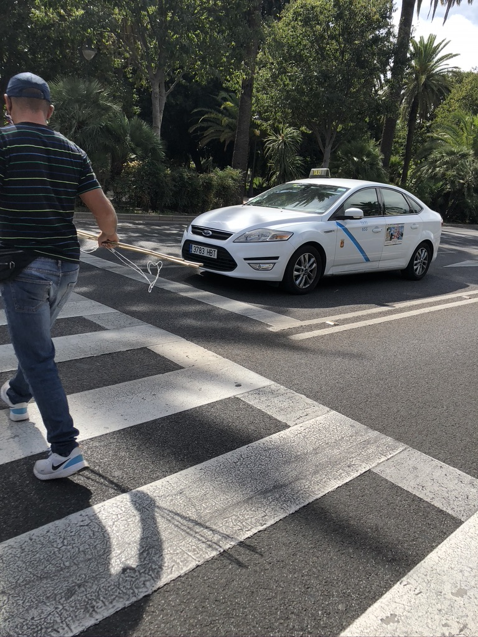
Location: Málaga
Capital of Costa del Sol
Fifth city in Spain in economic activity
Primary economic sector: tourism
2024: 2,720 taxis, 1,357 PHV (Uber, Cabify)
experiences in the field
10 months (2020-2021) ethnographic research
Mobile urban workers
Covid
35 participants (20 taxistas, 8 Uber, 7 Cabify)

Slide 4

Women platform workers
Uber/Cabify sector
Women drivers
Opacity in the sector
Fleet partners
Participants were employed by a third company
Drivers are employees
3 months – 4 years in the sector
Working in 12-hour-shifts, 6 days a week
App-based
“By law, you can’t just wait on the street for a fare to come. In reality, we do. But it makes me feel like a bandit from the Wild West.”
Puri, 4 years as Uber driver

Slide 5

Employment opportunities
Reasons to enter the sector: unemployment, unstable jobs (platform work = last resort); escape from routine and limiting jobs (i.e. health care, care of elderly)
Recruitment process (vs impersonal recruiting mechanisms): “They asked me very different questions” (Patricia, Uber driver) vs information sessions
Women are mainly hired in high-demand seasons – Covid-19 impact
Port of entry to new sectors/activities: taxi, driving instructor, BlaBlaCar

Slide 6

Who is the boss?
PATCHWORK LABOUR REGIME: Complex scheme where online and offline practices overlap
DOUBLE MANAGERIAL MECHANISMS – Who is the Boss?
ANTI-FLEXIBILITY PARADIGM
SURVEILLANCE & CONTROL: appearance, ratings, drivers’ metrics

Slide 7
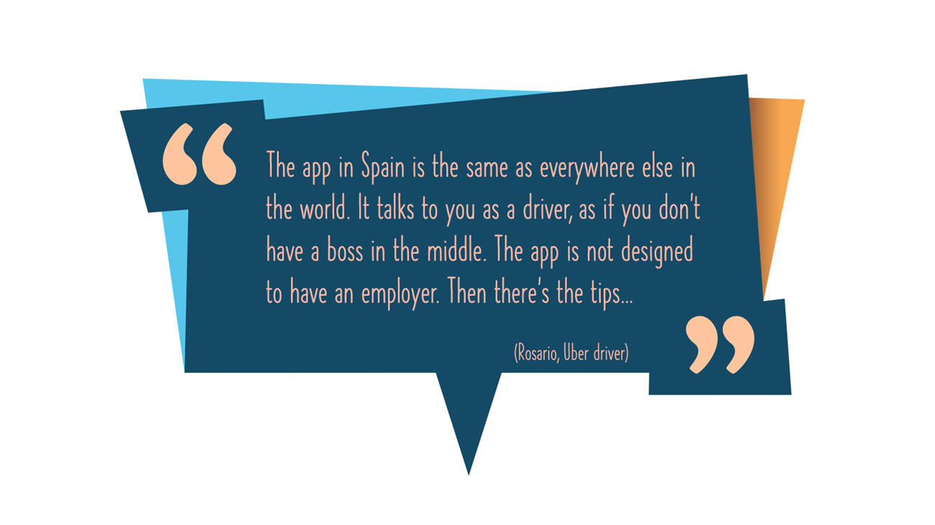

Slide 8
Concluding remarks
Platforms help increase women’s presence in typically male-dominated activities, such as ride-hailing services, which constitute progress in occupational numbers and gender segregation.
Female workers in digital labour platforms continue to struggle against invisibilities, precariousness, inequalities in access to work and wages, and lack of control and autonomy over one’s work.
Platform's control persists even if platform workers become employees.
Formality and regulation do not fix everything. Given that the algorithms play a central role in disciplining the workers, there is no scope for workers to bargain, challenge, or influence the system, and hence, there is no scope to negotiate with platforms or clients.
There is a need for more woman-centric platforms with more personal relationships between management and workers.

