Slide 1
Interrogating ‘Inclusion’ and ‘Empowerment’ : Women’s experiences in the ‘Gig’ Economy in India
Dr Kaveri Medappa
Postdoctoral researcher in Human Geography
University of Oxford
Notes:
examine, informed by the everyday experiences of women doing app-based work, how they sit alongside these widely prevalent discourses associated with women’s participation in the gig economy.

Slide 2


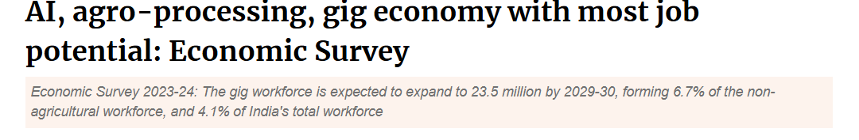
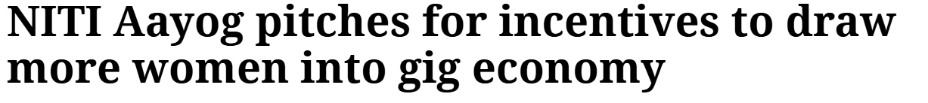


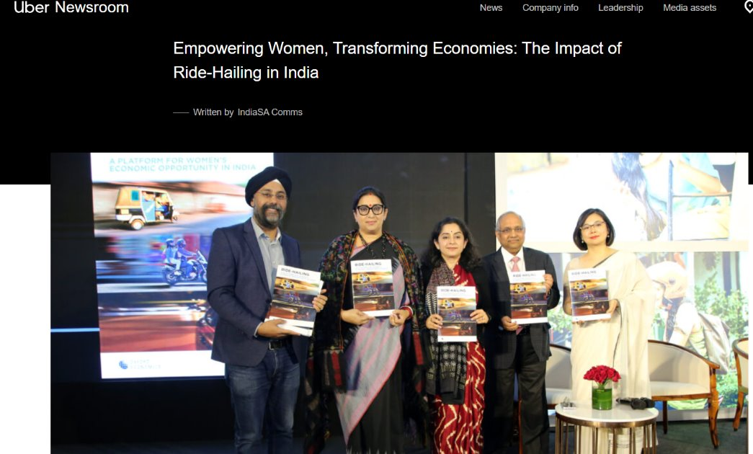
The ‘Gig’ Economy in India
Notes:
Just going to quickly situate the gig work in a broader political economic conjuncture in India. Startups and digital platforms occupy a prized place in the visions for development and economic progress in India. Our current PM, who’s right wing nationalist party have been in power for more than 10 years now, clearly loves startups. A powerful discourse that equates all things digital with development and progress. Demographic dividend but high rates of unemployment especially amongst educated youngsters – no plan to create jobs, startups like Uber (now a public company) are pitched as providing people work. Skill training and tie ups with private automobile companies to offer loans to youngsters to enter platform-based driving. More recently, calls for more women to enter taxi driving to create safer cities – last poster. So these are some of the broad discourses associated with the gig economy, women’s participation in it and the state and industry intervention to encourage more workers into it. But what are the everyday experiences of women workers catering these safe rides and food to more affluent customers? My focus – cab drivers and food delivery workers (less discussed in lit).

Slide 3
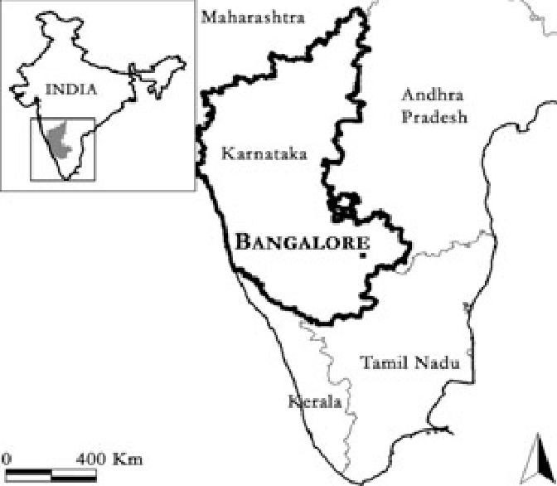
Research Background
Women's experiences in male dominated sectors of work: cab driving and food delivery services
Ethnographic research: June 2019 to March 2020 in the city of Bengaluru
10 women – 6 cab drivers and 4 food delivery workers (part of a larger study on 'gig' worker experiences in Bangalore, India)
Ages: 20 to 40; 5 of them bachelor’s degree holders
How they negotiate the everyday risks and dangers of mobile ‘gig’ work in the city
How do they relate to widely prevalent discourses of 'gig' work ushering in 'empowerment', 'inclusion' and 'equality'?

Slide 4
Labouring for Platforms
Negotiating the everyday risks and dangers of platform work
Dis-intermediation by Platforms: Mediation by informal support networks
Being ‘out of place’ – Risks to respectability and the risks of sexual harassment
Physical risks – bearing the costs of customer satisfaction
Platforms constructing women workers as a liability
Shielding women from financial liabilities - mediation by charity organisations
Notes:
Dressing like a boy, cutting hair really short, and covering oneself from head to toe to avoid attention to oneself among young single women. Customer obsession – encountering their subordination to customer satisfaction; differences between men who had greater access to support systems; safe cities for women but what about my own safety? Digital intermediation allowing no space to negotiate terms of work and remuneration linked to customer ratings and gamified remuneration schemes. Platforms also used digital surveillance mechanisms for families to track women workers and in case of mobile forms of work had explicit and implicit curfews. Swiggy auto log off at 6 pm. Uber and Ola advice women to go home by 7 or 8 pm.
Informal support groups – the workings of apps – food delivery the youngest person teaching older women; Family members accompanying women on work to prepare them for work; Uber for all its talk of empowerment – refused to let women access cars and refused them a secure salary; intermediation by an international charity but soon the deal fell apart. Uber not interested in intervening.

Slide 5
Key Takeaways
Caste, class identities and marital status shaping women's access to platform work
Informal labour relations, absence of physical infrastructure and meaningful state interventions to address power inequalities in platform work: policy push for ‘gig’ work dis-embedded from the socio-cultural workings of gender relations
Remuneration for a gig and not for the time spent at work leading to dissatisfaction among women
'Empowerment', 'Inclusion’: Women being made more responsible to provide unpaid and paid work to sustain families (Young, 2010)
A growing consciousness of being 'used’ - questioning 'pinkwashing' campaigns by platforms and their customer-centredness - and the mobilisation of women ‘gig’ workers in India.
Notes:
2. Except one of the women participants who works for a charity driving a mobile library, all the other participants quit ‘gig’ work. 3. Despite some arrangements struck by third parties such as charities, valuing one’s labour per ‘gig’ and not time spent at work has made women leave gig work. While men can stretch work hours to squeeze in ‘gigs,/tasks, unpaid care work responsibilities that women shoulder doesn’t let women do the same..so aligns with neoliberal, depoliticised understandings of empowerment and inclusion that as Stephen Young in the context of microfinance lending for women says simply means that women are…thus this did nothing to alter gendered societal norms, gender inequalities both at and outside of work…However, ….

