Slide 1

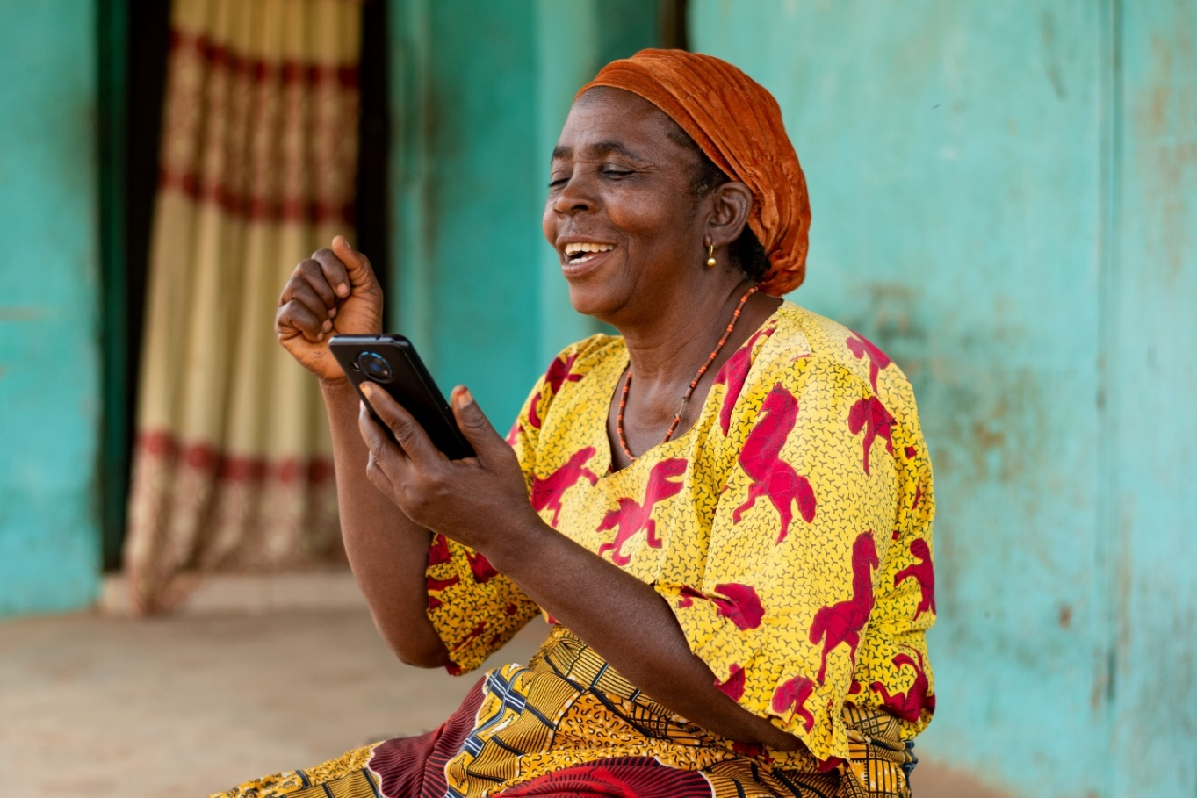
Platforms of precarity
Women's economic rights and the gig economy
February 2025
Presenter - Natalia Rodriguez-Malagon
Collaboration- Rachel Noble, Catalystas Consulting, Cecilia Cordova Liendo, Wangari Kinoti, Pranita Choudhry, Fatima Kelleher, Ana Alcalde, ActionAid colleagues from Brazil, Guatemala, South Africa, Ghana, Kenya, Vietnam and Bangladesh among others.
Notes:
Introduction
Title
Aknowedgements

Slide 2
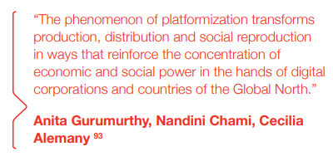
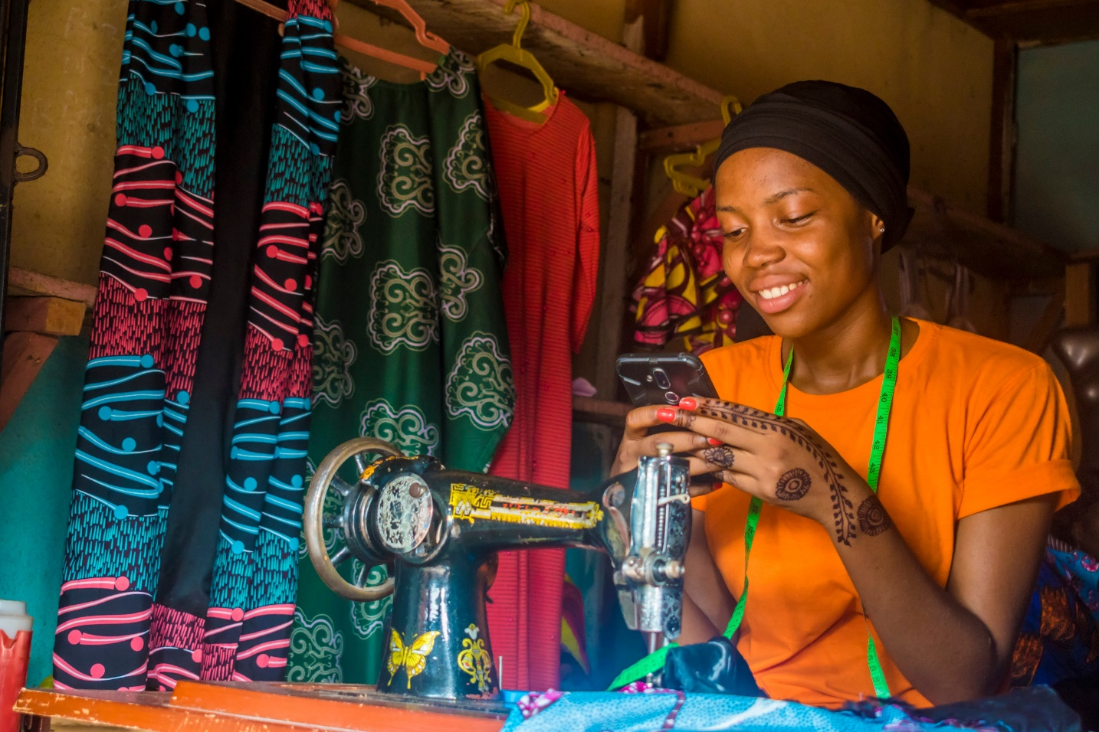
The rise of the gig economy and the Fourth Industrial Revolution
The digitalisation of our globalised economies is intensifying at an unprecedented rate
Governments are rolling out strategies aimed at harnessing the opportunities digitalisation can create, including in the world of work
As a lack of decent work opportunities continues to wrack the global economy millions of workers are signing up to online platform applications (‘apps’), as a means to seek a livelihood
Wider context: current dominant economic paradigm
Covers 7 countries (Ghana, South Africa, Kenya, Brazil, Guatemala, Bangladesh and Vietnam) across 3 global regions
Notes:
Pranita

Slide 3
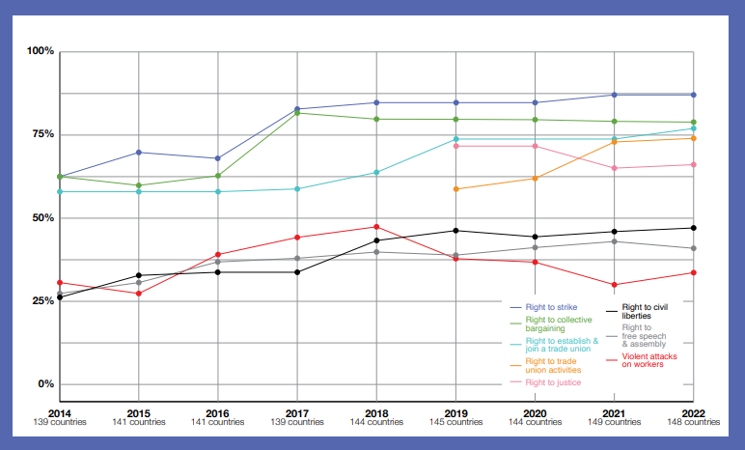
Credit: ITUC
Wider decline in workers’ rights
Notes:
Pranita

Slide 4
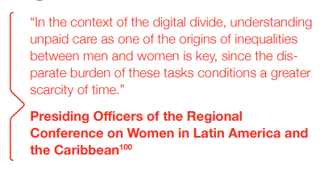
Intersectional digital divide
Digital divide determined by different factors such as gender, race, class, caste, language, migrant status, literacy and location
In many contexts, girls are denied access to education
Patriarchal norms which assign women and girls a greater share of unpaid care work than men curtail their time to engage in educational and training opportunities
Women and girls face constraints on their freedom of movement and control over economic resources and decision-making
An intersectional digital divide means that large numbers of women remain excluded
Notes:
Pranita

Slide 5
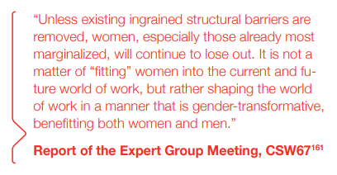
A fair gig for women?
New work opportunities - positive and empowering
Marginal increase in female participation in male-dominated sectors, such as ride-hailing and delivery
Greater sense of professionalization
Perceived benefits of such work include flexibility (67%) and an increase in income (46%)
There are numerous national or city-level companies, some of which provide better pay and conditions than larger platforms
Location-based platforms are creating new opportunities for paid work for some women. However, the broader picture is less positive:
Narratives of independence, flexibility and economic empowerment pushed by some companies and global financial institutions often mask conditions characterised by informality, precarity and lack of corporate accountability
The gender, class and race-based exploitation women face in the traditional world of work are significantly replicated, whilst new forms of discrimination and corporate control have emerged
Misclassification of workers perpetuating informality
Algorithms that penalise for unpaid care work and GBV
Notes:
Pranita

Slide 6
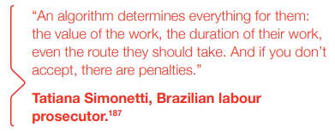

CASE STUDY 1: Ride-hailing and delivery
Because of contexts of violence fewer women sign-up as drivers and, when they do, drive fewer hours.
This has led the creation of several women-only ride-hailing and delivery platforms.
High costs needed to obtain a driving licence, purchase and maintain a vehicle, and pay for smartphone and data costs.
Women who work in this sector are unlikely to be enjoying decent working conditions
Simplistic narratives of women’s economic empowerment
Tax avoidance compounding gender inequality
Notes:
Pranita

Slide 7
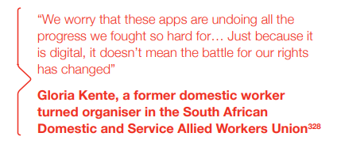
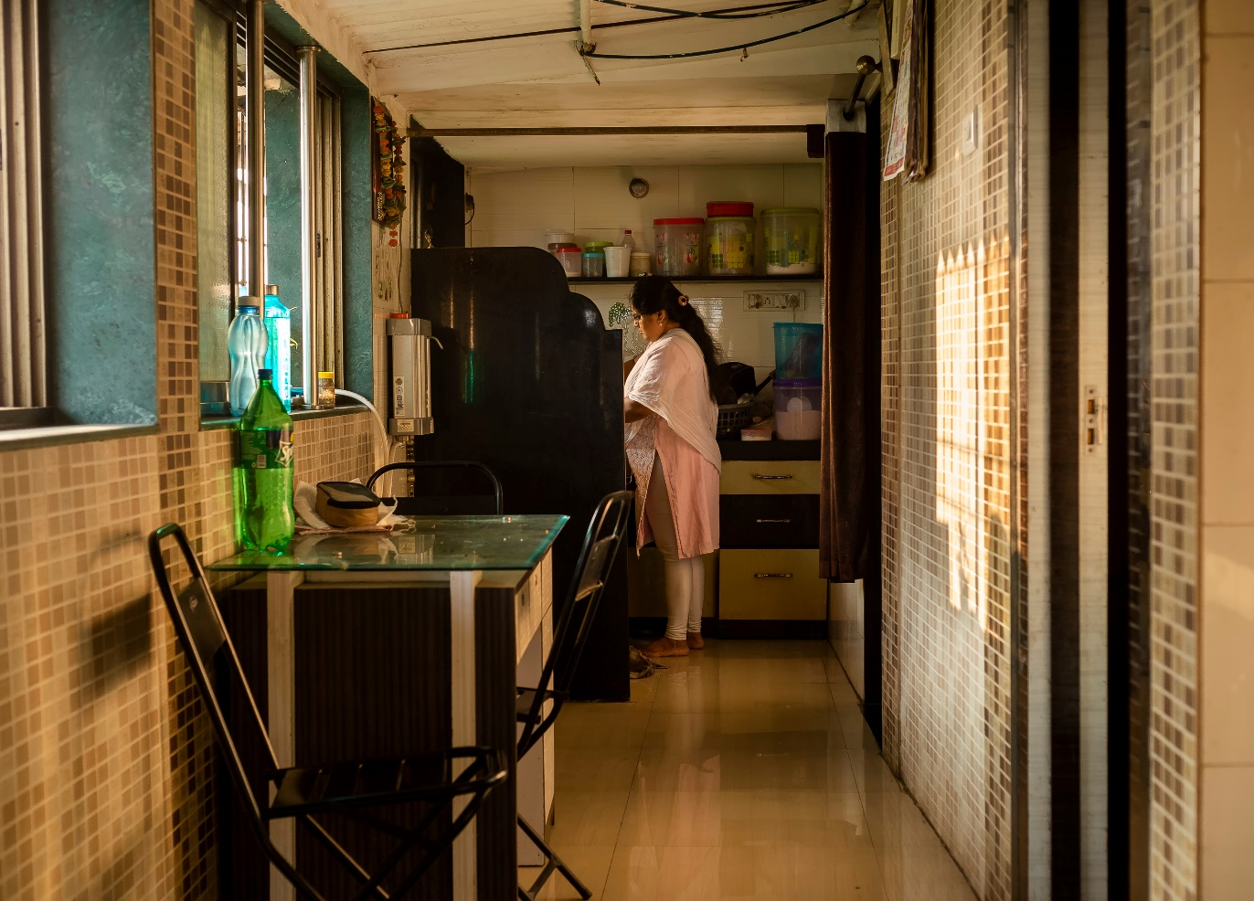
CASE STUDY 2: Domestic and care work
Domestic workers – the vast majority of whom are women, and many of whom are internal or international migrants – face some of the most punishing forms of marginalisation and discrimination in the world of work.
Intersecting forms of discrimination
Particularly hard-hit by the Covid-19 pandemic
Far less attention has been given to the platform care economy than ride-hailing and delivery
Replication of injustices in the traditional domestic work sector
Notes:
Pranita

Slide 8
Bangladesh: As of August 2021, HelloTask had 2,000 active female domestic workers enlisted in its platform, of which 2% identify as disabled.
Vietnam: JupViec offers liability and health insurance to its workers, but only to those it classifies as “high performing
Ghana: HelperChoice is a Hong Kong-based ‘social impact startup’ focusing largely on women migrating internationally to undertake domestic work.
Initiatives promoting
decent work for platform
domestic workers
Notes:
Pranita

Slide 9
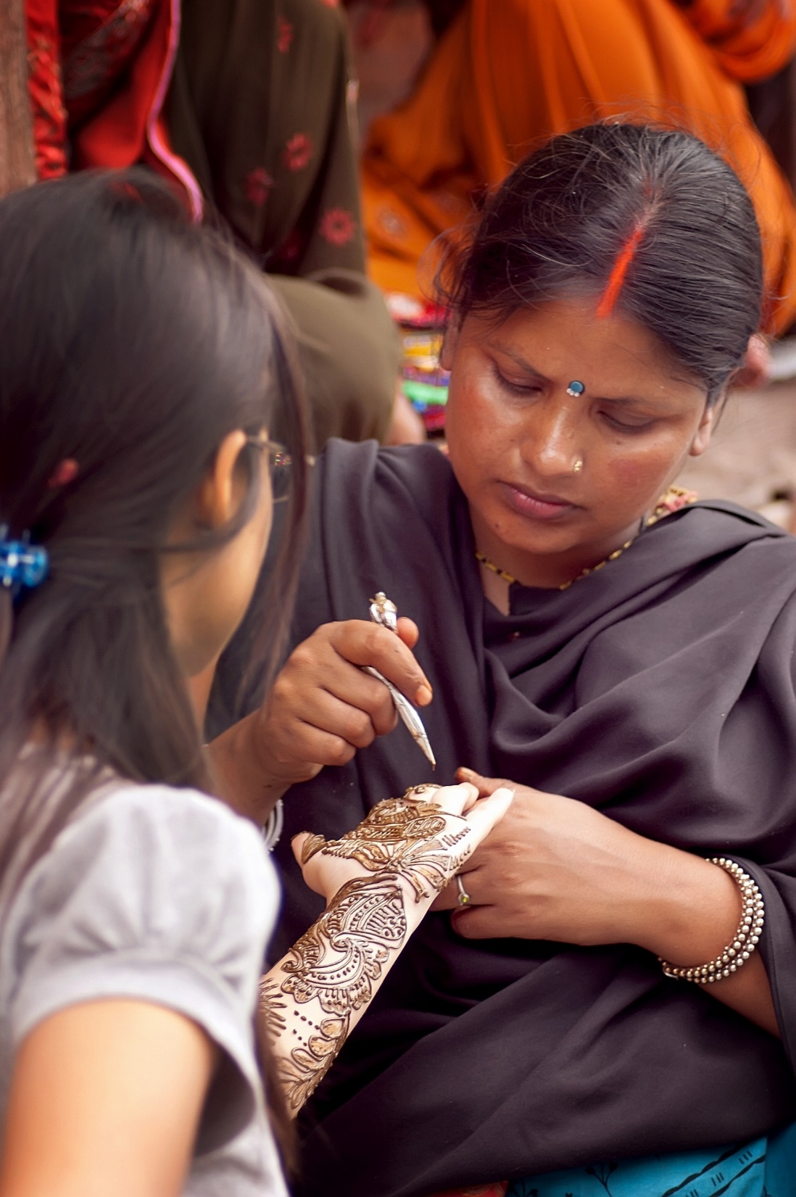
CASE STUDY 3: Beauty work
Another highly-feminised sector
characterised by low pay, long hours, poor workplace
safety, and a high degree of informality.
Data was particularly hard to find in all the countries
Like gig economy domestic workers, some women working in the app-based beauty sector report valuing the opportunities for training and professionalisation
The low wages and informal working arrangements faced by women in the traditional sector are being reproduced in platform work
Companies have been found to mandate workers to purchase equipment and products from them at unilaterally set prices
Notes:
Pranita

Slide 10
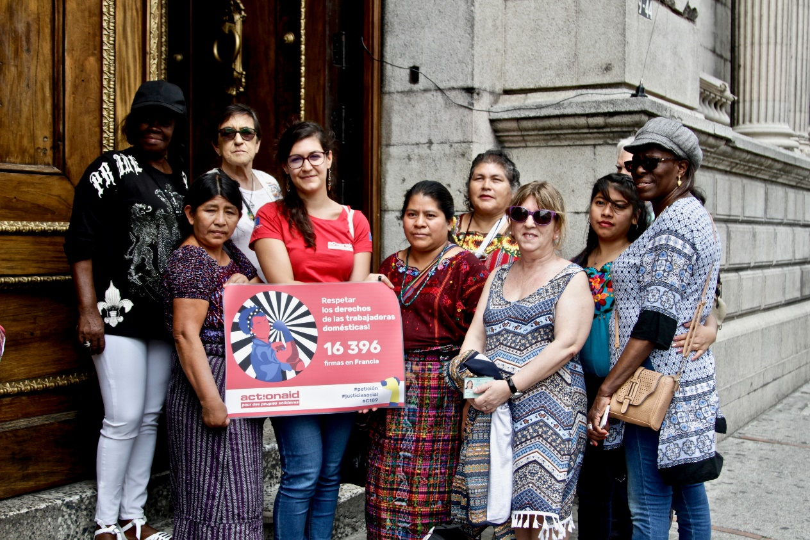
Legislative frameworks and developments
Legislative frameworks generally remain weak and poorly implemented.
Lack of clarity on how they extend to gig workers.
There is an urgency to this agenda given the rapid growth of the digital platform economy within a wider context of roll-backs on women’s rights and workers’ rights.
Brazil – only country from the report with a particular legislation pertaining the platform economy.
Law 14297 (2020): Defines the rights of delivery workers during the pandemic and provides specific employer responsibilities.
Developments at the global level:
The Centenary Declaration for the Future of Work
UN Global Digital Compact
Charter of Feminist Demands
UN Conference on the Status of Women
Regional Conference on Women in Latin America and the Caribbean
Legislative developments elsewhere:
Chile - Law of Digital Platform
Singapore - Platform Workers Advisory Commitee
Notes:
Pranita

Slide 11
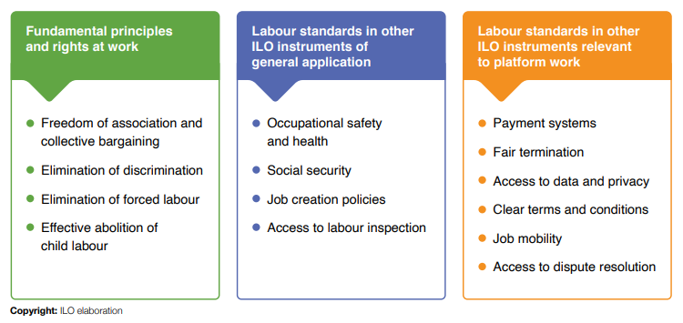
Decent work elements
applicable to all platform workers
irrespective of contractual status
Notes:
Pranita

Slide 12
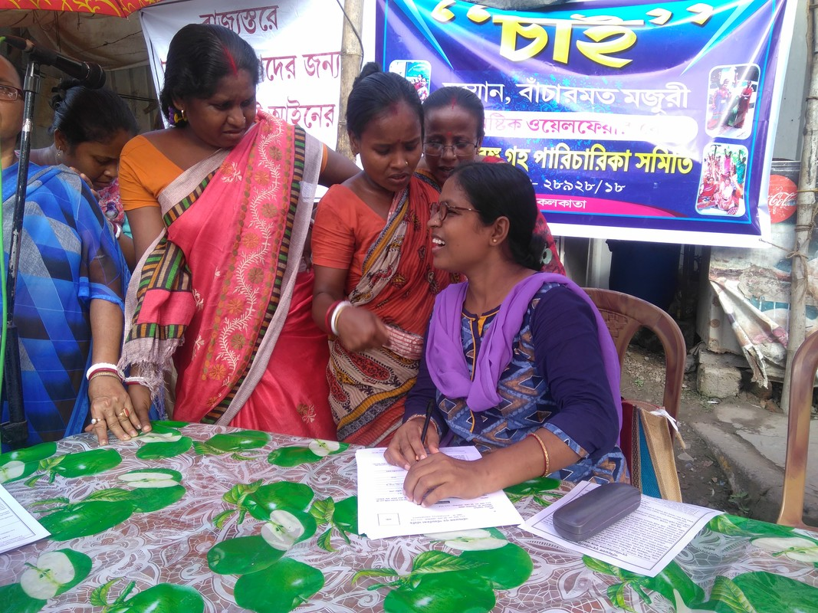
Activism and resistance
Platform workers face substantial challenges to collective organising
Despite this restrictive context, location-based gig workers have been coming together to confront exploitative practices
Seeking justice in the courts with some important wins
Women organising
Platform cooperativism in resistance
Using apps to secure rights
However, overall the numbers of gig workers organising collectively remain relatively small.
Notes:
Pranita

Slide 13
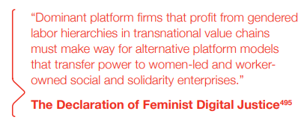

Conclusions & recommendations
Governments and policymakers at national and international level
Platform companies
CSOs, trade unions, WROs and academics
For the vast majority of women in the global South, the promises of the Fourth Industrial Revolution and located-based gig work are proving illusory
The intersectional digital divide means many women are excluded from taking advantage of those opportunities
Coherent policies on skills and education for women and girls, decent work, care infrastructure, preventing and responding to GBV, data rights, migrant rights and corporate accountability are required to respond to the opportunities and threats posed by the digital platform economy
Notes:
Natalia

Slide 14
Thank you! If you have any questions or comments, contact natalia.rodriguez@actionaid.org

