Slide 1

Data Protection for Researchers
February 2023
Helen Williamson
Head of Information Governance
and Data Protection Officer
Governance, Legal and Sector Regulation
Jon Ashton
Security Analyst, DTS

Slide 2
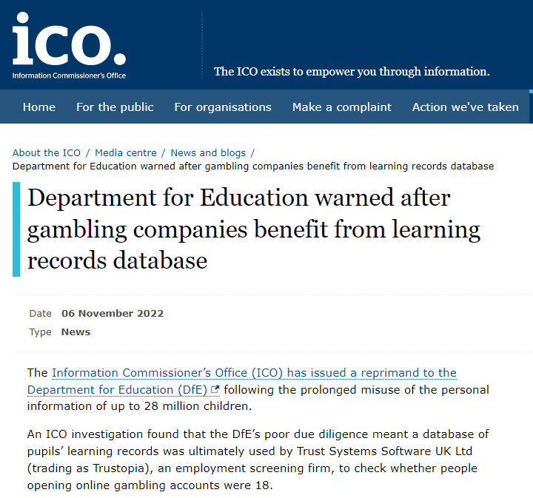
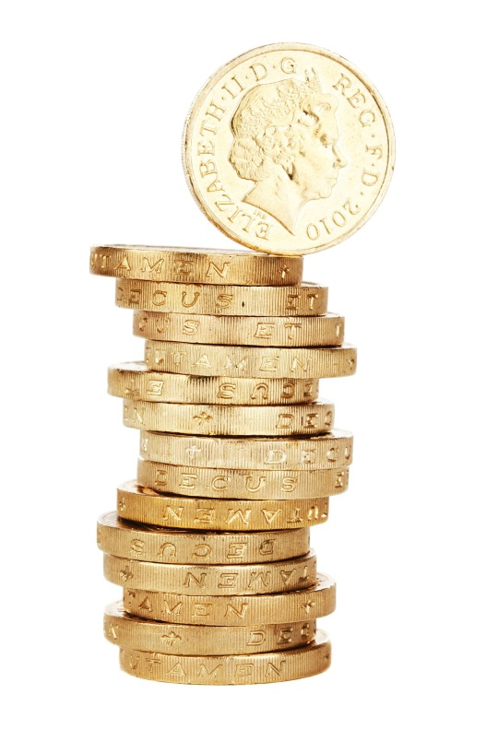
Consequences of
Non-compliance
UK GDPR
Max fine:
£17.5 million or 4% annual turnover
Lower tier fine:
£8.7 million or 2% annual turnover
Department for Education warned after gambling companies benefit from learning records database | ICO

Slide 3
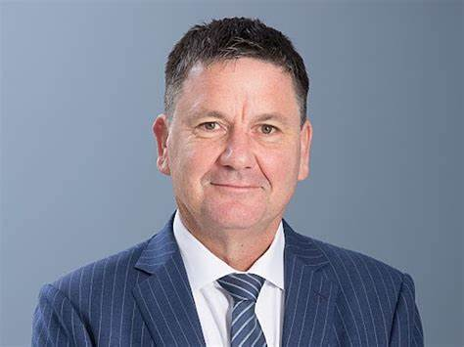
Why is DP compliance important?
“Privacy is a right not a privilege.
In a world where our personal data can drive everything from the healthcare we receive to the job opportunities we see, we all deserve to have our data treated with respect.”
John Edwards, Information Commissioner

Slide 4




Slide 5

Data Protection for Researchers:
When do data protection laws apply?
When does data protection apply to research?
What is personal data?
What is pseudonymised data?
When is data fully anonymised?

Slide 6
When will data protection laws apply to my research?
Data protection laws apply to any processing of personal data carried out by the University and this will include processing in the course of research activities.
Do I need to think about data protection for my project?

Slide 7
“Processing means taking any action with someone’s personal data.
This begins when a data controller starts making a record of information about someone, and continues until you no longer need the information and it’s been securely destroyed.
If you hold information on someone, it counts as processing even if you don’t do anything else with it.”
What is “processing”?
Collection of personal data or creation of a record
Combining, Matching, Using, Organising
Sharing & Disclosing
Destruction, Deletion, Anonymisation
Archiving & Storage

Slide 8
The UK GDPR definition of personal data is:
“’personal data’ means any information relating to an identified or identifiable natural person (‘data subject’);
an identifiable natural person is one who can be identified, directly or indirectly, in particular by reference to an identifier such as a name, an identification number, location data, an online identifier or to one or more factors specific to the physical, physiological, genetic, mental, economic, cultural or social identity of that natural person."
What is personal data?
In addition to your “research data”, you may also be processing the personal data of staff at collaborative partner organisations, research students, PPI contacts etc. This may be limited to names and contact details, but may also include expenses claims, personal opinions, CVs etc. Data protection laws apply to the processing of this personal data too.

Slide 9
An individual is ‘identified’ or ‘identifiable’ if you can distinguish them from other individuals.
e.g. via a name, unique identifier (such as staff number, student number, NHS number), corporate email address.
You don’t have to know someone’s name to distinguish them from other members of a group and identify them.
e.g. The elderly man who lives at 15 Purple Street and drives a Porsche Cayenne.
A combination of identifiers may be needed to identify an individual.
Indirect identification – combining the information we already hold with information from another source – held by a third party or in the public domain etc.
Is an individual identified or identifiable?

Slide 10


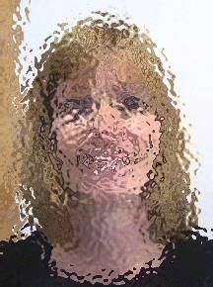
Anonymous Data/Anonymisation:
If the data is fully anonymised, then data protection law doesn’t apply because we aren’t processing data that relates to an identified or identifiable individual.
Reduces impact on individuals
Can be difficult to achieve. Stripping out the direct identifiers from a data set may not be enough to fully anonymise the data. Is there still enough information to identify an individual?
We can’t say that data protection doesn’t apply unless we are sure that the data really is anonymised – don’t want to be in a position where we don’t comply with DP requirements because we have mistakenly classified the data as anonymous.
When you anonymise personal data, you are still processing personal data up to and at that point. Only after the anonymisation process is complete have you finished processing personal data.
Anonymised data may not fulfil your research purposes. For example, if you need to track individuals in a longitudinal study, then aggregated or anonymous data would clearly make the research impossible.

Slide 11
Pseudonymisation: - a technique that replaces or removes information in a data set that identifies an individual (e.g. replacing names and other identifiers with a reference number).
Pseudonymisation means that people are not identifiable from the dataset itself. However, they are still identifiable by referring to other, separately held information. The data is still personal data and data protection law applies.
Data Subject Name | NHS number | Age | BMI | Allergies
Alice Barker | 123456 | 43 | 26 | Nut allergy
Bob Jones | 234567 | 25 | 18 | None
David Lyons | 345678 | 61 | 23.5 | Penicillin
Eve Smith | 456789 | 42 | 20.5 | None
Riley Trent | 567891 | 39 | 28 | Soy
Pseudonym | Data Subject Name | NHS number
Da45zp6h | Alice Barker | 123456
Le85pw7j | Bob Jones | 234567
Nq27kr6v | David Lyons | 345678
Cu18by9p | Eve Smith | 456789
Sh31ef5w | Riley Trent | 567891
Data set
Pseudonymisation Key
Pseudonym | Age | BMI | Allergies
Da45zp6h | 43 | 26 | Nut allergy
Le85pw7j | 25 | 18 | None
Nq27kr6v | 61 | 23.5 | Penicillin
Cu18by9p | 42 | 20.5 | None
Sh31ef5w | 39 | 28 | Soy
Pseudonymous/Pseudonymised Data

Slide 12
Special Categories of Personal Data
Criminal Offence Data
personal data revealing racial or ethnic origin;
personal data revealing political opinions;
personal data revealing religious or philosophical beliefs;
personal data revealing trade union membership;
genetic data;
biometric data (where used for identification purposes);
data concerning health;
data concerning a person’s sex life; and
data concerning a person’s sexual orientation.
“personal data relating to criminal convictions and offences or related security measures”
This covers a wide range of information about offenders or suspected offenders:
criminal activity
allegations
investigations
proceedings
penalties
conditions or restrictions placed on an individual as part of the criminal justice process
civil measures which may lead to a criminal penalty if not adhered to
unproven allegations
information relating to the absence of convictions.

Slide 13
Processing of Special Category Personal Data and/or Criminal Offence Data
Processing of these kinds of data is seen as more intrusive than processing other kinds of personal data.
A higher level of security is likely to be required to keep the data safe and secure.
A Data Protection Impact Assessment (DPIA) is more likely to be required.
You can only process special category personal data if you meet one of the conditions set out in Article 9 of the UK GDPR. Article 9 (2)(j) covers the use of special category personal data for research purposes.
You can only process criminal offence data if you meet one of the conditions set out in Schedule 1 of the Data Protection Act 2018. There is a condition at paragraph 4 for research purposes.
The University has a policy for processing special category personal data and criminal offence data. Please note that this policy will be reviewed and updated in 2022/23.

Slide 14
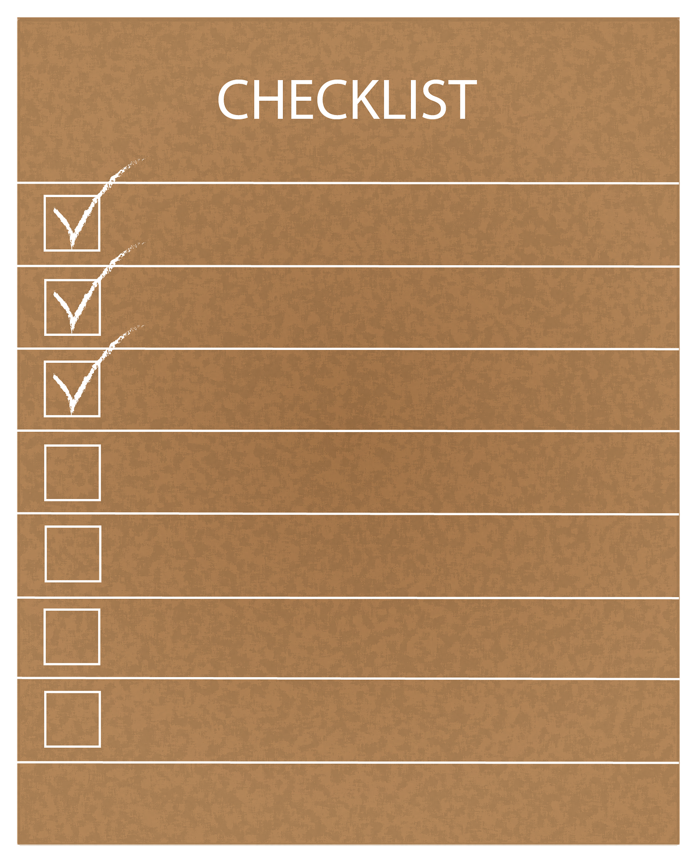
Data Protection for Researchers:
Data Protection Responsibilities
The data protection principles
When you can process personal data
Overview of compliance requirements

Slide 15

Identify roles: Controller & Processor
Data Protection Principles
Identify Personal Data
Transparency
Data Retention
Storage
Security
DPIA
Suppliers/
Data Processors
International Data Transfers
Data Sharing
Contracts &
Agreements

Slide 16
What are the Data Protection Principles?
These principles must be applied to all processing of personal data.
Personal data shall be:
processed lawfully, fairly and in a transparent manner,
collected for specified, explicit and legitimate purposes,
adequate, relevant and limited to what is necessary,
accurate and where necessary kept up to date,
kept in a form which permits identification of data subjects for no longer than is necessary for the purposes for which those data are processed, and
processed in a manner that ensures appropriate security of the personal data.
Additional Accountability Principle is central to GDPR. Data controllers are responsible for compliance with the principles and must be able to demonstrate this to data subjects and the regulator.

Slide 17






When Can We Process Personal Data?
Personal data cannot be processed unless there is a GDPR lawful basis. We explain which lawful bases we are relying on in our Privacy Notices/Participant Information Sheets. Six options:
Consent – the consent of the data subject to the processing of their personal data
Vital Interests – it is vital that specific data are processed for matters of life or death
Contractual necessity – processing is needed in order to enter into or perform a contract
Public task/Public Interest – public authorities and organisations in the scope of public duties and interest.
Legal obligation – the controller is required to process personal data to meet a legal obligation
Legitimate interest – There is a weighed and balanced legitimate interest where processing is needed and the interest is not overridden by others

Slide 18

Data Protection for Researchers:
Data storage and security
Risks
Appropriate measures
Data breaches
Fines and enforcement action

Slide 19
How do we keep data secure?
GDPR requires organisations to implement appropriate technical and organisational measures to keep data secure. i.e. appropriate to the risks, depending on the type of data and processing.
Risks:
Loss of Confidentiality, Integrity, and Availability of data, processing and systems (CIA)
Appropriate measures include:
robust policies and procedures
DPIAs and risk assessments and clear definition of responsibilities
technology - firewalls, anti-virus, anti-hacking technology and measures, password protection of electronic files
locking away paper files, laptops, memory sticks etc.
restricting access to offices, databases, filing systems, folders within shared drives
disposing of data securely - shredding, confidential waste, secure disposal of IT equipment etc.
care when mobile working
anonymising and pseudonymising data where possible and appropriate
staff induction, training, awareness, self-regulation

Slide 20
Common security breach types:
email errors – wrong recipients, not using BCC, errors with similar names or auto-fill, re-using emails instead of templates, sending to large group or mailing list by mistake
lost or stolen laptops, lost or forgotten papers
incorrect settings on documents – sharing/publishing too widely
phishing attacks
Common theme: human error – rushing to complete tasks, too many windows open at the same time, staff working when they are ill
GDPR online module: https://sheffieldhallam.sharepoint.com/sites/3037/SitePages/Information-Governance-training.aspx
Safe use of email guidance: Governance, Legal and Sector Regulation - Safe Email advice.pdf - All Documents (sharepoint.com)
Mobile working guidance: Governance, Legal and Sector Regulation - Mobile working data security.pdf - All Documents (sharepoint.com)
CyberAware course: Protecting the University from cyber threats (sharepoint.com)

Slide 21


What do I need to do if I think there has been a data breach?
Staff must report data security breaches IMMEDIATELY to the IT Service Desk. The Out of Hours service will report any incidents to the University and will escalate serious incidents to IT managers and the DPO .
THEN alert your line manager of the security incident
If you are sent data in error by a colleague you should report this immediately to the IT Service Desk. If you are sent data in error by another organisation, alert the sender of the email and follow their instructions to delete the data. If you use this data for any other purpose you may commit an offence.
IT Service Desk
 3333
Staff must also report 'near misses' or 'close calls' - this may assist the University to identify procedures that could be improved.

Slide 22



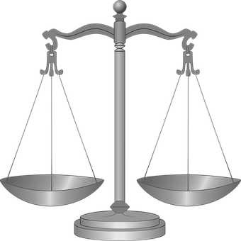


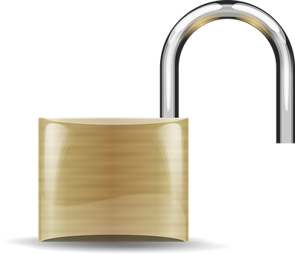
Factors to consider for data storage
Contractual Obligations
Content
Longevity
Legal/Regulatory Compliance
Security & Access
Back up/
Business Continuity

Slide 23
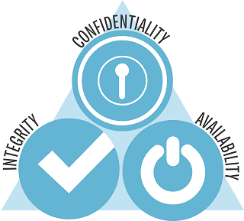
Security & Access
Keeping Data Secure
Keeping Data Clean
Keeping Data Accessible
DTS Security Team
Email:
itsecurity@shu.ac.uk
or call us via MS Teams
Jon Ashton
Senior Security Analyst
Andrew Fearnley
Senior Security Analyst

Slide 24
Where to save files securely
F Drive, N Drive, SharePoint, Onedrive for files containing personal data – must have appropriate access/permissions management in place for N drive folders and sharepoint.
Q drive research files ideal for anonymised data and pseudonymised personal data (key stored separately in different location), lower risk personal data ok, avoid very sensitive data on Q and where there are contractual requirements for audit trails of usage/access (this isn’t available on Q).
J drive for research data containing personal data/sensitive data or where there are contractual obligations that require greater levels of security. Built in audit trail.
Digital Skills Hub Guidance on storing and sharing data:
https://sheffieldhallam.sharepoint.com/sites/4042/SitePages/Where-do-I-save-and-share-my-work-.aspx
Covers other options for non-personal data
Contact Eddy Verbaan for advice on research archive for long-term archiving and access after project completion

Slide 25
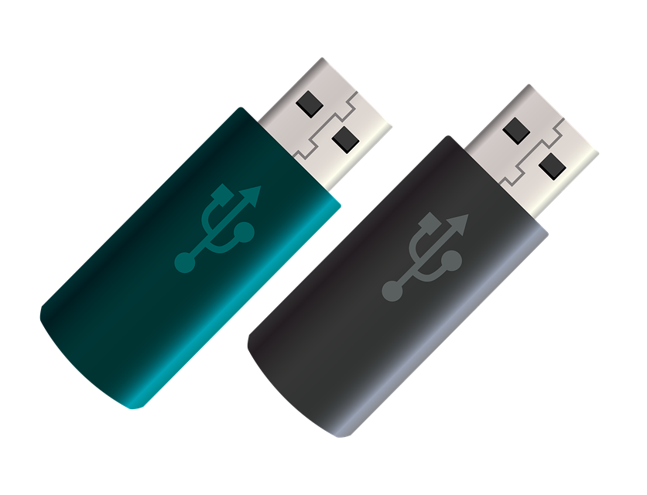

Avoid saving files to:
A local device or drive, i.e. a local drive on a personal or SHU owned PC or laptop (e.g. C or D) - UNLESS the files are duplicates of, and synchronising with, the original/master files in a cloud based location, or a network drive.
USB sticks or USB hard drives - UNLESS they are duplicates of originals needed as a backup or for access in a location which has no other means of accessing the originals. (must be encrypted for personal data)
Personal/Private cloud storage services (OneDrive / Google Drive / Dropbox etc).
Any device which can be accessed be accessed by other members of your household using YOUR account.

Slide 26

Do use for research data containing personal data:
ZendTo
SHU encrypted email
Onedrive
Sharepoint guest access
Access to Q drive folders
Sharing Files
Googledrive – under review and not for special category personal data without additional safeguards
Don’t use for research data containing personal data:
Unencrypted email
Private/non-University cloud services or communications channels
unencrypted USB sticks

Slide 27
Information Governance Team
Email:
DPO@shu.ac.uk
or call us via MS Teams
Helen Williamson
Head of Information Governance & Data Protection Officer
Ali Forward
Deputy Head of Information Governance
David Goldberg &
Amber Rhodes
Information Governance Officers
Emma Scholes
Senior Administrator

