Slide 1
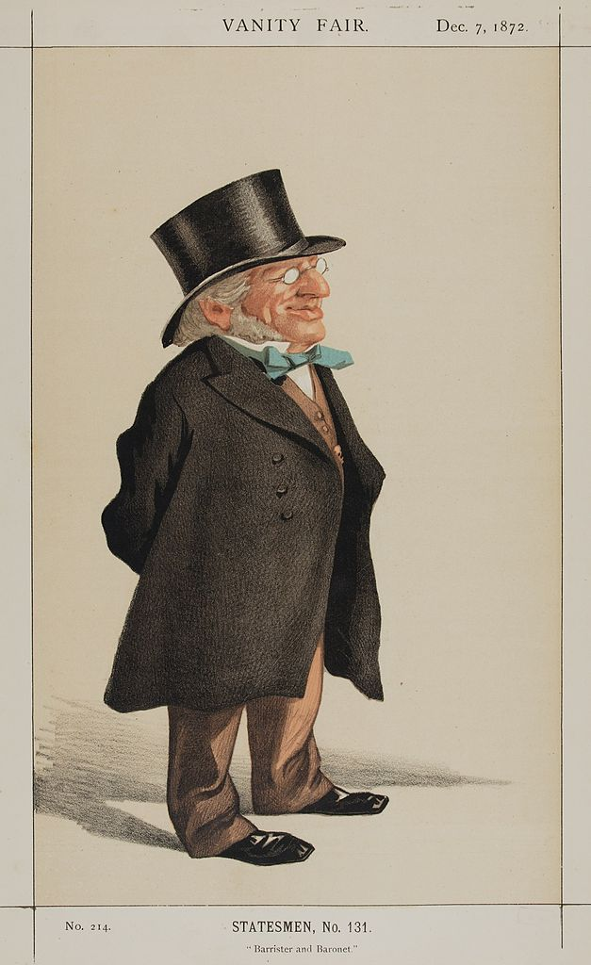

Francis Goldsmid
Andrew Watson.
This Photo by Unknown Author is licensed under CC BY-SA

Slide 2
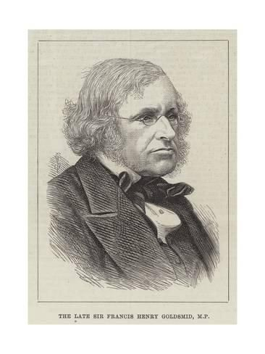
Jewish Emancipation in Nineteenth Century Britain : Francis Goldsmid; Barrister; Legislator; Human Rights Campaigner; Religious Reformer and Philanthropist.
Francis Henry Goldsmid (Chaim Tsevi Hirsch Isaac Aryeh HaLevi), born 1808, died 1878.
Son of Isaac Lyon Goldsmid, brother of Anna Maria Goldsmid (educationalist and translator).
Married Louisa Sophia Goldsmid ( philanthropist and educationalist) 1839.
Called to the bar 1833 – first professing Jewish barrister and first QC 1858.
At heart of struggle for Jewish Emancipation.
Member of Parliament 1860 – 1878.

Slide 3
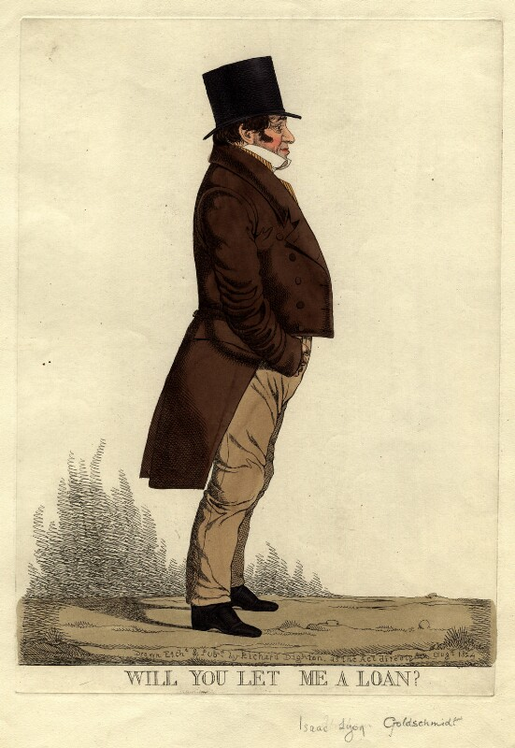
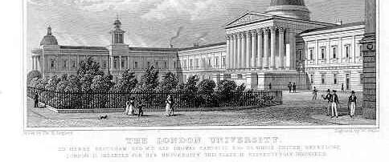
Isaac Lyon Goldsmid, 1778 - 1859

Slide 4
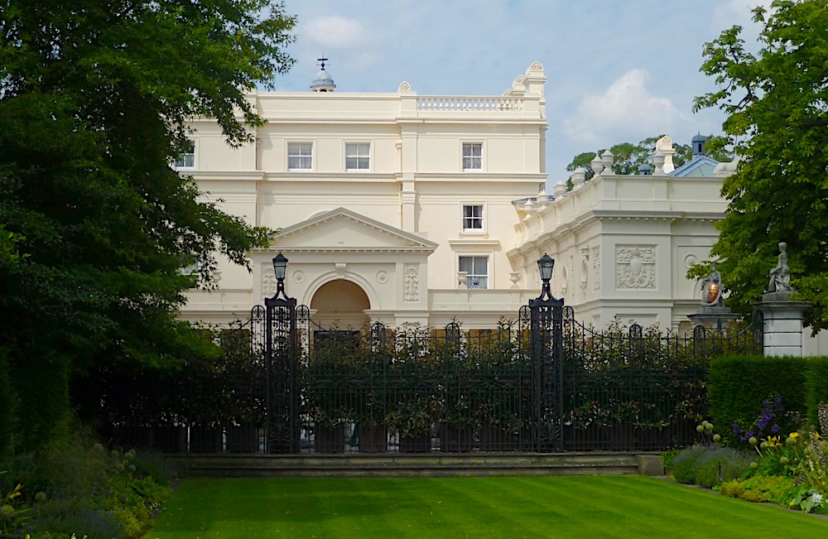
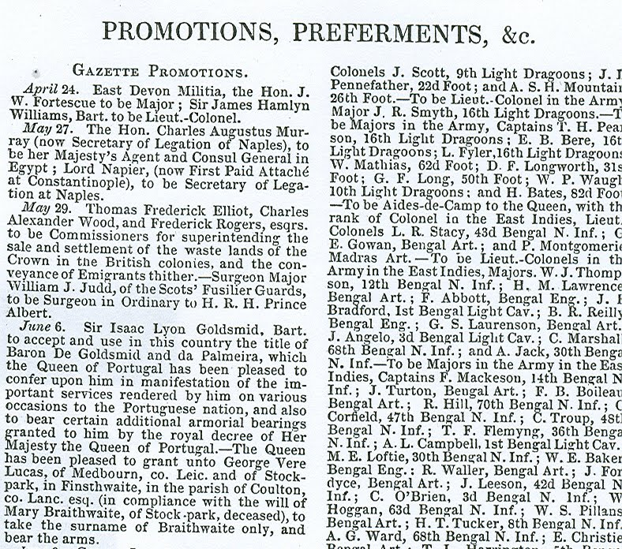
t
St John’s Lodge, Regent’s Park.

Slide 5
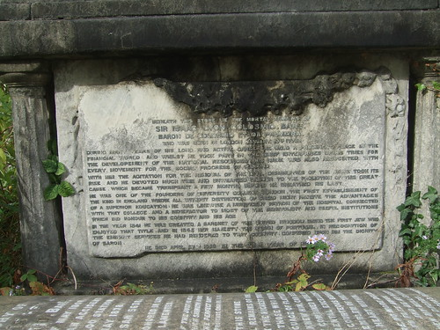
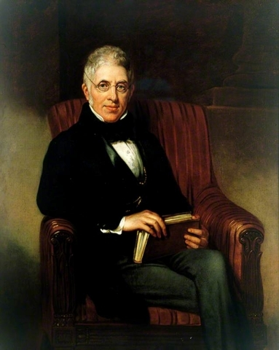
Isaac Lyon Goldsmid.
Inscription on grave in Balls Pond Jewish Cemetery, Islington.
IssaIsaac
Balls Pond Jewish Cemetery, Islington, Middlesex, England.

Slide 6
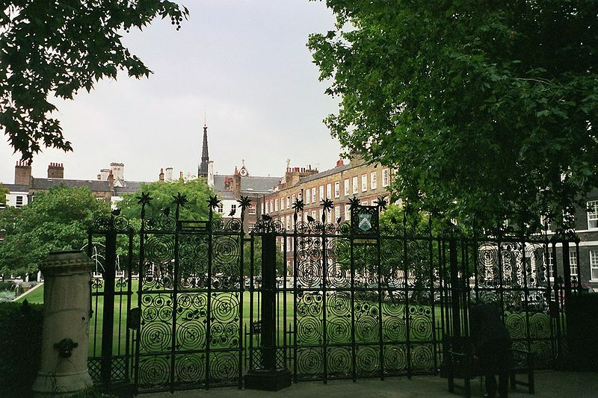
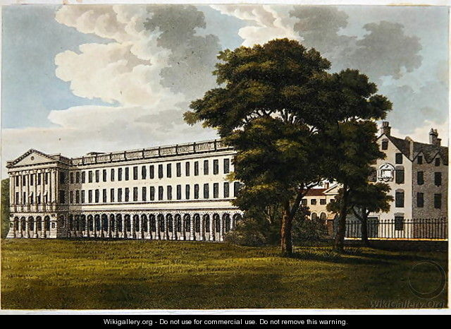
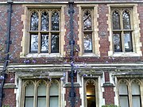
Lincoln’s Inn.
Stone Buildings.
Old Square.

Slide 7
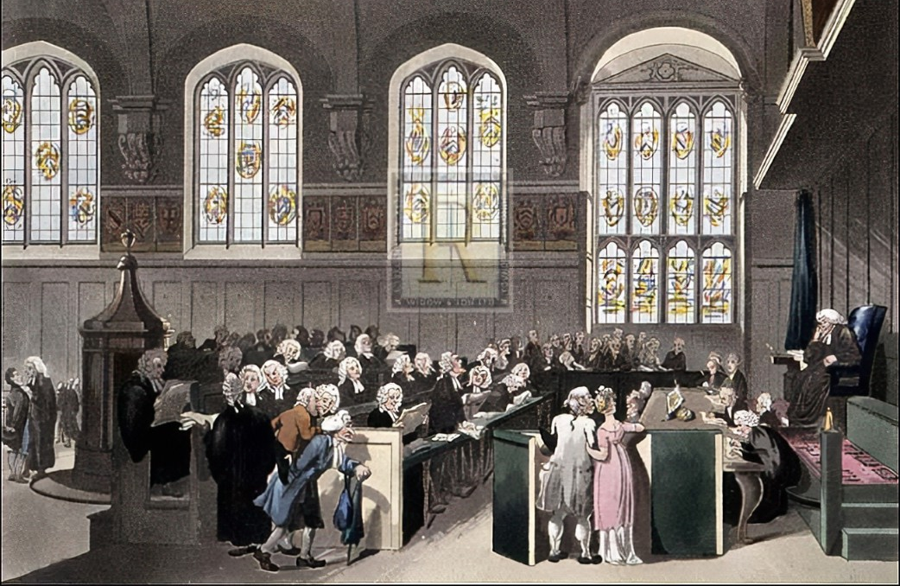
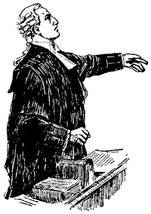
Court of Chancery sitting in Old Hall Lincoln’s Inn.
This Photo by Unknown Author is licensed under CC BY-SA

Slide 8
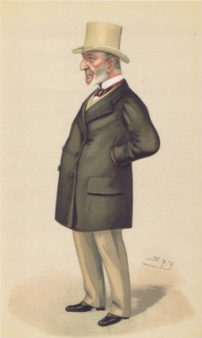
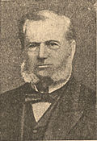
John Simon. Second professing Jewish Barrister and first to practice Common Law.

Slide 9
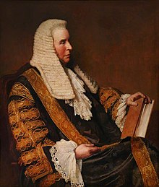
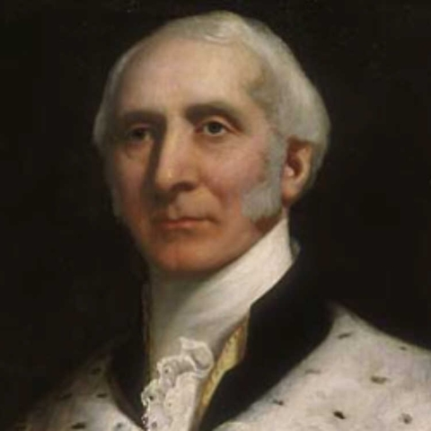
Sir David Solomons 1797 – 1873, Called 1849. Inter alia first Jewish magistrate.
Sir George Jessel, 1824 -1883, Called in 1847, one of the most influential commercial law and equity judges of his time, and Master of the Rolls 1873 – 1883.

Slide 10
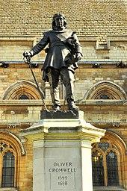
Civil and Political Disabilities.
By 1830, the Jews of Britain, numbering about twenty seven thousand, eighteen thousand living in London and the rest in small communities in provincial towns and ports, were the only remaining religious minority subject to serious civil and political disabilities.
After returning to Britain in 1655 under Cromwell Jews were not subject to restrictions found at times in other parts of Europe. They could live where they wished, employ non-Jewish labour in their homes or businesses, deal in any commodity and engage in any business or manufacture. Retail trading within the City of London was restricted as was membership of the stock exchange. There was some haziness in land law about their ability to own freehold property, but this was dealt by granting leases on peppercorn rents for indefinitely long periods.

Slide 11
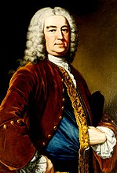
Civil and Political Disabilities.
Professing Jews were excluded by tests, oaths and declarations from employment by the Crown, municipal corporations, from Parliament, administration of justice, education and from most professions . In practice those few males who met the general property qualification were allowed to vote in parliamentary elections, although the returning officer had the power, seldom used, to demand voters swear the Oath of Abjuration (of the former Royal House of Stuart) on the true faith of a Christian; not possible for professing Jews.
Since the repeal, of the Jewish Naturalisation Act 1753 - to allow individual foreign born Jews to seek naturalisation by the expensive and difficult process of promoting a Private Bill - just one year after it had been passed, amidst a tremendous outburst of hostility, the majority of Jews led rather secluded lives. Seeking to avoid rekindling the rancour of 1753/1754, remembered and lamented by their parents and grandparents, the engagement of most with wider society was generally limited to commerce and trade.
Henry Pelham who brought in
the Jewish Naturalisation Act,1753.

Slide 12
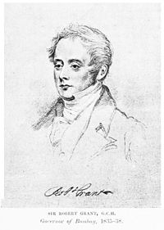
The long campaign.
The Association for obtaining for British Jews Civil Rights and Privileges was formed with Isaac Goldsmid elected as Chairman. The push for Jewish emancipation was driven by the wealthy elite, Isaac and Francis Goldsmid, members of the Rothschild family, Nathan, Meyer and Lionel, and David Salomons foremost amongst them, and by Christian supporters, especially in the Whig/Liberal Party.
A campaign over a quarter of a century : Never a mass movement, some opposition, scepticism and indifference within the Jewish community.
Failure of four Bills, promoted in the Commons by Sir Robert Grant, supported by Thomas Macauley and in the Lords by Lord Holland, aimed at complete and immediate emancipation introduced between 1830 and 1836 to remove all disabilities affecting British subjects. Last two passed the Commons but defeated by in the Lords where Tory Party and Bishops were strong.

Slide 13
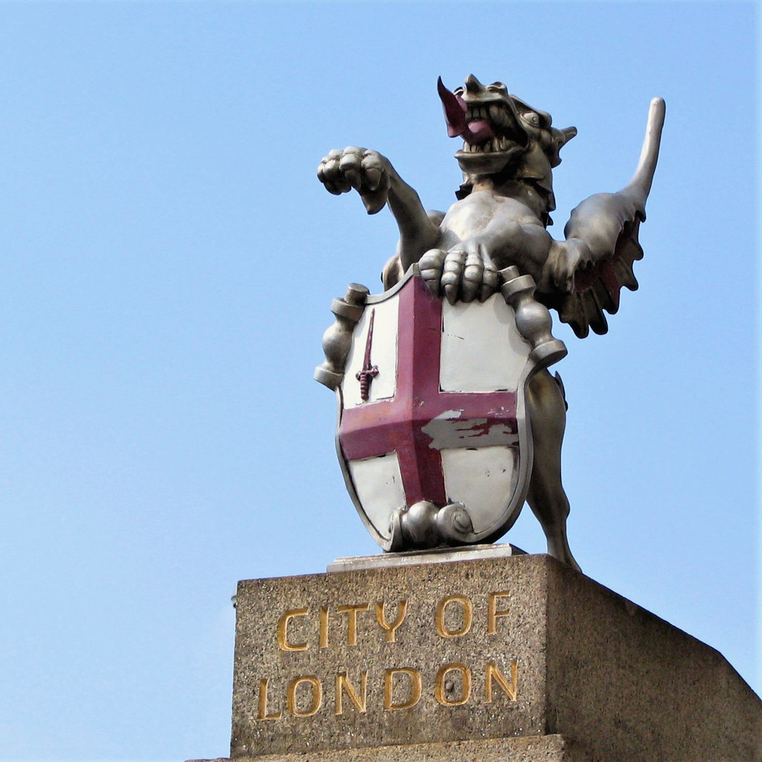
Some limited progress.
Prohibition, of minimal practical importance, preventing Jews from carrying on retail trade within the small area of the City of London was lifted in 1830.
A declaratory Act of Parliament in 1833 confirmed the right of Jews to own freehold property.
Legislation in 1835 making it clear professing Jews, who met the post Reform Act 1832 property requirements, were to be allowed to vote in parliamentary elections.
The Sheriffs Declaration Act, 1835 also in that year, enabled David Solomons to serve as Sheriff in the City of London without taking the statutory Christian oath (After this he successfully fought the City Aldermen for the right to sit on their council).
In 1835 the earliest recorded professing Jewish juryman was sworn on the Torah as a member of the Grand Jury at the Kirkdale Quarter Sessions in North Yorkshire.
This Photo by Unknown Author is licensed under CC BY-NC-ND

Slide 14
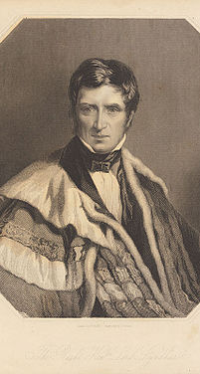
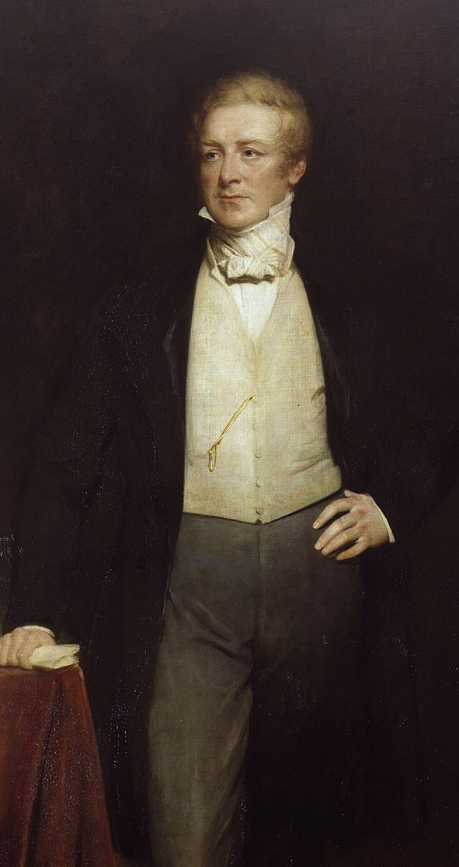
Local government and religious protection.
After the failure of the four Bills in the 1830s to achieve their ends advocates of Jewish equality turned their attention to obtaining admission to local government. A Bill to achieve this got as far as a first reading in the Lords by one vote, in 1841, but was lost on a second reading. However, after the Conservative Prime Minister Robert Peel arranged the Bill’s progress through the Lords in 1845, Lord Lyndhurst’s Jewish Municipal Relief Act became law.
The Religious Opinions Relief Act 1846 extended to Jewish congregations the code of recognition and protection for nonconformist worship, chapels, schools and property ( It also formerly repealed the intolerant Statutum de judeismo of 1271 and an Act of 1702 compelling Jews to maintain their Protestant children).

Slide 15
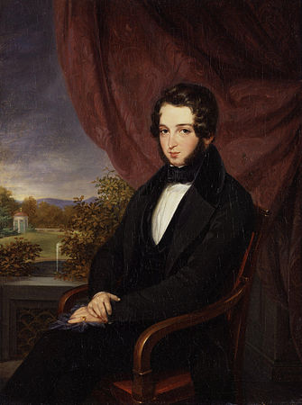
The General Election of 1847.
Five Jewish candidates stood for the Liberal Party. Francis Goldsmid Great Yarmouth; Isaac Goldsmid Beverley, Yorkshire; Baron Meyer de Rothschild Hythe, Kent; David Solomons Greenwich; and Baron Lionel de Rothschild one of the four City of London seats. In other constituencies Liberal candidates were asked, as price of Jewish votes, to promise their support for a measure to admit Jews to parliament.
Lionel de Rothschild was elected for the City but, as unable to take the stipulated Christian oath of office, his seat fell vacant. Rothschild was re-elected. Seat declared vacant after Rothschild again met the barrier of the oath. This pattern of election by the City voters followed by declaration of a parliamentary vacancy was repeated over the next ten years.
Lionel de Rothschild.

Slide 16
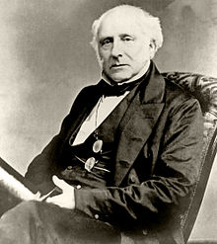
Blocking by the Lords and David Solomon’s action.
Failure in House of Lords of Jewish Disabilities Bill of 1848, to put Jews on the same footing as Roman Catholics and allow them to enter Parliament,and of the Parliamentary Oaths Bill, 1849, to remove the obstacle of the form of oath.
David Solomons, after elected for Greenwich in 1851, takes oath, but without “on the faith of a true Christian”, occupies a seat, speaks in a debate to remove him before being ejected by the sergeant –at –arms.
Trial in Court of Exechequer and fined £500 for each of three occasions he spoke. Chief Baron expressed regret he was bound by law. Sentiments repeated on appeal in Exchequer Chamber.
Blocking by House of Lords of nearly annual attempts passed by Commons thereafter to allow elected Jewish MPs to take their seats.

Slide 17
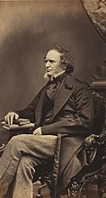
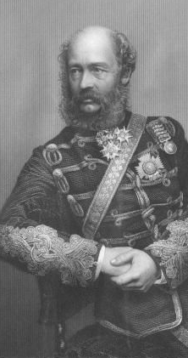
Jewish Relief Act 1858 – Lord Derby’s Compromise.
Compromise. mainly because of political damage and concern about consequences of Lords repeatingly denying of the will of the Commons.
Acceptance of suggestion Lord Lucan each House be allowed to decide by Resolution form of oath administered for Jews.
The Resolution procedure was converted to a Standing Order by an Act of 1860 ( 23 & 24 Victoria , cap . 49 ) making admission of Jews a matter of right rather than privilege. By the Parliamentary Oaths Act 1866 (29 & 30 Victoria ,cap. 19) a new and simplified oath for both Houses was introduced omitting reference to “true faith of a Christian” .
Lord Derby.

Slide 18
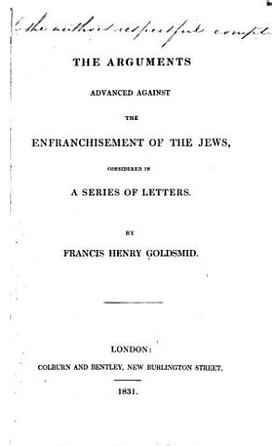
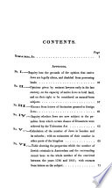
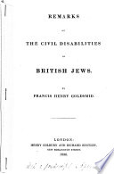
Francis Goldsmid’s particular contributions to Jewish Emancipation.
A series, over eighteen years. of clearly expressed, analytical and well received pamphlets, mainly to enlist support of non – Jews; the first was “Remarks on the Civil Disabilities of British Jews”, written whilst training for the bar in 1830.
In The arguments advanced against the enfranchisement of the Jews, considered in a series of letters ,1831,he was perhaps the first member of the Anglo-Jewish leadership to recognize the potential of the “Jewish vote” in Parliamentary constituencies for the campaign to remove civil and political disabilities.

Slide 19
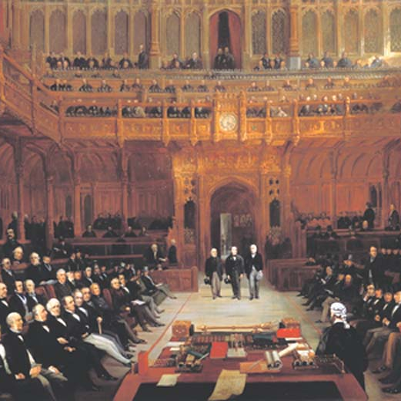
The first Practising Jewish MPs.
Lionel de Rothschild,1858 , the City
Meyer de Rothschild, 1859, Hythe.
David Solomons, 1859, Greenwich.
Francis Goldsmid, 1860, Reading.
Converts to other religions, facing no difficulty with the prescribed oath, had sat in parliament before. Famous amongst them being: Benjamin Disraeli born to a Sephardi family, but baptised at 12 into the Church of England, entered parliament in 1837, later rising to prime minister; and David Ricardo, economist and financier, also from a London Sephardi family, became a Unitarian at 21 and served as an MP from 1819 to 1823.
Lionel Nathan de Rothschild introduced in the House of Commons on 26 July 1858 by Lord Russell and Mr John Abel Smith, by Henry Barraud, 1872

Slide 20
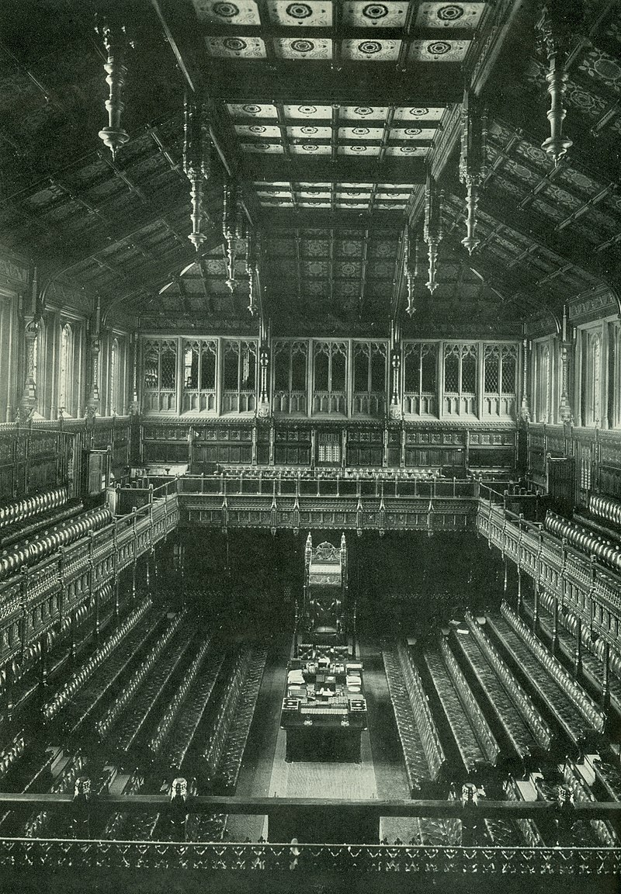
Francis Goldsmith Member of Parliament.
Assiduous constituency MP and frequent attender at Parliament.
Advised party on drafting, legality of legislation and chaired Committees.
General interventions covered broad range of economic and social matters. Gradualist on extending franchise. Strongly favoured improvements in education and housing. Described as a “temperate Liberal”.

Slide 21
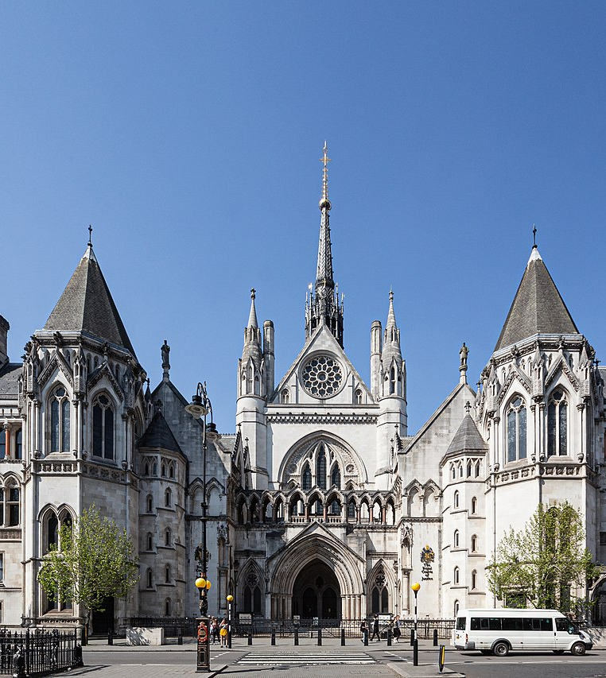
Law and procedural reform.
Endorsed Universities Tests Act,1871.
Supported reforms of trustee law favouring Dissenters.
Affirmations Bill 1863, supported.
Backed legislation for building Royal Courts of Justice in 1865.
Supported the Supreme Court of Judicature Bill, 1873.
Opposed creation of a General , or University, School of Law advocated by Sir Roundell Palmer.
Endorsed the Married Women’s Property Act, 1870.
Opposed Lord Cairn’s Land Titles and Transfer Act, 1874

Slide 22
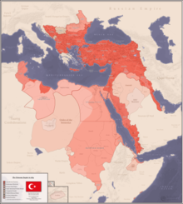
“The member for Jewry”.
Recognised spokesman for Jewish Community.
Powerful denunciations in Parliament of attacks and abuses of Jews in Russia, North Africa, Syria, Asia Minor, Persia, the Danubian provinces and Bulgaria.
Key Role in establishing the Anglo Jewish Association in 1871 for the promotion and protection of Jews overseas.
Campaigned against harsh conditions imposed on Poles and Hungarians and organised public meetings.
On the Eastern Question supported continuing British support for the declining Ottoman Empire. Refused to follow Gladstone’s crusade against Disraeli’s pro – Ottoman foreign policy : May explain why he never achieved government office.

Slide 23
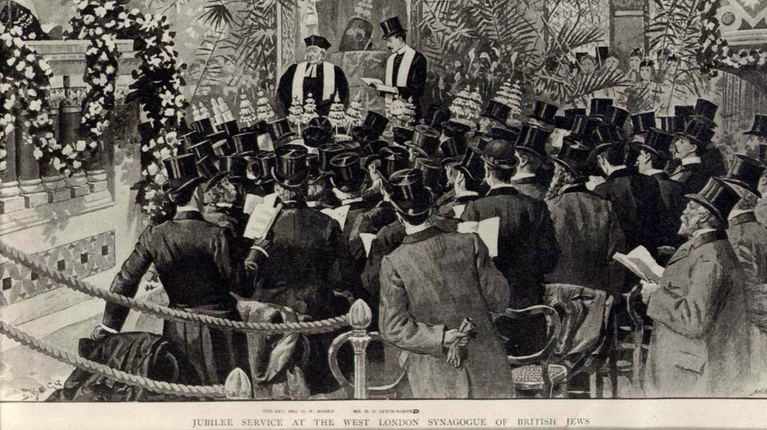
Francis Goldsmid and Reform Judaism.
Prominent in establishing Reform Judaism in Britain.
Amongst group of twenty four at Bedford Hotel Meeting, Southampton Row in 1840 to establish a “British” synagogue.
Opening of West London Synagogue, Burton Street, in 1842. Chairman of Council of Founders, donator of time and money.
Establishment of WLS gave promoters of Jewish emancipation a platform independent of The London Committee of Deputies of British Jews, which, under the leadership of Sir Moses Montefiore was at best lukewarm to the cause, fearing greater civic engagement would dilute devotion to Judaism.

Slide 24
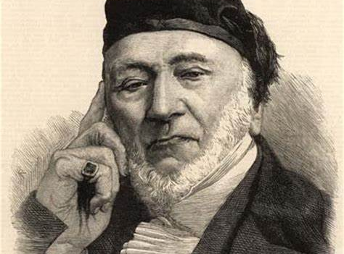
Sir Moses Montefiore.

Slide 25
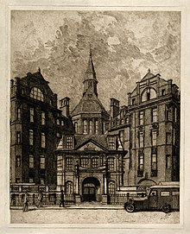
Philanthropy and civic responsibility.
Profuse contributor, privately and publicly, to many charities and causes.
Adult and child education:
Benefactions to University College London; great attender of the council and President of the Senate;
Central in establishing in 1841 Jews’ Infants School, Houndsditch – becoming the largest infant school in England – and West Metropolitan Jewish School in 1845.
Donation of considerable sums to University College Hospital and served as treasurer 1857 – 1868.
Greatly improving housing, sanitation, access and school education in Rencomb village , Gloucestershire ( near his Italianate mansion ) making it a model village.
Cruciform Building UCH.

Slide 26
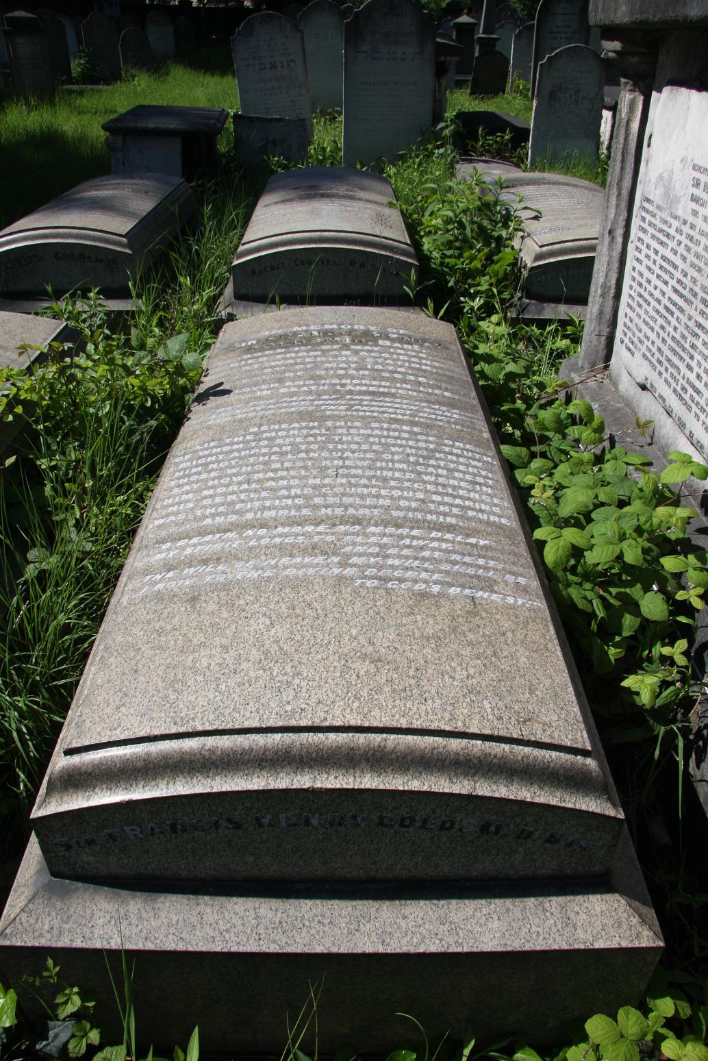
Conclusion.
In addition to his contribution to the history of the English Bar, Francis Goldsmid deserves recognition for: his involvement at the heart of the campaign to achieve full Jewish emancipation in Britain; for being a fully participating and conscientious Member of Parliament who used his position on behalf of his constituents, his party and liberal beliefs, law reform and to relieve suffering and oppression of Jews and non – Jews overseas; for his contribution to religious reform; and for his numerous philanthropic donations and support for enlightened and socially improving activities, perhaps most notably university and children’s education and for establishing hospital care.
Kingsbury Road Cemetery.

