Slide 1
Coatings for Dry High Speed Machining Applications Papken Eh. Hovsepian and Arutiun P. Ehiasarian National HIPIMS Technology Centre, Materials and Engineering Research Institute, Sheffield Hallam University, Howard Street, Sheffield S1 1WB, UK,

Slide 2
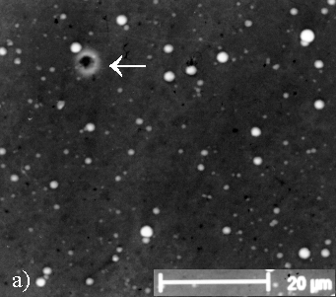
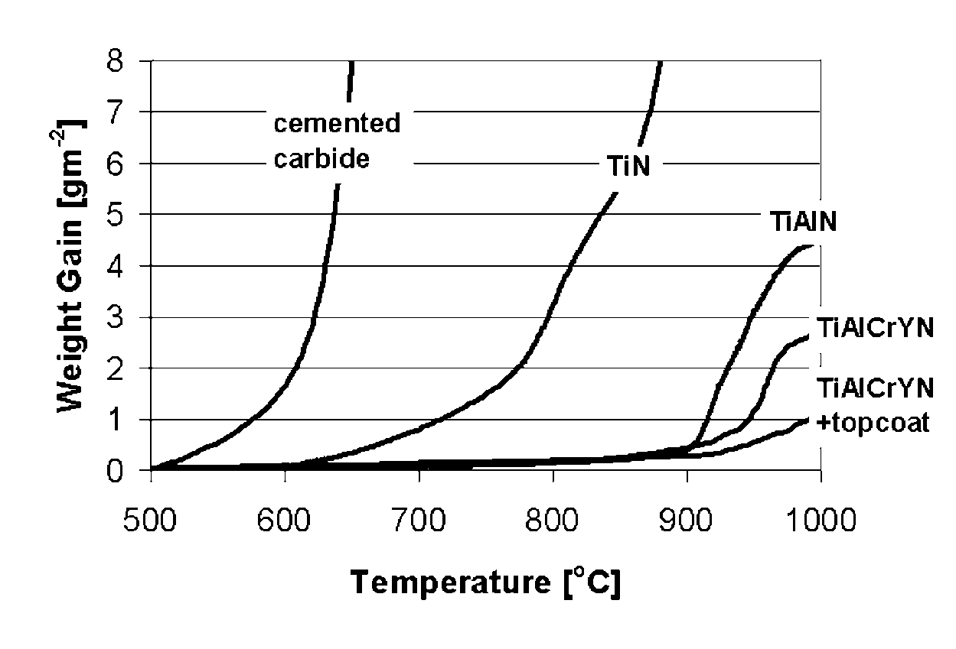
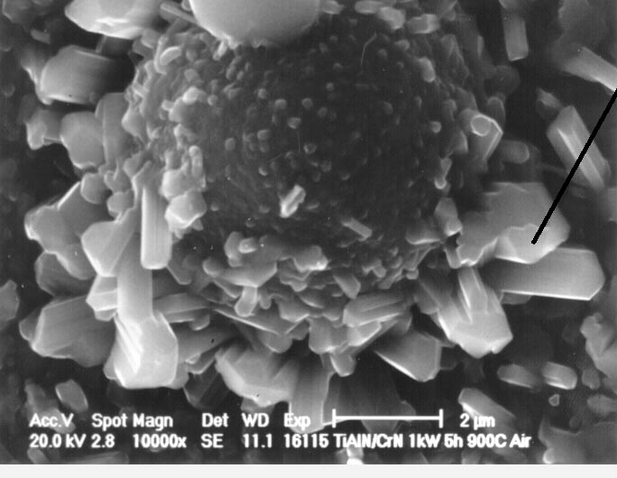
The motivation
TG curves showing the temperatures for the onset of rapid oxidation for various PVD coatings.
SEM images of TiAlCrYN coating showing the surface defects resulted from the use of Arc discharge for surface pre-treatment, (ABS technology).

Slide 3
As-deposited and TiAlCrYN coated CC end mill after heat treatment: 850 C, 1 hour
In these conditions the coated part of the tool remains protected whereas the uncoated shank of the tool is covered with a very thick W-oxide scale. The experiment demonstrates the barrier properties of the coating.

Slide 4
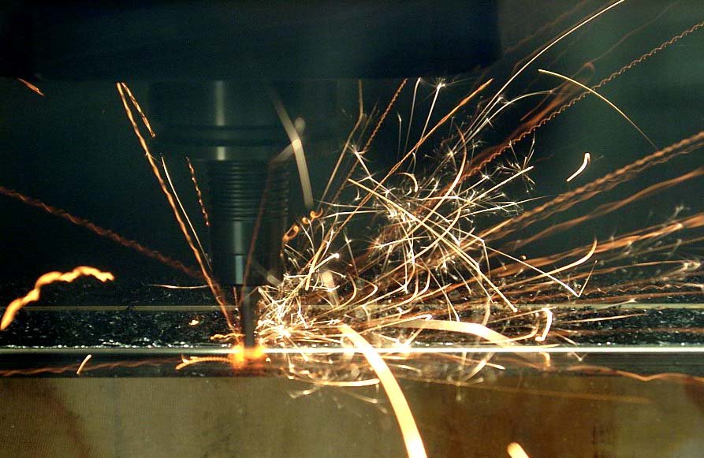
Dry High Speed Milling of Hardened, (58 HRC) High Speed Steel, Cutting Speed 385 m/min
The temperature at the cutting edge during machining in these conditions exceeds 950 °C

Slide 5
Nanoscale Multilayer CrAlYN/CrN Deposited by HIPIMS Technology
Ti free coating formula
Y- stabilised interface by Y⁺ and Cr⁺ ion etching using HIPIMS
CrAlYN/CrN nanoscale multilayer structure , (Δ = 3 - 5 nm) deposited by HIPIMS technology.
CrAlN
interface
SUBSTRATE
P.Eh. Hovsepian, C. Reinhard, A.P. Ehiasarian, CrAlYN/CrN superlattice coatings deposited by the combined high power impulse magnetron sputtering technique. Surf. and Coat. Technol 201(2006)4105-4110.

Slide 6
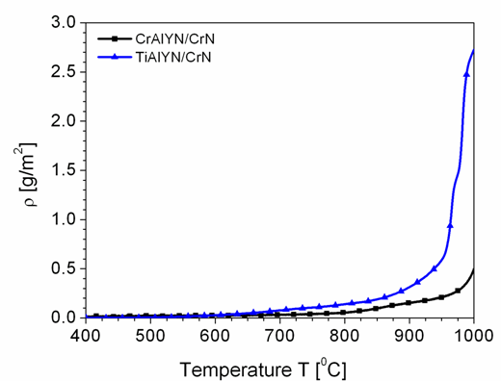
Thermogravimetric Analysis of Ti containing TiAlYN/CrN and Ti free CrAlYN/CrN nanoscale multilayer coatings deposited by HIPIMS. Effect of Coating Composition.

Slide 7
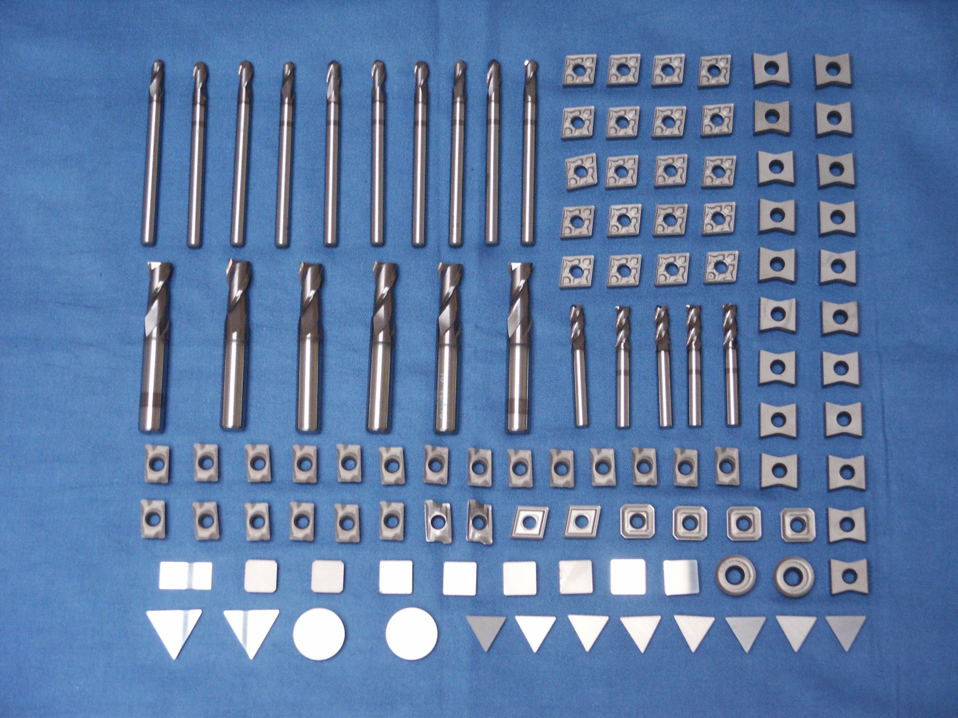
CrAlYN/ CrN Coated Cutting Tools for Dry High Speed Machining

Slide 8
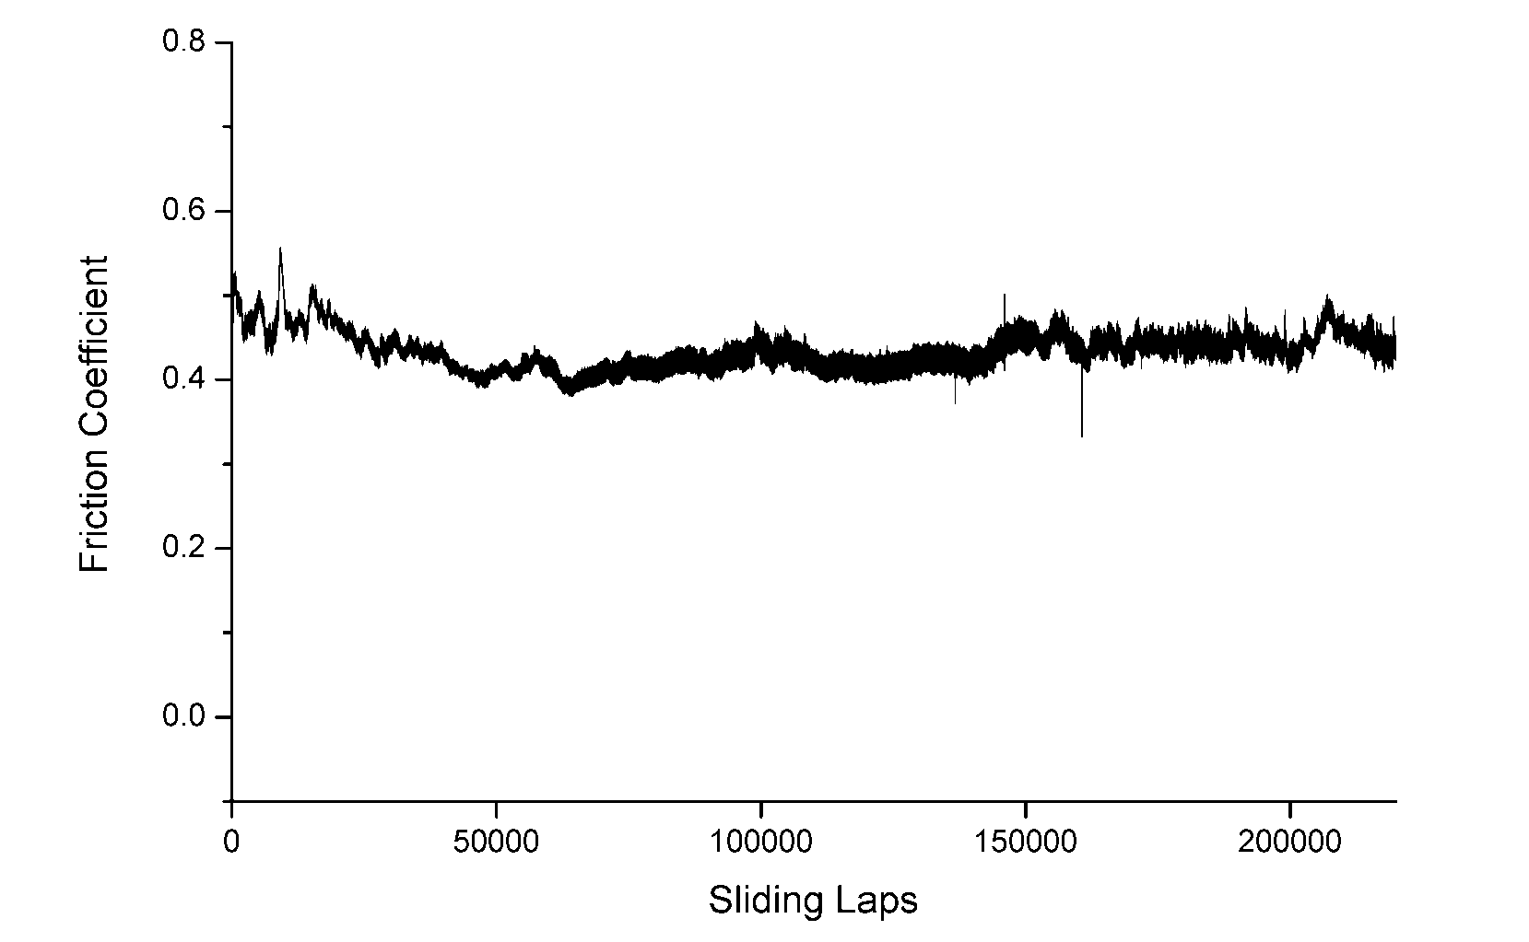
Friction and Wear coefficients of CrAlYN/CrN pin-on disk, Al₂O₃, Load= 5 N, dry
μ = 0.45
K_{s} =2.87 x 10⁻¹⁷ m³/Nm

Slide 9
Wear Coefficients of various PVD coatings pin-on-disc, Al₂O₃, Load= 5 N, dry

Slide 10
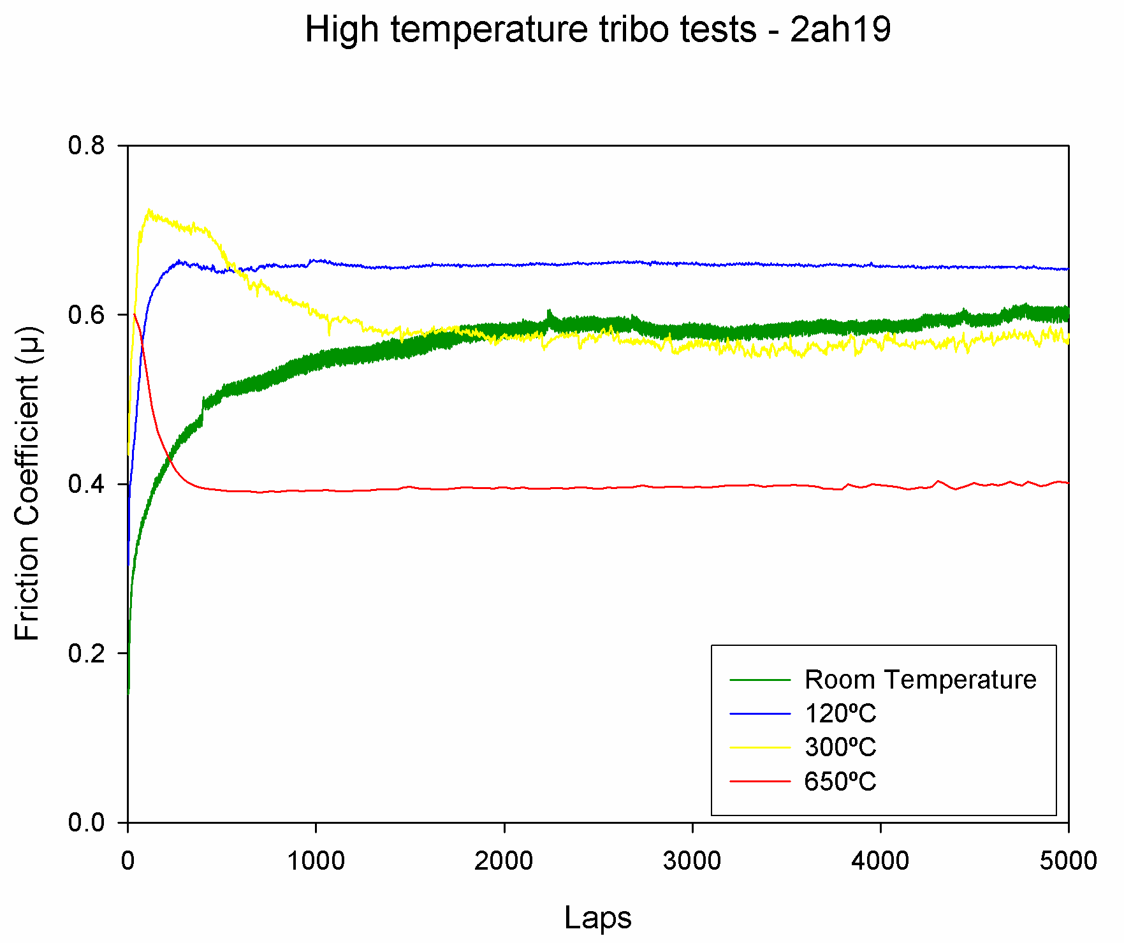
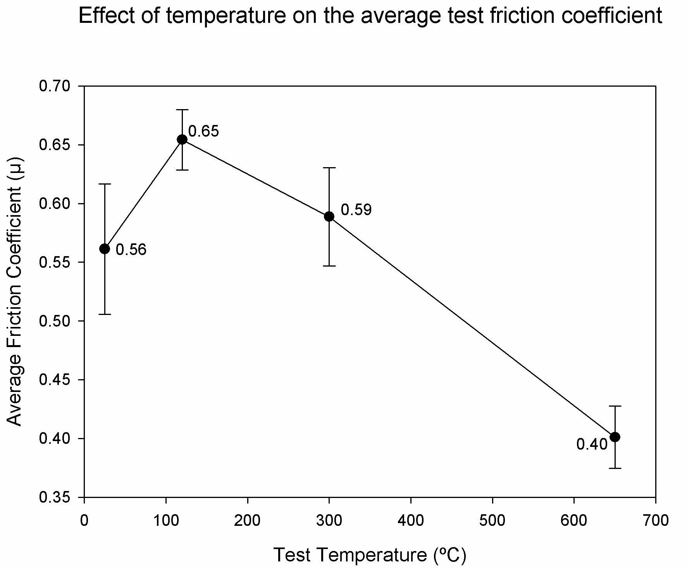
High Temperature Tribological Behaviour of CrAlYN/CrN

Slide 11
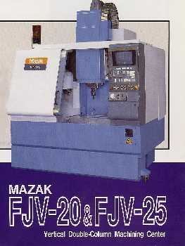
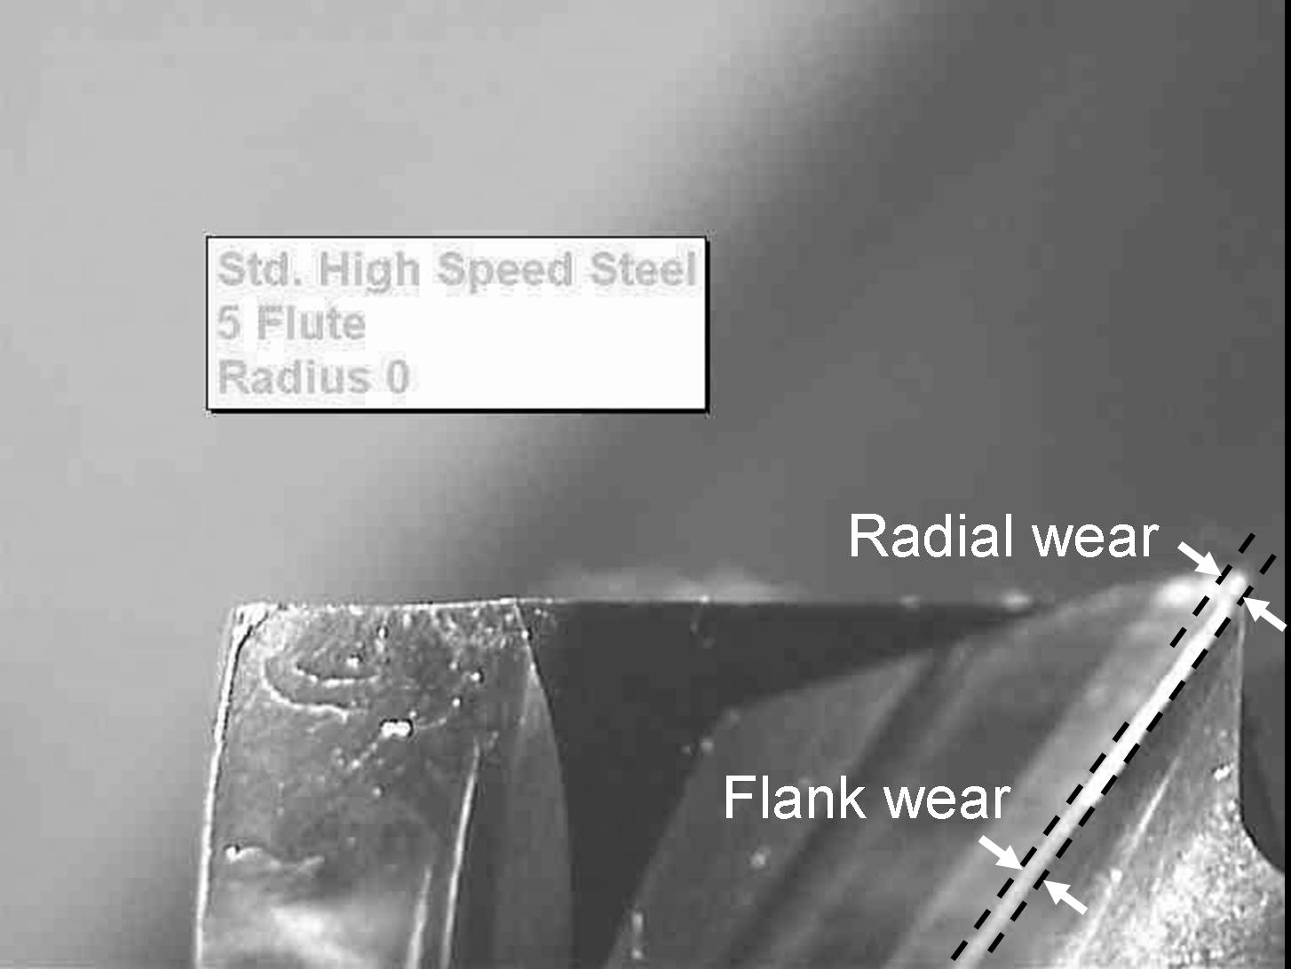
MILLING TEST
Evaluation criteria:
Flank wear ≥ 0.23mm, or
Radial (tip) wear ≥ 0.50mm
24,000 rpm, 1,886 m/min
0.33 mm/rev, 2-flute
Depth 4 mm, width 2 mm

Slide 12
Tool Life Time in A2, (58 HRC) Steel, of coated 8 mm CC Ball Nose End Mill, Speed 385 m/min

