Slide 1
WEAR MECHANISM OF HIPIMS Mo-W DOPED CARBON COATINGS IN DRY AND BOUNDARY LUBRICATION CONDITIONS
Papken Eh. Hovsepian ¹⁾, Paranjayee Mandal, ¹⁾ Arutiun P. Ehiasarian ¹⁾, G. Sáfrán ²⁾, R. Tietema ³⁾, D. Doerwald ³⁾
¹⁾National HIPIMS Technology Centre, Materials and Engineering Research Institute, Sheffield Hallam University, Howard Street, Sheffield S1 1WB, UK,
²⁾ Hungarian Academy of Sciences, Research Institute for Technical Physics and Materials Science, H-1121 Budapest, Konkoly-Thegeut 29-33 Hungary,
³⁾ IHI Hauzer Techno Coating B.V. Van Heemskerckweg 22, 5928 LL Venlo, The Netherlands
National HIPIMS Technology Centre, UK

Slide 2
Me-C Thin Films
100 % Metal
Me films
Me-Carbide + Me films: Me-type and Coating Structure
50 % Me
50 % C
Me- Carbide films: Me-type and Coating Structure
Me-Carbon films: Me-type and content, graphitic- mainly Sp² bonding, Coating Structure
Me-doped DLC films: Me-type and content, % Sp³ bonding, H- content
100 % Carbon
Diamond and DLC films: % Sp³ bonding
Me-free DLC films: % Sp³ bonding, H- content
Utilisation of tribochemical reactions to achieve low friction and high wear resistance of Mo-W- C films in boundary lubrication and elevated temperature conditions. Application: automotive components
National HIPIMS Technology Centre, UK

Slide 3
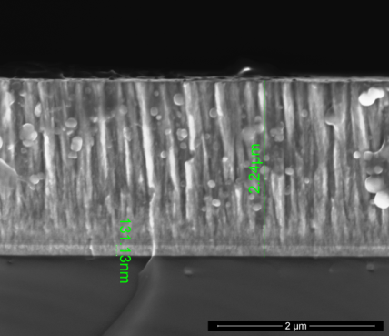
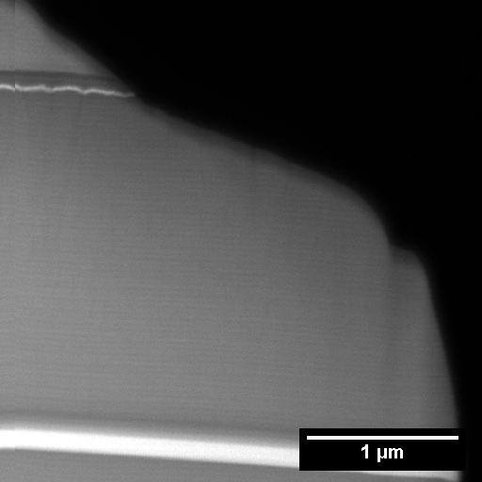
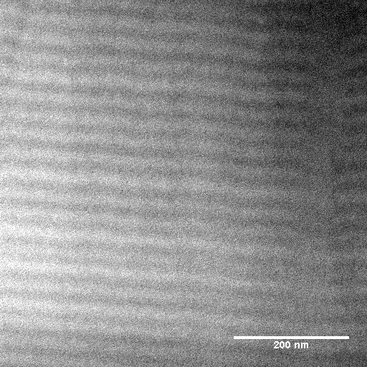
XSEM and TEM analyses of Mo-W doped Carbon films
National HIPIMS Technology Centre, UK

Slide 4
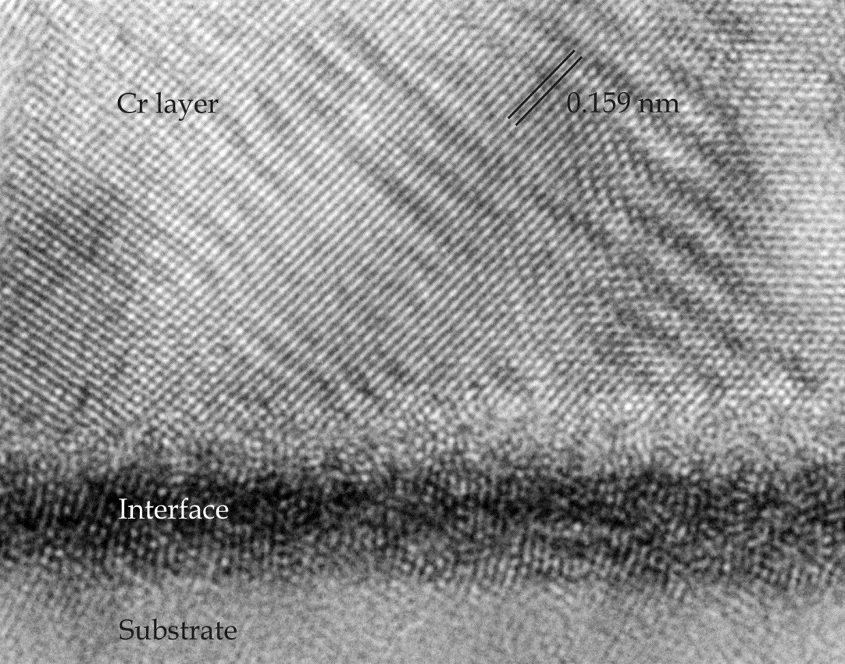
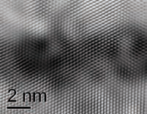
Interface structure after Ar- ion and Me - ion surface pre-treatment
a) Standard Ar-ion pre-treatment b) HIPIMS Me-ion pre-treatment
Amorphised interface with a more random structure Crystaline interface with well-defined orientation
Results in poor adhesion Results in strong adhesion EC, Innovatial Project
Image courtesy of Jeff Th.M. De Hosson, NMP3-CT-2005-515844
Department of Applied Physics,.
Mater Scientific Centre, University of Groningen,
The Netherlands
National HIPIMS Technology Centre, UK

Slide 5
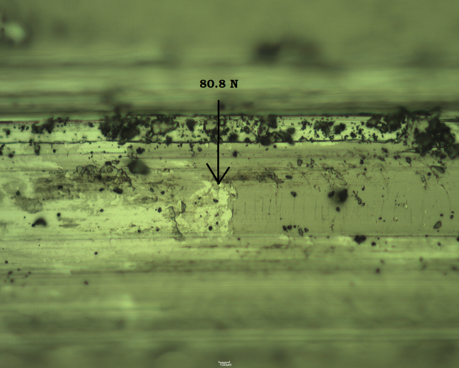
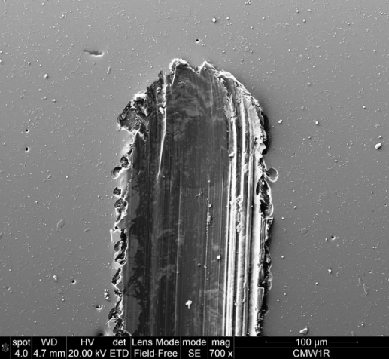
Adhesion of coating Mo-W-C deposited on HSS at 100N normal load
Lc=100N
National HIPIMS Technology Centre, UK

Slide 6
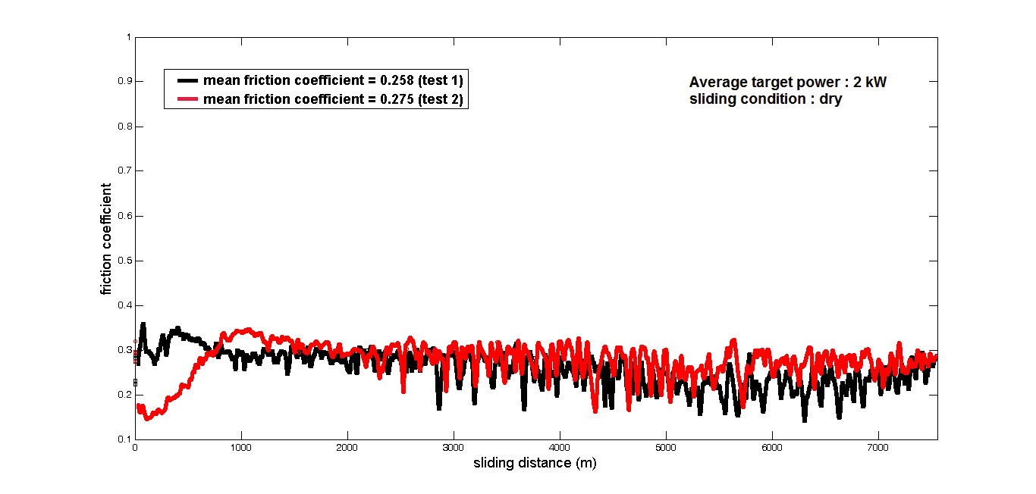
Friction behaviour of the Mo-W-C coatings after 7.5 km of dry sliding
National HIPIMS Technology Centre, UK

Slide 7
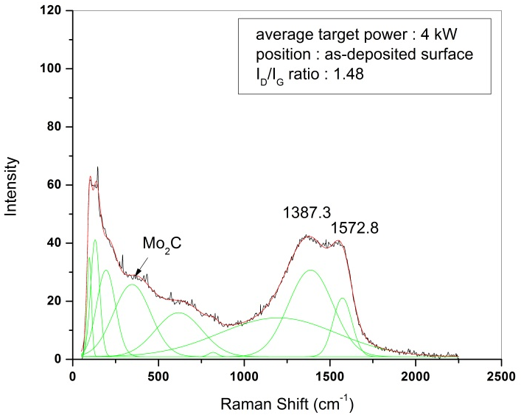
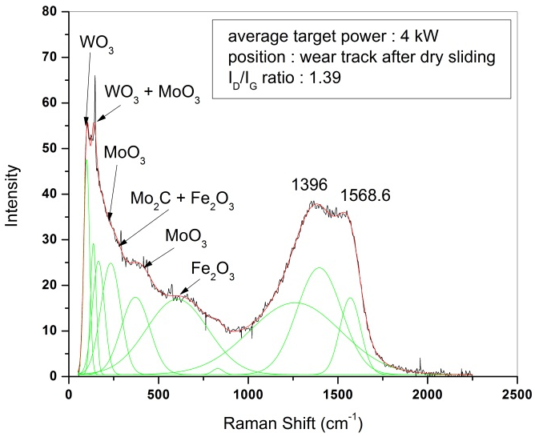
Raman analyses of the wear track after dry sliding at room temperature
National HIPIMS Technology Centre, UK

Slide 8
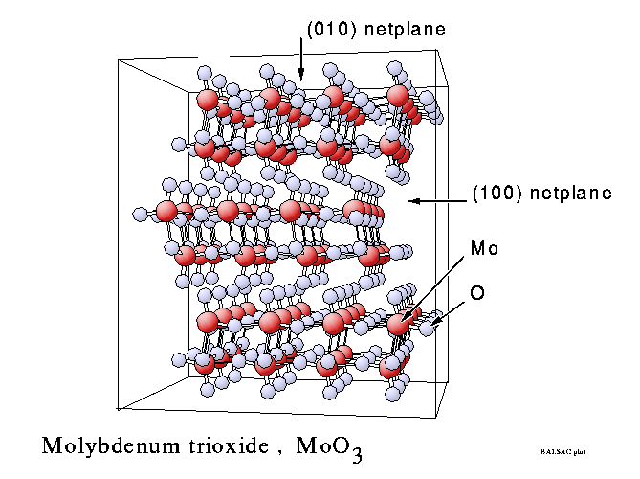
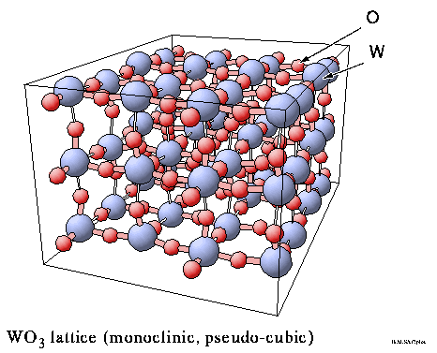
Crystal structure of MoO₃ and WO₃
National HIPIMS Technology Centre, UK

Slide 9
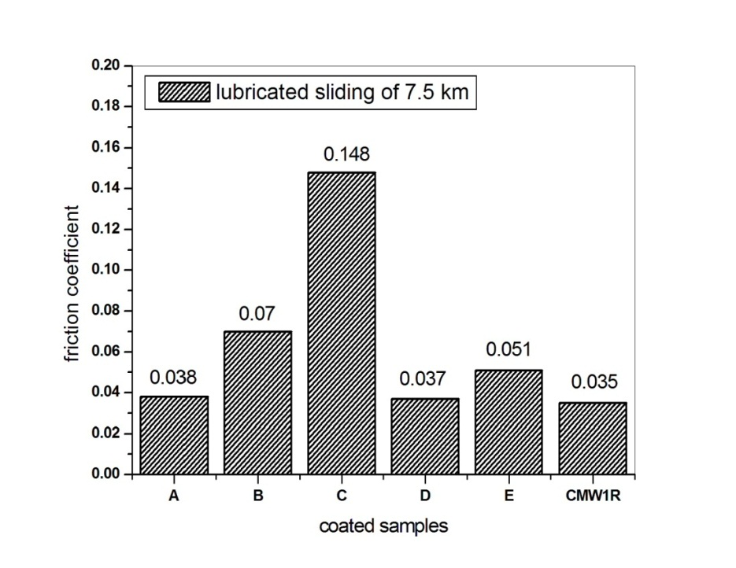
Coefficient of friction of various DLC coatings compared to the Mo-W-C, (CMW1R) coating
Tests carried out with highly viscous Mobil1 Extended lifeTM 10W-60 multigrade synthetic engine oil free of friction modifiers
National HIPIMS Technology Centre, UK

Slide 10
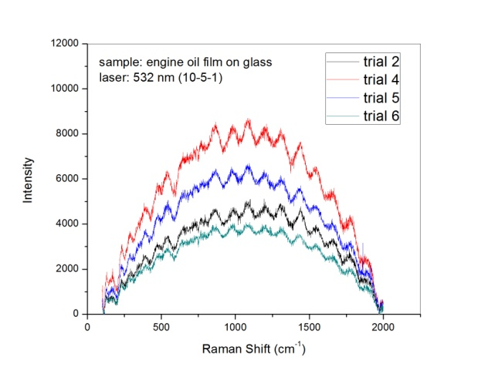
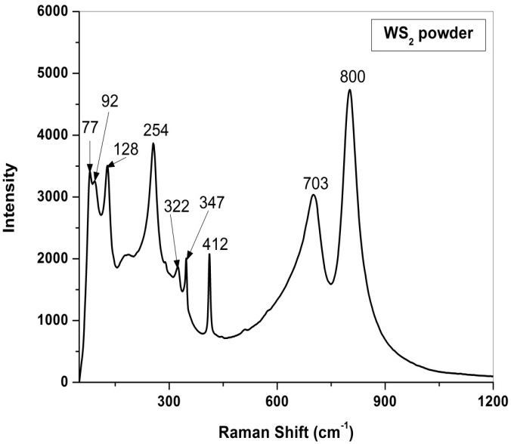
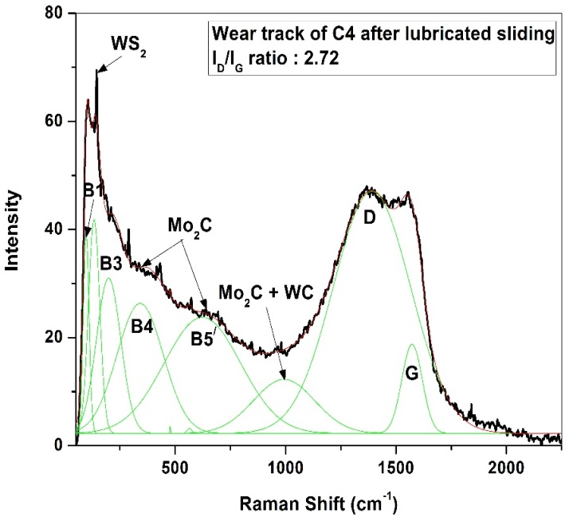
Raman analyses of the wear track after lubricated sliding at room temperature
Lubricant, 10W-60 engine oil
WS2 powder used as a standard
Wear track of Mo-W doped Carbon film
National HIPIMS Technology Centre, UK

Slide 11
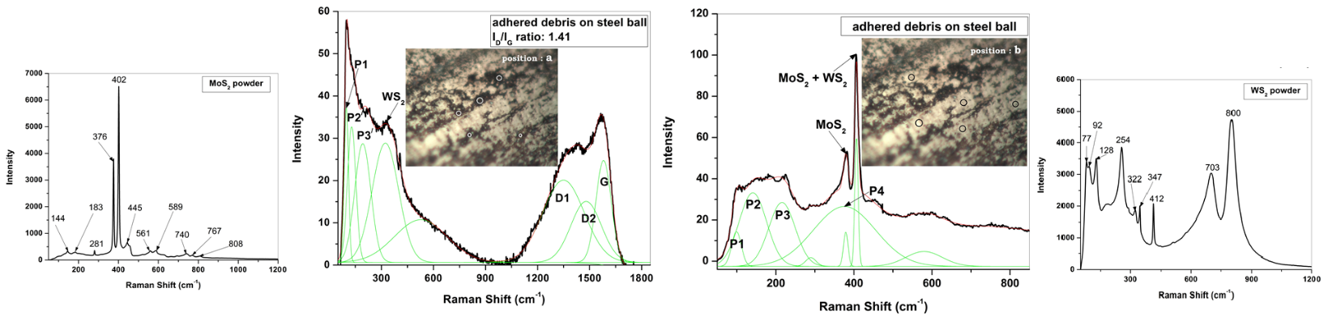
Raman analyses of the wear track after lubricated sliding at 200ºC
MoS2 powder used
as a standard
Different positions in the wear track of Mo-W doped Carbon film
WS2 powder used
as a standard
National HIPIMS Technology Centre, UK

Slide 12
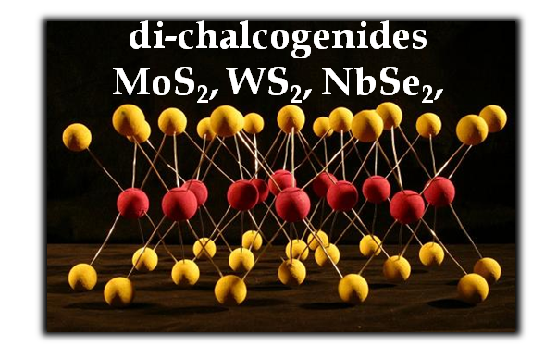
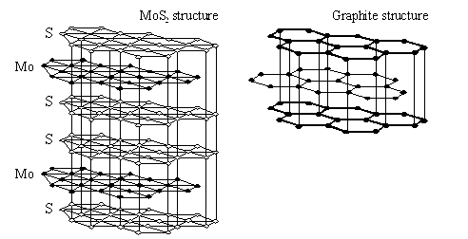
National HIPIMS Technology Centre, UK

Slide 13
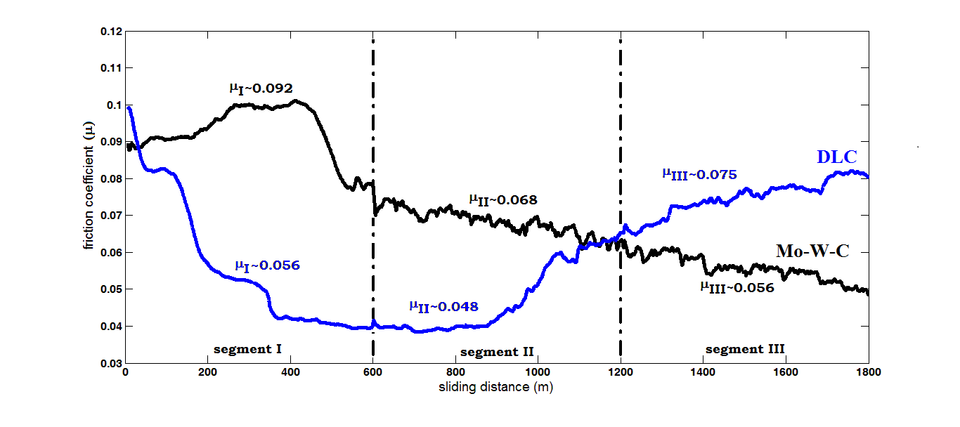
Coefficient of friction of Mo-W-Carbon and DLC films as a function of sliding distance in lubricated sliding at 200ºC against a 100Cr6 counterpart
National HIPIMS Technology Centre, UK

Slide 14
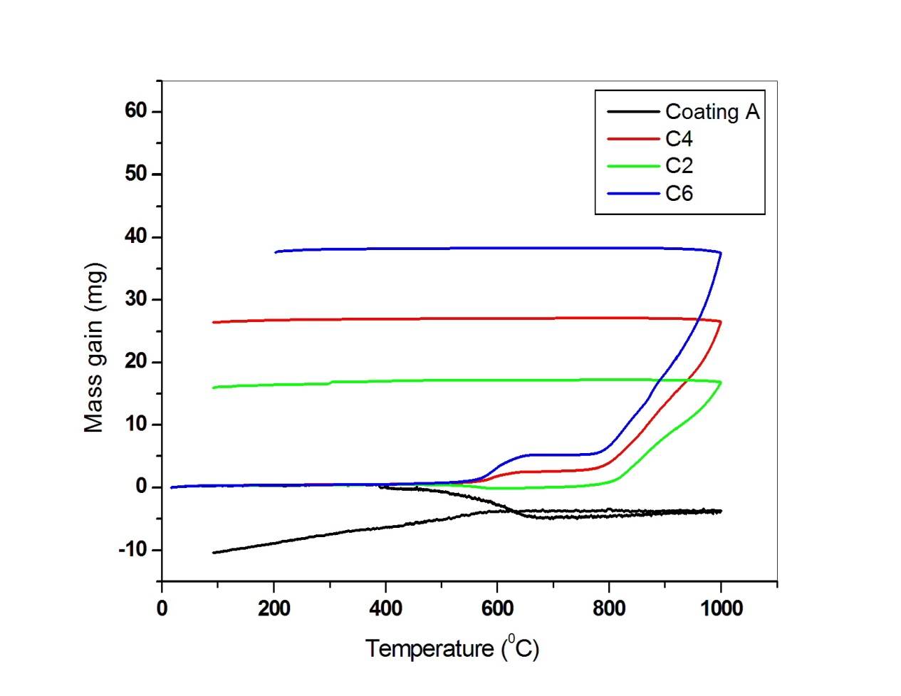
Thermogravimetric analyses of various Me-doped C coatings and SOA DLC coating
National HIPIMS Technology Centre, UK

Slide 15
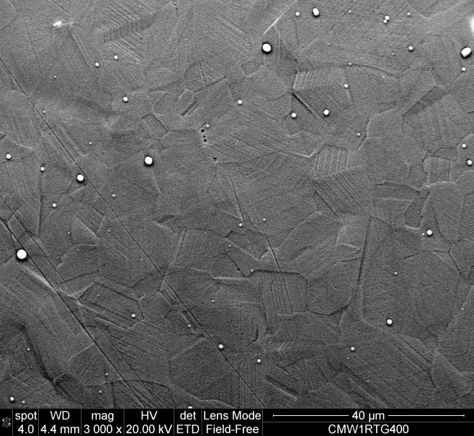
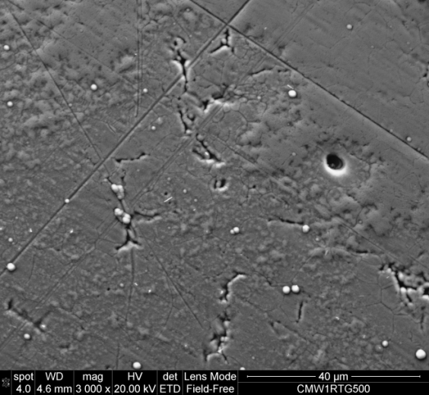
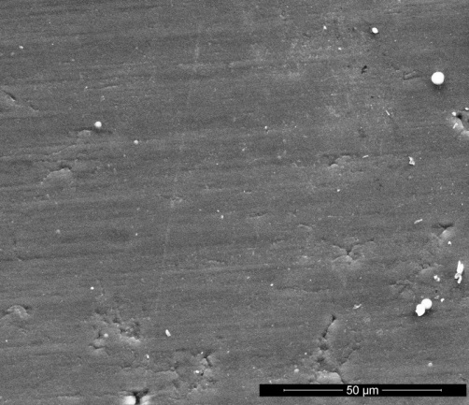
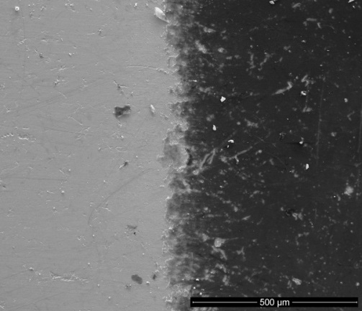
Static oxidation behaviour of Me-C and DLC coatings
Me-C, 400ºC
Me-C, 500ºC
DLC, 400ºC
DLC, 500ºC
Substrate exposed
Coating
National HIPIMS Technology Centre, UK

Slide 16
CONCLUSIONS
Me-doping of Carbon based films is a powerful tool for manipulation of coating structure, properties and therefore performance.
In dry sliding conditions the wear debris consisted of MoO₃ and WO₃ as well as debris of graphitic nature as indicated by the well pronounced D and G band in the Raman spectra. This is typical for oxidative wear mechanism.
In boundary lubrication condition, the friction behaviour of the Mo-W doped C coatings is dominated by the in situ formation of solid lubricants MoS₂ and WS₂ at the asperity contacts, which is typical for the tribochemical reaction wear mechanism.
Simultaneous doping of Carbon films with Mo and W is a key to maintain low coefficient of friction in wide temperature range . WS₂ forms readily at low temperatures where as MoS₂ contributes more effectively at higher temperatures.
Mo and W dopants provide effective tool for further enhancement of the high temperature stability of the Carbon based coatings.
The use of the HIPIMS technology brings further advantages as it provides conditions for deposition of highly adherent, very dense and smooth coatings.
Mo-W doped C coating solution is patent pending
National HIPIMS Technology Centre, UK

