Slide 1
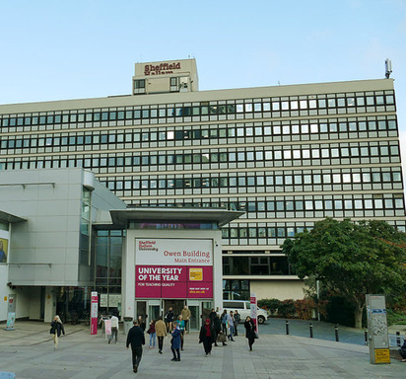
Welcome to Sheffield Hallam
WELCOME TO SHEFFIELD HALLAM
SUPPORT FOR CARE LEAVERS
OUR OFFER
Named contact
You will get a named contact who will:
support you with issues or concerns. You can speak to the one-to-one and contact them over phone or through email.
be a link between you and your local authority
help you access all our support services
send monthly newsletters year round detailing opportunities and events
HELP WITH YOUR FINANCES
You'll receive:
a bursary of up to £1,500 a year for each taught year of study paying full fees. In addition you'll receive an award form our Student Success Scholarship of £2,000 (if eligible)
priority access to our money skills support through one to one appointments or in a workshop.
support with student funding issues.

Slide 2
Named contact information and support
Contact us:
Named contacts: Kate WIlkinson and Robin Kerr
Email us at: inclusivesupport@shu.ac.uk
Call us on: 0114 225 2679
Read about us at Student Wellbeing
ADDITIONAL SUPPORT
Student well being
Offer guidance and support on a range of personal issues and topics, through self-help and online resources as well as group or specialist 1:1 sessions. We have a named contact within this service for care leaver students who may wish to access this support.
Students' Union Advice Centre
Offers free, independent and confidential advice on: Funding: Academic problems: Benefits: Debts: Housing.
Course support
Hallam help is your first point of contact for all enquiries - they will either answer your query or signpost you in the right direction. You can check the knoweldge base on My Hallam or drop Hallam Help a call or email.
Accommodation
If you need information, advice or help with finding somewhere to live or with your current accommodation you can call or drop them an email.

Slide 3
Useful resources
USEFUL RESOURCES
Coram Voice
Coram Voice enables and equips children and young people to hold to account the services that are responsible for their care .
https://coramvoice.org.uk/
The Care Leavers' Association
A network of care leavers whose aim is to improve the current care system, improve the quality of life of care leavers throughout their life and change society's perception of people who have been in care.
https://www.careleavers.com/
Facebook group
We have a Facebook group for Student care leavers. Just search for 'SHU care leavers' in Facebook groups.
The Skills Centre
Offers workshops, small group forums and drop ins for students to help develop academic skills throughout your studies. 1:1 tutorials for students with disabilities are also available.
Topics include: Literature reviews: Assignment planning: Critical writing: Presentation skills.
Careers Connect
Offer support with choosing the right career, looking for jobs - both graduate and part-time, applying for jobs and support when you graduate. They also run a career mentoring scheme which pairs student mentees with professionals who mentor and help them to make decisions about their career. We have a named contact within this service for care leaver students who may wish to access this support.

Slide 4
Top tips
TOP TIPS
If you are having problems applying or accessing your funding, one of our advisers can help to resolve complex SFE enquiries and assist with Hardship support for students facing financial crisis. Speak to Robin or Kate for more information
Get support managing your money. Our money skills advisers can offer lots of useful information and practical steps to help you manage your money. You can find more info here:
https://students.shu.ac.uk/shuspacecontent/finance/money-skills-help-budgeting
Join a club or society. It's one of the best ways to meet people and have fun. Check out
https://www.hallamstudentsunion.com/
If you start to start to feel lonely or isolated, speak to someone. Lots of students struggle to settle into University life, you're not alone! But we understand that it may be more complicated if you aren't sure who to turn to for support. We can help you through until you are feeling more confident and settled. Just get in touch with Kate or Robin for more information or ask Hallam Help to signpost you to the Student Wellbeing Service.
Stay connected with other students - search for 'SHU Care leavers' in Facebook and join our group.

Slide 5
Top tips continued
TOP TIPS
Keep a note of key contacts at University. You may never need to call on them, but it's good to know just in case! There is a list of useful contacts in this booklet.
Get familiar with the city and campus - we know this year is going to be different, but it can help create a sense of belonging when you are more familiar with your surroundings. If you ever get stuck and aren't sure where a room or building is, just head to Hallam Help.
Join the SHU GoGlobal Facebook group to find out about social activities and meet students from different countries - facebook,com/goglobalatSHU
Start thinking about your career early. Take advantage of the specialist Careers and Employability team. Contact Kate or Robin for more information.
If you are looking for work alongside your studies Careers Connect can also help you search for part-tiime jobs both on and off campus. You could even become a Student Ambassador, supporting other students. For more info, contact the service as above.
Visit our Student Wellbeing site for more information about support.

Slide 6
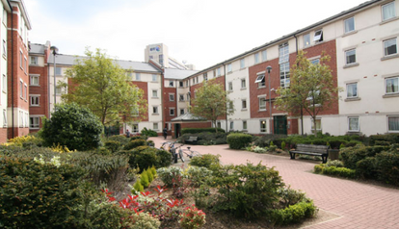
Covid-19 advice and information
COVID-19 ADVICE AND INFORMATION
My Hallam is kept up to date with the latest advice and information , including; Our Commitments; Safety measures; Campus facilities; Teaching and learning; Accommodation; and Student Support.
Make sure you check in with this regularly to ensure you stay in the know https://www.shu.ac.uk/keeping-safe-on-campus
Good to know...
Accommodation
Whether you are living in halls managed by Sheffield Hallam, private student accommodation or shared student houses the guidance is the same:
Discuss any concerns with your hall manager or landlord
Contact the Hallam Help team to speak to a Student or Residential Support Adviser.

Slide 7
Contacts
CONTACTS...
Hallam Help:
0114 225 2222
hallamhelp@shu.ac.uk
https://www.shu.ac.uk/myhallam/help-and-support
Student Wellbeing:
0114 225 2136
student.wellbeing@shu.ac.uk
https://www.shu.ac.uk/wellbeing
Careers Connect:
0114 225 3752
careers@shu.ac.uk
https://careersconnect.shu.ac.uk/
Students Union Advice Centre:
0114 225 4148
https://www.hallamstudentsunion.com/advice_help/
Skills centre:
https://blogs.shu.ac.uk/skillscentre/
Accommodation:
0114 225 5555
https://www.shu.ac.uk/study-here/accommodation

