Slide 1

Northern Powerhouse Devolution and the Politics of Austerity:
The case of the Sheffield City Region
David Etherington and Martin Jones

Slide 2
Understanding Economic Development
Jobs Gap
Training and Skills
Competitiveness/Labour Market Inequalities
Work Programme
Low Pay

Slide 3
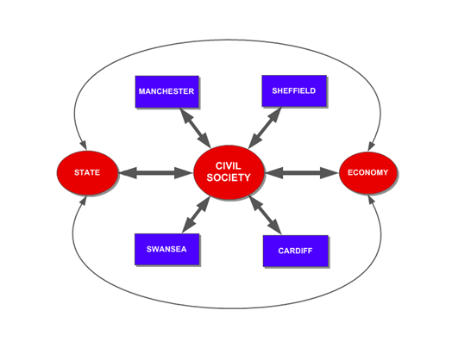
Introduction and background
The research arises from current research on City Regions and Civil Society carried out by Sheffield University (Jones) and recent research on welfare reform and employment policy by Middlesex University (Etherington)

Slide 4
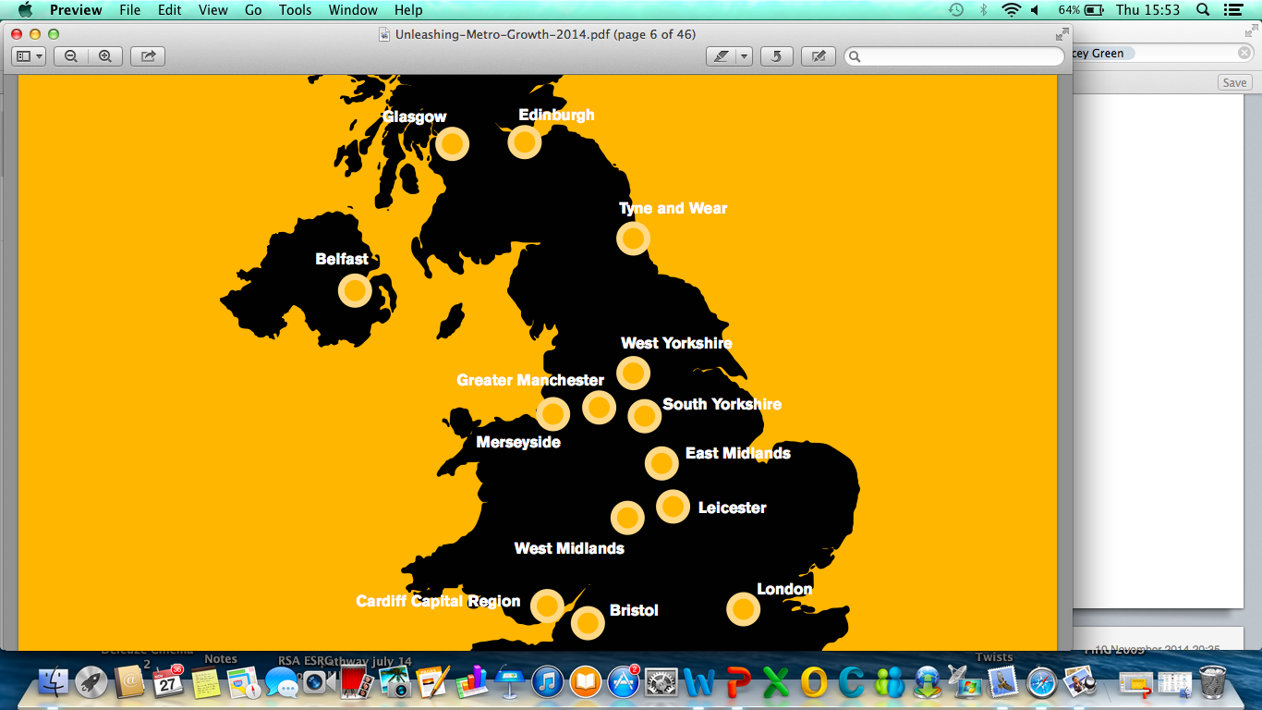
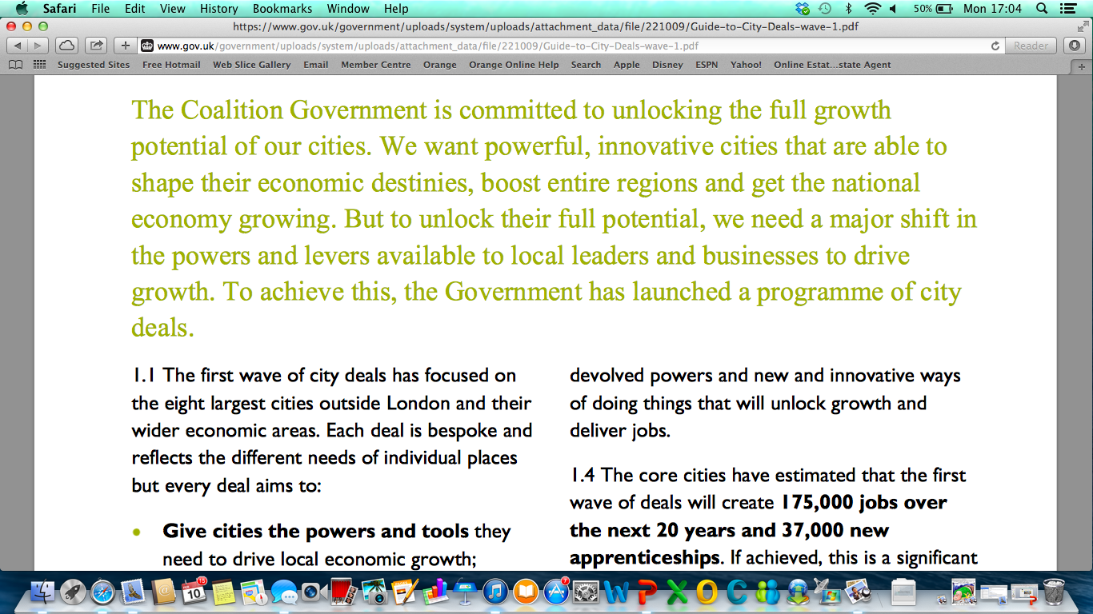


Slide 5
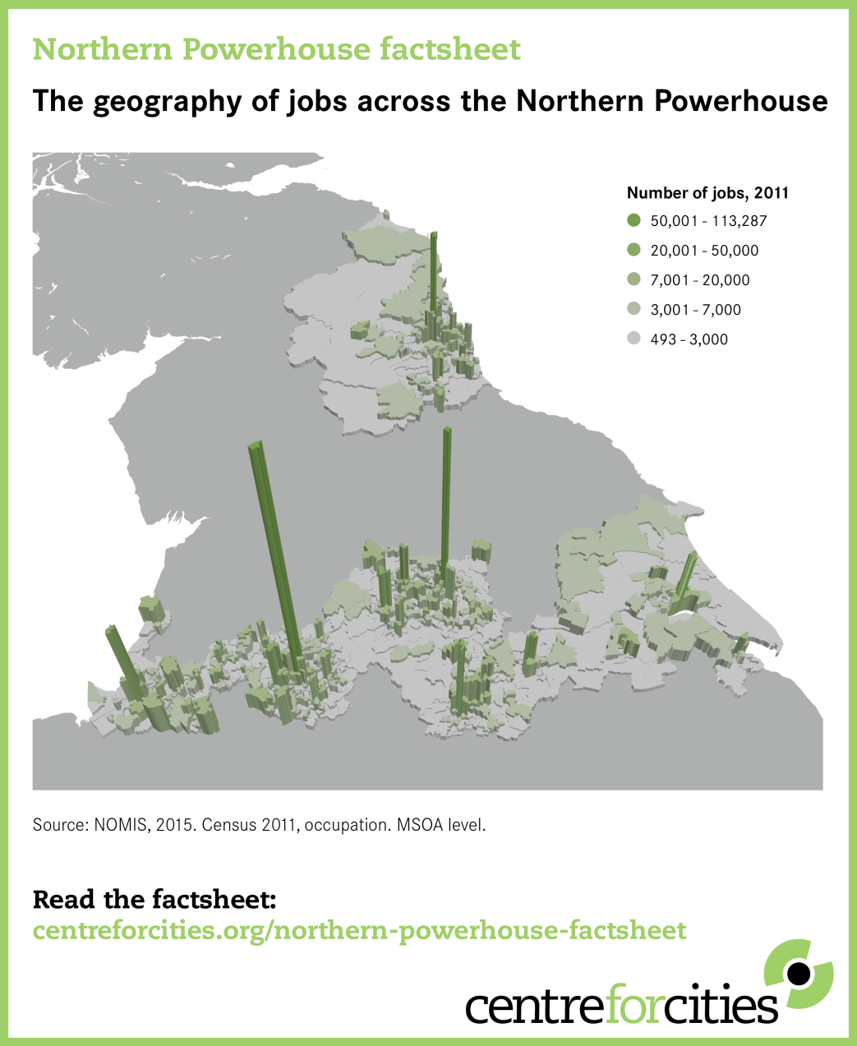

Slide 6
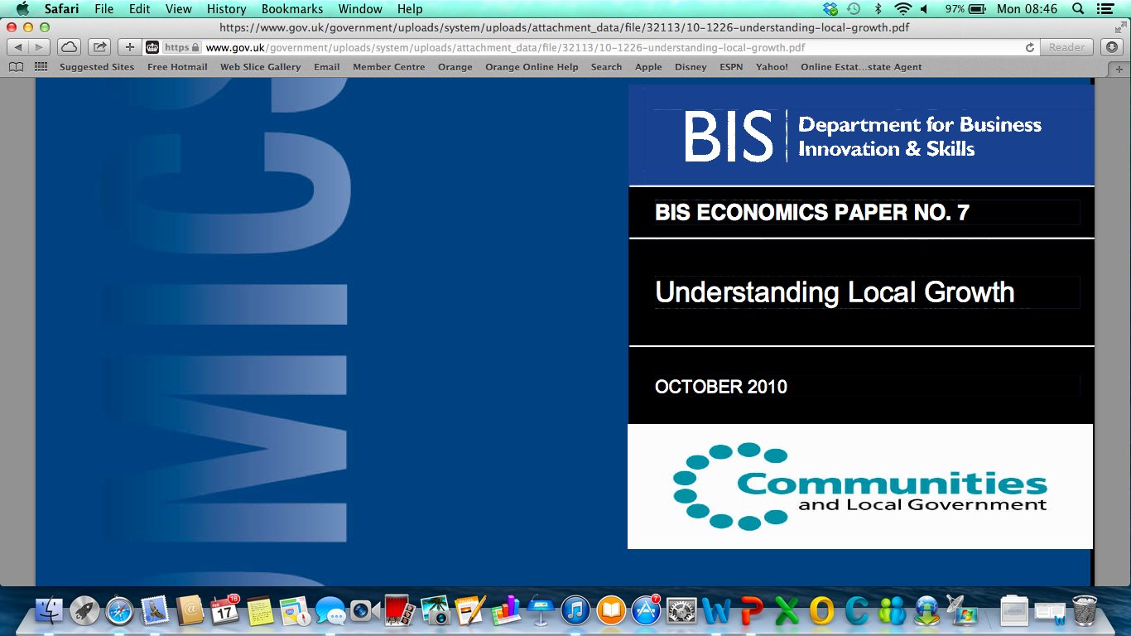
“The policy implications of theories of agglomeration
is that enabling people and firms to benefit from
proximity to centres of activity, bring beneficial
economic outcomes … This implies empowering
and incentivising local government, firms and
people across economic centres and natural
economic geographies [Cities] to promote
growth and correct the market and government
failures which are acting as barriers to
economic development” (BIS 2010: 25).
Agglomerone?

Slide 7

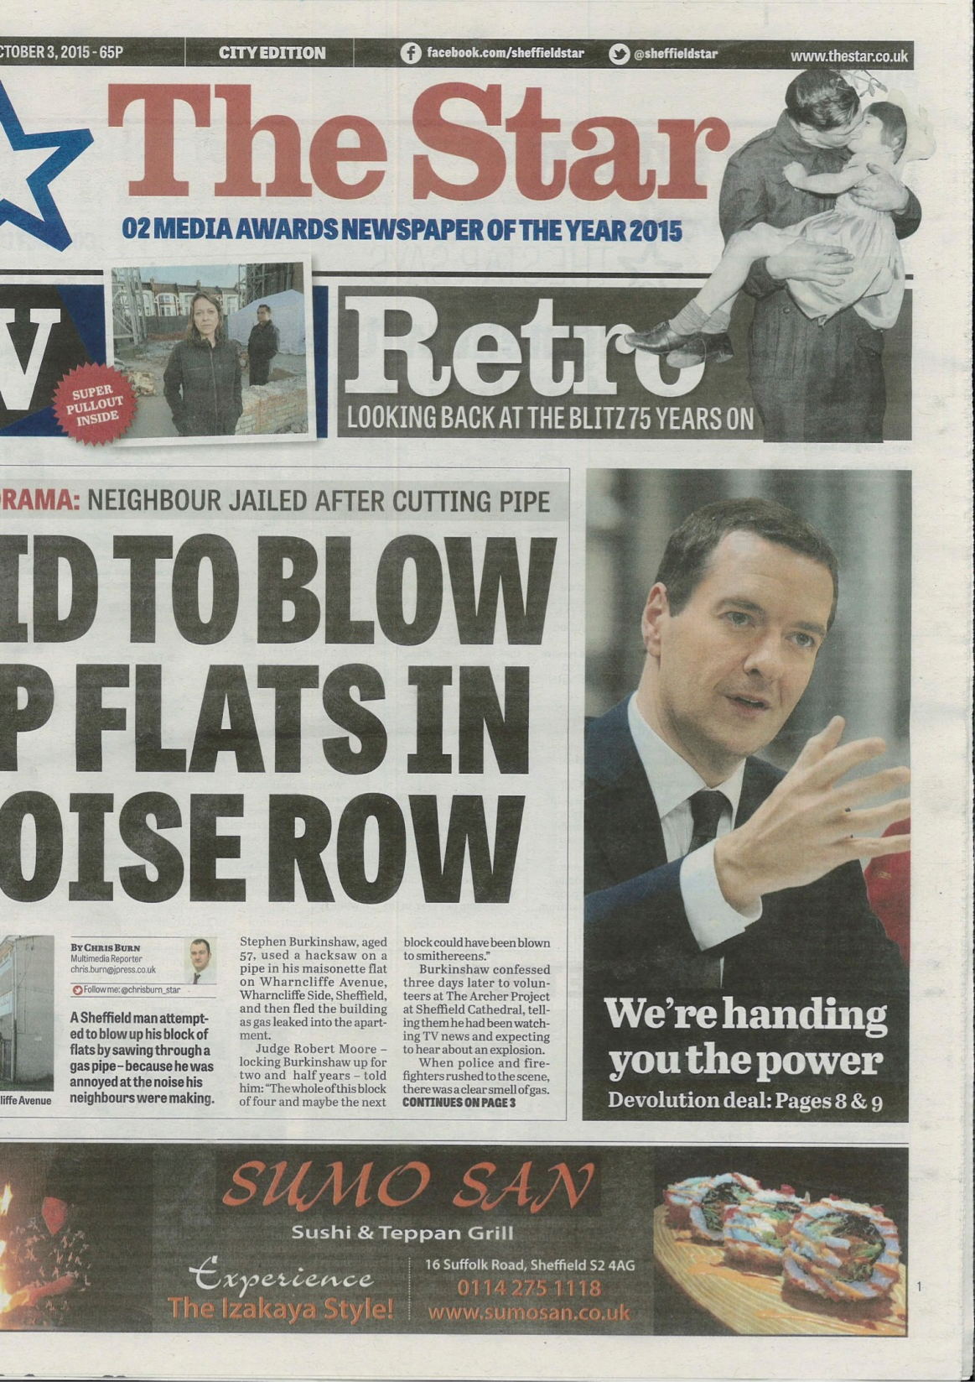
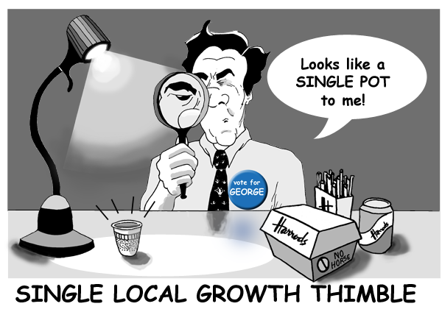
£900m over 30 years ‘immune’ from
Spending review

Slide 8
“This will be unique in the world and be a true new industrial revolution. It looks more like the place that the Thunderbirds was set than what you would imagine of a transformed coal coking plant”
(Sir Keith Burnett, VC, University of Sheffield, 2nd October 2015).

Slide 9

“Former Blue Peter host Anthea Turner has revealed that she still
has that Tracy Island model she made in the 90s”
(Radio Times 13th September 2015).

Slide 10


Slide 11

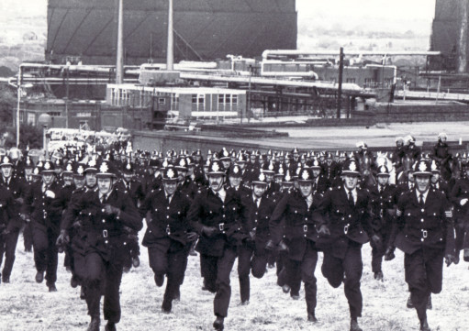

Slide 12
But …
There is a significant gap in our knowledge relating to the nature, role of and impact of welfare, employment and skills policies on disadvantaged and marginalized groups
This research, which has been funded by the University of Sheffield as part of a collaborative R&D initiative involving the Sheffield City Region Combined Authority

Slide 13
Methods
Scoping and literature review and text analysis as well as stakeholder mapping
30 semi-structured interviews with key actors operating across the SCR, including interviews with WP providers, LEP, local partnerships, NGOs
Data was obtained from Sheffield First forums on Devolution, Fairness and State of Sheffield (2016)
Focus group involving unemployed participants randomly assigned from records held by Sheffield College. The group was broadly representative in terms of age, gender, ethnicity, disability and length of unemployment
Focus group on triangulating research findings with those interviewed plus other national, regional, and local stakeholders

Slide 14
Objectives of research
The broad objectives of the research are to explore how Northern Powerhouse strategy, spatial rebalancing, and devolution deals are impacting on employment, skills and welfare policy within Sheffield City Region (SCR)
The extent to which City Region growth strategies addresses the economic needs of deprived groups
Explore what would constitute an inclusive growth agenda
Focus of presentation is to present our findings on the link between devolution and austerity

Slide 15
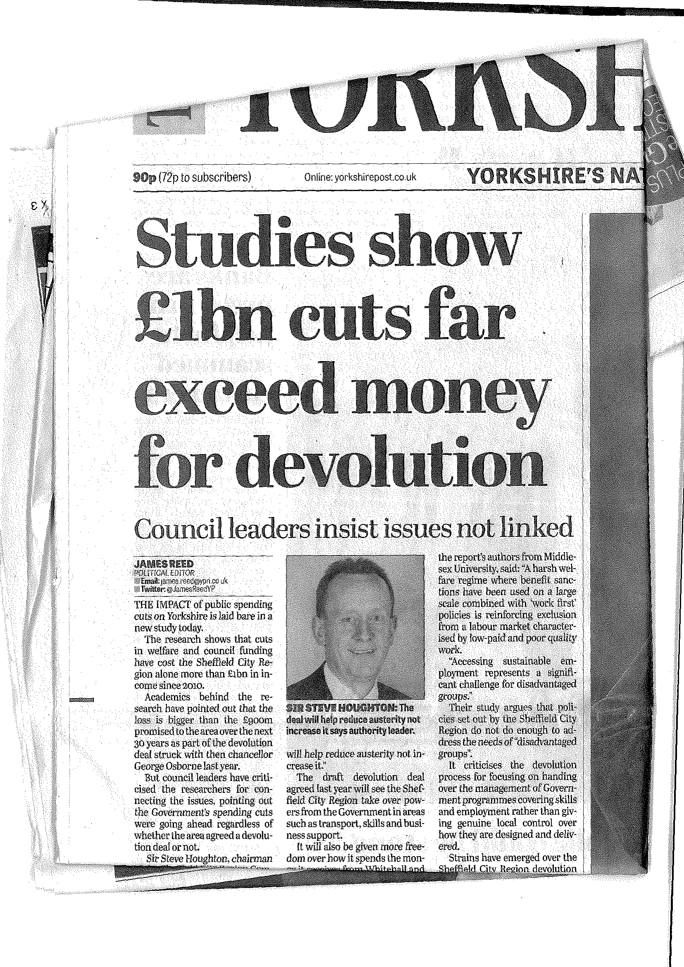

Slide 16
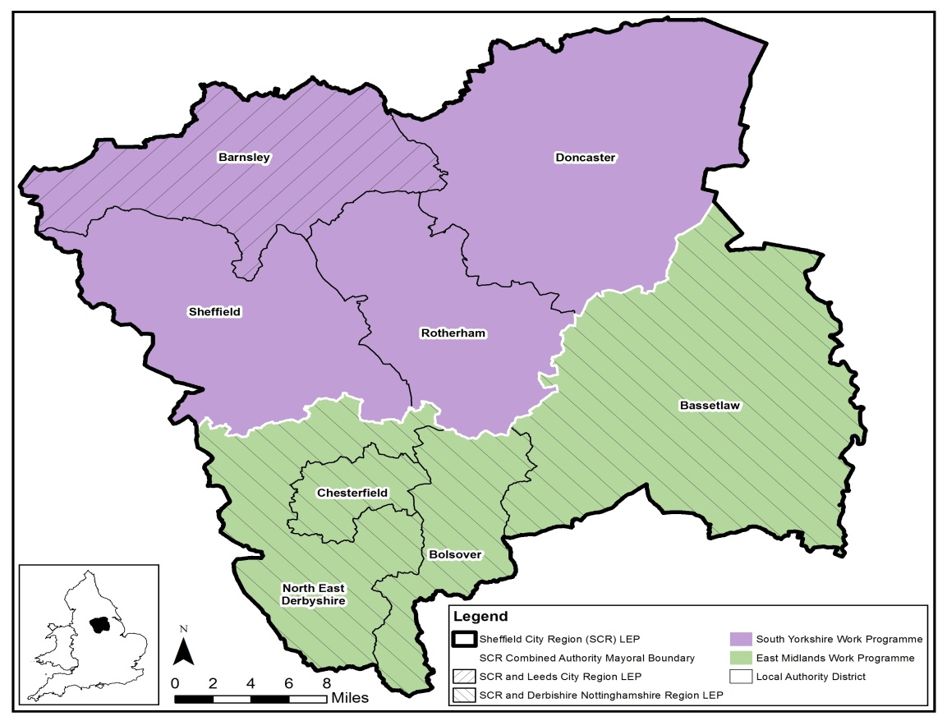

Slide 17
Sheffield CR Employment and Skills Initiatives
Skills (19+) -The Government will enable local commissioning of outcomes to be achieved from the 19+adult skills budget starting in academic year 2016/17; and will fully devolve budgets to the Sheffield City Region Combined Authority from academic year 2018/19 (subject to readiness conditions
Skills (16-18) Area Based Review of post-16 education and training leading to agreed recommendations by February 2016. The outcomes of the Area Based Review will be taken forward in line with the principles of the devolved arrangements the SCR Combined Authority will work in partnership with local colleges and providers to publish a local skills strategy
Employment - Sheffield City Region Combined Authority will work with DWP to co-design the future employment support, from April 2017, for harder-to-help claimants, many of whom are currently referred to the Work Programme and Work Choice.

Slide 18
Welfare and employment policies
Across City Region – Ambition (L.A. run programme addressing youth unemployment) and Apprenticeships (Skills Bank Skills Made Easy)
Jobcentre Plus – Claimant agreement and employment support, Sector Academies and Skills Conditionality
Work Programme Providers – Serco, (SY) People Plus (SY and N Derbyshire) Ingeus (N. Derbyshire
Employment and Skills Providers – private linked to Work Programme and Skills Funding Agency programmes.
Local authority schemes for disadvantaged groups and employment and skills strategies; providing support services
Voluntary Sector – Lottery funded programme on youth plus advice services

Slide 19
Key Issues relating to devolution
1. Austerity driven cuts challenge city region growth
The total expenditure reduction for the nine SCR local authorities between 2010-2014 amounted to around £442.4m; with the loss of income as a result of welfare changes among resident population in 2015 alone amounting to approximately £577m. This collectively is a £1.19b loss of income from the SCR, which needs to be compared to the Sheffield devolution promise of £900m over 30 years.
In addition, the estimated cumulative cuts (savings) for the 2016/17-year for the nine local authorities amount to a further £131million.

Slide 20
2. A harsher welfare regime (including benefit cuts)
There is evidence that the welfare changes negatively impact on benefit claimants in terms of increasing levels of impoverishment and this can create barriers to accessing the employment skills system.
Between 2012 and 2015, approximately 70,000 Job Seekers Allowance sanctions have been implemented within the SCR and there is evidence that this has led to poverty
New welfare to work settlement in the SCR framed by significant reduction in spending for employment support for disabled people (cf ERSA estimates)
Labour market distortion and segmentation which undermines devolution growth objectives

Slide 21
3. Cuts to adult skills budgets adversely impact on disadvantaged groups
The European Union Social Fund (ESF) has co-funded with the Skills Funding Agency (SFA) a significant number of programmes (between 2012-2015) targeted at disadvantaged groups in the labour market have now ended and this is the equivalent of a loss of nearly £40 million. Given the recent decision to leave EU and the skills funding cuts, it is unlikely that these will be continued or replaced under the new devolution arrangements.
The Adult Skills budget cuts have been ongoing for a number of years reducing access to skills for disadvantaged groups. Ewart Keep estimates that between 2010 and 2018 the DBIS budget will have been cut by 42.5%.
Devolution policies operate within these spending allocations and in this way are devolving the cuts

Slide 22
Concluding comments: Devolution missing an inclusion framework? Depoliticising Austerity?
The SCR faces pressing questions on the extent to which disadvantaged groups will access jobs created via economic development strategies.
There is a lack of transparency regarding the nature and impact of employment and skills programmes in the SCR.
There are weak links between welfare-to-work programmes and SCR initiatives and partnerships.
There is little provision in the devolution agreements for organisations representing disadvantaged groups to be involved in decision-making.

Slide 23
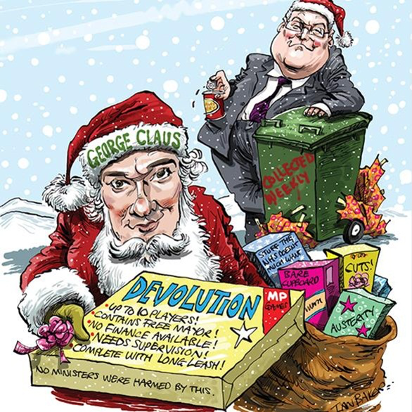

Slide 24

“When asked who might be frontrunner for Mayor, Mr Mothersole [Chief Executive of Sheffield City Council] said: ‘Buzz Lightyear’”
(The Star, 3rd October 2015).

Slide 25
Where next? Some guiding principles for an Inclusive Growth Strategy for the SCR
Lessons should be drawn from the Leeds City Region Joseph Rowntree collaboration “Connecting growth and poverty reduction More jobs better jobs in the Leeds City Region.”
Address gender disadvantage and gender pay gap via audit and assessment of growth policies (for example advanced manufacturing, construction) and other non-traditional women’s work to break down gender segregation in the labour market.
Highlight the financial case for inclusion by undertaking a cost benefit analysis of anti-poverty initiatives and the public expenditure savings that can be accrued.
Changing the narrative about the role of the public sector – its role in shaping growth and addressing disadvantage

Slide 26
Increasing emphasis upon employment rights, in-work support, and progression
Increase access to apprenticeships for disadvantaged groups—learn from best practice (e.g. LGA review).
Promote high-quality apprenticeships in the context of expanding numbers and supporting the research of the TUC and Ofsted.
Promote employee voice in the city region through the Unionlearn model.
Pilot a Job Rotation model within the Sheffield City Region.
Promote Living Wage.

