Slide 1
Can devolution deliver inclusive growth?
Rich Crisp (CRESR)
SIPS Policy Forum
30th November 2016
Notes:
Thanks to Peter, Paul and Camilla..
Timely presentation Brexit and election and Trump...lot of political soul searching about how to re-engage and support those left behind by economic change
Rising up the agenda of the devolved institutions, especially the CAs. Interested in scope for devolution of new funds + F&Fs to deliver inclusive growth.
Key question = can devolution deliver on inclusive growth? Too early to answer that conclusive as in in infancy but reflect on why gaining traction; what it means; what it might look like; and what are the prospects of success given what we now about how devo works.
Bit of a pick and mix approach - drawing on research that myself and colleagues have done...

Slide 2
An idea whose time has come?
IMF Inclusive Capitalism conference (2014)
OECD Inclusive Growth in Cities campaign (2016)
All Party Parliamentary Group on Inclusive Growth (2014-16)
RSA launch Inclusive Growth Commission (2016-17)
GM, Leeds and Sheffield city regions + others all pursuing IG agendas
....'an economy that works for everyone'... to make sure that everyone can share in the country’s wealth (PM May)
Notes:
Series of institutions - both international and domestic- have picked up the mantel. Now in the middle of RSA Commission
Interesting...some orgs you wouldn't necessarily expect. Oxymoron..
What matters for this presentation is that...lot of talk of inclusive growth or good growth at city regional level...how can it be reoriented to support goals around reducing poverty, tackling worklessness and providing good quality employment.
Why gaining traction?
Persistent social and spatial inequalities
Brexit and the 'left behind'
Poverty and inequality as a brake on growth

Slide 3
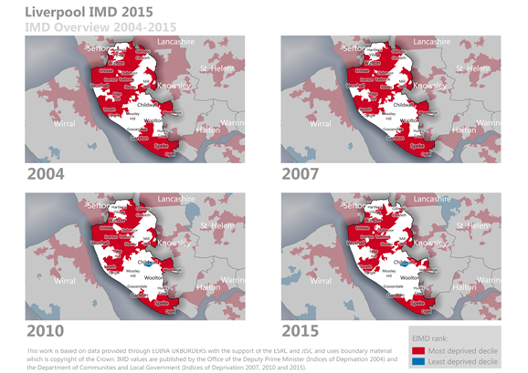
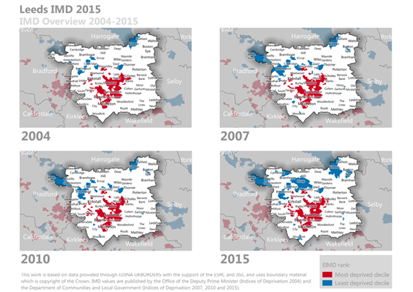
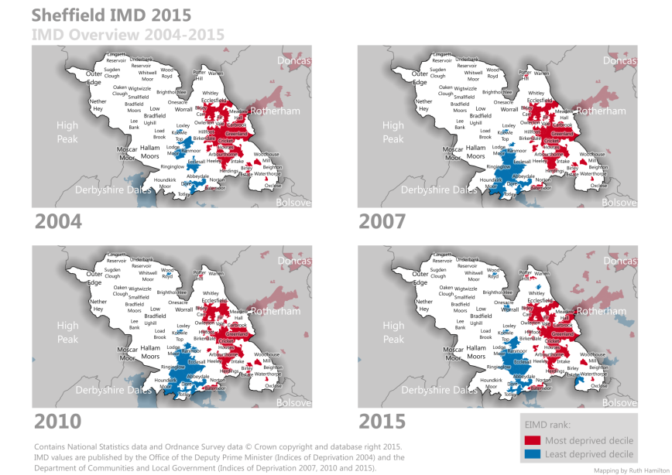
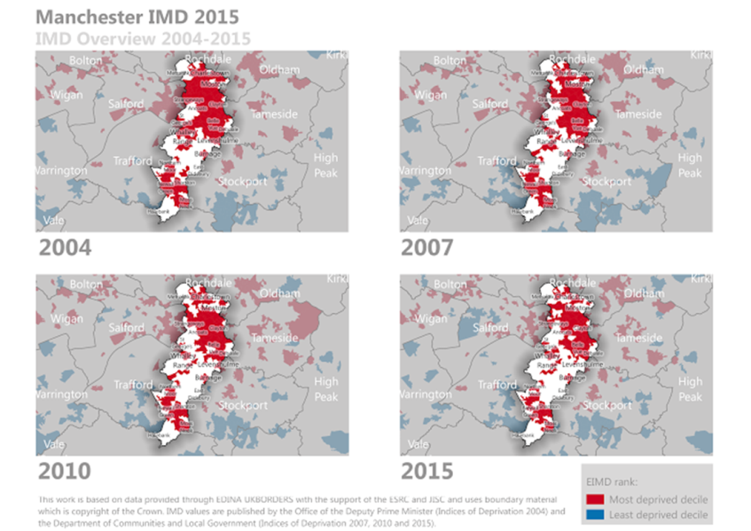
Enduring inequalities
Source: Rae et al. (2016)
Notes:
Inequalities are entrenched and enduring.
Shows least and most deprived areas over four points in time

Slide 4
Brexit and the 'left behind'
Source: RSA (2016)
Notes:
And that economic marginalisation is seen as part of story around vote to leave EU
Older industrial areas - tended to vote leave in high numbers. (Using Industrial communities Alliance definition of old industrial areas). All OIA in Scotland voted to remain

Slide 5
The Inclusive Growth Monitor
Full report and technical note:
https://www.jrf.org.uk/report/inclusive-growth-monitor
Notes:
Why also did some work for JRF to develop an inclusive growth monitor which essentially looked to explore the relationship between poverty and growth.
We did this at LEP level - to capture FEAs and also to reflect the way in which city regions are increasingly the scale at which strategy and policy are being decided.
Basketof indicators representing p + d (called inclusion indicators) and a set of indicators representing economic performance (prosperity).
Using these you can come up with a score for each to see how areas are doing in any year or over a period of time.

Slide 6
Dimensions and indicators in inclusion theme
Dimension | Indicator | Full definition of indicator
Income | Out of work benefits | % of WAP receiving out-of-work benefits
 | In-work tax credits | % in-work households with and without children receiving Child and/or Working Tax Credits
 | Low earnings | Gross weekly pay at the 20th percentile
Living costs | Housing affordability | Ratio of lower quartile house prices to lower quartile earnings
 | Housing costs | Median monthly rents for private sector dwellings
 | Fuel poverty | % of households classed as 'fuel poor'
Labour market exclusion | Unemployment | % of WAP not in employment but actively seeking work
 | Economic inactivity | % of WAP classed as economically inactive
 | Workless households | % of working-age households with no-one in work
Notes:
Each theme represented by nine indicators. Table shows all nine indicators for the inclusion theme.

Slide 7
Dimensions and indicators in prosperity theme
Dimension | Indicator | Full definition of indicator
Output growth | Output | Gross Value Added (GVA) per capita
 | Private sector businesses | Number of private sector workplaces per 1000 WAP
 | Wages/earnings | Median gross weekly pay for full-time workers
Employment | Workplace jobs | Employee and self-employed jobs by working-age population (jobs density)
 | People in employment | % of WAP in employment (employment rate)
 | Employment in low pay sectors | % of workers employed in administrative and support services, wholesale and retail trade, accommodation and food services, and residential and social care sectors
Human Capital | Higher level occupations | % workers in managerial, professional and technical/scientific occupations
 | Intermediate and higher level skills | % WAP qualified at NVQ Level 2 and above
 | Educational attainment | % of pupils at the end of Key Stage 4 achieving 5 or more GCSEs or equivalent at grades A* to C (including English and Mathematics)
Notes:
Nine indicators for prosperity theme.
Covert the performance of each area for each indicator into a score between 0 and 1 depending on how well they do compared to other LEPs.
Highest employment rate = 1; lowest = 0. All rest in between.
End with an two overall scores for inclusion; overall score for prosperity which in theory can be anywhere between 0 and 9.

Slide 8
Prosperity doesn't always benefit all...
Notes:
This chart shows performance over time relative to all other LEPs
If you're doing well on eco performance you're over to the right
If you're doing well on inclusion near the top
Ideally want to be in top right hand.
Show growth doesn't benefit all.
Updated annually

Slide 9
What does Inclusive Growth mean?
"Broad-based growth that enables the widest range of people and places to benefit from economic success. It's purpose is to achieve more prosperity alongside greater equity in opportunities and outcomes"
Source: RSA (2016)
Source: IGAU (2016)
Notes:
Suggests a need to do things differently - to ensue that prosperity moves in lockstep with inclusion rather than leaves some people behind.
Marrying of social and economic objectives
Ensuring that growth creates a more socially inclusive society - in terms of the distribution of jobs and income generated by growth. Tackles poverty, brings people in LM and delivers good jobs.
Crucially, economic inclusion - boosting employment and skills - is seen to improve productivity and drive further growth
This is not just about ensuring more people get a piece of pie but in doing so that their pie can grow in a virtuous circle.
Explains involvement and interest of IMF and OECD. Not in detail ..research shows that inequality can be a brake on growth..so inclusive growth seen as way of unlocking bottlenecks in economic potential.

Slide 10
Different shades of inclusive growth
Notes:
No single definition
Ruth - helpful work on different understandings. Distinguishes
One is essentially business as usual - you stick with existing economic model but try and better connect people to jobs (improving skills, transport, employment support infrastructure). Opportunities exist - just need to ensure people can access them.
They emphasise issues such as better connectivity, remodelled and improved public services, and developing assets, resilience and enterprise.
Economy needs changing - you need to change the way employers do things (living wage) or reshape the economy to develop different and more inclusive forms of enterprise - coop, mutuals etc or boost sectors that create quality jobs

Slide 11
Inclusive devolution?
City regions seen as key (but not only) spatial scale to deliver inclusive growth:
Need for 'social' devolution and 'more funding to support inclusive growth at local level' (RSA IG Commission)
'By 2020, the Manchester city-region will have pioneered a new model for sustainable economic growth based around a more connected, talented and greener city-region where all our residents are able to contribute to and benefit from sustained prosperity and enjoy a good quality of life” (GM Stronger Together Strategy, 2013)
Notes:
Rationale at play here:
- broadly functional economic areas - make sense to think about the economy at this scale
- devo provides oppo to access additional funding and tools
- oppo to work across district boundaries and join up different policy areas to achieve goals
Want to reflect on the opportunities but also constraints of trying to achieve IG at that scale.

Slide 12
What might that look like?
IGAU (2016) consultation proposes:
A more inclusive economy (Living wage, procurement policies, flexible working, social economy, quality jobs, philanthropy)
Including more people in opportunity (basic skills, in-work IAG, workforce development, targeted apprenticeships, supporting HTR) plus actions around transport, health/social care and early years and education.
Notes:
Early days to talk about exactly what inclusive growth strategies might look like - many CAs and other instituions exploring options
Maybe more innovation on inclusive economy side; more of an inclusive economy model - but reliant on changing private sector practice
People in opportunity - weaker version of inclusive growth (growth plus model) - lot of it is about public sector + partners working collaborative through supply-side interventions
Through reporting on these conversations and strategies, we aim to help build an understanding of some of the things that might be done locally in order
to build a more inclusive economy and to include more people in economic opportunity.
Weak version of inclusive growth: growth plus - come back to signficance
Increasing the number of employers paying the Living Wage,
Maximising the local employment impact of the activities of the city’s ‘anchor institutions’ by increasing local procurement
Understanding the contribution of flexible working to reducing non-employment and under-employment
promoting different forms of business organisation (e.g. co-ops, mutual and social enterprises)
Developing sectors that may be slower or lower growing but create higher quality
Understanding more about the ways in which wealth generated within the Greater Manchester economy
can be utilised for greater local benefit (for example through local investments, philanthropy or in-or in-kind
support to small firms or civil society organisations)
A key point is that much of the action proposed here relies on the private sector, although the potential for leadership by the city-region’s public sector anchor institutions was also repeatedly stressed. While the development of a more inclusive economy appears to have wide support, it also requires large-scale change and the development of new policies and strategies that have not been part of mainstream urban economic development in recent years.
Ensuring that opportunities for people to gain basic and Level 1 skills are not squeezed out through a combination of funding constraints and centralised commissioning.
Offering effective advice, guidance and funding to people who have moved from unemployment into employment in order to enable them to progress.
Working with business to help them to see the benefits of workforce development and directly linking them to funding and support opportunities.
Using apprenticeship funding strategically to support entry to employment for young people in disadvantaged areas.
Ensuring long term, intensive and holistic support for those furthest from the labour market.
Working with with employers to develop training and into-work programmes directly linked to actual vacancies.
The search appeared to be less for innovation in delivery than for systems of commissioning and funding that could allow the sustainability of effective programmes, and for new ways of levering system-wide change. Funding from central government was clearly implicated. Nevertheless, devolution was seen as an opportunity to develop a shared vision and collaborative working across traditional public sector silos at the local level. Success is unlikely to be achieved unless employers are convinced of the business cases for local recruitment, apprenticeships, training and in-work progression so these cases have to be well evidenced and well communicated, working with employers.

Slide 13
Reasons to be cheerful...?
Recognises weaknesses of existing economic models
Renewed focus on social and spatial inequality
Devolution provides opportunities to design and deliver local solutions
Notes:
Are opportunities here..
Can't just carry on with a model of economic development alongside entrenched inequalities
Lot of concern in 2010 that the effective end of regeneration as understood for the previous 40 years meant that central government had effectively washed its hands of disadvantaged places - puts the issue firmly back on the table
Devolution - new funds, freedoms and flexibilities provides opportunities for:
1) Circumvent national policy or ameliorate worst excesses
2) Locally sensitive solutions to be delivered. Far better to design (or at least co-design) employment programmes than to have them handed down by DWP

Slide 14
..or reasons to be cautious?
Additional £7.4bn funding through devo deals over 30 years set against annual losses in CA areas of:
£4.89bn from public spending cuts
£4.09bn in household incomes from welfare reforms
Source: NAO, 2016; RSA, 2016
Notes:
Ron Martin et al. - Devolution as' ad-hoc and piecemeal'
Three points I'd emphasise
1. Some city regions are getting devolved funding and powers - others are not, so ability to deliver the maximum amount of growth will depend on the political will and capacity to negotiate a deal (and that is fragile - est Yorks yet to get, NE had theirs withdrawn)
2. Even if you do get additional funding it might not amount to that much.
Public spending cuts = CA reductions 2010/11-2014/15
Welfare reforms = by 2016 as a result of 2010-15 changes
Devolving austerity...
Policies have spatial impacts.
Expectation that areas can square the circle of shrinking budgets and growing demand through greater efficiencies and joined up working but limits to the extent that PSR can deliver enhanced outcomes.
3. A lot of work for JRF on devolved housing and planning policy in city regions and the extent to which this can support low income families.
And one point is that the deal-based nature of devolution means city regions end to ask for what they are likely to get - more funds for private housing is on the table; money for traditional housing-led regen and council house building is not. Tends to preclude more radical solutions that go against the grain of national policy. Works against likelihood of achieving more radical forms of inclusive growth.
National policy pulls out the rug - policies like the bedroom tax and the focus on Starter Homes all undermine local owrk on supporting housing-related needs of low income families.
Against this backdrop, change might be hard to achieve.

Slide 15
Final reflections
Devolution provides opportunities to reflect on inequalities and how these might be addressed
But difficult to achieve inclusive growth without spatial rebalancing
New concept, old solutions? Growth plus model timid and lacks innovation
Too much expectation placed on devolution as vehicle for delivering inclusive growth
Notes:
Value in the very exercise in consulting a range of stakeholders on a how a series of policy areas can be aligned and developed to better connect residents to opportunity
But by definition IG relies on growth and we live in a country with a hugely imbalanced economy (the elephant in the room) in terms of the distribution of economic growth and political power.
Not going to get into debates about how to rebalance the economy but growth can't be inclusive if uneven/anaemic... Not a model that works for everywhere - growth cannot be inclusive if it's anaemic.
Some solutions innovative but require changes in private sector practice.

Slide 16
...what about the wider model of growth?
'Capitalism has been characterized by “excess”—in risk-taking, leverage, opacity, complexity, and compensation. It led to massive destruction of value. It has also been associated with high unemployment, rising social tensions, and growing political disillusion – all of this happening in the wake of the Great Recession'
Largarde, MD, IMF 2014
Notes:
Radical firebrand
IG (largely) can't touch issues to do with regulation of the financial sector, tax avoidance and evasion, gross inequalities in pay, tax and benefits system, lack of regional industrial strategy, public spending and public employment sector employment.
City regions have a role to play in delivering more inclusive forms of growth but neither should we place too much expectation on their shoulders.

